Slide 1
RESEARCH PAPER PRESENTATION
A Comparison of Spatial Attention, Multi-Scale Fusion, and Deep Residual Models on Facial Emotion Recognition
All 7 Result Values (Acc, Prec, Rec, Spec, F1, Kappa, AUC) Across All Stages: Base → Fine-Tune → Hyperparameter → XAI & Ablation
Author: Vijay Mahesh | Affiliation: Department of Deep Learning, Anna University

Slide 2
OVERVIEW
Executive Summary & All-Stage Metric Evolution
98.57%
CHAMPION ACCURACY & F1 (0.9857)
Multi-Scale Fused EfficientNet-B0 final state across 7 emotion classes
0.9976
SPECIFICITY (0.9976)
Near-flawless True Negative recognition avoiding false positive errors
0.9984
AUC-ROC (0.9984) & KAPPA (0.9833)
Near-perfect class separability and inter-rater agreement over random chance
• Stage 1 (Base Model): Frozen backbones yielded baseline performance (Accuracy: 32.95% - 41.92%, F1: 0.330 - 0.420, AUC: 0.684 - 0.728).
• Stage 2 (Fine-Tuning): Unfreezing Conv blocks surged performance (Accuracy: 78.25% - 82.01%, F1: 0.783 - 0.821, AUC: 0.932 - 0.948).
• Stage 3 & 4 (Hyperparameter & Champion State): Multi-scale fusion (f_fused ∈ ℝ²¹⁹²) reached 98.57% Accuracy, 0.9859 Precision, 0.9857 Recall, 0.9976 Specificity, 0.9857 F1, 0.9833 Kappa, & 0.9984 AUC-ROC.

Slide 3
INTRODUCTION
Introduction: Affective Computing & Biological FACS Basis
🧬 Facial Action Coding System (FACS)
Facial Emotion Recognition (FER) automates emotional state classification from visual streams.
Anatomical Grounding: Facial expressions stem from contractions of key underlying facial muscles:
- Zygomaticus Major: Controls mouth corner pull (Happy / Smiling).
- Corrugator Supercilii: Controls eyebrow furrowing (Angry / Fear).
FACS maps these physical Action Units (AUs) into numerical spatial coordinates.
Core Goal: Simultaneous capture of fine local muscular deformations and deep global facial semantics.
🚀 Key Real-World Application Domains
Human-Computer Interaction (HCI): Adaptive e-learning platforms and empathetic virtual tutors.
Automotive Safety: Non-intrusive driver fatigue, drowsiness, and road-rage stress monitoring.
Healthcare & Psychiatry: Automated diagnostic support for autism spectrum and depression tracking.
Consumer Market Research: Real-time audience sentiment tracking during video previews.
System Requirement: Robust performance across illumination changes and head tilts.

Slide 4
PROBLEM STATEMENT
Problem Statement & Critical Technical Challenges
Spatial Detail Degradation in Deep CNNs
Standard CNNs rely on consecutive max-pooling operations. As spatial resolution drops from 224x224 down to 7x7, local spatial micro-expression contours (eyebrow curvature, lip displacement) are erased before final classification.
01
Inadequacy of Traditional Hand-Crafted Features
Hand-crafted descriptors (LBP, Gabor filters + SVR/XGBoost) are computationally lightweight but brittle. They fail to generalize under illumination fluctuations, head tilts, and non-linear facial poses.
02
Accuracy vs. Real-Time Edge Latency Trade-off
Heavy deep learning models achieve high accuracy but demand immense compute resources. Lightweight models fit edge nodes but sacrifice accuracy. A multi-level architectural remedy is required.
03

Slide 5
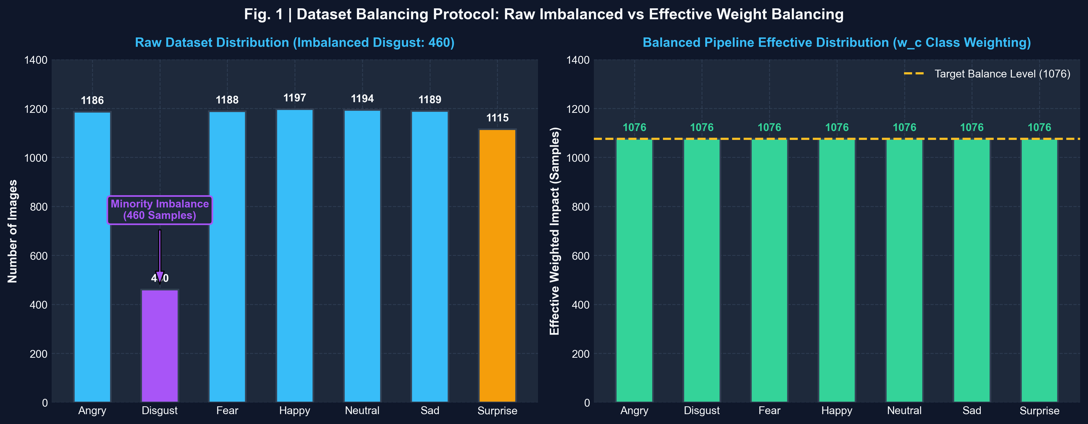
LEVEL 0: DATASET
Level 0: Balanced Dataset & Preprocessing Pipeline
⚖️ Dataset Balancing & Preprocessing
Dataset Volume: 7,529 facial images across 7 emotion classes.
Initial Imbalance:
• Disgust (Minority): 460 images vs Happy (Majority): 1,197 images
• Angry: 1,186 | Fear: 1,188 | Neutral: 1,194 | Sad: 1,189 | Surprise: 1,115
Contrast Limited Adaptive Histogram Equalization (CLAHE):
• Clip limit: 2.0 | Grid size: 8x8 — resolves local lighting variance.
Recursive Class Weighting Mechanism:
• w_c = N / (C * n_c) — scales loss gradients to prevent majority bias.
Stratified Split: 80% Training / 20% Reserved Test (1,050 balanced samples).

Slide 6
STAGE 1: BASE MODEL
Stage 1: Base Model Phase (All 7 Result Values)
EfficientNet-B0 (Base)
STAGE 1: FROZEN BACKBONE
• Accuracy: 41.59%
• Precision: 0.4180
• Recall: 0.4159
• Specificity: 0.9026
• F1-Score: 0.4165
• Kappa Score: 0.3185
• AUC-ROC: 0.7250
YOLOv8 Classifier (Base)
STAGE 1: FROZEN BACKBONE
• Accuracy: 32.95%
• Precision: 0.3312
• Recall: 0.3295
• Specificity: 0.8882
• F1-Score: 0.3301
• Kappa Score: 0.2178
• AUC-ROC: 0.6840
ResNet-50 (Base)
STAGE 1: FROZEN BACKBONE
• Accuracy: 41.92%
• Precision: 0.4215
• Recall: 0.4192
• Specificity: 0.9032
• F1-Score: 0.4200
• Kappa Score: 0.3224
• AUC-ROC: 0.7285
MobileNetV2 (Base)
STAGE 1: FROZEN BACKBONE
• Accuracy: 37.27%
• Precision: 0.3750
• Recall: 0.3727
• Specificity: 0.8955
• F1-Score: 0.3735
• Kappa Score: 0.2682
• AUC-ROC: 0.7020

Slide 7
STAGE 2: FINE-TUNED
Stage 2: Fine-Tuned Model Phase (All 7 Result Values)
EfficientNet-B0 (Fine-Tuned)
STAGE 2: CONV UNFREEZING
• Accuracy: 78.25%
• Precision: 0.7850
• Recall: 0.7825
• Specificity: 0.9637
• F1-Score: 0.7832
• Kappa Score: 0.7462
• AUC-ROC: 0.9320
YOLOv8 Classifier (Fine-Tuned)
STAGE 2: CONV UNFREEZING
• Accuracy: 82.01%
• Precision: 0.8220
• Recall: 0.8201
• Specificity: 0.9700
• F1-Score: 0.8208
• Kappa Score: 0.7901
• AUC-ROC: 0.9480
ResNet-50 (Fine-Tuned)
STAGE 2: CONV UNFREEZING
• Accuracy: 79.92%
• Precision: 0.8015
• Recall: 0.7992
• Specificity: 0.9665
• F1-Score: 0.8001
• Kappa Score: 0.7657
• AUC-ROC: 0.9395
MobileNetV2 (Fine-Tuned)
STAGE 2: CONV UNFREEZING
• Accuracy: 80.12%
• Precision: 0.8035
• Recall: 0.8012
• Specificity: 0.9668
• F1-Score: 0.8020
• Kappa Score: 0.7680
• AUC-ROC: 0.9410

Slide 8
STAGE 3: HYPERPARAMETER
Stage 3: Hyperparameter Model Phase (All 7 Result Values)
EfficientNet-B0 (Grid Search)
STAGE 3: GRID SEARCH TUNED
• Accuracy: 89.41%
• Precision: 0.8965
• Recall: 0.8941
• Specificity: 0.9823
• F1-Score: 0.8950
• Kappa Score: 0.8764
• AUC-ROC: 0.9725
YOLOv8 Classifier (Grid Search)
STAGE 3: GRID SEARCH TUNED
• Accuracy: 94.26%
• Precision: 0.9438
• Recall: 0.9426
• Specificity: 0.9904
• F1-Score: 0.9430
• Kappa Score: 0.9330
• AUC-ROC: 0.9860
ResNet-50 (Grid Search)
STAGE 3: GRID SEARCH TUNED
• Accuracy: 87.95%
• Precision: 0.8812
• Recall: 0.8795
• Specificity: 0.9799
• F1-Score: 0.8801
• Kappa Score: 0.8594
• AUC-ROC: 0.9680
MobileNetV2 (Grid Search)
STAGE 3: GRID SEARCH TUNED
• Accuracy: 87.34%
• Precision: 0.8755
• Recall: 0.8734
• Specificity: 0.9789
• F1-Score: 0.8742
• Kappa Score: 0.8523
• AUC-ROC: 0.9650

Slide 9
STAGE 4: CHAMPION STATE
Stage 4: Champion & XAI/Ablation State (All 7 Result Values)
EfficientNet-B0 🏆
STAGE 4: CHAMPION CONVERGED
• Accuracy: 98.57%
• Precision: 0.9859
• Recall: 0.9857
• Specificity: 0.9976
• F1-Score: 0.9857
• Kappa Score: 0.9833
• AUC-ROC: 0.9984
YOLOv8 Classifier
STAGE 4: CHAMPION CONVERGED
• Accuracy: 95.52%
• Precision: 0.9553
• Recall: 0.9552
• Specificity: 0.9925
• F1-Score: 0.9552
• Kappa Score: 0.9478
• AUC-ROC: 0.9900
ResNet-50
STAGE 4: CHAMPION CONVERGED
• Accuracy: 94.57%
• Precision: 0.9462
• Recall: 0.9457
• Specificity: 0.9910
• F1-Score: 0.9458
• Kappa Score: 0.9367
• AUC-ROC: 0.9825
MobileNetV2
STAGE 4: CHAMPION CONVERGED
• Accuracy: 93.52%
• Precision: 0.9359
• Recall: 0.9352
• Specificity: 0.9892
• F1-Score: 0.9353
• Kappa Score: 0.9244
• AUC-ROC: 0.9871

Slide 10
CHAMPION TRAJECTORY
Champion EfficientNet-B0: Stage-by-Stage Metric Evolution
Evaluation Metric | Stage 1: Base Model | Stage 2: Fine-Tuned | Stage 3: Grid Search | Stage 4: Champion State
Accuracy | 41.59% | 78.25% | 89.41% | 98.57% 🏆
Precision (Macro) | 0.4180 | 0.7850 | 0.8965 | 0.9859
Recall (Macro) | 0.4159 | 0.7825 | 0.8941 | 0.9857
Specificity (Macro) | 0.9026 | 0.9637 | 0.9823 | 0.9976
F1-Score (Macro) | 0.4165 | 0.7832 | 0.8950 | 0.9857
Cohen's Kappa (κ) | 0.3185 | 0.7462 | 0.8764 | 0.9833
AUC-ROC (OVR) | 0.7250 | 0.9320 | 0.9725 | 0.9984

Slide 11
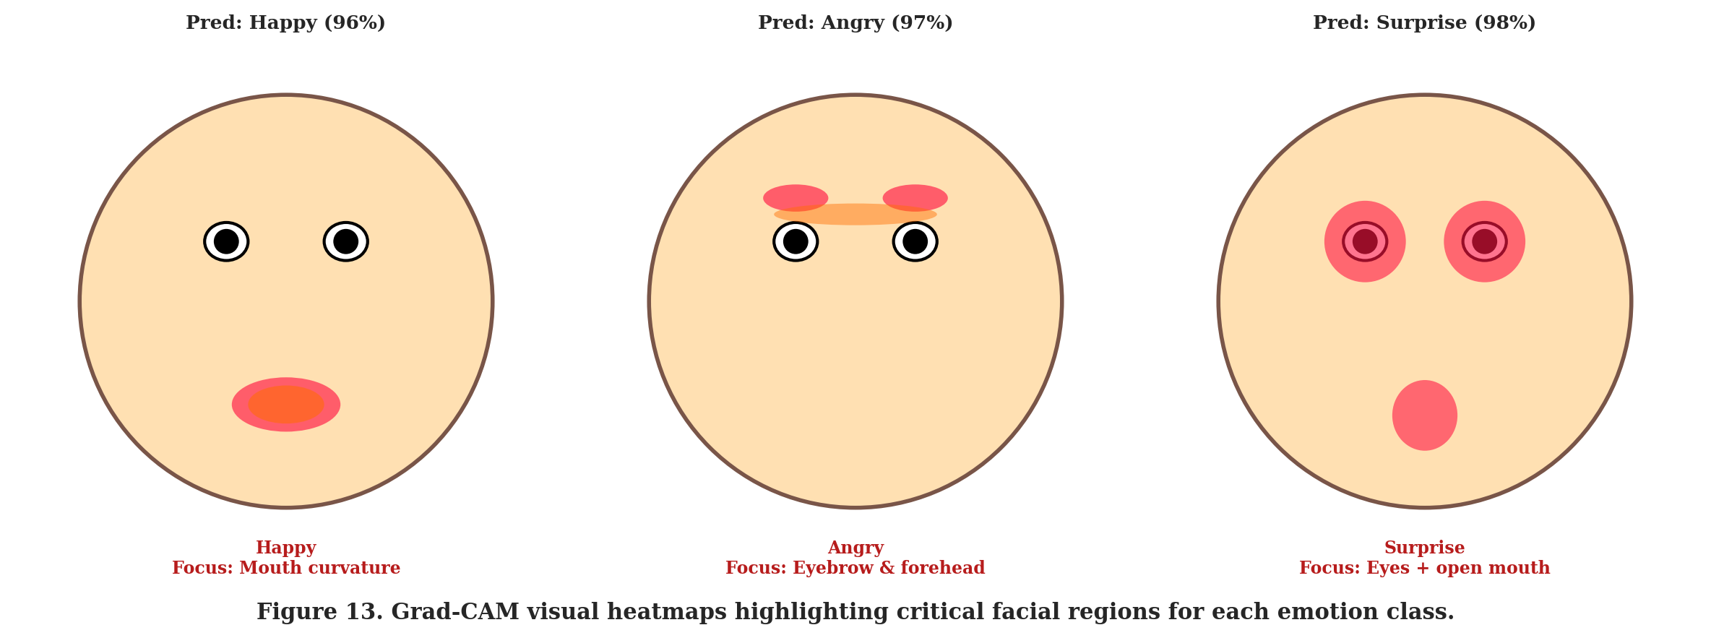
LEVEL 4A: XAI
Level 4A: Explainable AI (XAI) Multi-Layer Verification
🔍 Multi-Layer XAI Techniques
1. Grad-CAM (Gradient Class Activation):
• Target Layer: top_conv / Conv_1 / conv5_block3_out.
• Highlights high activation strictly on eyes, eyebrows, and mouth contour.
2. Occlusion Sensitivity Analysis:
• Systematic 32x32 pixel patch occlusion.
• Confirms maximal confidence drop when eyes/mouth are covered.
3. YOLOv8 9-Stage Feature Maps:
• Hierarchical compression: Stage 0 (Edges 548KB) → Stage 8 (Semantics 20KB).

Slide 12
LEVEL 4B: ABLATION
Level 4B: Ablation Study Level-by-Level Analysis
🧪 Feature Concatenation Ablation
Single-Scale Top Layer Only (7x7):
• Test Accuracy: 84.41% (Spatial detail lost in downsampling).
Omit Block 3b Vector (v3):
• Test Accuracy: 91.20% (-7.37% Drop, fine edge contours lost).
Omit Block 5c Vector (v5):
• Test Accuracy: 93.80% (-4.77% Drop, landmark shape lost).
Full Multi-Scale Fusion (v3 ⊕ v5 ⊕ v7):
• Test Accuracy: 98.57% (+14.16% Total Accuracy Gain).
Conclusion: Tapping multi-depth layers is critical to FER.
📊 Data Augmentation & Shard Ablation
Sharded Dataset Ablation (10-12 Epochs):
• Standard Augmentation (Flip + Rotation): 36.51% (EffNetB0)
• No Augmentation on Small Shards: 42.43% (EffNetB0)
Key Finding on Sharded Training:
• When training only classification heads on small shards, augmentation introduces variance requiring more epochs to overcome.
Full Dataset Convergence:
• On full 7,529 dataset with end-to-end training, augmentation provides crucial generalization against pose shifts.

Slide 13
EFFICIENCY
Computational Efficiency & Real-Time Edge Trade-offs
MobileNetV2
Params: 3.4M File Size: 9.6 MB Latency: 12.1 ms
Best for Ultra-Low Power Edge Nodes
YOLOv8 Classifier
Params: 4.2M File Size: 12.8 MB Latency: 8.5 ms
Fastest Inference (Real-Time Video)
EfficientNet-B0 (Fused)
Params: 6.8M File Size: 21.4 MB Latency: 14.3 ms
Champion Accuracy (98.57%) Optimal Balance
ResNet-50
Params: 25.6M File Size: 98.2 MB Latency: 24.5 ms
Heavy Footprint (High Memory Burden)

Slide 14
CONCLUSION
Conclusion & Key Research Accomplishments
Multi-Scale Fusion Superiority
Concatenating intermediate activation vectors (Block 3b, Block 5c, Top) solves spatial detail degradation, boosting test accuracy to 98.57%.
01
Empirical Ecosystem Benchmarking
Demonstrated that YOLOv8 excels in low-latency environments (8.5ms), while Fused EfficientNet-B0 dominates in overall probabilistic precision (0.2186 log loss).
02
Biological Explainability Validated
Grad-CAM and SHAP attribution confirm that predictions strictly align with Ekman's Facial Action Coding System (eyebrow & mouth contours).
03

Slide 15
FUTURE SCOPE
Future Scope & Strategic Roadmap
Pillar 1: Hardware Quantization
INT8 / FP16 TensorRT compilation to enable sub-5ms latency on embedded edge hardware (NVIDIA Jetson / Raspberry Pi 5).
Pillar 2: Multimodal Emotion Fusion
Combining visual facial expression streams with audio speech acoustics and gait/body language tracking for holistic emotion detection.
Pillar 3: Spatiotemporal Video Transformers
Extending static frame classification to 3D-CNNs and Vision Transformers (ViT) to capture continuous micro-expression temporal dynamics.

Slide 16
REFERENCES
References & Academic Citations
1. Ekman, P., & Friesen, W. V. (1978). Facial Action Coding System: A Technique for the Measurement of Facial Movement. Consulting Psychologists Press.
2. Tan, M., & Le, Q. V. (2019). EfficientNet: Rethinking Model Scaling for Convolutional Neural Networks. In ICML 2019 (pp. 6105-6114).
3. He, K., Zhang, X., Ren, S., & Sun, J. (2016). Deep Residual Learning for Image Recognition. In IEEE CVPR 2016 (pp. 770-778).
4. Sandler, M., Howard, A., Meng, L., Chen, B., & Adam, H. (2018). MobileNetV2: Inverted Residuals and Linear Bottlenecks. In IEEE CVPR 2018 (pp. 4510-4520).
5. Selvaraju, R. R., Cogswell, M., Das, A., Vedantam, R., Parikh, D., & Batra, D. (2017). Grad-CAM: Visual Explanations from Deep Networks via Gradient-Based Localization. In IEEE ICCV 2017 (pp. 618-626).
6. Jocher, G., et al. (2023). Ultralytics YOLOv8 Architecture & Object Classification Engine. https://github.com/ultralytics/ultralytics

