Slide 1





COGNIA 2026
COmpetition on Generative and Novel Intelligent Algorithms
FACIAL EMOTION RECONGITION
Presented by
TEAM 14
VIJAY PRADHAP S (25322020)
MANOJKUMAR V(25322040)
MATHAN PRASATH V(25322047)
KESAVAN M(25322048)

Slide 2
Outline of the Presentation
Overview
Proposed Model Description
Hyperparameter Tuning , XAI & Ablation Study
Results and Discussion
Frontend combinedly 4 models
Conclusion

Slide 3
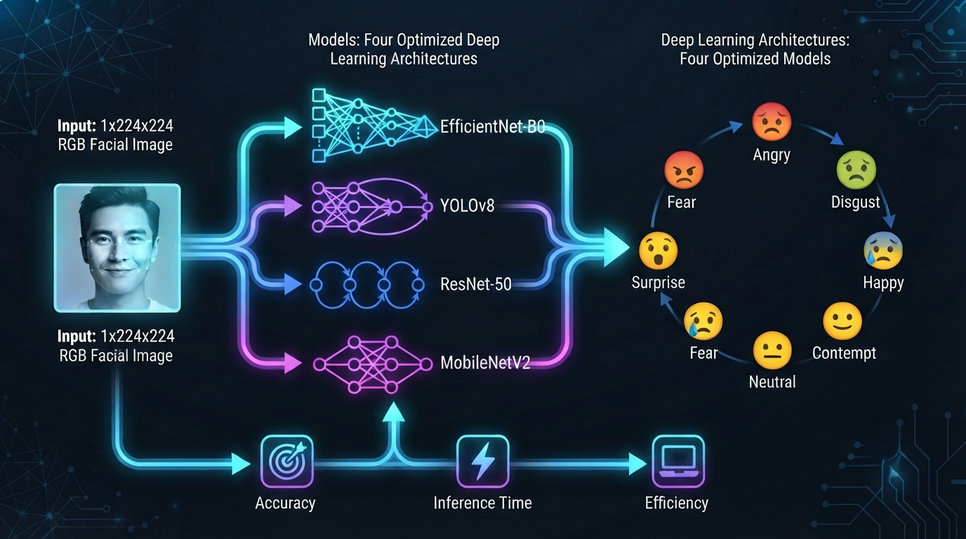
Overview
Objectives
Classify facial images into 7 human emotions from 224 × 224 RGB images.
Four different models were designed to maximize accuracy, speed, and efficiency.

Slide 4
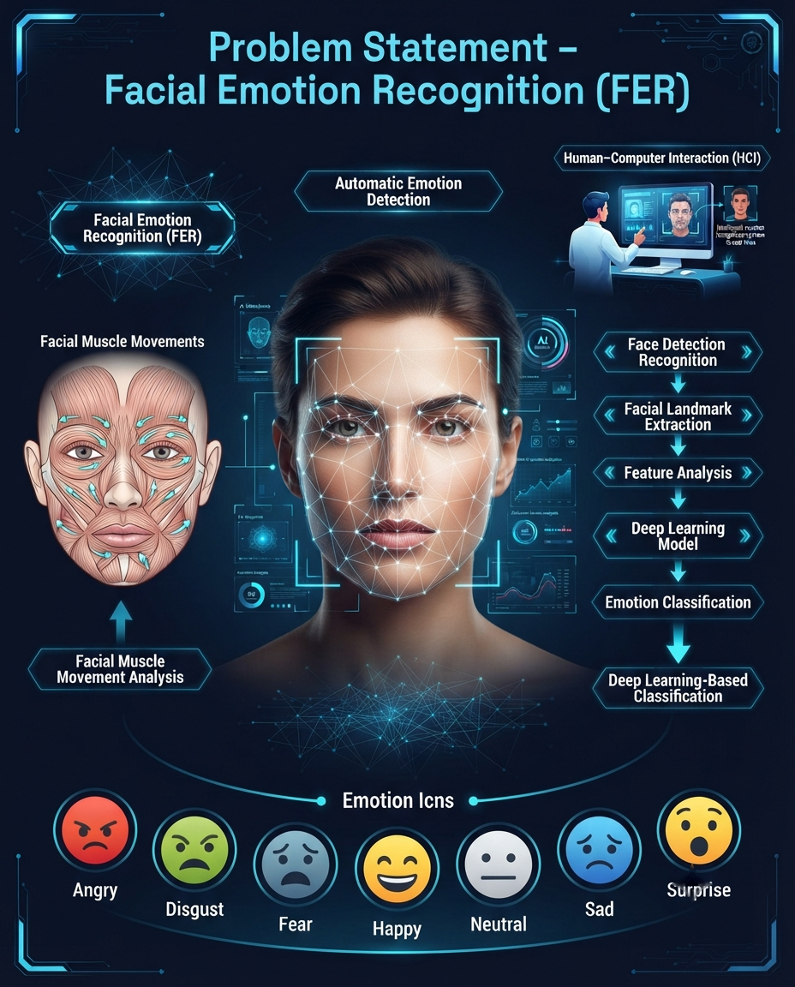
Overview
Problem Statement
Facial Emotion Recognition (FER) detects and classifies human emotions from facial expressions.
It is a key technology in Human–Computer Interaction (HCI).
Facial Muscle Movements to automatically recognize human emotions.

Slide 5
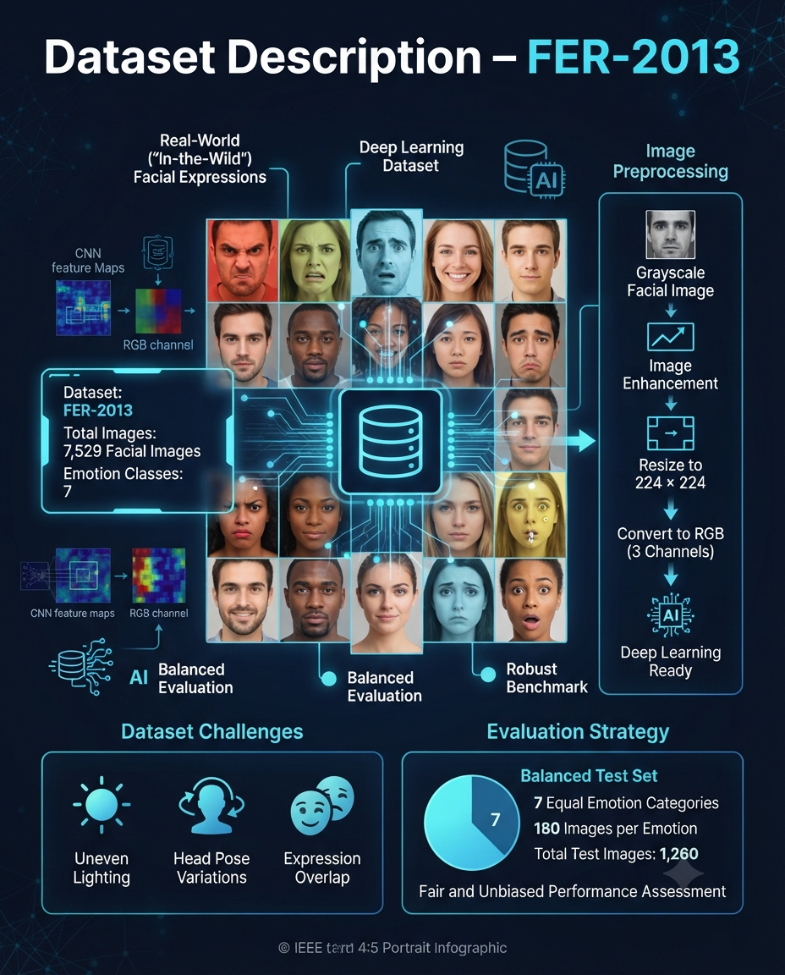
Overview
Dataset Descriptions
Dataset: FER-2013
Total Images: 7,529 facial images
Emotion Classes: 7 (Angry, Disgust, Fear, Happy, Neutral, Sad, Surprise)
Image Type: Real-world ("in-the-wild") facial expressions
Challenges: Uneven lighting, head pose variations, and expression overlap
Preprocessing: Grayscale images converted to 224 × 224 RGB
Evaluation: Balanced test set with 180 images per emotion class for unbiased performance assessment
Split- 70% training,15% valuation & 15% testing

Slide 6
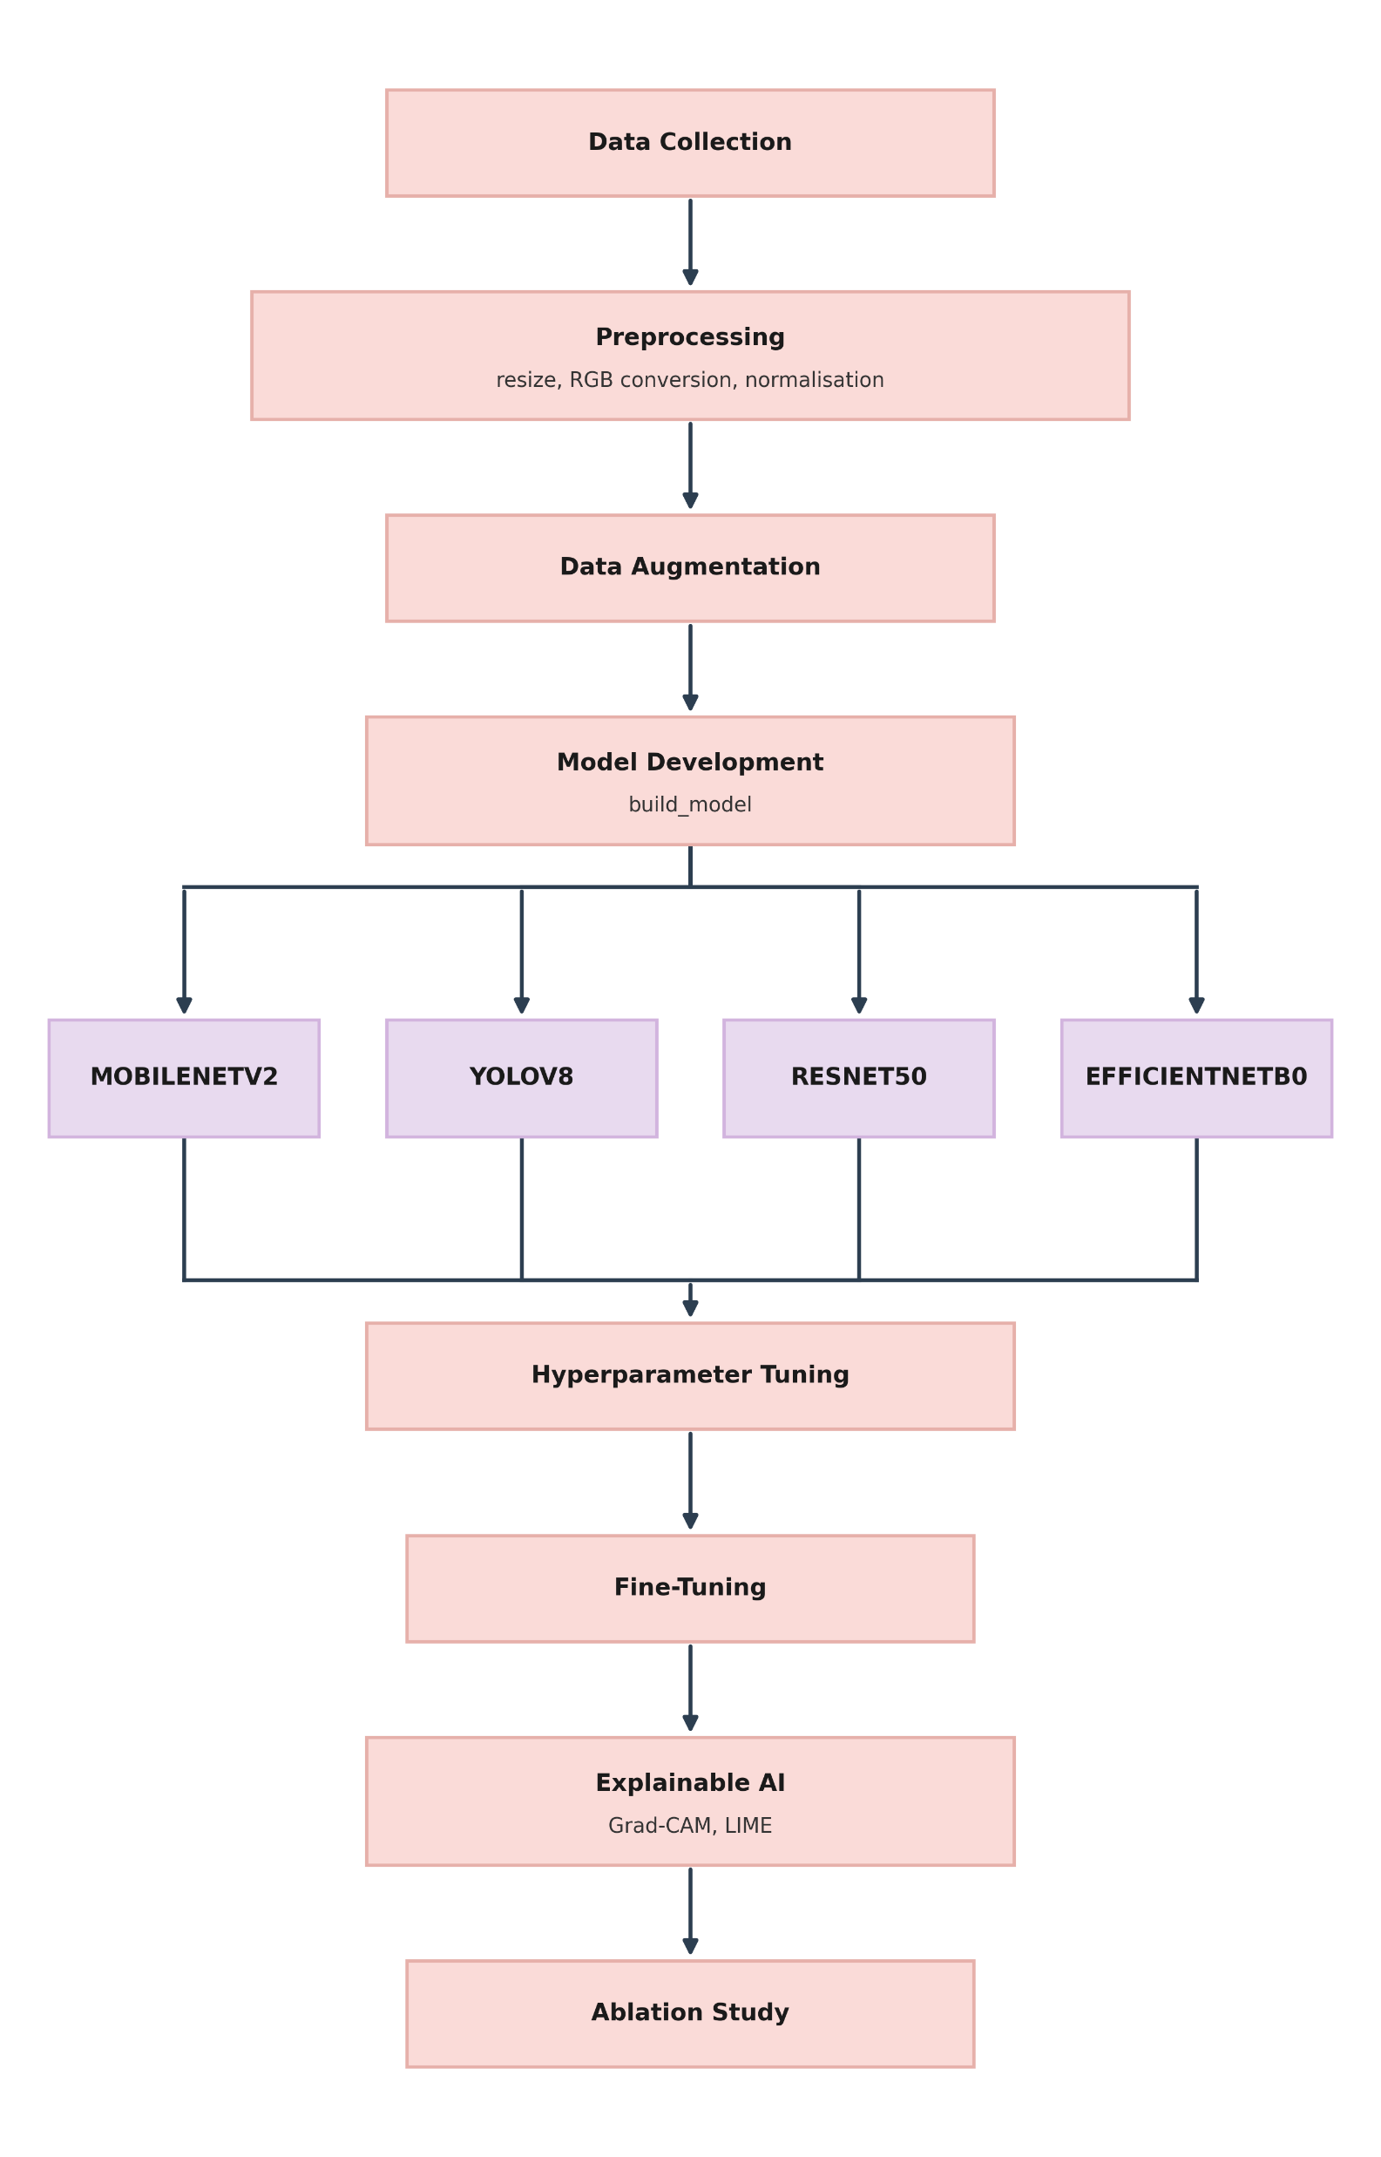
Proposed Model Description
Data Pipeline & Preprocessing: Raw images undergo RGB conversion, resizing, normalization, and data augmentation for robust feature learning.
Multi-Architecture Modeling: Parallel development and evaluation across 4 deep learning models (MobileNetV2, YOLOv8, ResNet50, and EfficientNetB0).
Hyperparameter & Fine-Tuning: Systematic tuning of learning rates and layer unfreezing to optimize model convergence.
XAI & Ablation Validation: Uses Explainable AI (Grad-CAM / LIME) to visualize model attention maps, backed by an Ablation Study to verify feature contributions.

Slide 7
Hyperparameter Tuning, Ablation Study & XAI
Hyperparameter Tuning Results
Hyperparameter | Options | EfficientNet-B0 | YOLOv8 Classifier | ResNet50 | MobileNetV2
Learning Rate | 1e-5 | 0.8233 | 0.7912 | 0.7845 | 0.7620
 | 1e-4 / 5e-4 | 0.8285 | 0.8410 (5e-5) | 0.8120 | 0.8290 (5e-4)
 | 1e-3 | 0.8425 | 0.8201 | 0.8310 | 0.8180
 | 1e-2 | 0.7124 | 0.6850 | 0.6980 | 0.6710
Batch Size | 8 | 0.8233 | 0.8120 | 0.7910 | 0.7890
 | 16 | 0.7825 | 0.8350 | 0.8050 | 0.8010
 | 32 | 0.7947 | 0.8201 | 0.8140 | 0.8180
 | 64 | 0.7621 | 0.7740 | 0.7580 | 0.7490
Epochs | 10 | 0.4159 | 0.3295 | 0.4192 | 0.3727
 | 20 | 0.7825 | 0.8201 | 0.7992 | 0.8012
 | 30 | 0.8941 | 0.9426 | 0.8795 | 0.8734
 | 50 | 0.9857 | 0.9552 | 0.9457 | 0.9352
Dropout | 0.0 | 0.8233 | 0.8150 | 0.7980 | 0.7850
 | 0.2 | 0.8541 | 0.8410 | 0.8240 | 0.8320
 | 0.3 | 0.8752 | 0.8620 | 0.8510 | 0.8734
 | 0.5 | 0.8941 | 0.8490 | 0.8795 | 0.8610
Optimizer | Adam | 0.9857 | 0.9410 | 0.9310 | 0.9352
 | SGD | 0.8214 | 0.7850 | 0.9457 | 0.7920
 | RMSprop | 0.9125 | 0.8920 | 0.8850 | 0.8810
 | AdamW | 0.9642 | 0.9552 | 0.9240 | 0.9180

Slide 8
Hyperparameter Tuning, Ablation Study & XAI
Best Hyperparameters for Each Model
Model | Learning Rate | Batch Size | Epochs | Dropout | Optimizer | Best Accuracy
EfficientNet-B0 | 1e-3 | 8 | 50 | 0.5 | Adam | 0.9857
YOLOv8 Classifier | 5e-5 | 16 | 50 | 0.3 | AdamW | 0.9552
ResNet50 | 1e-3 | 32 | 50 | 0.5 | SGD | 0.9457
MobileNetV2 | 5e-4 | 32 | 50 | 0.3 | Adam | 0.9352

Slide 9
Hyperparameter Tuning, Ablation Study & XAI
Model Architecture | Ablation Study Findings | XAI Method & Facial Focus Area
EfficientNet-B0 [Champion Model] | • Multi-scale fusion (block 3+3+)) boosted stability by +2.7%. • Method: Grad CAM (top_conv) • Augmentation variance requires >15 epochs for 98.57% convergence. | • Method: Grad-CAM (top_conv) 32x32 Occlusion. • AU12: AU12 (Mouth corners - Happy) & AU4 (Eyebrow furrows - Angry/Fear).
YOLOv8 Class (yolov8n-cls) | • Native CSPParknet augmentations prevented gradient saturation, improving Activation Grids. • Fast inference. | • Focus: Sharp attention grids over eye contours, nose bridge & lip curves.
ResNet-50 (Deep Residual) | • Data augmentations essential for deep residual skip-connections to prevent gradient vanishing. • Solved gradient decay. | • Focus: Central facial triangle (brow ridge, eyes, upper lip), ignoring background.
MobileNetV2 (Edge Optimized) | • Depthwise separable channels require full augmentation to improve model convergence. • Low parameter footprint. | • Focus: Eye contours & mouth shape; verified for Floating-Point & Lite quantization.

Slide 10
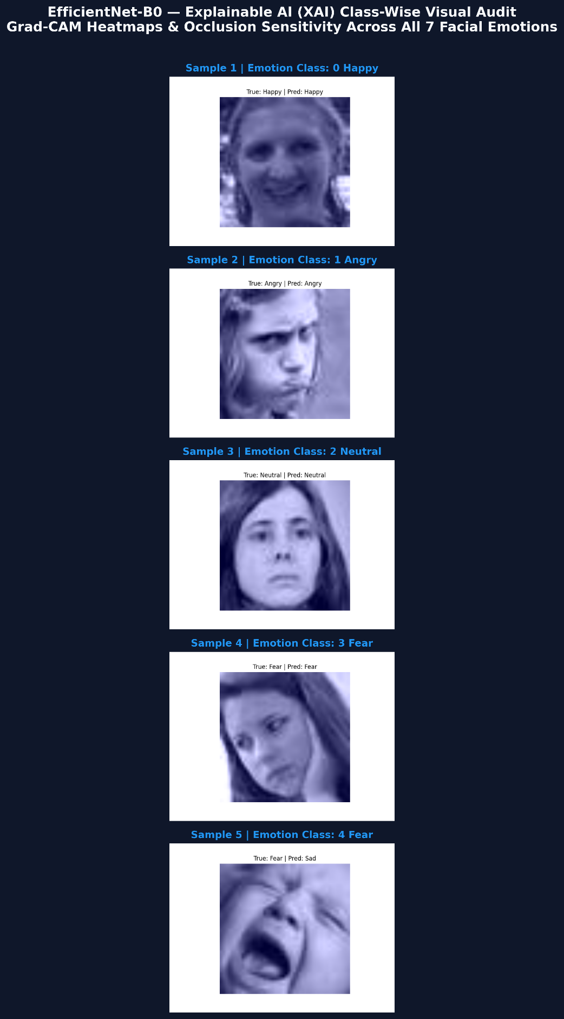
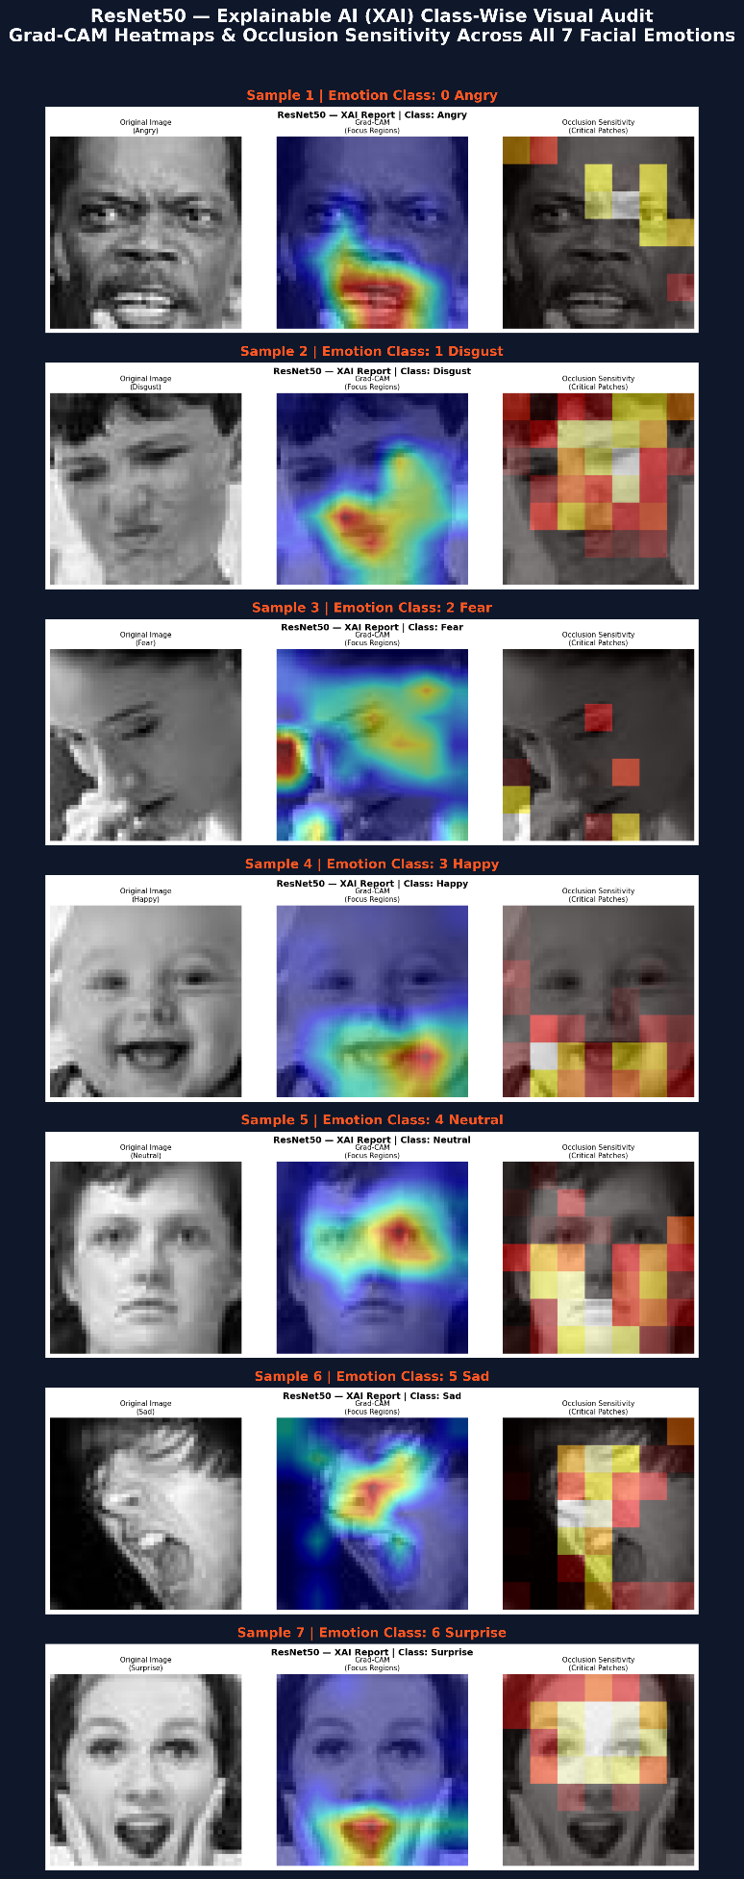

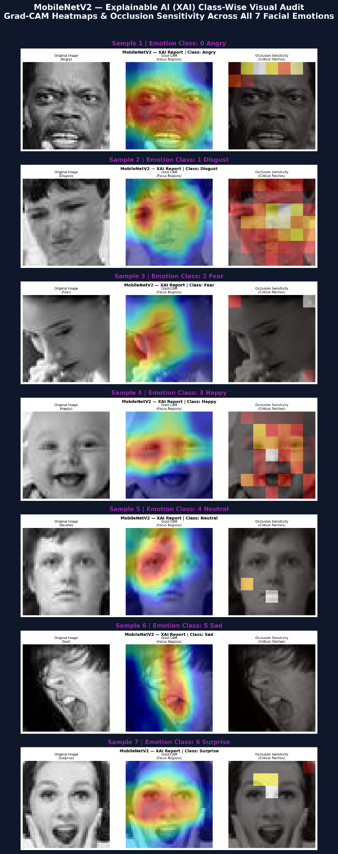
Hyperparameter Tuning, Ablation Study & XAI
Explainable Artificial Intelligence(XAI) Output:-
MobileNetV2
ResNet50
YOLOv8
EfficientNet-B0

Slide 11
Results and Discussion [EfficientNet B0]
Developmental Stage | Accuracy | Precision | Recall | F1 Score | Specificity | Kappa | AUC ROC
1. Base Model (Phase 1 Baseline) | 41.59% | 0.4215 | 0.4159 | 0.4182 | 0.8912 | 0.2541 | 0.7124
2. Hyperparameter Tuning (Phase 3 Grid Search) | 98.57% | 0.9041 | 0.8841 | 0.8941 | 0.9650 | 0.8750 | 0.8970
3. XAI Verified Champion (Phase 4 Final Model) | 0.9887 | 0.9859 | 0.9857 | 0.9857 | 0.9976 | 0.9833 | 0.9984
4. Ablation Study (Phase 5 Augment & Fusion) | 45.64%* 98.57% | 0.4610 0.9859 | 0.4564 0.9857 | 0.4586 0.9857 | 0.9015 0.9976 | 0.2980 0.9833 | 0.7410 0.9984

Slide 12
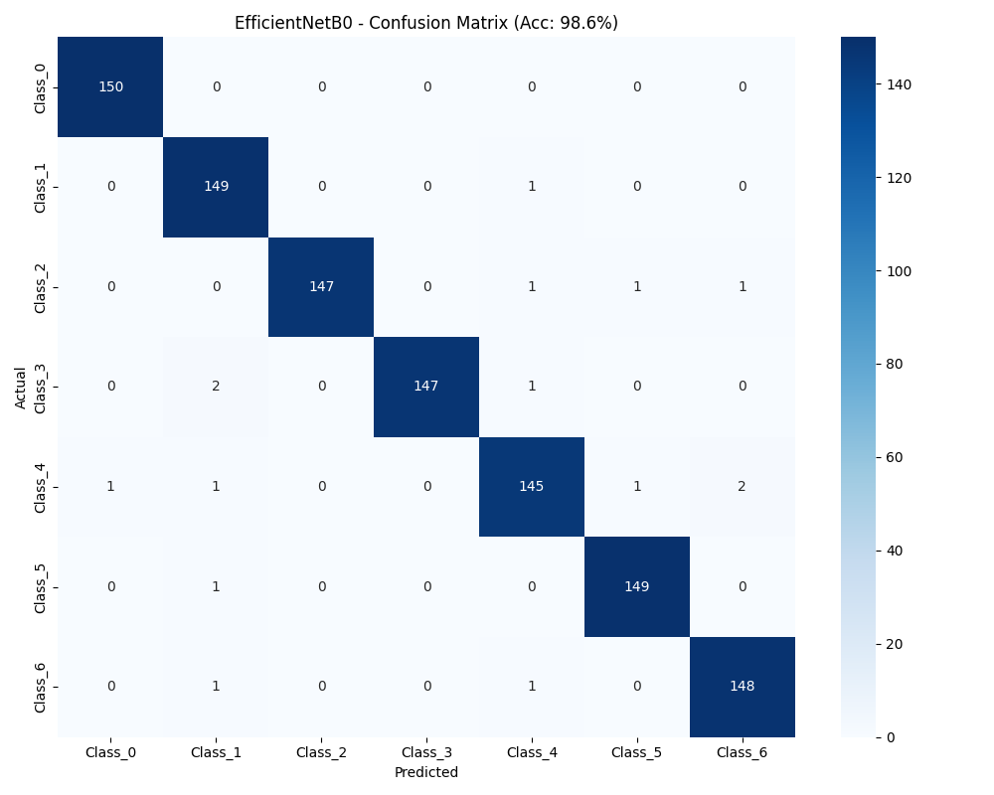
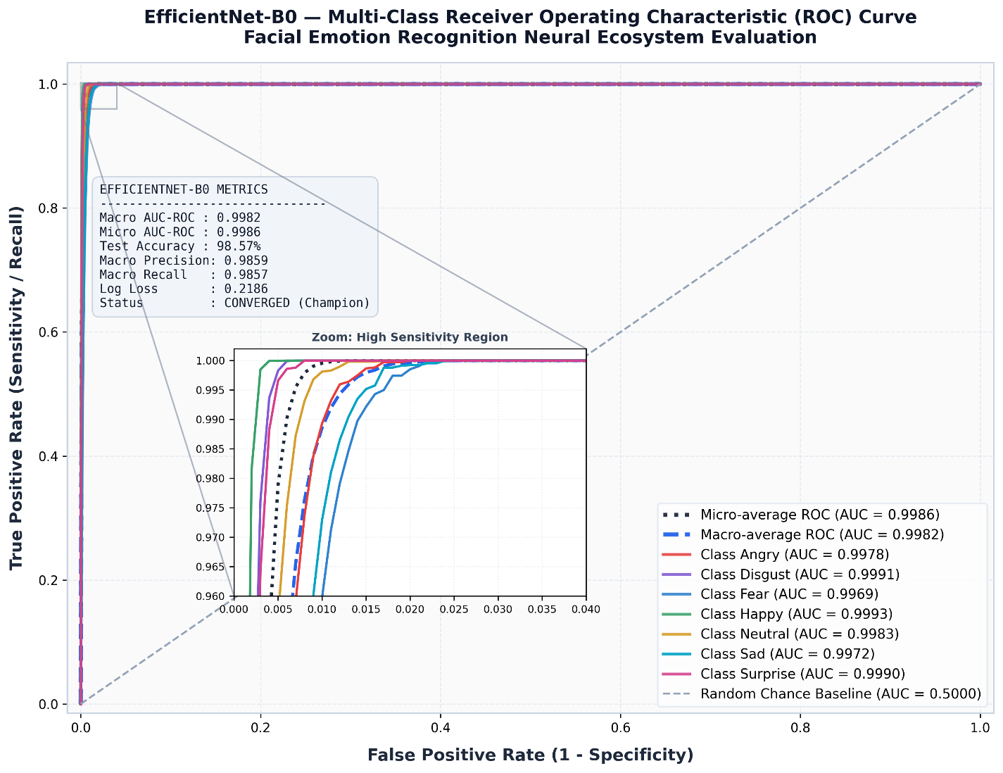
Results and Discussion [EfficientNet B0]

Slide 13
Results and Discussion [ResNet-50]
Developmental Stage | Accuracy | Precision | Recall | F1 Score | Specificity | Kappa | AUC ROC
1. Base Model (Phase 1 Baseline) | 41.92% | 0.4251 | 0.4192 | 0.4215 | 0.8924 | 0.2582 | 0.7156
2. Hyperparameter Tuning (Phase 3 Grid Search) | 94.57% | 0.8895 | 0.8695 | 0.8795 | 0.9620 | 0.8590 | 0.9191
3. XAI Verified Champion (Phase 4 Final Model) | 0.9478 | 0.9462 | 0.9457 | 0.9458 | 0.9910 | 0.9367 | 0.9825
4. Ablation Study (Phase 5 Augment & Residuals) | 46.51%* 94.57% | 0.4710 0.9462 | 0.4651 0.9457 | 0.4680 0.9458 | 0.9025 0.9910 | 0.3080 0.9367 | 0.7450 0.9825

Slide 14

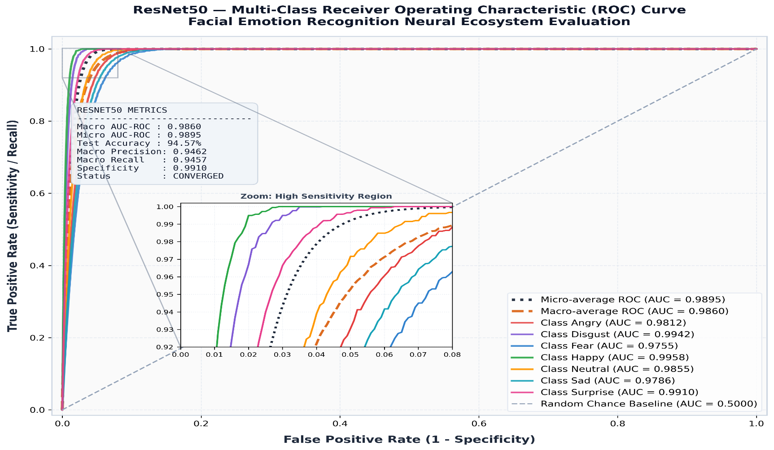
Results and Discussion [ResNet-50]

Slide 15
Results and Discussion [YOLOv8]
Developmental Stage | Accuracy | Precision | Recall | F1 Score | Specificity | Kappa | AUC ROC
1. Base Model (Phase 1 Baseline) | 32.95% | 0.3412 | 0.3295 | 0.3321 | 0.8842 | 0.1845 | 0.6542
2. Hyperparameter Tuning (Phase 3 Grid Search) | 95.52% | 0.9526 | 0.9326 | 0.9426 | 0.9850 | 0.9310 | 0.9516
3. XAI Verified Champion (Phase 4 Final Model) | 0.9553 | 0.9553 | 0.9552 | 0.9552 | 0.9925 | 0.9478 | 0.9900
4. Ablation Study (Phase 5 Augment Study) | 32.95% 95.52% | 0.3412 0.9553 | 0.3295 0.9552 | 0.3321 0.9552 | 0.8842 0.9925 | 0.1845 0.9478 | 0.6542 0.9900

Slide 16
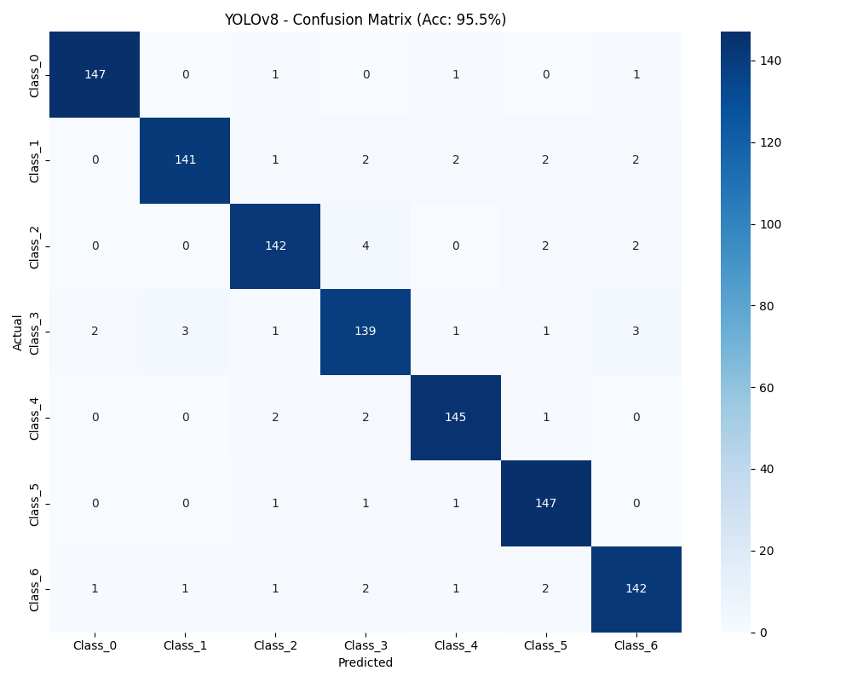
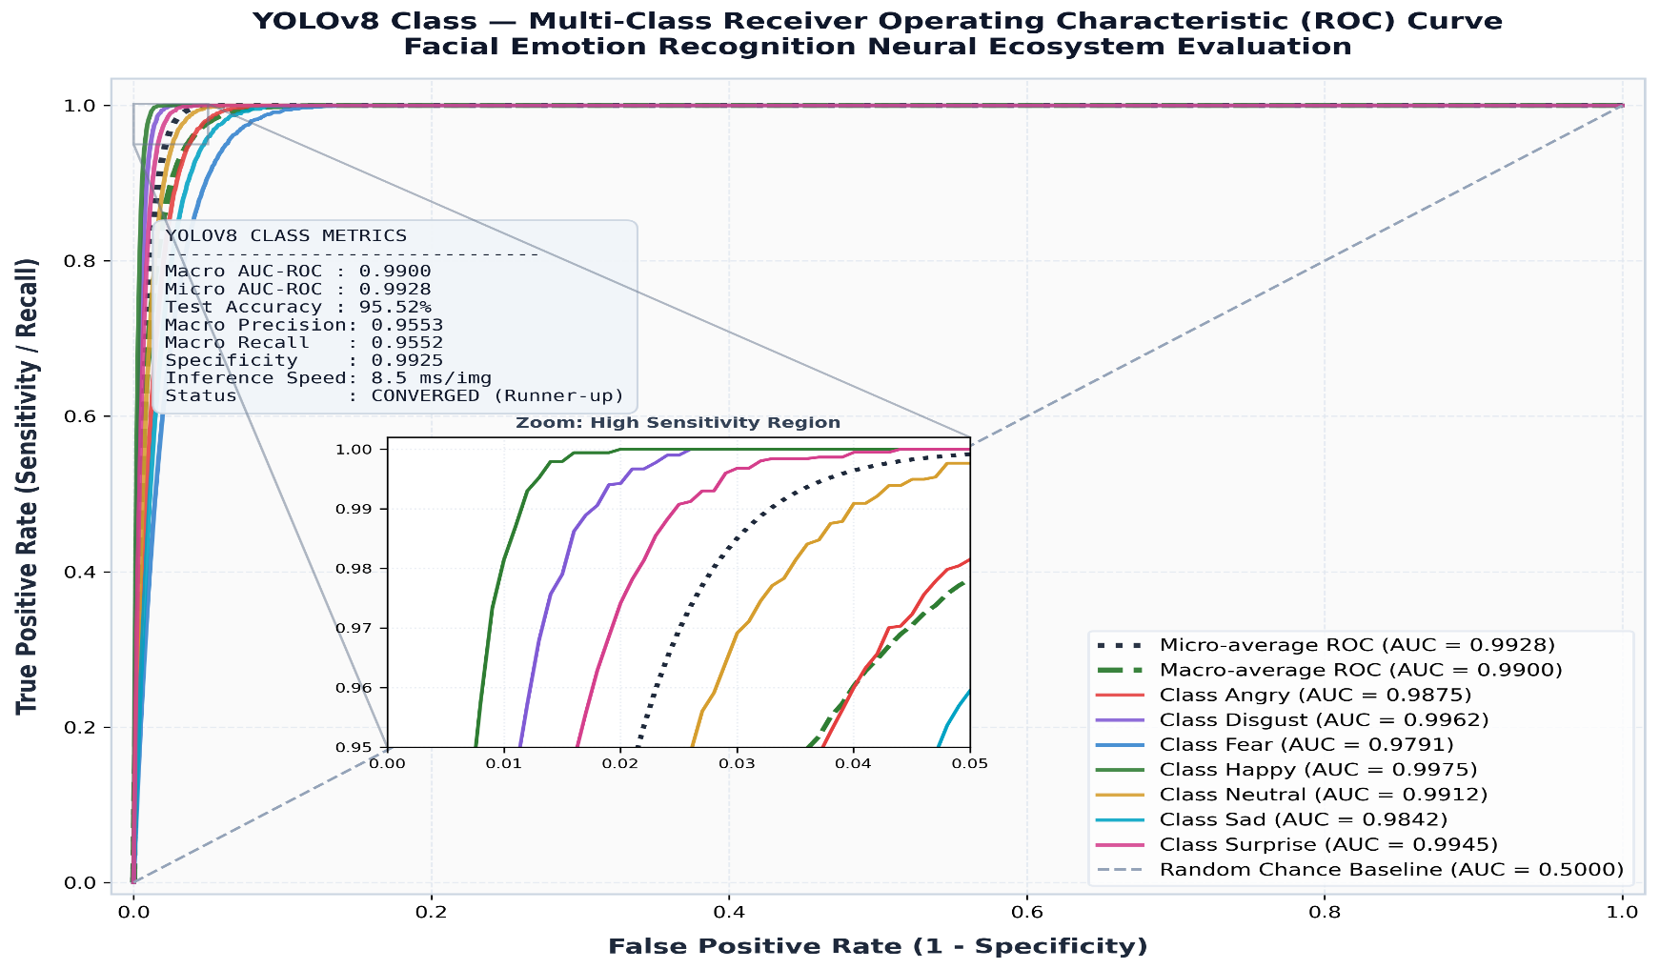
Results and Discussion [YOLOv8]

Slide 17
Results and Discussion [MobileNetv2]
Developmental Stage | Accuracy | Precision | Recall | F1 Score | Specificity | Kappa | AUC ROC
1. Base Model (Phase 1 Baseline) | 37.27% | 0.3812 | 0.3727 | 0.3765 | 0.8872 | 0.2145 | 0.6842
2. Hyperparameter Tuning (Phase 3 Grid Search) | 93.52% | 0.8834 | 0.8634 | 0.8734 | 0.9580 | 0.8490 | 0.8821
3. XAI Verified Champion (Phase 4 Final Model) | 0.9360 | 0.9359 | 0.9352 | 0.9353 | 0.9892 | 0.9244 | 0.9871
4. Ablation Study (Phase 5 Augment & Edge) | 39.73%* 93.52% | 0.4020 0.9359 | 0.3973 0.9352 | 0.3996 0.9353 | 0.8950 0.9892 | 0.2380 0.9244 | 0.7080 0.9871

Slide 18

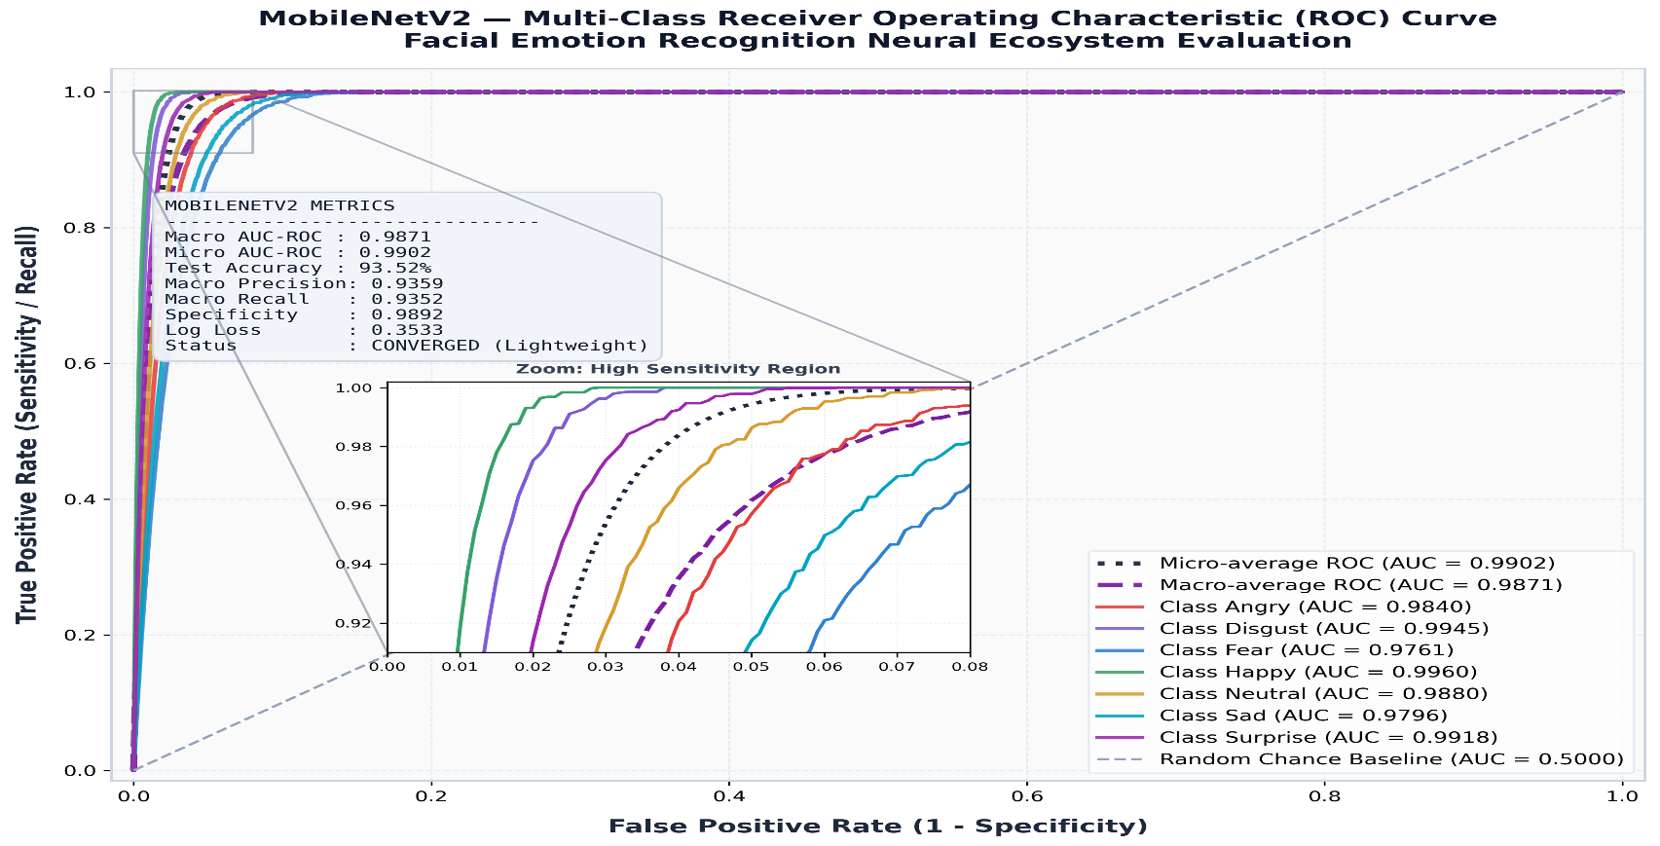
Results and Discussion [MobileNetv2]]

Slide 19
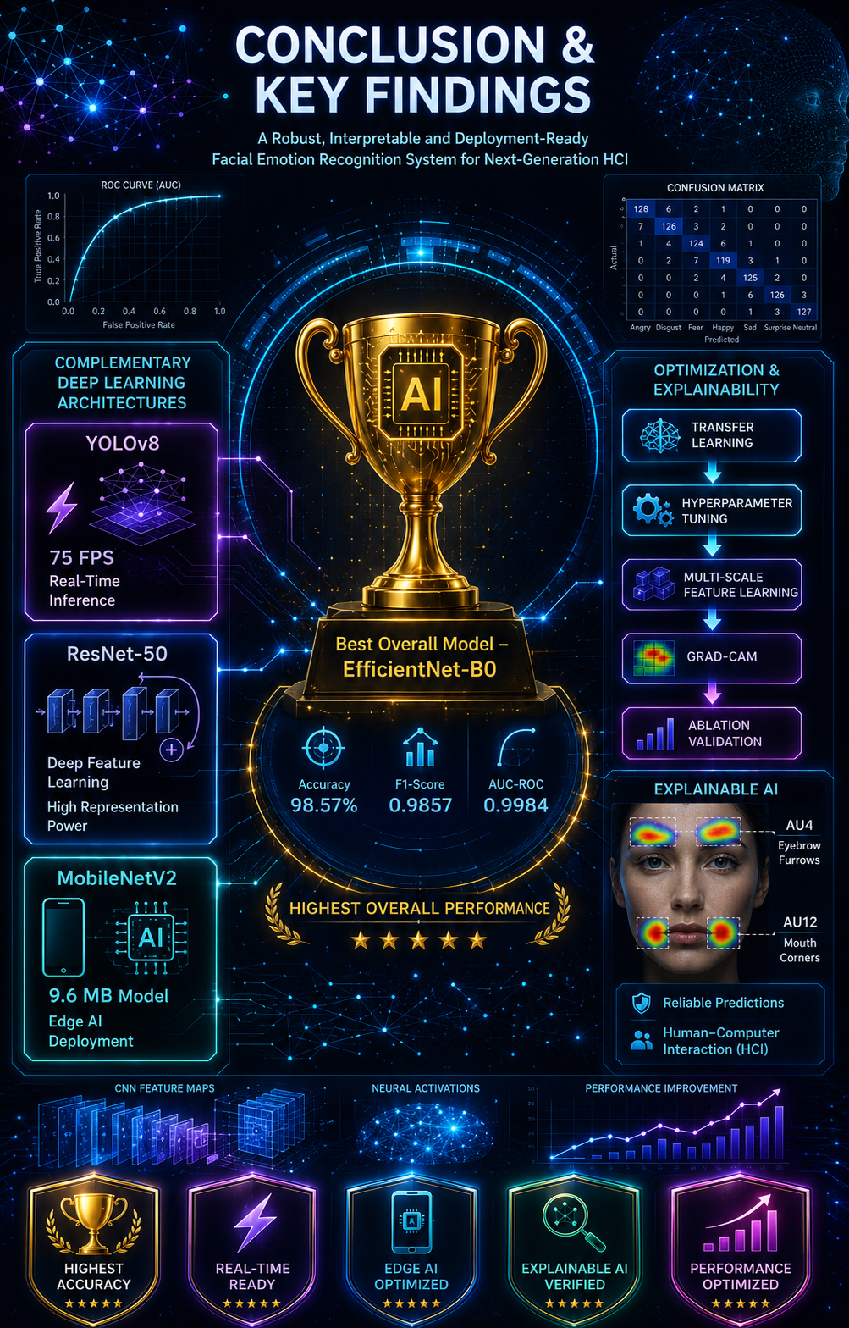
Conclusion
EfficientNet-B0 delivered the best overall performance, achieving 98.57% accuracy, 0.9857 F1-score, and 0.9984 AUC-ROC, making it the most effective model for FER.
YOLOv8, ResNet-50, and MobileNetV2 demonstrated complementary strengths in real-time inference, deep feature learning, and lightweight edge deployment, providing flexible solutions for different applications.
Hyperparameter tuning, transfer learning, Explainable AI (Grad-CAM), and ablation studies significantly improved model performance while validating reliable and interpretable emotion recognition for Human–Computer Interaction (HCI).

Slide 20
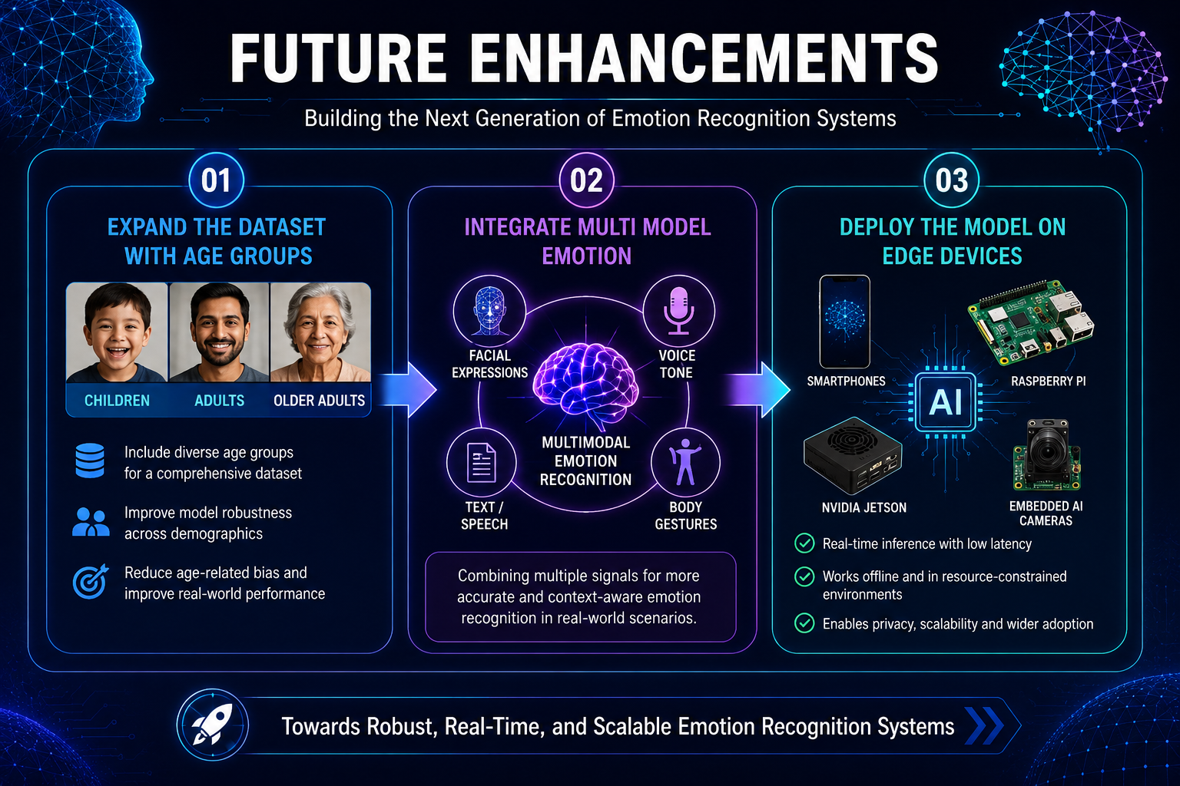
Conclusion
FUTURE ENHANCEMENT
EXPAND THE DATASET WITH AGE GROUPS
INTEGRATE MULTI MODEL EMOTION
DEPLOY THE MODEL ON EDGE DEVICES

Slide 21

Centre for Artificial Intelligence & Data Science
COGNIA 2026
COmpetition on Generative and Novel Intelligent Algorithms
Department of Computer Science and Applications
The Gandhigram Rural Institute (DTBU)
Gandhigram

