Slide 1
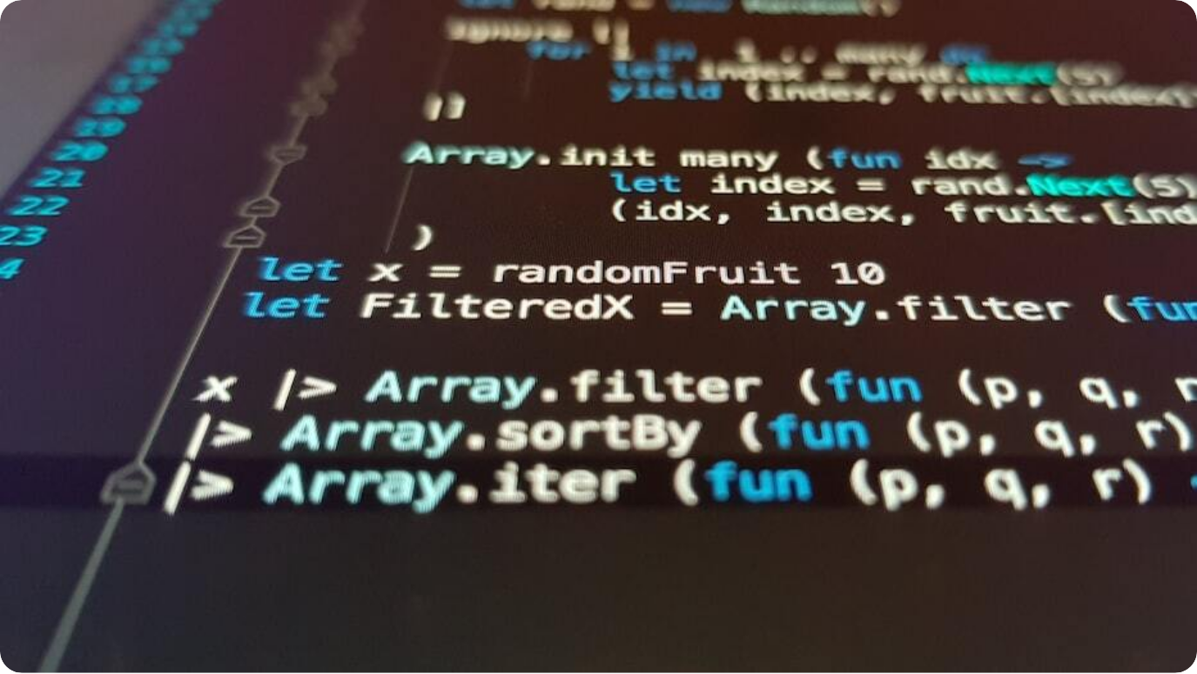
What is Programming?
Basic Concept
Definition: Programming is writing instructions for a computer to perform specific tasks.
Instructions: These instructions are written in languages that computers can understand.
Purpose: To automate tasks, solve problems, or create systems and applications.
Notes:
Programming is the foundation of all modern software. It involves instructing computers using specific languages to carry out desired operations. These instructions allow us to create everything from simple calculators to complex artificial intelligence systems. Understanding this concept is key to learning any programming language, including Java.

Slide 2



High-Level vs Low-Level Programming
Types of Programming Languages
High-Level Languages
Closer to human languages (e.g., Java, Python), easy to read and write.
Low-Level Languages
Closer to machine language (e.g., Assembly, Machine code), harder to understand.
Translation Required
High-level code needs to be translated into low-level for execution.
Notes:
Programming languages can be broadly classified into high-level and low-level. High-level languages are designed to be easy for humans to use, with syntax that resembles natural language. Low-level languages, on the other hand, are more suited to the hardware and are harder for humans to interpret. Understanding the distinction is key when learning how programs are executed.

Slide 3
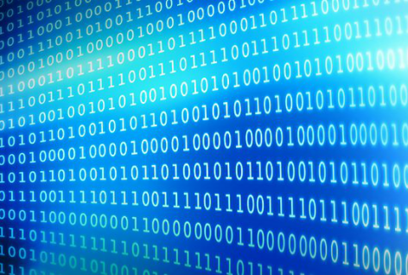
What is Binary Code?
The Language of Computers
Binary System: Binary uses only two digits: 0 and 1, representing off and on states.
Machine Language: All computer operations are ultimately expressed in binary.
Conversion: High-level code is translated to binary for computer execution.
Notes:
Binary code forms the core of all computer operations. It uses a system of 0s and 1s to represent electrical signals—off and on states. This is the only language directly understood by a computer's hardware. Everything you write in Java or any other language is eventually converted into binary before it's executed.

Slide 4
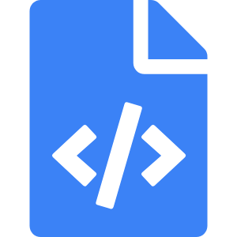


Compiler and Interpreter
Translating Code
Compiler
Translates the entire program into machine code before execution.
Interpreter
Translates code line-by-line during execution.
Java
Uses both: compiles to bytecode, then interpreted by JVM.
Notes:
In programming, translation is key for converting high-level code into machine-readable instructions. Compilers do this all at once, translating and saving the entire code before it's run. Interpreters, on the other hand, do this live, executing each line in real-time. Java uniquely uses both methods by compiling code into bytecode, which is then interpreted or compiled further by the Java Virtual Machine (JVM).

Slide 5
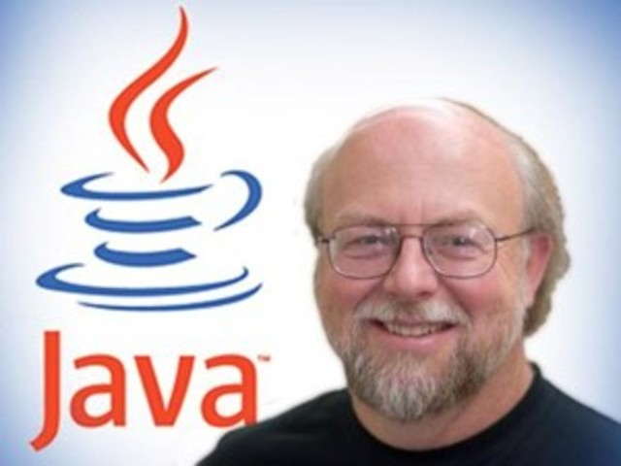
History of Java
Timeline Overview
1991 - Project Started: Java was initiated by Sun Microsystems as the Green Project and initial name was OAK.
1995 - Java Released: Renamed it to Java and Java 1.0 launched with write-once-run-anywhere philosophy.
2010 - Oracle Acquisition: Oracle acquired Sun Microsystems and took over Java.
2014 – Java 8 Released: Some major changes happened in java in this version.
2025 – Java 24 Released: New Java version released on March 18 2025 .
Notes:
Java has a rich history beginning in 1991 with the Green Project at Sun Microsystems. It was designed to be a platform-independent language suitable for consumer electronics. Java officially launched in 1995 and quickly gained popularity for its portability. In 2010, Oracle acquired Sun Microsystems and has continued Java's development ever since.

Slide 6
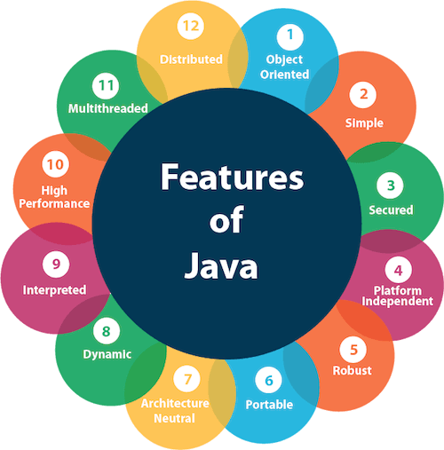
Features of Java
Why Java is Popular
Platform Independent: Java bytecode can run on any device with JVM.
Object-Oriented: Supports OOP concepts like inheritance, encapsulation, and polymorphism.
Strictly Typed Language: Requires explicit declaration of variable types, helping to catch type-related errors at compile time.
Automatic Garbage Collection: Manages memory automatically by removing unused objects.
Robust & Secure: Java can handle errors gracefully and keeps running without crashing.
Secure: There are no pointers, you can’t directly access memory.
Notes:
Java's enduring popularity is rooted in its powerful features. It's platform independent, meaning code compiled on one system can run anywhere the JVM exists. Java is also fully object-oriented, promoting modularity and reusability. Its built-in security mechanisms and strong memory management make it robust and secure for enterprise and web applications.

