Slide 1
Building Resilient Microservices
From Monolith to Distributed Systems with Spring Boot 3.5 & Spring Cloud

Slide 2
The Monolithic Starting Point
**Unified Presentation Layer**
Single User Interface handling web, mobile, and external API consumers seamlessly.
**Centralized API Routing**
One foundational routing layer containing all project controller classes and mapped paths.
**Single Deployable Unit**
All core business capabilities (Product, Order, Inventory, Auth, Notification) compiled inside one fat JAR artifact.
**Shared Database Instance**
Every distinct application domain module connects directly to one massive shared database store.

Slide 3
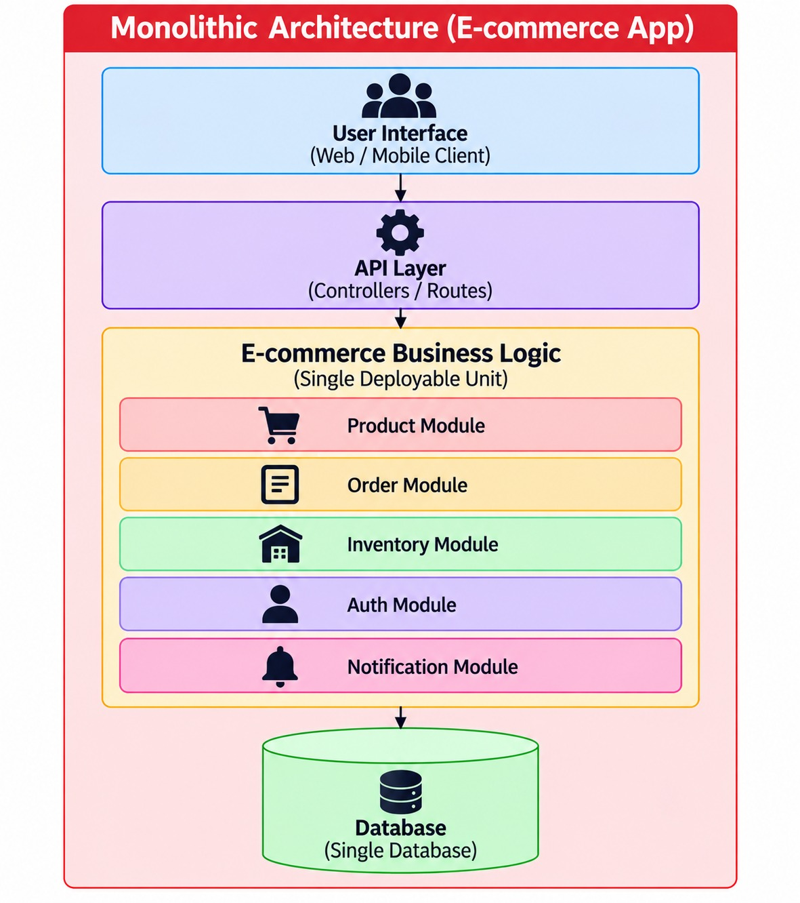

Slide 4
Evaluating the Monolith (Trade-offs)
**Core Advantages (Pros)**
Quick to develop, compile, and stand up initially.
Simpler data management via localized ACID transactions.
Straightforward debugging without remote network complexities.
Suited well for early-stage validation prototypes.
**Critical Drawbacks (Cons)**
Highly difficult to scale single bottlenecked segments isolatedly.
Tight architectural coupling risks cascading module failures.
Slower development velocity as team sizes scale upward.
Single point of failure brings down the entire business runtime.

Slide 5
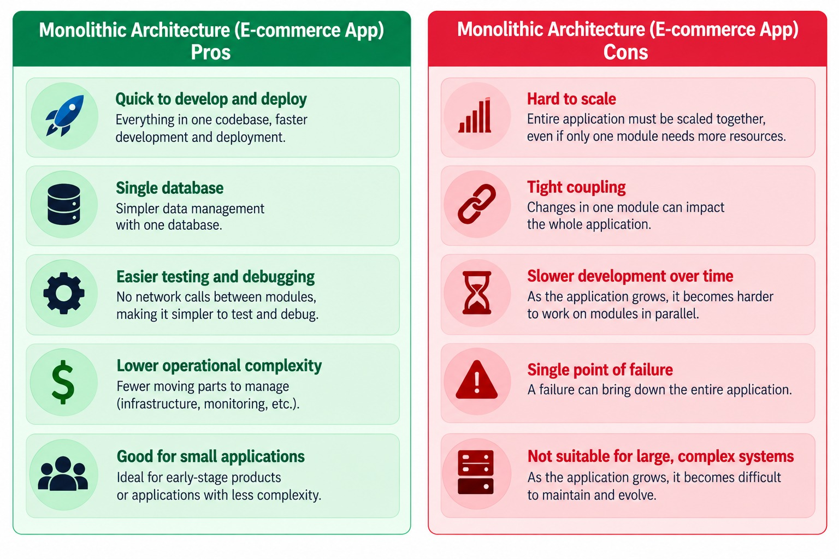

Slide 6
Transitioning to Microservices
**Decoupled Capabilities**
Every separate domain is developed, maintained, and scaled as its own completely autonomous system application.
**Database-per-Service Pattern**
Strict isolation rules where services exclusively command their own dedicated DB engines (Product DB, Inventory DB, etc.).
**Central Routing & Security**
A singular API Gateway operates upfront to handle edge routing, global load balancing, and auth interception.
**Infrastructure Backbone**
Dynamic network coordinates managed via service registry discovery and properties externalized via a central config server.

Slide 7
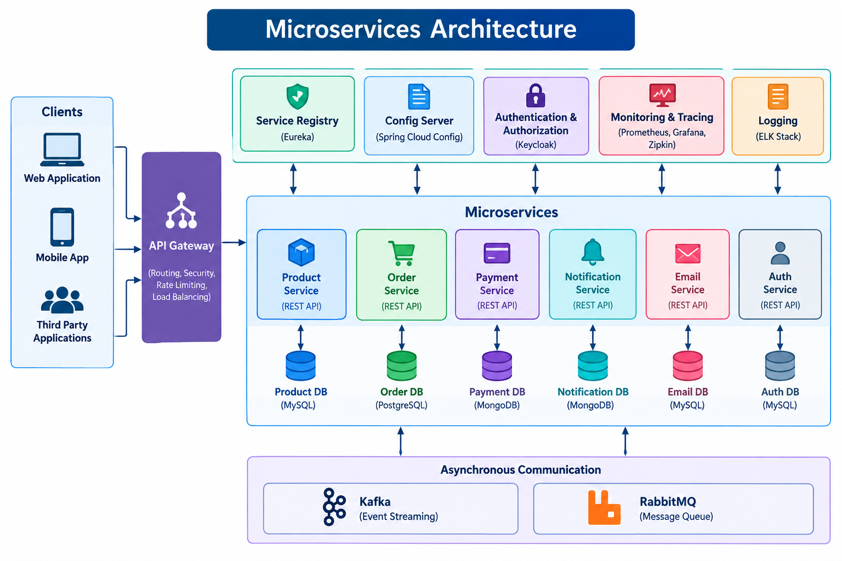

Slide 8
PROS & CONS Let’s See

Slide 9
Phase 1: Startup & Registration Flow
**1. Config Server Bootstrapping**
The centralized Configuration Server initializes first to expose managed runtime properties globally.
**2. Service Registry Ignition**
The Eureka Discovery Server boots directly next to establish the central runtime coordinator database.
**3. Target App Configuration Fetch**
Each application microservice queries the Config Server for active database credentials, connection limits, and internal timeouts.
**4. Dynamic Service Registration**
Microservices push their registration parameters (Application ID, IP, port, and health endpoints) out onto Eureka.

Slide 10
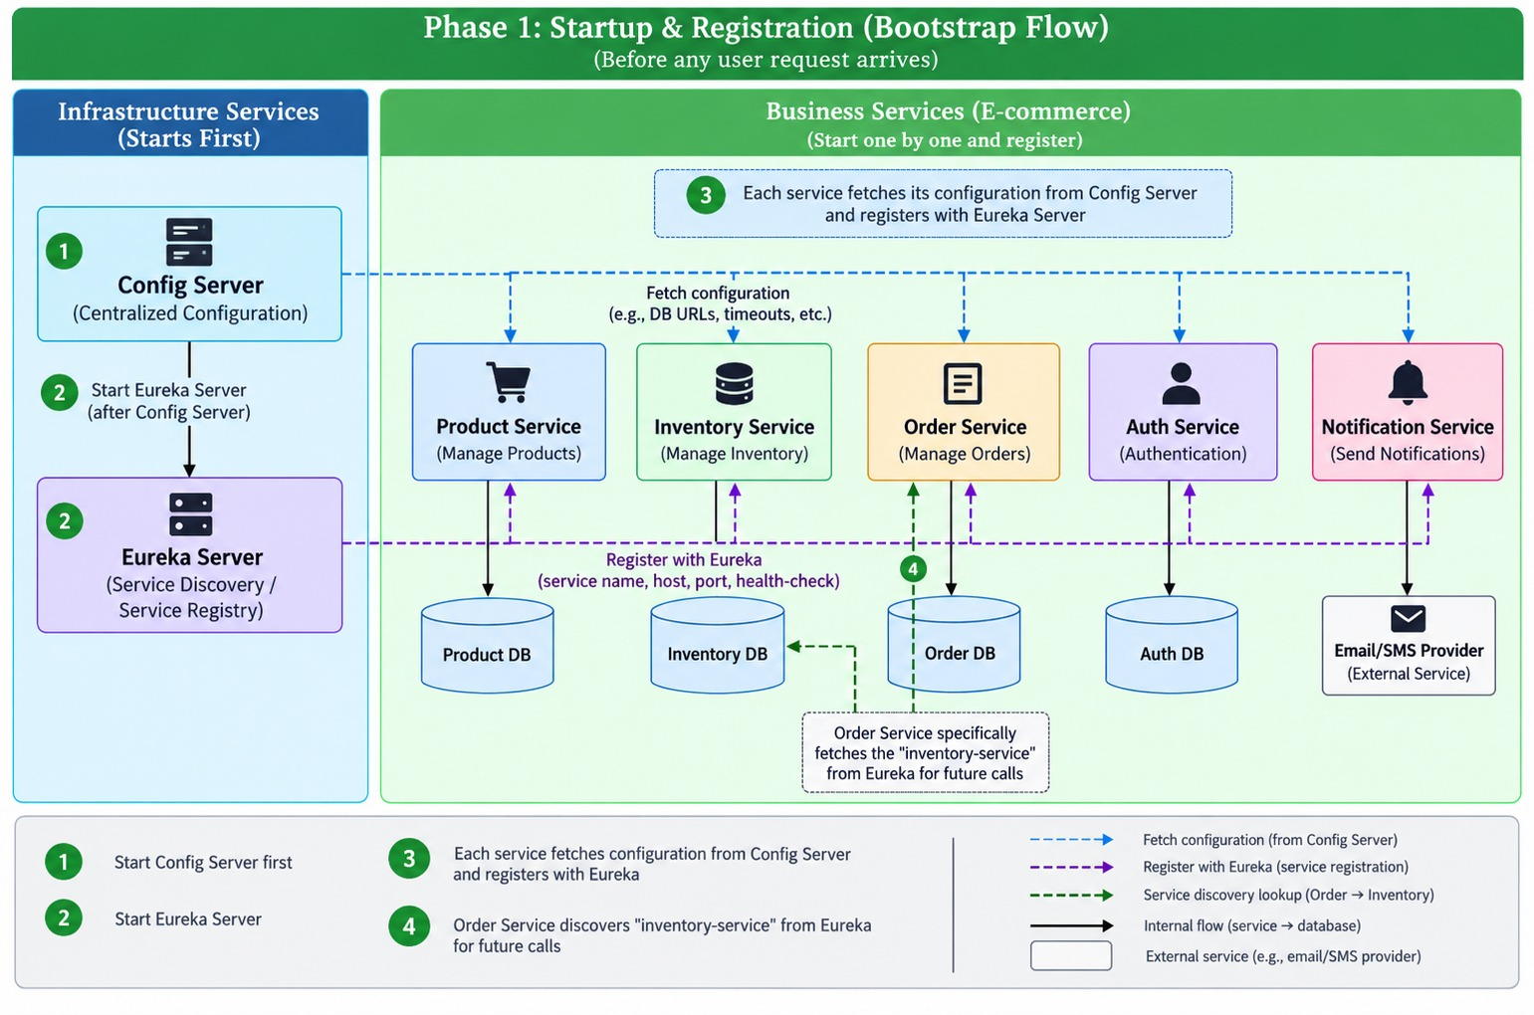

Slide 11
Phase 2: The API Gateway Entry Flow
**1. Intercepting Client Actions**
Clients issue payload actions toward paths like POST /api/orders carrying an appended JWT validation bearer string.
**2. Edge Gateway Inspection**
The WebFlux-based API Gateway traps the request and proxies details to the Auth Service to evaluate signature validity.
**3. Conditional Security Branches**
If token fails validity verification, the gateway abruptly terminates the pipeline returning a raw 401 Unauthorized block.
**4. Intelligently Route Downstream**
If verified, the gateway tracks cached configuration maps to dispatch the client request straight to the Order Service.

Slide 12
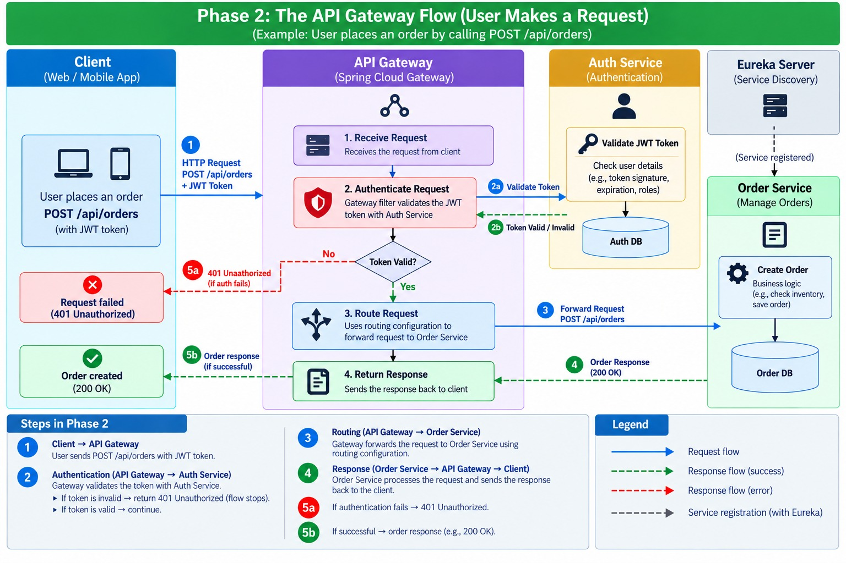

Slide 13
Phase 3: Synchronous Business Dependencies
**1. Processing Incoming Payload**
Order Service reads parameters (Product ID, target quantity) and saves status immediately as PENDING inside the Order DB.
**2. Isolated Target Context Check**
The service checks live inventory availability by creating an external connection directly over to the Inventory Service.
**3. Execution Branching Outtakes**
Success (200 OK): Stock is verified, order marks CONFIRMED.
Out of Stock (400): Request gets rejected, order marks FAILED.
Timeout Failure (503): System triggers local resilience rules.

Slide 14
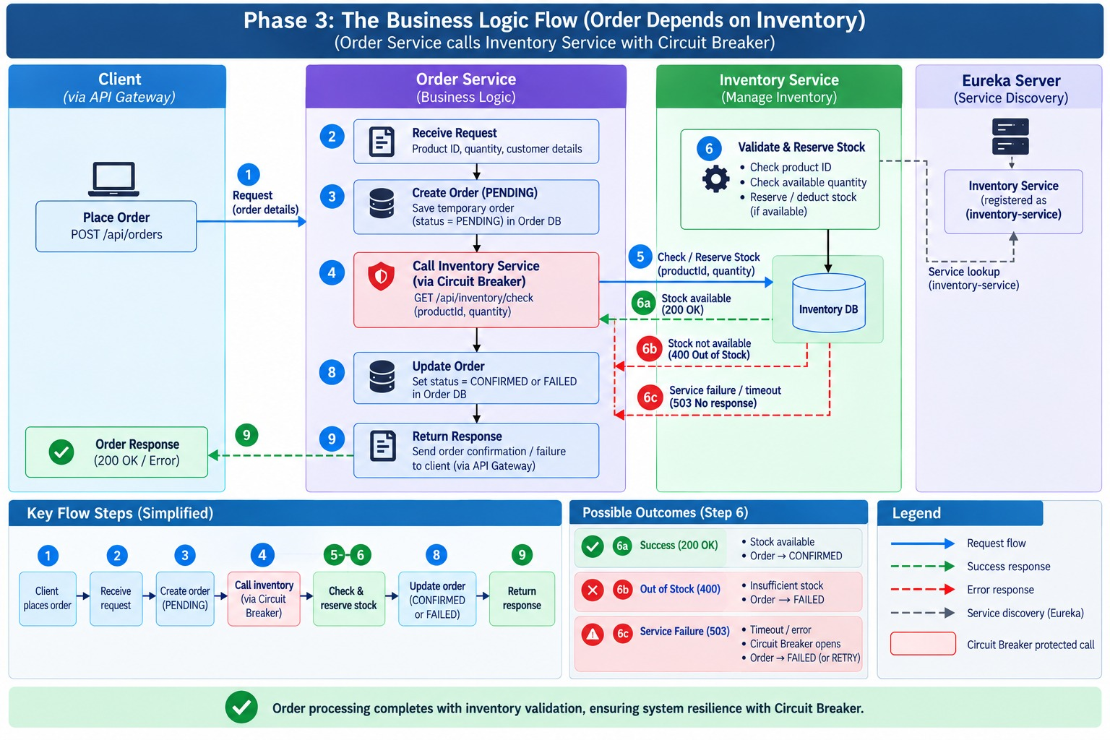

Slide 15
Phase 4: Circuit Breaker State Transitions
**1. Closed State Management**
Normal operations running cleanly. Calls route regularly down to downstream endpoints while collecting continuous performance data.
**2. Open State Interception**
Triggered instantly when error metrics exceed configured tolerances. Network requests get severed completely.
Incoming callers receive rapid local feedback via manual fallback actions.
**3. Half-Open Safe Re-entry**
A configured timeout window elapses, allowing a brief stream of sample trial calls through to test downstream viability.
If tests pass successfully, the circuit seals closed.
If failures repeat, it snaps immediately back open to protect resources.

Slide 16
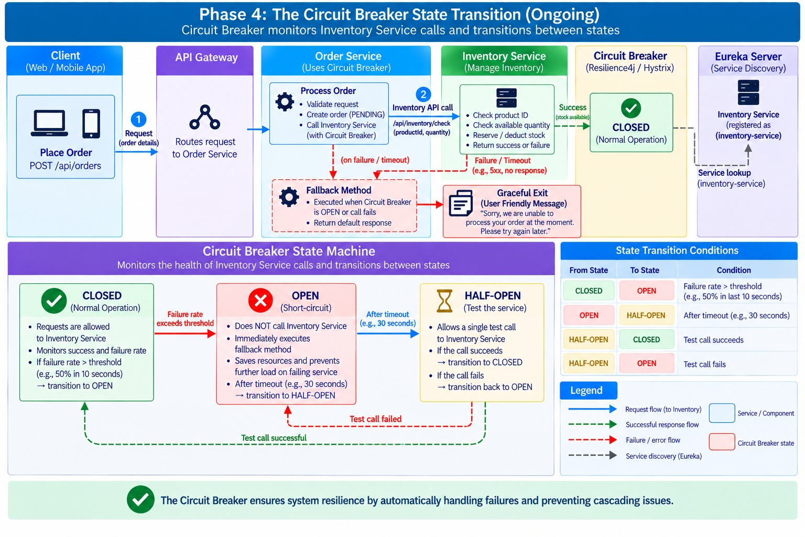

Slide 17
Phase 5: Asynchronous Decoupling Flow
**1. Finalizing Synchronous Work**
Once internal validation ends and records state updates (CONFIRMED/FAILED) inside the database, execution steps conclude.
**2. Event Publishing Routine**
The service converts transaction outcomes into event models and fires them down onto an active Kafka queue topic.
**3. Immediate Client Response**
A fast response code loops back to the caller immediately. The user never waits on ancillary tasks.
**4. Non-blocking Notification Steps**
The standalone Notification Service consumes events via @KafkaListener strings and safely handles slow external SMS/Email APIs.

Slide 18
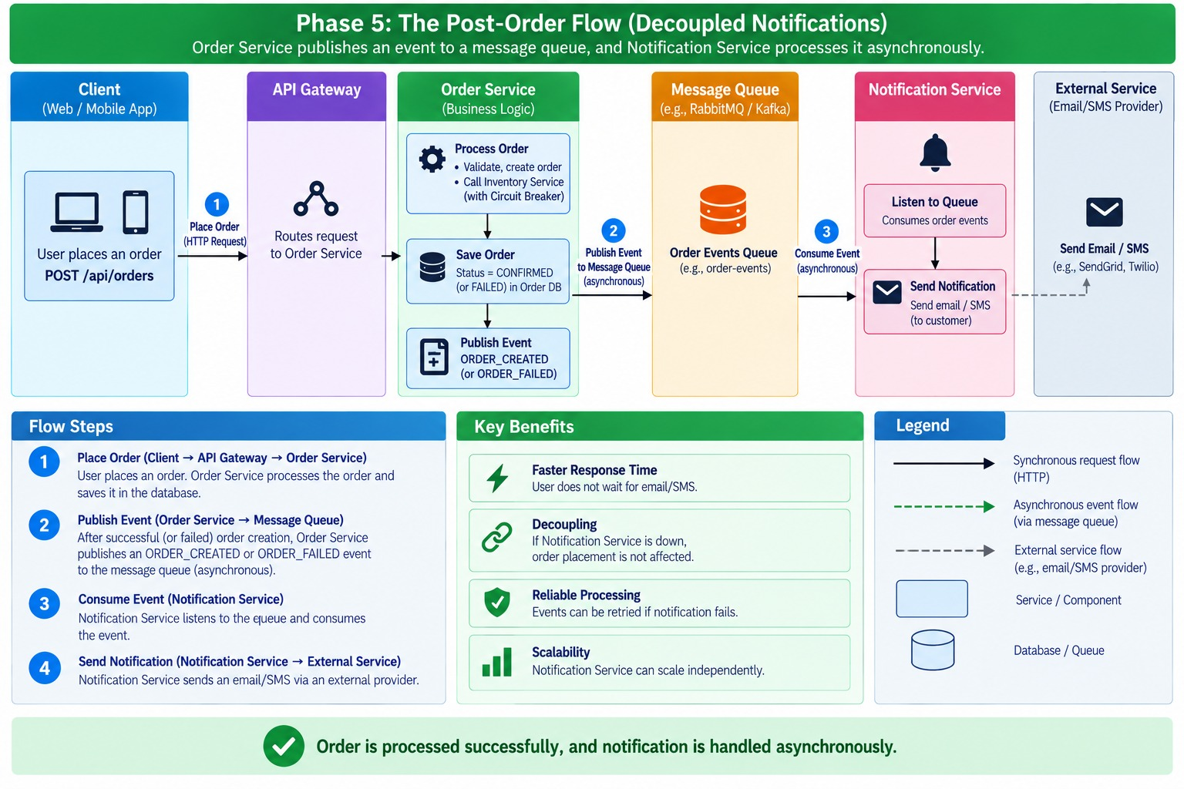

Slide 19
Phase 6: Continuous Registry Maintenance
**1. Active Heartbeat Signals**
Live service micro-runtimes transmit periodic heartbeat pings directly to Eureka every 30 seconds to maintain their status.
**2. Caching Client Routing Maps**
Edge gateways and consuming clients poll Eureka consistently to keep their local downstream load balancing paths up to date.
**3. Failure Detection Mechanisms**
If any microservice engine stops sending pings, Eureka flags the target container instance as DOWN after a 90-second lease window.
**4. Automatic Path Isolation**
Consuming load balancers sweep internal maps to completely clean out broken nodes, preventing systemic cascading drops.

Slide 20
