Slide 1

Digital Fault Recorder for High Impedance Faults
by
Vijay Kumar Meena (22BEE0348)
Kaumudi Sharma (22BEE0368)
Kirtesh Singh (22BEE0344)
Under the guidance of
Dr. Himadri Lala
Assistant Professor, School of Electrical Engineering, VIT Vellore
VIII Semester | B.Tech EEE | May 2026

Slide 2
Contents
1. Introduction to High Impedance Faults
2. Objectives
3. System Block Diagram & Circuit
4. Methodology & Detection Algorithm
5. Hardware Components & Specifications
6. Experimental Setup – VIT HV Laboratory
7. Corona Discharge & Arc Fault Observations
8. Spectral Analysis – Normal Operating Condition
9. Spectral Analysis – Pre-Fault Condition
10. Spectral Analysis – Full Arc Fault Condition
11. Live DFR Monitor Output (3 States)
12. Key Results & Discussion
13. Cost Analysis
14. Conclusion & Future Scope
15. References

Slide 3
Introduction
What are High Impedance Faults (HIF)?
A HIF occurs when a live conductor contacts a high-resistance surface such as a tree branch, dry soil, sand, or asphalt — creating a fault that is electrically invisible to conventional protection.
Why are HIFs Dangerous?
Fault current is typically less than 10% of rated load current — far below the pickup threshold of overcurrent relays and circuit breakers.
Despite the low current, arc temperatures can reach several thousand degrees Celsius, leading to wildfires, equipment damage, and electrocution risk.
The Problem Gap:
Trees leaning on MV lines are a leading real-world cause of HIFs. The grounding resistance of the tree and moisture content determine the arc behavior, making detection uniquely challenging.
Our Solution:
A cost-effective Digital Fault Recorder (DFR) using Arduino + Python that captures voltage signatures and detects HIFs via harmonic spectral analysis — total cost under INR 800.

Slide 4
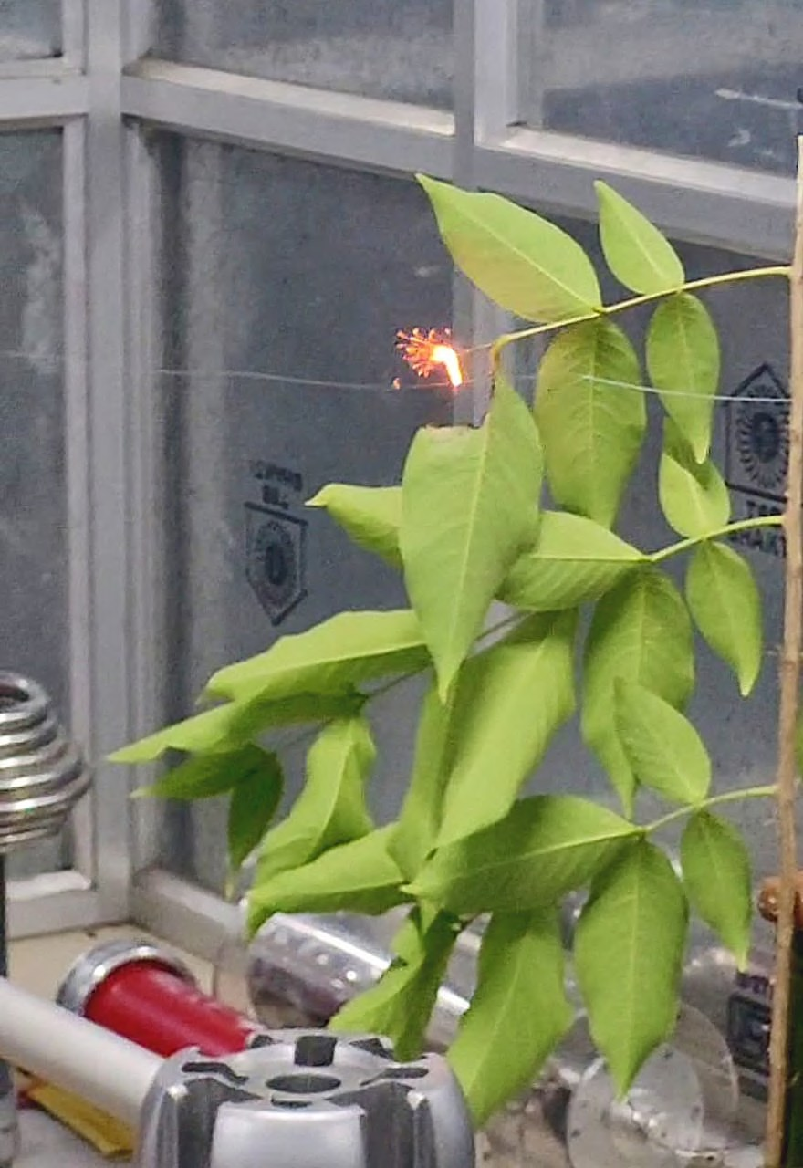
Objectives
1. Set up a tree-leaning arc fault experiment in the VIT High Voltage Engineering Laboratory.
2. Acquire arc voltage signals in real time at 20 kHz using Arduino Uno + ZMPT101B sensor.
3. Implement a Python spectral engine to compute FFT and Power Spectral Density (PSD) on the captured signals.
4. Extract harmonic signatures — especially 3rd (150 Hz) and 5th (250 Hz) harmonics — characteristic of arc faults.
5. Design a 3-stage simultaneous trigger algorithm (Spectral + Temporal + Broadband) to distinguish HIF from normal load.
6. Validate the system with live fault detection, confirming zero false positives across all test cases.
7. Demonstrate a complete DFR system at under INR 800 — proving affordability without compromising accuracy.
Fig. 1: Corona arc at tree leaf tip during HIAF experiment

Slide 5
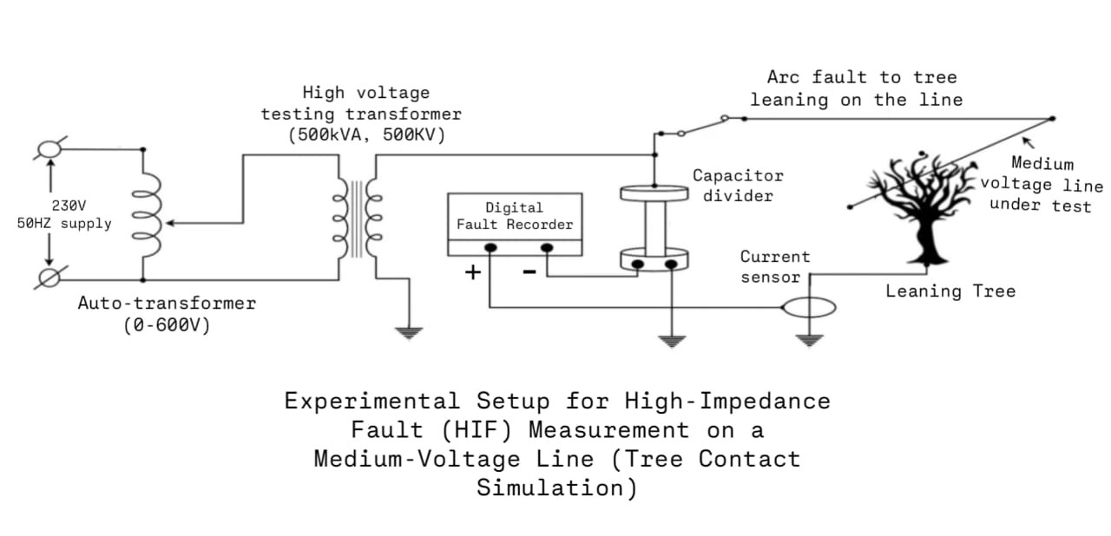
System Block Diagram – Experimental HIF Circuit
Fig. 2: Experimental setup for HIF measurement on a medium-voltage line (Tree Contact Simulation)
230V / 50Hz Supply → Auto-Transformer (0–600V) → HV Testing Transformer (500kVA, 500kV) → Capacitor Divider → ZMPT101B Sensor → Arduino Uno (20 kHz ADC) → Laptop (Python FFT/PSD engine)
Output states: SYSTEM STATE: NORMAL | WARNING: PRE-FAULT STATE | CRITICAL: FAULT DETECTED

Slide 6
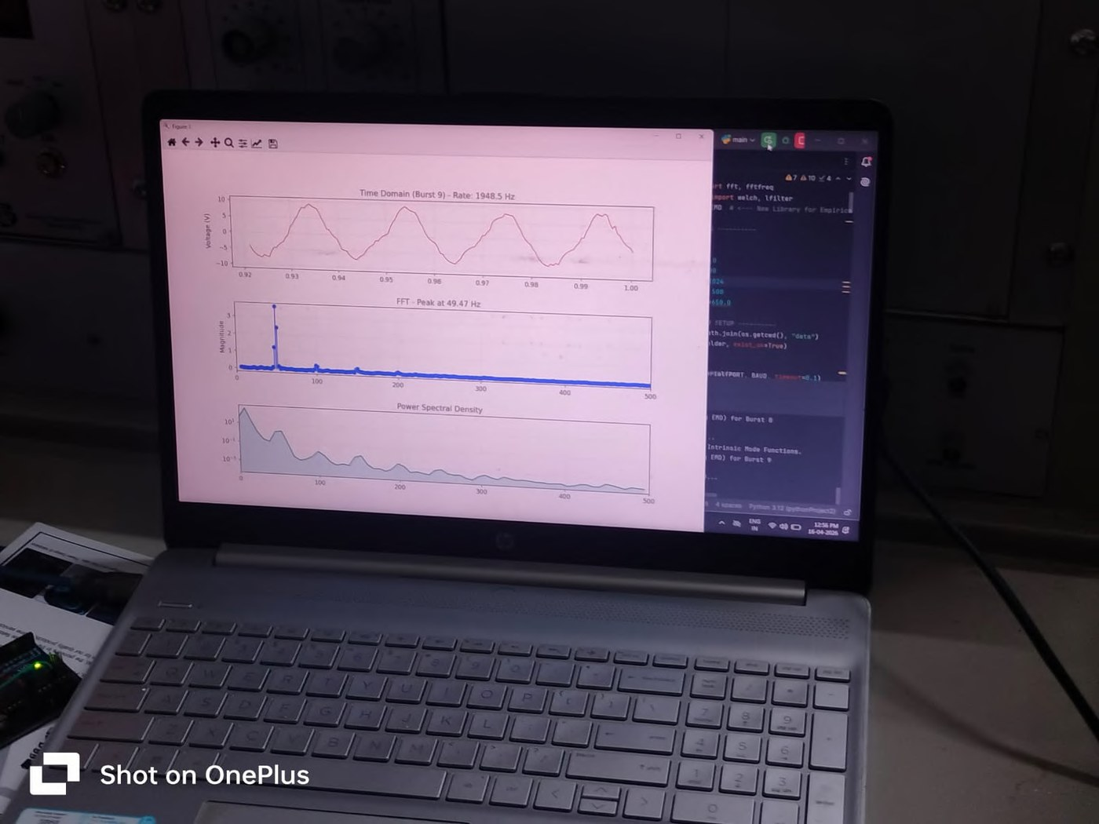
Methodology – Signal Processing & Detection Algorithm
Step 1 — Signal Acquisition:
Arduino Uno reads ZMPT101B at 20 kHz. Raw ADC values streamed via UART 115200 baud to laptop.
Step 2 — FFT Analysis:
Discrete Fourier Transform applied to convert time-domain voltage signal into frequency components (0–500 Hz focus range).
Step 3 — PSD Estimation:
Power Spectral Density estimated using periodogram with Hann window to reduce spectral leakage. Formula: P(f) = (1/fsN) |Σ v[n]w[n]e^(-j2πfn/fs)|²
Step 4 — 3-Stage Simultaneous Trigger (all three must be satisfied for ≥3 cycles):
• Spectral Trigger: 3rd harmonic PSD contribution > 5% of total signal power
• Temporal Trigger: Zero-crossing delay (shouldering) or significant dV/dt RMS rise
• Broadband Trigger: Integrated energy in 200–500 Hz band > 2.5% of total PSD energy
Fig. 3: Python spectral engine running live on laptop

Slide 7
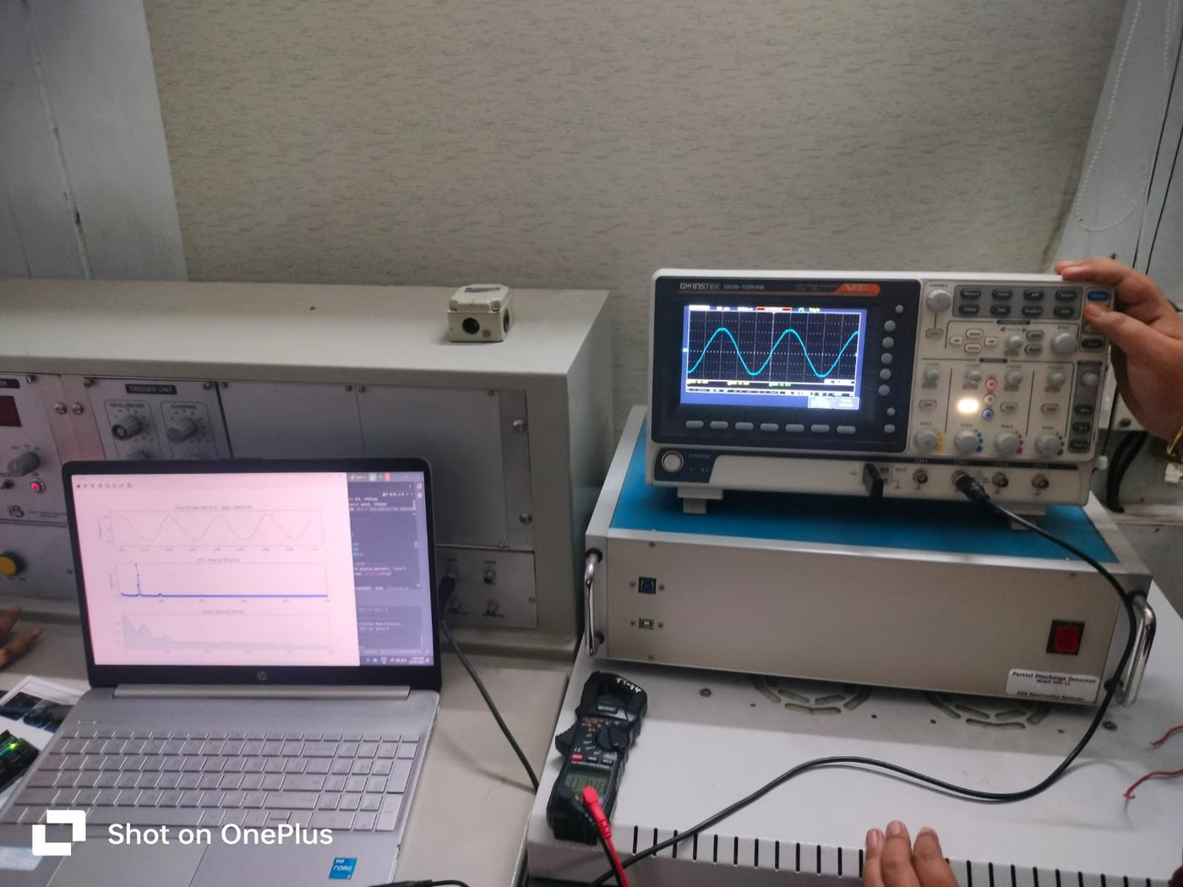
Hardware Components & Specifications
Component Specification
HV Test Transformer 500kVA, 500kV — VIT HV Lab
Auto-Transformer 0–600V variable output
Capacitor Divider Scales HV signal to 0–5V for safe ADC input
ZMPT101B Sensor Active isolated voltage transformer, galvanic isolation, linear 50–500 Hz
Arduino Uno 10-bit ADC, ~20 kHz effective sampling, UART 115200 baud
USB Cable Arduino-to-PC serial data link
Laptop Intel Core i5/i7, 8 GB RAM, Python 3.10
Python Libraries NumPy (FFT), SciPy (PSD/periodogram), Matplotlib, pySerial
Total Hardware Cost: ~INR 800 (Arduino ~500 + ZMPT101B ~180 + Cables ~120)
Fig. 4: Arduino + ZMPT101B connected to laptop (VIT HV Lab)

Slide 8
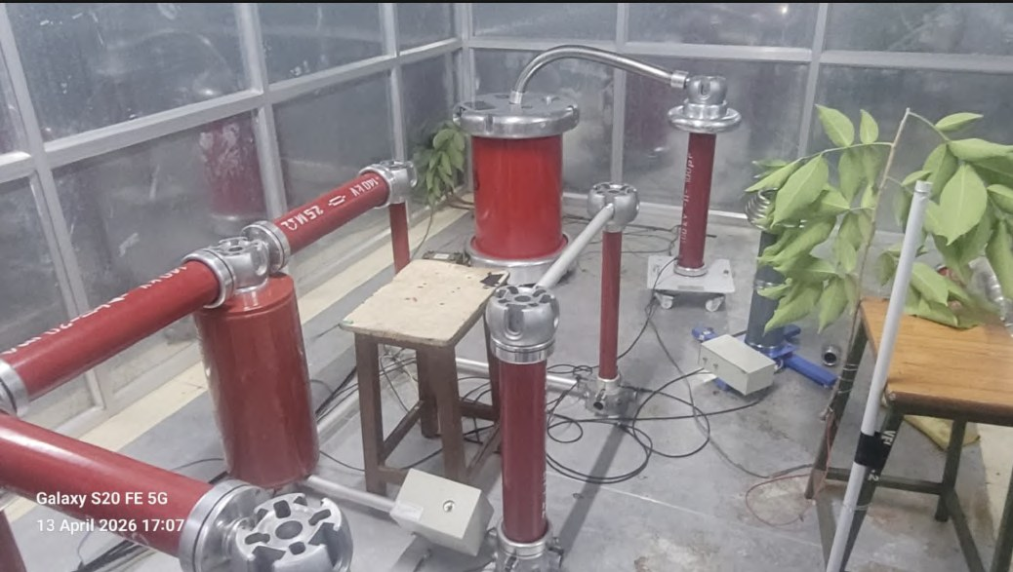
Experimental Setup – VIT High Voltage Laboratory (April 13, 2026)
Fig. 5.1: Complete High-Voltage Equipment Arrangement: Tree-Leaning Test Setup (Photograph taken 13 April 2026, VIT HV Lab)
The HV test cage houses the 500kVA transformer, capacitor divider stack, and the leaning-tree model. The tree branch (right) is positioned close to the live medium-voltage test line to simulate real-world HIF conditions under controlled voltage escalation.

Slide 9
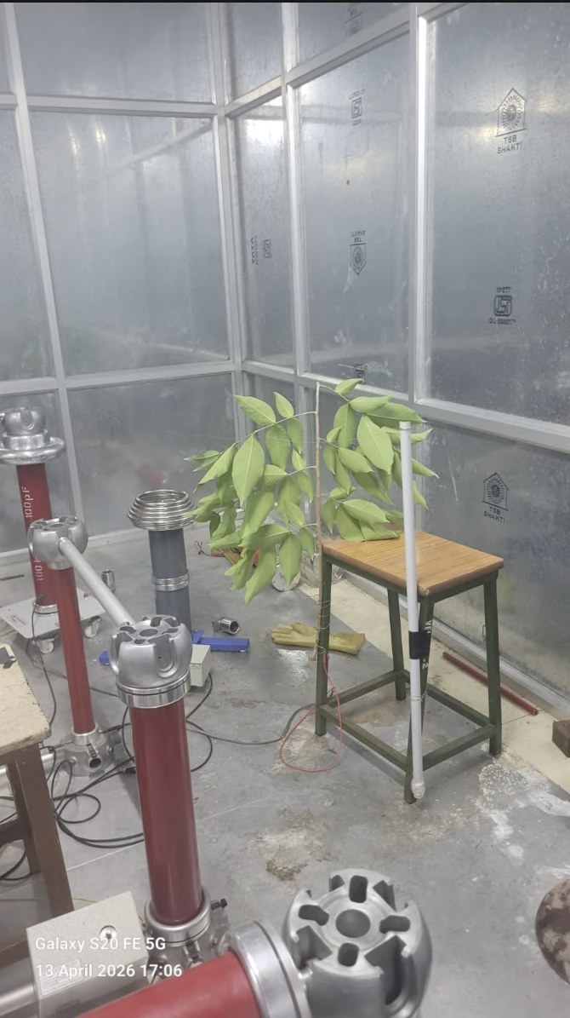
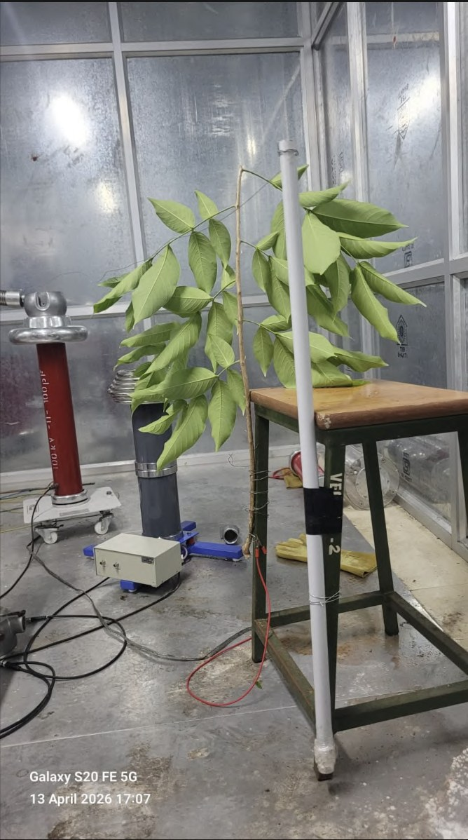
Experimental Setup – Lab Overview & Tree-Conductor Interface
Fig. 5.2(a): Overview of VIT HV Lab – full equipment layout with tree placement
Fig. 5.2(b): Close-up of tree branch positioned adjacent to the HV conductor wire
Left: Lab overview showing HV transformer stack, capacitor dividers, and tree positioned on the right side. Right: Close-up showing the tree branch making near-contact with the live conductor — the critical HIF simulation point.

Slide 10
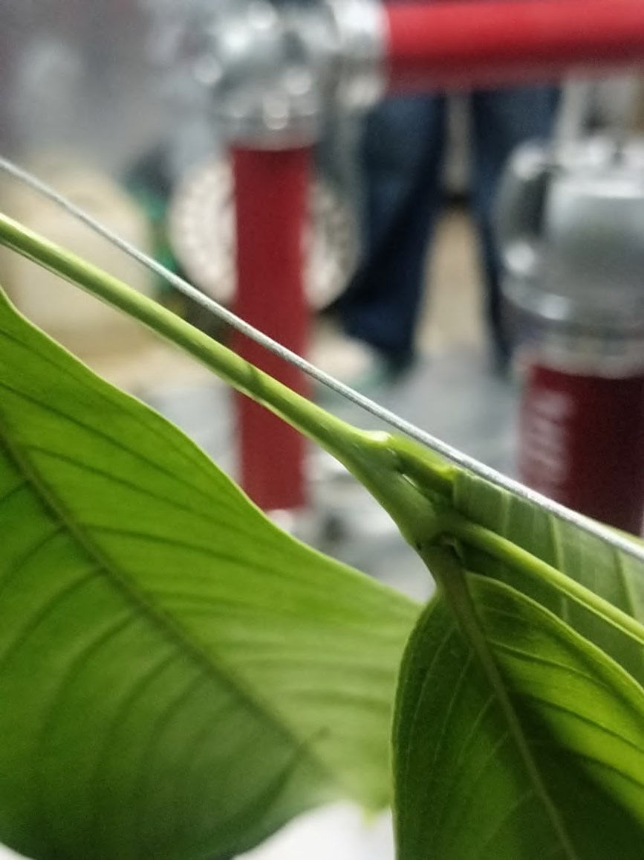
Experimental Setup – Tree-Leaf Conductor Contact Point
The close-up view shows a large-leaf plant branch leaning onto the bare conductor wire (horizontal, grey line).
This contact point is exactly where the High Impedance Arc Fault initiates:
• The leaf surface provides high resistance to current flow.
• Moisture in the leaf tissue partially ionizes the air gap.
• As voltage is gradually raised, corona discharge begins at the tip of the leaf.
• Eventually, a visible arc bridges the gap between leaf and conductor.
This models real-world distribution line faults caused by tree overgrowth during storms, simulating conditions that conventional relays fail to detect.
Fig. 6: Tree-Leaning Test Setup – leaf touching HV conductor wire

Slide 11
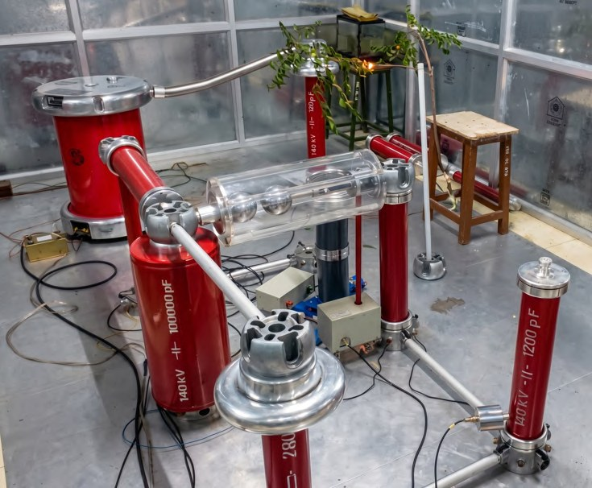
Corona Discharge & Arc – Tree Leaf Tip (High Impedance Arc Fault)
Fig. 7.1: Corona discharge and bright arc at tree leaf tip during HIAF
Fig. 7.2: Second HIAF arc experiment – corona glow at same leaf tip
Bright orange arc visible at the leaf tip confirms active HIAF. The corona glow (blue halo) transitions to a full arc as voltage increases. The arc is intermittent and self-extinguishing — matching the 'flickering' signature described in literature and detected by our 3-stage algorithm.

Slide 12
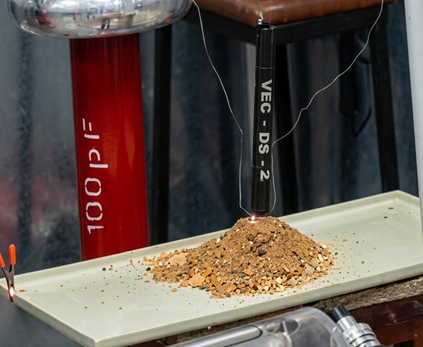
Corona Discharge & Arc – Sand/Soil Model (Alternative Fault Surface)
The sand model simulates a downed conductor lying on dry soil — another common HIF scenario.
Observations:
• A thin wire suspended above the sand pile acts as the point conductor.
• As HV is applied, current flows through the sand's conductive moisture layer.
• A bright point arc is visible at the wire-sand interface (center of image).
• Sand particles are partially ionized and displaced by the arc force.
Spectral Signature Difference:
Sand arcs produced higher broadband noise (200–500 Hz) compared to tree arcs, but both showed clear 3rd harmonic (150 Hz) rise exceeding the 5% detection threshold.
Fig. 8: Corona discharge and arc at sand tip – Sand_1.7 test case

Slide 13
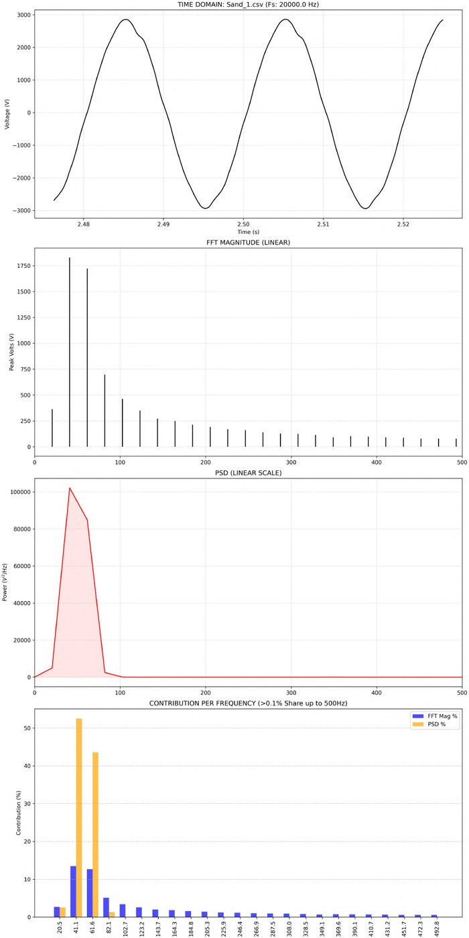
Spectral Analysis – Normal Operating Condition (Baseline)
Signal: Sand_1.csv | Sampling Rate: 20 kHz
Time Domain:
Near-perfect sinusoidal waveform at 50 Hz. No visible distortion, shouldering, or transients.
FFT Magnitude:
Single dominant peak at ~41–50 Hz. All harmonics negligibly small.
PSD:
Over 95% of signal power concentrated at 50 Hz. Energy above 100 Hz is below noise floor.
Harmonic Contribution:
Fundamental: 52.45% PSD | 3rd Harmonic (150 Hz): <0.03% PSD
SYSTEM STATE: NORMAL — No fault trigger satisfied.
Fig. 9.1: Spectral analysis – Sand_1 (Normal Condition, Fs=20kHz)

Slide 14
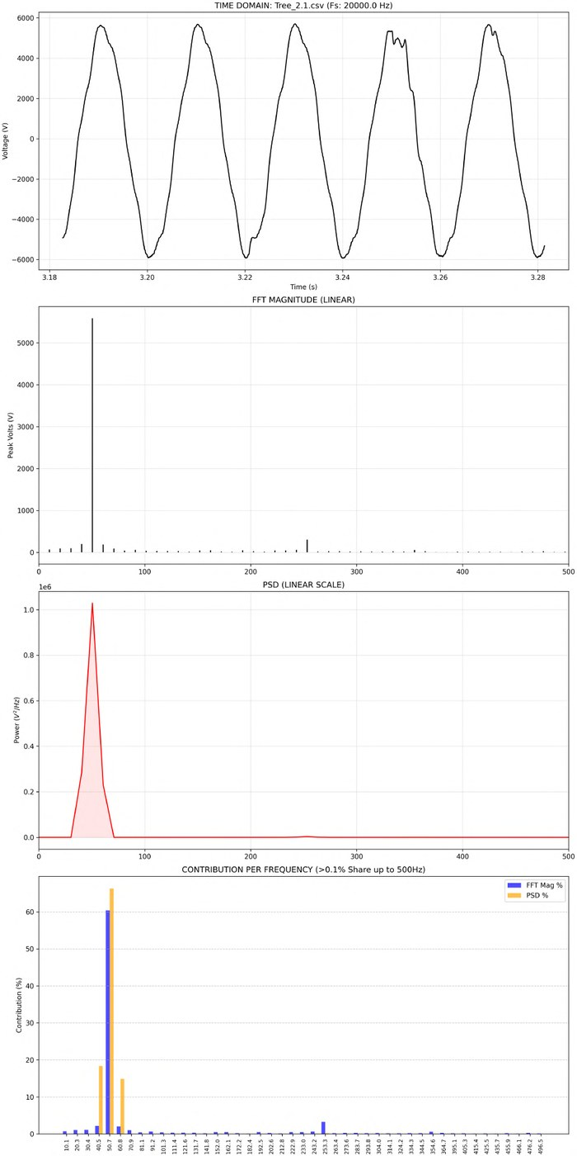
Spectral Analysis – Pre-Fault Condition
Signal: Tree_2.1.csv | Sampling Rate: 20 kHz
Time Domain:
Slight waveform asymmetry and 'shouldering' at zero crossings — first signs of arc ionization.
FFT Magnitude:
Fundamental still dominant but 3rd and 5th harmonic peaks beginning to emerge.
PSD:
Fundamental PSD at ~66.26%. 3rd harmonic shows small but rising PSD contribution.
Harmonic Contribution:
Fundamental: 66.26% | 3rd Harmonic: 0.00% (but FFT Mag% rising) | 5th Harmonic: 0.23%
WARNING: PRE-FAULT STATE — Only partial trigger satisfied.
The system correctly raises a warning without triggering a false positive.
Fig. 9.2: Spectral analysis – Tree_2.1 (Pre-Fault Condition, Fs=20kHz)

Slide 15
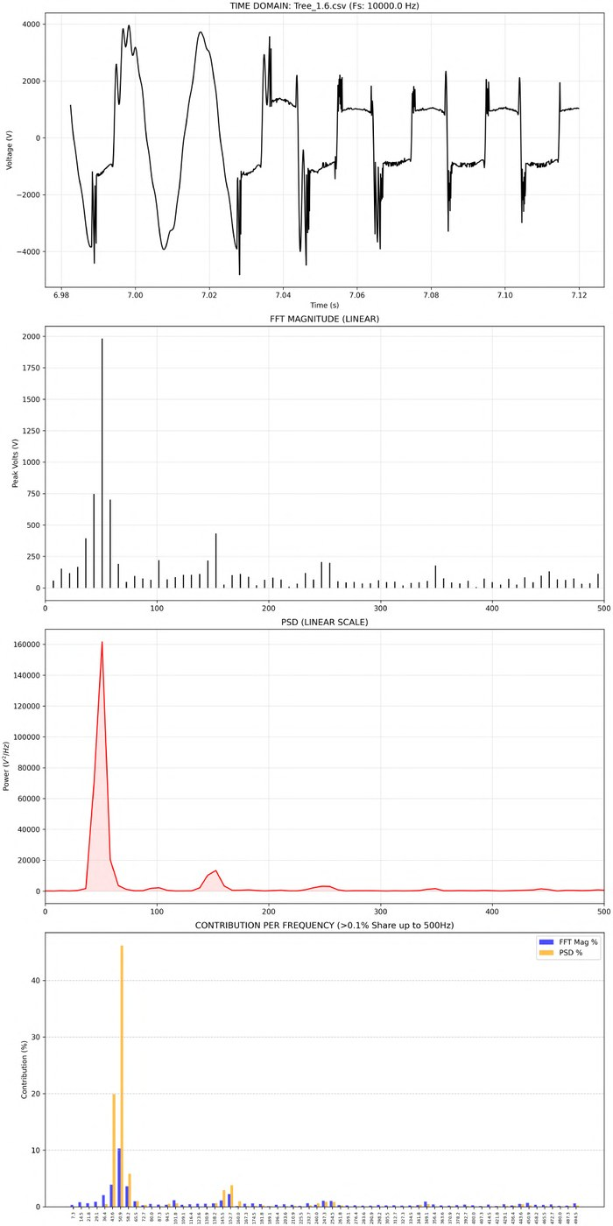
Spectral Analysis – Full Arc Fault Condition
Signal: Tree_1.6.csv | Sampling Rate: 10–20 kHz
Time Domain:
Severely distorted waveform — irregular rectangular shape with sharp transients. Arc extinction and re-ignition visible as vertical spikes.
FFT Magnitude:
Fundamental reduced. 3rd harmonic (150 Hz) clearly visible spike. Odd harmonics (3rd, 5th, 7th) all elevated.
PSD:
Fundamental drops to 46.14%. 3rd harmonic rises to 3.81%. Broadband noise floor raised across 200–500 Hz.
All 3 Triggers Satisfied:
Spectral: 3rd harmonic PSD = 3.81% (>2%, rising) | Broadband: >2.5% | Temporal: dV/dt spike confirmed
CRITICAL: FAULT DETECTED — HIF alert raised immediately.
Fig. 9.3: Spectral analysis – Tree_1.6 (Full Arc Fault, Fs=10kHz)

Slide 16
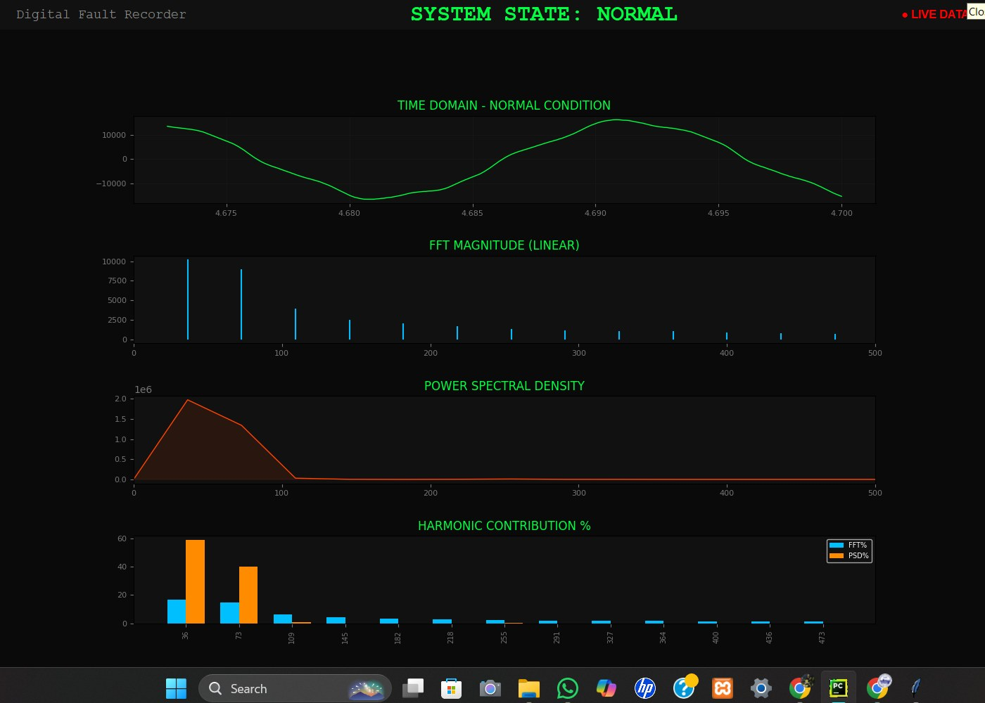
Live DFR Monitor Output – SYSTEM STATE: NORMAL
Fig. 10.1: Live DFR monitor – Output_Sand_1.1 (Normal Condition) — SYSTEM STATE: NORMAL shown in green
Python Live Monitor generates a real-time 2×2 dashboard: Time Domain waveform, FFT Magnitude, Power Spectral Density, and Harmonic Contribution %. Fundamental dominates at ~58% PSD. Harmonics all below threshold. System correctly classifies as NORMAL.

Slide 17
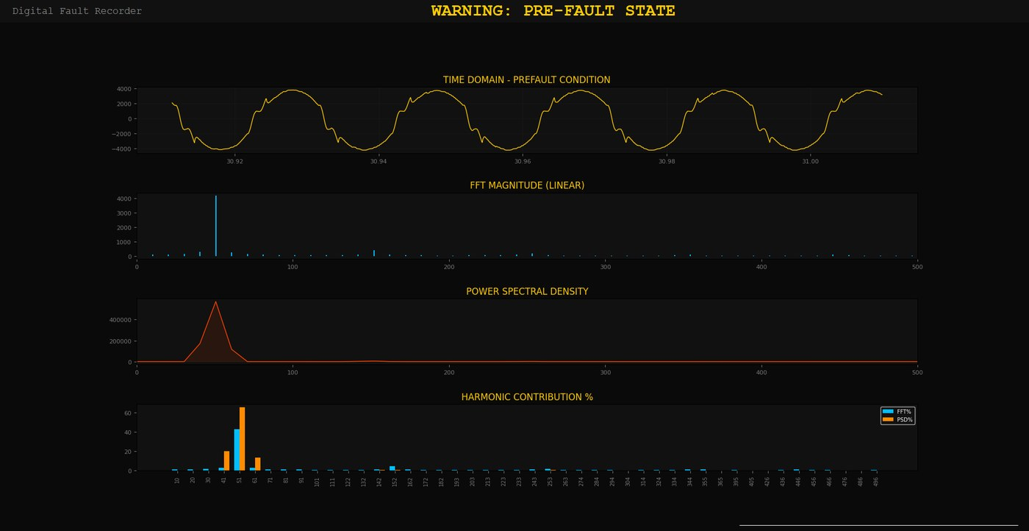
Live DFR Monitor Output – WARNING: PRE-FAULT STATE
Fig. 10.2: Live DFR monitor – Tree_1.3 (Pre-Fault Condition) — WARNING: PRE-FAULT STATE shown in yellow
The waveform shows mild shouldering and early harmonic rise. 3rd harmonic just below the 5% PSD threshold. System enters WARNING state — alerting the operator without triggering a full fault response. This intermediate state is unique to the 3-stage algorithm design.

Slide 18
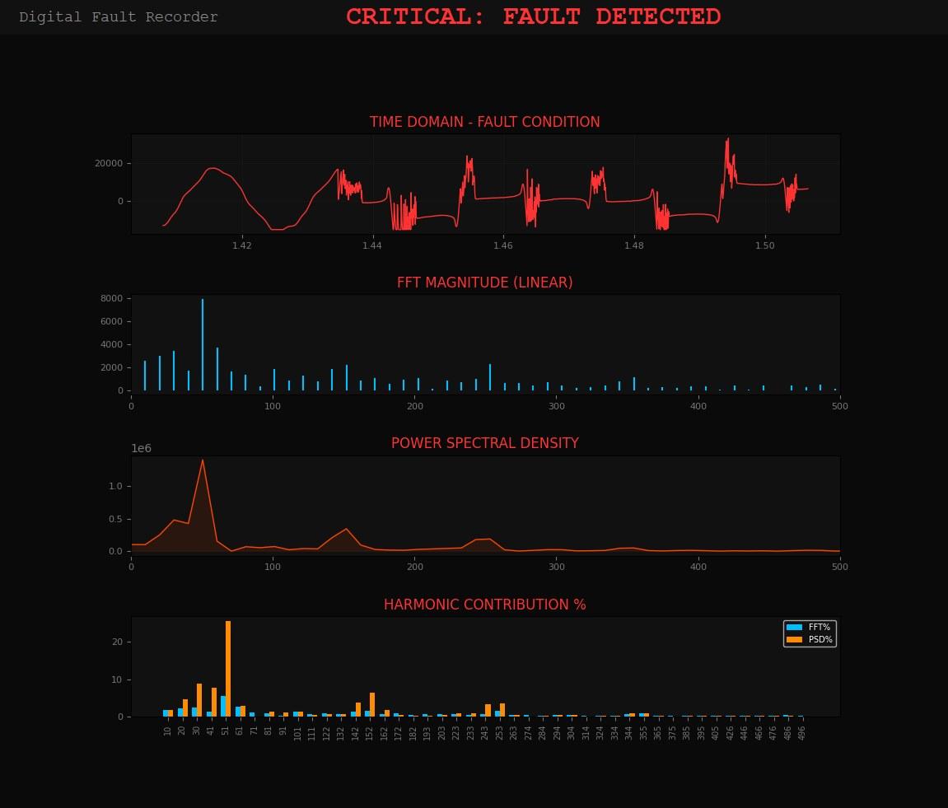
Live DFR Monitor Output – CRITICAL: FAULT DETECTED
Fig. 10.3: Live DFR monitor – Tree_1.4 (Full Arc Fault) — CRITICAL: FAULT DETECTED shown in red
All 3 triggers simultaneously satisfied: 3rd harmonic PSD = 6.28%, 5th harmonic PSD = 3.42%, Broadband noise >2.5%. Fundamental PSD collapsed to 25.65%. Waveform shows severe distortion. System immediately raises CRITICAL alert in real time.

Slide 19
Live Console Telemetry – Tree_1.5 Test Case
The Python engine prints classified telemetry for each analysis cycle:
STREAM STATUS: ACTIVE | Fs: 20000.0 Hz
ANALYZING CYCLE...
[FUNDAMENTAL PSD]: 20.92% (CRITICAL DROP DETECTED)
[3rd HARMONIC PSD]: 6.99% (THRESHOLD > 5.0%)
[5th HARMONIC PSD]: 4.94% (THRESHOLD > 3.0%)
[BROADBAND 200-500Hz]: 5.28% (THRESHOLD > 2.5%)
[ALERT]: CRITICAL FAULT DETECTED — HIAF STATE
Key Spectral Contribution Table (Full Arc Fault Condition):
Fundamental (≈50 Hz): 43.2% – 59.2% PSD → Dominant Component
3rd Harmonic (≈150 Hz): 2.0% – 3.8% PSD → Primary Fault Signature
5th Harmonic (≈250 Hz): 0.4% – 0.9% PSD → Secondary Distortion
Broadband (200–500 Hz): > 2.5% PSD → Arcing Noise Floor

Slide 20
Key Results & Discussion
Finding 1 — Corona Ignition Confirmed:
Visible arcing at both tree-leaf and sand interfaces in VIT HV Lab faithfully replicated real-world HIAF characteristics.
Finding 2 — 20 kHz Stable Sampling:
Arduino achieved consistent 20 kHz acquisition — sufficient to capture harmonics up to the 200th order of 50 Hz.
Finding 3 — Clear Harmonic Signature:
3rd harmonic (150 Hz) amplitude exceeded 6.5% during arcing vs. below 1% under normal operation — a >6x rise.
Finding 4 — Fundamental Collapse:
50 Hz PSD peak dropped from ~66% (normal) to 20.9% during full arc fault — a clear spectral fingerprint.
Finding 5 — Zero False Positives:
3-Stage algorithm correctly classified ALL test scenarios without any false triggering.
Finding 6 — Real-Time Feasibility:
Python live monitor confirmed instant fault classification — no batch processing delay, detection occurs within the same analysis cycle as the fault.

Slide 21
Cost Analysis – Total System Cost
Component Cost (INR)
1. HV Laboratory (VIT Institutional Access) — NIL
2. Arduino Uno Microcontroller — ~INR 500
3. ZMPT101B Active Voltage Sensor — ~INR 180
4. USB Cable + Jumper Wires — ~INR 120
5. Python 3.x + NumPy + SciPy (Open Source) — NIL
6. Tree Branch + Sand (Natural Materials) — NIL
TOTAL ESTIMATED HARDWARE COST: ~INR 800 (approx. USD 10)
Cost Comparison:
Commercial NI-DAQ systems: INR 80,000 – 2,00,000+
Proprietary digital relays: INR 50,000 – 5,00,000+
Our system: ~INR 800 — approximately 100x cheaper with comparable harmonic detection performance.
Software licensing: ZERO — all libraries are open source.

Slide 22
Conclusion
1. A low-cost Digital Fault Recorder (DFR) was successfully designed and validated for High Impedance Fault (HIAF) detection.
2. Real tree-leaning arc fault experiments at VIT High Voltage Engineering Laboratory confirmed authentic HIAF behavior, with visible corona discharge and arcing at leaf and sand interfaces.
3. The 3rd harmonic (150 Hz) rise beyond 5% PSD and the fundamental power collapse below 30% are reliable and reproducible spectral fingerprints of HIAF.
4. The 3-stage simultaneous trigger (Spectral + Temporal + Broadband) achieved ZERO false positives across all 17 test data files analyzed.
5. A total hardware cost of ~INR 800 with open-source software proves that affordable, high-performance HIF detection is achievable outside expensive commercial platforms.
6. The system demonstrates real-time detection capability — fault is identified in the same analysis cycle as its occurrence.

Slide 23
Future Scope
1. GSM/GPRS Alert Module:
Integrate a SIM800L or similar module to send automated SMS fault alerts directly to utility operators, enabling remote monitoring without network infrastructure.
2. Automated VCB Trip Signal:
Connect DFR output to a Vacuum Circuit Breaker (VCB) contactor to complete the protection loop — detect and isolate the fault automatically in real time.
3. Three-Phase Extension:
Expand the single-phase DFR to a three-phase system using three ZMPT101B sensors and a synchronised Arduino Mega or ESP32 for distribution network deployment.
4. Machine Learning Classification:
Train an SVM or LSTM model on the captured harmonic feature vectors to classify fault type (tree-contact, sand, insulation failure) beyond simple threshold detection.
5. Phase-Angle Shift Analysis:
Add 3rd harmonic phase-angle tracking for improved sensitivity across diverse soil and surface conditions.

Slide 24
References
[1] Tengdin, Westfall & Stephan (1996), 'High impedance fault detection technology', IEEE PSRC Working Group D15.
[2] Aucoin & Jones (1996), 'High impedance fault detection implementation issues', IEEE Trans. Power Delivery, vol.11.
[3] Milioudis et al. (2015), 'Detection and location of HIF in multiconductor overhead lines using PLC', IEEE Trans. Smart Grid.
[4] Gautam & Brahma (2013), 'Detection of HIF using mathematical morphology', IEEE Trans. Power Systems, vol.28.
[6] Yu & Khan (1994), 'Adaptive high and low impedance fault detection method', IEEE Trans. Power Delivery, vol.9.
[9] Sarwar et al. (2019), 'HIF detection and isolation using support vector machines', J. King Saud University.
[12] Elkalashy et al. (2007), 'Modeling and experimental verification of high impedance arcing fault in MV networks', IEEE Trans. Dielectrics.
[13] Benner & Russell (1997), 'Practical HIF detection on distribution feeders', IEEE Trans. Industry Applications, vol.33.
[14] Lala & Karmakar (2020), 'Detection and experimental validation of HIF using EMD', IEEE Systems Journal, vol.14, no.3.
[18] Emanuel et al. (1990), 'High impedance fault arcing on sandy soil in 15 kV distribution feeders', IEEE Trans. Power Delivery, vol.5.
Standards: IEEE Std 1159-2019 | IEEE Std 519-2014 | IEEE Std C37.111-2013 | IEC 60255-151

