Slide 1
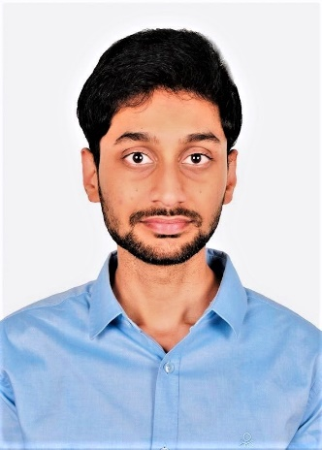
Vijay Chaitanya Boyina
Summary of Experience
An accomplished Technocrat with over six years of experience in full-stack J2EE development and Legacy Modernization in an enterprise environment Demonstrated excellence in the development of high performance, scalable web applications using Angular 7, J2EE technologies along with strong background in configuration, and maintenance of extensive J2EE based architecture solutions Profound knowledge in utilizing JUnit(Integrated and Independent) for unit and integration testing Proficient in the entire service stack from the service interfaces to the database along with conducting unit testing, code reviews Hands-on experience on JavaScript packages which are used for building and optimizing complex browser-based applications Practiced in developing and deploying applications in AWS (EC2, Code Commit) and PCF (Pivotal Cloud Foundry) Expertise in backend object oriented programming language like Java and databases such as MySQL Hands-on experience in Angular 7 (HTML, CSS, Type Script, Karma Jasmine), Spring boot with Micro Services, Spring Data JPA, Spring Data Mongo Adept in Design, Development and Implementation of multi-tier thin/thick client web based applications using Object Oriented Methodologies Strong acumen in Micro services and conversant in transforming a legacy monolithic application to a Micro service based architecture
Sample of Domains/Clients Served
Life Sciences & Health Care: Health Care Service Corporation Current Assignment: TA – API Team - Challengers
Role
Developer
Location:
Bangalore, India
Email
viboyina@deloitte.com
Mobile
+91 9566001973
Summary
I have ~6 years of applied experience in Full Stack Development(Angular, J2EE) and a proven record of accomplishment of expertise enterprise solutions. Currently working in the core development team on a set of technological transformation initiatives for some of the prestigious Fortune 100 Customers in the World. Driven by the passion to drive the business growth and delivery excellence through technological solutions.
Certification: OCJP, MCD Level 1
Education
B.Tech (Computer Science & Engineering)

