Slide 1
QAI Products & Services Roadmap
Bhadale IT Innovations Pvt. Ltd.

Slide 2
Vision & Mission
Vision: To pioneer Quantum-AI powered hubs, products, and services that modernize industries and societies with secure, intelligent, and scalable platforms.
Mission: To deliver a universal, modular hub ecosystem that integrates classical, AI, and quantum technologies for research, modernization, and enterprise-scale operations.

Slide 3
Core Anchors of the Roadmap
Hub/Center | Purpose | Roadmap Role
QAI Research Hub (CoE) | Repository of research, disruptive innovation, applied AR for upgrading legacy systems into QAI-ready platforms. | Feeds Applied Research & Disruptive Innovation roadmap phases.
QAI IT Hub Core | Middleware backbone: integrates platforms, runtimes, APIs, libraries, domains, and quantum protocols. | Enables modernization, migration, integration, provides runtime middleware, API hubs, and simulation tools.

Slide 4
High-Level Roadmap Steps
Phase | Timeline | Milestones | Deliverables | Standards | Anchors
Foundation & Charter | 0–6 mo | Establish Program Office, TRL baselines, Hub Core sandbox | Program charters, Hub Core skeleton, inventory of legacy products | IEEE 15288, NIST RMF | QAI IT Hub Core
MVP & Acceleration Kits | 6–12 mo | MVPs integrated with Hub Core middleware | MVP pilots, Hub APIs, initial Solution Café client | SAFe PI Planning, Scrum | Min Viable Products repo
Modernization Tracks | 12–18 mo | ERP/ICS-OT modernization via Hub Core + OR | Modernized ERP, ICS/OT secured infra, Hub Core deployment | ITIL4, IEC 62443, NIST CSF | IT Hub Core
Applied Research Programs | 12–24 mo | Launch CoE research (QAI Research Hub), integrate Hub | Research outputs, disruptive prototypes, Hub-based AR pipelines | IEEE/ACM, Horizon Europe AR | QAI Research Hub
Disruptive Innovation Tracks | 18–30 mo | Develop quantum internet, 6G, blind QC via Hub Core | Disruptive prototypes, beyond-2030 tech docs | ISO 56000, ISO/IEC 42010 | IT Hub Core + AR links
NexGen Enterprise Scaling | 18–36 mo | Deploy Hub Core at enterprise/national scale | QAI ERP integrated, Hub-as-a-Service, national data centers | SAFe LPM, Industry 4.0 | NexGen Enterprises repo
Global Compliance & Growth | 24–48 mo | Certify Hub-based solutions (ISO/NIST/IEC) | Certified Hub servers/clients, compliance kits, global rollout | ISO 27001/27701, GDPR, CCPA | Compliance Frameworks repo

Slide 5
Program Objectives
Objective | Description | Hub Role
Universal QAI Middleware | Create a universal middleware for quantum + classical workloads | Hub Core as central runtime + libraries
OR-Driven Modernization | Use Ops Research to optimize migration paths | Hub Core integrates OR models
Secure Quantum Internet R&D | Blind QC, teleportation, dense coding | Hub Core as quantum comms backbone
Enterprise/National Hubs | Scale to enterprises, datacenters, GovTech | Hub Core as modular server + Solution Café client

Slide 6
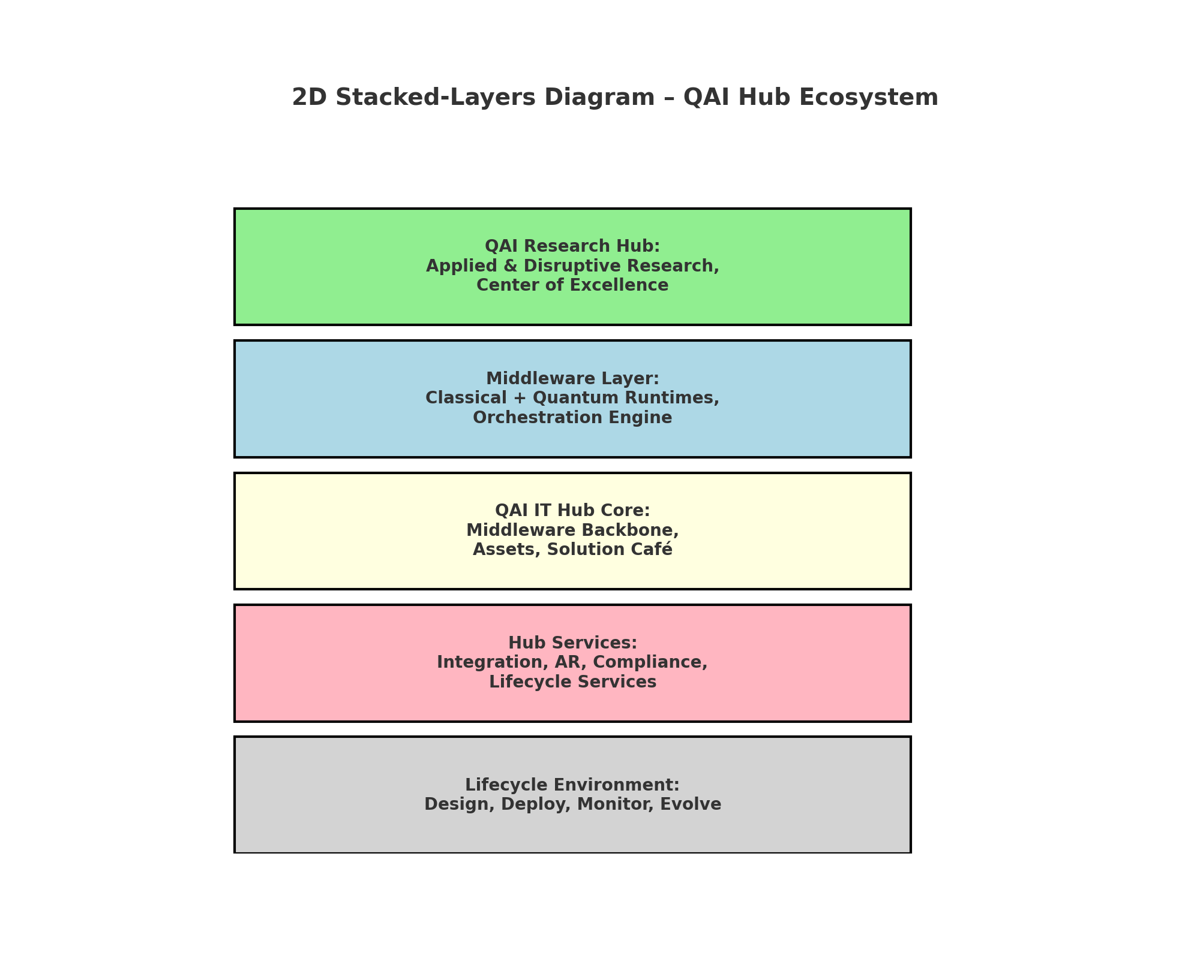
Visual Diagram – QAI Hub Ecosystem

