Slide 1
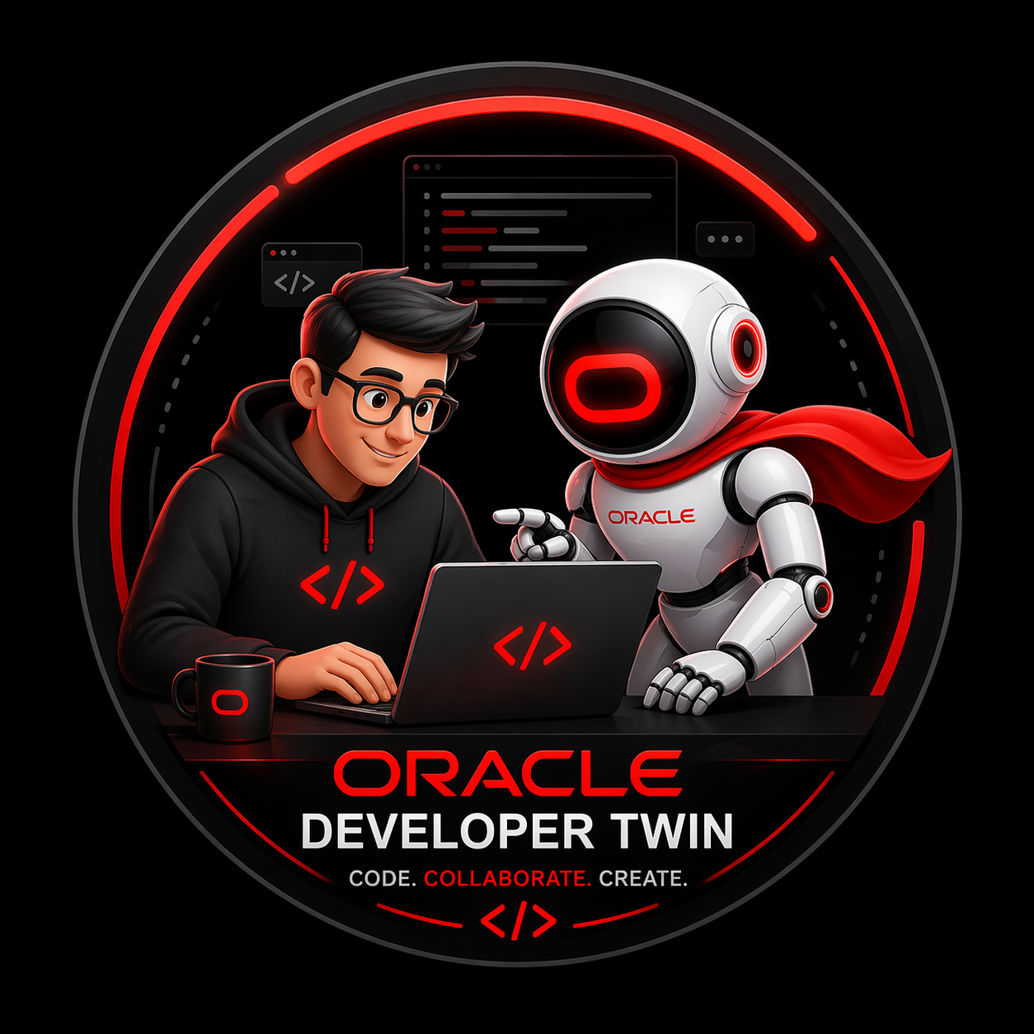
Oracle Code Assist (OCA) Hackathon 2026 Oracle CSS Innovation Studios
Governed Digital Worker for Software Delivery
Oracle Developer Twin (ODT)
Submission Category: Engineering Productivity
Individual Submission: OCA-2026-32960
Vijay N vijay.n@oracle.com
1

Slide 2
Oracle Developer Twin (ODT)
Problem Statement: Developers spend significant time translating tickets into engineering action
understanding requirements
finding impacted code files
planning changes
identifying regression areas
remembering VPAT/WCAG and keyboard rules as per guidelines
preparing prompts for coding assistants
That orchestration work is repetitive, hard to standardize, and easy to miss under delivery pressure.
Who faces this problem?
Developers, tech leads, reviewers, delivery managers, and software delivery teams.
Solution – Digital Worker: Oracle Developer Twin automates much of the repetitive preparation work between a ticket and implementation. It helps teams turn a requirement into a clearer action plan, identify likely impacted areas, prepare stronger AI-ready prompts, bring testing and accessibility guidance earlier, and keep human review in control before the work is finalized.
reduces manual ticket-to-code preparation with 7-stage guided planning
highlights likely impact and regression areas and hardens prompts
prepares stronger prompts for coding assistants while keeping devs in control
brings testing and accessibility checks earlier in the flow
keeps human approval in the final decision
Expected Outcomes or Improvements
Impact: clearer requirement-to-action flow, earlier visibility into impact and accessibility, and stronger human-reviewed AI handoff.
Measurable KPIs: reduced planning prep time, faster implementation handoff, increased review-ready artifact coverage, earlier accessibility visibility, and less repetitive support work.
2
Notes:
In real software delivery, the effort is not only in writing code.
Teams first need to understand the requirement, identify impacted
files, think about testing, think about accessibility, and then
carefully review the result before accepting it. These are essential
activities, but they can take a lot of time and attention, especially in
larger repositories.
So the problem we are solving is this: how do we help teams move
faster from requirement to implementation, while still keeping the
process explainable, reviewable, and human controlled?

Slide 3
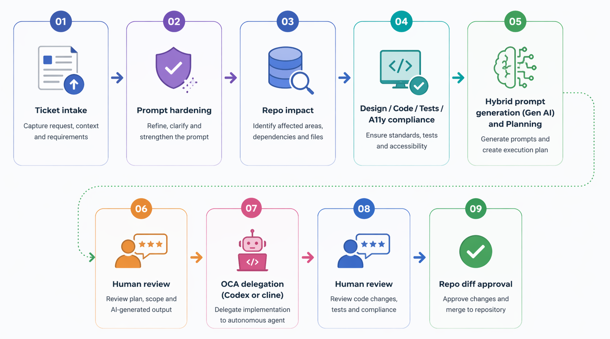
Oracle Developer Twin
Executive Brief
Digital Worker Flow
What the Digital Worker does
A human-reviewed SDLC co-worker that keeps developers closer to the requirement from intake to governed implementation.
It assists with ticket intake, prompt hardening, repo impact analysis, hybrid prompt generation using Gen AI LLM Models, code and test guidance, maintain accessibility standards, and execution handoff.
It improves the workflow between requirement -> plan -> review -> delegate -> approve.
Human review is included before re-analysis, before delegation, and before merge.
Why It Stands Out ODT + OCA: AI Speed, Human Control
Guided prompts, repo-aware planning, Codex-powered execution, and developer approval in one governed workflow.
3

Slide 4
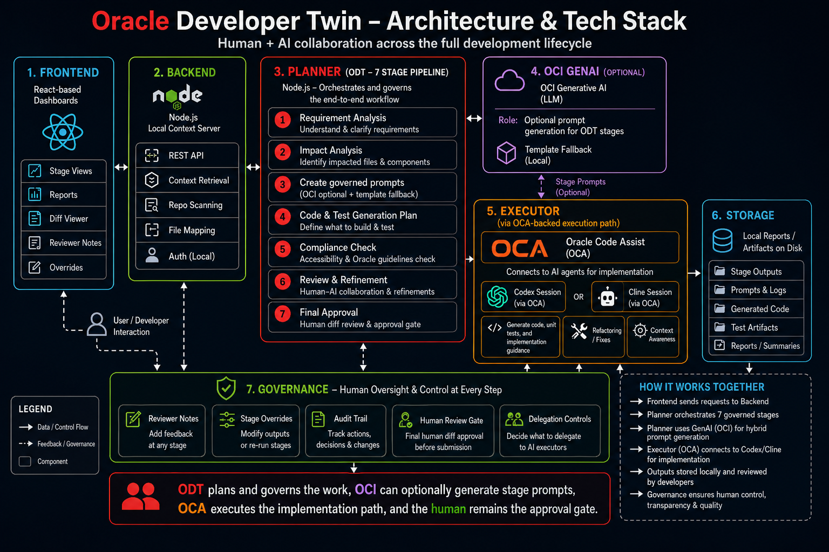
Technical Architecture
4
Notes:
ODT plans and governs the work, OCI can optionally generate stage prompts, OCA executes the implementation path, and the human remains the approval gate.

Slide 5
Operational Detail
How This Digital Worker Works : Explained in detail in slide No: 6, 7,8, and 9
Who uses ODT and where value is realized Developers, reviewers, and tech leads can use ODT. Value: Speed + control: rapid execution with human governance.
Execution model ODT plans and governs; OCA-backed Codex or Cline sessions execute implementation against the target repo.
Guardrails and governance
Prompt hardening, repo validation, accessibility guidance aligned to Oracle expectations, and mandatory human approval before merge.
Interaction flow
Requirement -> ODT Workspace -> reports/odt artifacts -> execute prompt -> OCA session -> repo diff review.
Hybrid prompting and integration points OCI GenAI can generate stage prompts with an LLM path, while fallback prompts and reviewer overrides keep the workflow resilient and customizable. ODT connects this with the local context server, dashboards, demo React app, and OCA execution path.
Why judges should care ODT helps teams collaborate with AI in a way that is explainable, reviewable, requirement-aware, and demo-ready today.

Slide 6
Who Uses ODT and How Value Is Realized
Developers use ODT to turn a requirement into clear scope, impacted files, hardened prompts, code guidance, unit-test guidance, and accessibility checkpoints.
Reviewers and tech leads use ODT to inspect evidence, add reviewer notes or stage overrides, request re-analysis, and standardize the software development process.
Primary interface: ODT/FEDIT dashboard with generated reports/odt artifacts for intake, impact, design, code, test, and compliance stages, delegation and action buttons.
Day-to-day workflow: enter work item -> review generated evidence -> refine if needed -> delegate approved execution path -> review diffs -> approve or refine.
Value realized: less repetitive planning effort, clearer scope, AI assisted coding and unit testing, more consistent review, earlier accessibility visibility, and better human + AI collaboration and accelerated delivery.
ODT helps teams stay closer to the requirement while keeping execution governed and review-ready

Slide 7
Execution, Guardrails, and Governance
How the Digital Worker Operates in Practice
Execution model: ODT plans and governs; OCA-backed Codex or Cline sessions execute implementation against the target repository. Local backend control plane: a lightweight Node.js context server handles intake updates, repo validation, uploads, ODT run requests, execution bundle creation, and agent launch status.
Hybrid prompting: OCI GenAI can optionally generate stage prompts; fallback prompts and reviewer overrides (custom prompt) keep the workflow resilient and customizable.
Guardrails: 7 stage guided pipeline, prompt hardening, repo-aware impact analysis, Oracle accessibility guidance before delegation, and mandatory human approval before delivery.
Decision points: human can refine scope, update prompts, request re-analysis, approve delegation, review changed files, and fill gaps before final approval.
Automation boundaries: ODT does not auto-merge, bypass human approval, or replace developer judgment.
Integration points: ODT/FEDIT dashboard, reports/odt artifacts, OCI GenAI, fallback prompt templates, local context server, OCA Codex/Cline, repo diff review.
ODT makes AI-assisted delivery explainable, reviewable, and safe to use in enterprise development.

Slide 8
Digital Worker Operates in Practice- Practical Tested and Real Working Example
Example: New Feature Story + Existing Defect Flow
Work item entered in ODT/FEDIT: Add the Employee Finder section to the home page with search and department filtering and fix the linked defect where the Submit Request button is enabled even when mandatory fields are incomplete.
ODT planning: ODT hardens the story and defect into clear execution-ready workpacks, identifies impacted files across the finder UI, form component, validation utilities, and test assets, and prepares review-ready design, code, unit-test, and accessibility guidance.
Reviewer checkpoint: A reviewer adds a note that the defect fix must not only disable the button initially but also re-disable it when a required field becomes empty or invalid, while preserving keyboard and screen-reader behavior.
Governed execution: The approved execution path is delegated to OCA-backed Codex or Cline; OCI GenAI can enrich stage prompts, while fallback prompts and reviewer overrides remain available for resilience and control.
Human approval: The returned diff is reviewed for filter behavior, validation correctness, test alignment, user-facing consistency, and accessibility expectations before the change is accepted or sent back for refinement.
Oracle Developer Twin turns both feature work and defect fixes into a governed delivery path by combining repo-aware planning, optional OCI GenAI prompting, OCA-backed execution, and mandatory human approval before code is accepted.

Slide 9
Deep Dive: Execution in Practice
ODT turns one work item into 7 governed stage prompts: Intake, Impact, Tech Design, Code, Unit Tests, Compliance, Verify
OCI GenAI can generate stage prompts; fallback templates keep the workflow resilient
Reviewer edits and stage overrides can refine any stage before delegation
Integration points: ODT/FEDIT, reports/odt, local context server, target repo, OCI GenAI, and OCA Codex/Cline
Decision logic: unclear input triggers prompt hardening; changed scope triggers re-analysis; OCI unavailability triggers fallback prompts
Automation boundaries: no auto-merge, no approval bypass, and no final delivery without human diff review. Human review remains active before delegation and before final acceptance
ODT governs execution by breaking one request into seven reviewable prompts, then delegating only the approved execution path.

Slide 10
Technology Stack Used
Frontend: React 18 UMD FEDIT dashboard plus generated HTML/CSS/JS ODT dashboard for intake, uploads, reviewer notes, stage overrides, and status visibility
Backend: local Node.js context server using http, fs, path, and child_process for intake save/update, repo checks, uploads, run/execute actions, and agent status Planner: ODT 7-stage Node.js pipeline for requirement hardening, repo impact, tech design, code workpack, unit tests, compliance, and verification
Optional GenAI: OCI prompt generation through OCI CLI with template fallback for resilient stage-prompt drafting
Execution: Codex or Cline CLI sessions consume the governed prompt bundle, work against the target repo, and return diff/log/output artifacts
Storage: local reports/ filesystem stores JSON, Markdown, HTML, uploads, logs, prompts, summaries, and execution evidence

Slide 11
Appendix
Governed Technical Flow
Human review checkpoints
A step-by-step governed flow showing where accessibility guidance enters and where human review can refine the path before and after OCA execution.
OCI GenAI remains optional for stage prompting
Phase 1 Understand and scope
Phase 2 Prepare and govern
Phase 3 Execute and approve
1. Requirement / Jira / Reviewer Input
Work item details, repo context, mockups, and reviewer intent.
4. Hybrid Prompt Generation
OCI GenAI option, fallback prompts, and reviewer stage overrides.
7. Delegation to Codex / Cline via OCA Powered
Governed execution against the target repository.
2. ODT Intake + Prompt Hardening
Normalize the ask, strengthen clarity, and prepare governed prompts.
5. Code + Unit Tests + Oracle A11y Guidance
Implementation guidance, test expectations, and accessibility checks.
8. Review Changed Files + Fill Gaps
Inspect diffs, validate tests and a11y, and close remaining misses.
3. Repo Impact Analysis
Identify hotspots, candidate files, tests, and impacted surfaces.
6. Human Review + Refine + Re-analyze
A developer or lead can update scope, prompts, and guidance before delegation.
9. Final Human Approval + Deliver
Approve, refine, or reject before merge, submission, or handoff.
Accessibility enters at step 5 before delegation. Human review checkpoints appear at step 6 before OCA execution and step 9 before final delivery.
11
Notes:
Use this appendix slide only if judges ask for technical depth. It shows the governed sequence clearly: ODT intake and impact analysis, hybrid OCI or fallback prompting, code and unit-test guidance with Oracle accessibility expectations, a human review checkpoint before delegation, governed OCA execution, and final human approval before delivery.

Slide 12
Summary
Digital Worker
Business impact
Reduction in planning overhead, accelerated delivery, improves review consistency, surfaces accessibility earlier, and gives teams a reusable Oracle delivery pattern.
Responsible AI
Human-in-the-loop review is mandatory; prompts and artifacts are traceable and can be customizable; fallback behavior keeps the flow safe when OCI Gen AI is unavailable.
Demo summary
The demo shows intake, seven-stage planning, dashboard evidence, reviewer edits, OCA delegation, and final repo-level human approval.
Closing takeaway ODT is not just an AI handoff tool. It uses a seven-stage guided pipeline to make work clearer, better scoped, easier to review, and better prepared before it reaches an OCA-enabled coding assistant.
ODT starts earlier before code generation. It helps teams move from requirement to execution through a guided, review-ready path with human approval at the end.
12

Slide 13
13

