Slide 1
Oracle Code Assist (OCA) Hackathon 2026 Oracle CSS Innovation Studios
Governed Digital Worker for Software Delivery
Oracle Developer Twin
Submission Category: Digital Worker using OCA
Individual Submission
Vijay N.
Notes:
Oracle Developer Twin is a human-reviewed Digital Worker for software delivery. Instead of jumping straight to code generation, it starts by helping developers stay closer to the requirement, understand scope, and prepare a safe implementation path.

Slide 2
Oracle Developer Twin (ODT)
Executive Brief
Problem Statement:
A significant amount of delivery effort goes into turning a requirement into clear scope, impacted files, test direction, accessibility guidance, and reliable execution prompts before implementation begins.
Who benefits most?
Frontend developers, reviewers, tech leads, delivery managers, and teams working across large repositories with governance expectations.
Solution – Digital Worker:
ODT turns one work item into a seven-stage, repo-aware, review-ready workflow with prompt hardening, hybrid Oracle Gen AI prompting, durable artifacts, and governed delegation to an OCA-backed execution session.
Expected Outcomes or Improvements
Impact: developers stay closer to the requirement, review becomes more consistent, accessibility is surfaced earlier, and execution handoff becomes clearer.
Measurable KPIs: planning prep time reduced, review-ready artifact coverage increased, a11y issues found earlier, and less repetitive support work around delivery.
Notes:
In enterprise delivery, a significant amount of effort goes into turning a requirement into clear scope, impacted files, test direction, accessibility guidance, and reliable execution prompts. Oracle Developer Twin helps organize that necessary work so developers can focus on the decisions that matter most.

Slide 3
Oracle Developer Twin
Executive Brief
Digital Worker Flow
Why it stands out
Unique Value Proposition
ODT turns necessary supporting work into a visible, governed delivery flow. It is not replacing developer expertise; it is organizing the inputs, evidence, and AI collaboration around it.
What the Digital Worker does
A human-reviewed SDLC co-worker that keeps developers closer to the requirement from intake to governed implementation.
It assists with ticket intake, prompt hardening, repo impact analysis, hybrid prompt generation, code and test guidance, and execution handoff.
It improves the workflow between requirement -> plan -> review -> delegate -> approve.
Human review is included before re-analysis, before delegation, and before merge.
Requirement intake -> prompt hardening -> repo impact -> OCI GenAI or fallback prompts -> code/tests/compliance guidance -> human review -> OCA delegation -> repo diff approval
Notes:
ODT acts as a governed SDLC co-worker. It hardens the requirement, analyzes repo impact, prepares hybrid prompts, supports code and test guidance, and keeps human review in the loop before re-analysis, before delegation, and before merge.

Slide 4
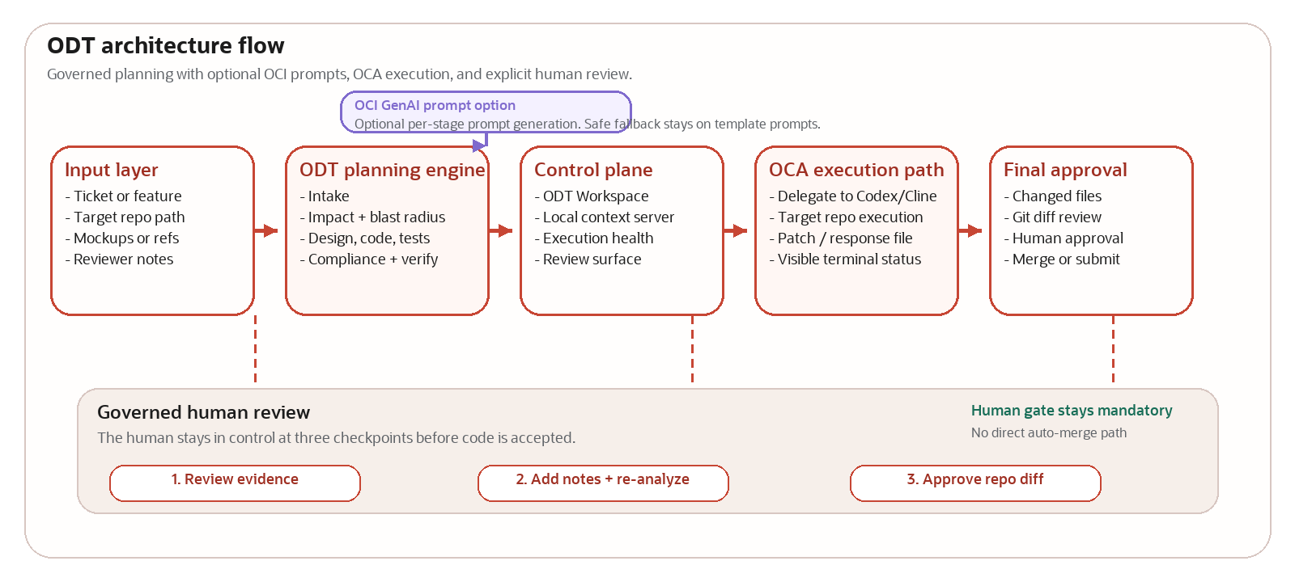
Technical Architecture
High-level architecture, OCI prompt option, OCA execution path, and governed human review.
Notes:
ODT plans and governs the work, OCI can optionally generate stage prompts, OCA executes the implementation path, and the human remains the approval gate.

Slide 5
Operational Detail
Who uses ODT and where value is realized A developer enters the work item, chooses the repo, reviews the evidence, and delegates only when ready. A reviewer or lead can add edits, stage overrides, and request re-analysis.
Execution model ODT plans and governs; OCA-backed Codex or Cline sessions execute implementation against the target repo.
Guardrails and governance
Prompt hardening, repo validation, accessibility guidance aligned to Oracle expectations, and mandatory human approval before merge.
Interaction flow
Requirement -> ODT Workspace -> reports/odt artifacts -> execute prompt -> OCA session -> repo diff review.
Hybrid prompting and integration points OCI GenAI can generate stage prompts with an LLM path, while fallback prompts and reviewer overrides keep the workflow resilient and customizable. ODT connects this with the local context server, dashboards, demo React app, and OCA execution path.
Why judges should care ODT helps teams collaborate with AI in a way that is explainable, reviewable, requirement-aware, and demo-ready today.
How This Digital Worker Works
Notes:
In practice, a developer enters the work item, selects the repo, reviews the evidence, and delegates only when ready. Reviewer edits and stage overrides can be added at any point, and OCI GenAI prompt generation remains optional because fallback prompts keep the workflow resilient.

Slide 6
Summary
Digital Worker
Closing takeaway: Oracle Developer Twin helps developers and AI collaborate in a governed way by keeping the requirement, the repo, and the human review step connected.
Business impact
Reduces repetitive delivery-preparation work, improves consistency, surfaces accessibility earlier, helps reduce backlog pressure, and gives teams a reusable Oracle delivery pattern.
Responsible AI
Human-in-the-loop review is mandatory; prompts and artifacts are traceable; fallback behavior keeps the flow safe when OCI is unavailable.
Demo summary
The demo shows requirement hardening, repo-aware planning, OCI prompt options, dashboard evidence, reviewer edits, OCA delegation, and final repo-level human approval.
Notes:
The business value is straightforward: less repetitive support work around delivery, more consistent review, earlier accessibility visibility, and better collaboration between developers and AI. Human judgment remains central to the final outcome.

Slide 7
Appendix
Governed Technical Flow
Human review checkpoints
A step-by-step governed flow showing where accessibility guidance enters and where human review can refine the path before and after OCA execution.
OCI GenAI remains optional for stage prompting
Phase 1 Understand and scope
Phase 2 Prepare and govern
Phase 3 Execute and approve
1. Requirement / Jira / Reviewer Input
Work item details, repo context, mockups, and reviewer intent.
4. Hybrid Prompt Generation
OCI GenAI option, fallback prompts, and reviewer stage overrides.
7. Delegation to OCA Codex / Cline
Governed execution against the target repository.
2. ODT Intake + Prompt Hardening
Normalize the ask, strengthen clarity, and prepare governed prompts.
5. Code + Unit Tests + Oracle A11y Guidance
Implementation guidance, test expectations, and accessibility checks.
8. Review Changed Files + Fill Gaps
Inspect diffs, validate tests and a11y, and close remaining misses.
3. Repo Impact Analysis
Identify hotspots, candidate files, tests, and impacted surfaces.
6. Human Review + Refine + Re-analyze
A developer or lead can update scope, prompts, and guidance before delegation.
9. Final Human Approval + Deliver
Approve, refine, or reject before merge, submission, or handoff.
Accessibility enters at step 5 before delegation. Human review checkpoints appear at step 6 before OCA execution and step 9 before final delivery.
Notes:
Use this appendix slide only if judges ask for technical depth. It shows the governed sequence clearly: ODT intake and impact analysis, hybrid OCI or fallback prompting, code and unit-test guidance with Oracle accessibility expectations, a human review checkpoint before delegation, governed OCA execution, and final human approval before delivery.

