Slide 1
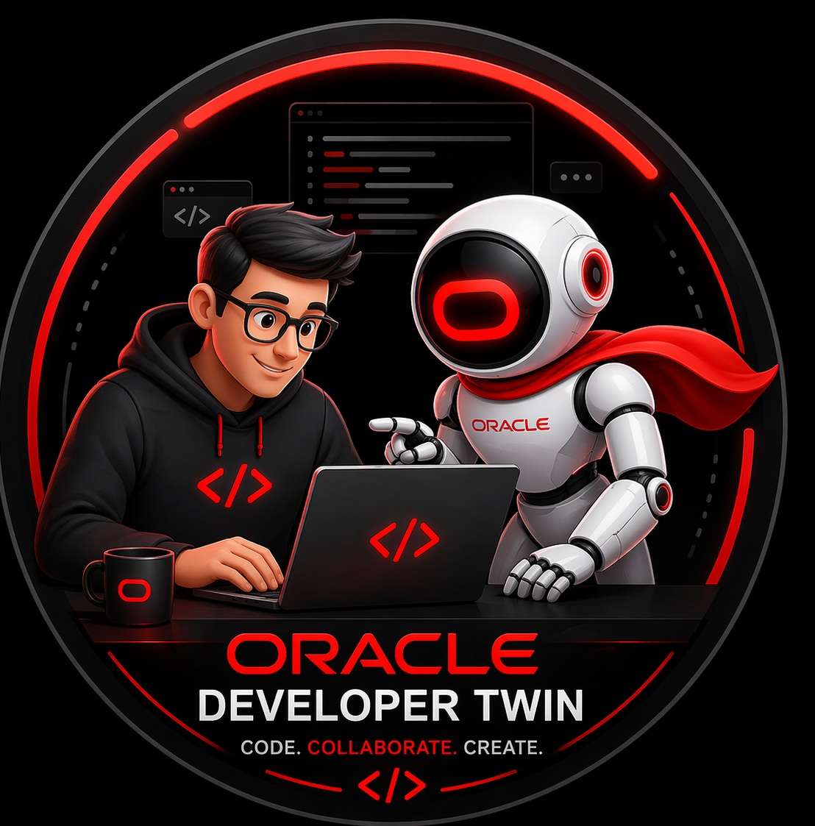
ORACLE DEVELOPER TWIN
HACKATHON 2026
ODT
Turning AI Into a Governed
Digital Worker for Software Delivery
ODT turns a ticket into a guided, review-ready delivery flow, while keeping human approval in control.
Not another copilot. A digital worker for the work before coding.
Visible demo surface: FEDIT
MOVES FASTER
EXPLAINS ITSELF
PROTECTS QUALITY
Execution agents: Codex / Cline
Cuts the setup work that slows delivery before implementation starts.
Shows impact, guidance, and evidence in one visible flow.
Keeps accessibility, testing, and review in the flow from the start.
Human-reviewed before merge
It solves the hidden work between a ticket and a safe change.
1
Copyright © 2026, Oracle and/or its affiliates | Confidential: Internal/Restricted/Highly Restricted
Notes:
Opening slide: establish that ODT is a governed digital worker, not just another AI prompt box.
[Sources]
- docs/Oracle-Developer-Twin-Hackathon-Pitch.md
- docs/Oracle-Developer-Twin-Architecture-Note.md
- README.md

Slide 2
THE PROBLEM
The expensive part of delivery often happens before code begins
01
02
03
04
05
Clarify intent
Find repo impact
Plan the change
Check obligations
Prepare handoff
Acceptance criteria, scope, and edge cases are often scattered across tickets and chats.
Developers still have to infer which files, modules, and regressions are actually in play.
Technical design and patch strategy vary by person and time pressure.
Testing, keyboard behavior, and accessibility often arrive too late in the cycle.
Coding agents need structured context, or quality becomes unpredictable.
Before code starts, teams are already losing time and building risk.
ODT targets that hidden layer of work.
2
Copyright © 2026, Oracle and/or its affiliates | Confidential: Internal/Restricted/Highly Restricted
Notes:
Show the bottleneck before coding: manual interpretation, impact discovery, planning, compliance, and handoff.
[Sources]
- docs/Oracle-Developer-Twin-Hackathon-Pitch.md
- docs/Oracle-Developer-Twin-Architecture-Note.md

Slide 3
THE SHIFT
ODT removes setup work, not developer judgement
Intent -> evidence -> execution
Before ODT
With ODT
Manual interpretation
Structured intake
Business asks still have to be translated into engineering action.
Requirements and constraints are captured in one governed flow.
Hidden blast radius
Repo-aware impact
Impact discovery still relies on memory, search, and guesswork.
Candidate files and regression areas are ranked before coding begins.
Late quality checks
Guided execution
Accessibility and regression planning can slip until the very end.
Design, code, test, and compliance workpacks are ready to use.
Unstructured prompting
Visible review gate
Execution agents get uneven context, so output quality can vary.
FEDIT makes decisions clearer before any merge decision.
3
Copyright © 2026, Oracle and/or its affiliates | Confidential: Internal/Restricted/Highly Restricted
Notes:
Contrast the current fragmented pre-coding workflow with the governed ODT flow.
[Sources]
- docs/Oracle-Developer-Twin-Hackathon-Pitch.md
- docs/Oracle-Developer-Twin-Architecture-Note.md
- docs/Oracle-Developer-Twin-Hackathon-Runbook-5-Minute.md

Slide 4
DIFFERENTIATION
Why this is more than a coding copilot
Typical coding copilot
Oracle Developer Twin
Starts with a prompt
Starts with a work item, structured intake, and target-repo context.
Mainly returns code or text
Creates dashboards, impact analysis, workpacks, prompt contracts, and verification artifacts.
Repo understanding is ad hoc
Impact is inferred and ranked so change scope becomes visible before execution.
Quality checks are optional
Accessibility, testing, and review checkpoints are built into the flow.
Responsibility can feel blurry
Human approval remains explicit before merge or release.
Codex and Cline can execute. ODT makes execution safer and more consistent.
4
Copyright © 2026, Oracle and/or its affiliates | Confidential: Internal/Restricted/Highly Restricted
Notes:
Differentiate ODT from generic copilots in simple business language.
[Sources]
- docs/Oracle-Developer-Twin-Hackathon-Pitch.md
- docs/Oracle-Developer-Twin-Architecture-Note.md

Slide 5
IMPLEMENTED TODAY
Built. Running. Demoable today.
This is a working delivery flow, not a concept mockup.
7
32
What the demo proves right now
Review-ready run
Artifacts on disk
Target-repo a11y verification
Live worker console
Governed stages from intake to verify
Runs stored in ODT history
Current product flow
Persisted run trail
0
1
Hybrid AI path also works: OCI prompt generation with safe fallback.
Blockers in current demo a11y scan
Visible console for the digital worker
Latest target-repo verification
FEDIT dashboard
Oracle VPAT guidance primary
WCAG 2.1 AA fallback
OCI prompt generation wired
Safe template mode preserved
5
Copyright © 2026, Oracle and/or its affiliates | Confidential: Internal/Restricted/Highly Restricted
Notes:
Use real repo facts: stages, stored runs, accessibility posture, and hybrid OCI capability.
[Sources]
- reports/odt/run-summary.json
- docs/CS4I-AI-Lab-Hybrid-Setup.md
- reports/a11y/findings.json
- reports/a11y/coding-agent-prompt.md

Slide 6
ARCHITECTURE
Simple architecture. Clear control points.
Every layer has one job. That keeps the AI path understandable and safe.
INPUT LAYER
PLANNING ENGINE
CONTROL SURFACE
HUMAN DECISION
Ticket, acceptance criteria, mockups, constraints, and repo target define the request.
Repo analysis, prompt hardening, design guidance, code and test workpacks, and compliance review.
FEDIT shows status, explainability, launch controls, and run telemetry.
A developer or reviewer inspects artifacts and diffs before approving merge or release.
Technology foundation
Node.js CLI engine
FEDIT dashboard
Local context server
OCI GenAI optional
Codex / Cline handoff
Oracle VPAT / WCAG mapping
ODT plans. Agents execute. Humans decide.
6
Copyright © 2026, Oracle and/or its affiliates | Confidential: Internal/Restricted/Highly Restricted
Notes:
Translate architecture into plain language: input, planning, control, human review.
[Sources]
- docs/Oracle-Developer-Twin-Architecture-Note.md
- README.md
- reports/odt/run-summary.json
- docs/CS4I-AI-Lab-Hybrid-Setup.md

Slide 7

DEVELOPER EXPERIENCE
What a developer actually does
The workflow is simple, even though the engine underneath is rich.
1
Paste the ticket
FEDIT Digital Worker Console
RUN DIGITAL WORKER
Set the repo and add constraints or design input if needed.
Prompt Hardening
Visible Agent Workflow
Explainability
2
Run Digital Worker
Structured intake
and stage
controls
Impact
Design
Verify
Ranked files,
prompts,
notes.
ODT runs the seven-stage flow and prepares evidence.
3
Review the evidence
Impact, design, tests, compliance, and verify outputs appear in FEDIT.
Completion
Ready for
review
Intake
Impact
Design
Code
4
Delegate to agent
Tests
Compliance
Verify
Codex or Cline can implement with prepared guidance.
Human review stays
the final decision point.
5
Approve or reject
DELEGATE TO AGENT
A human reviewer still decides before merge.
7
Copyright © 2026, Oracle and/or its affiliates | Confidential: Internal/Restricted/Highly Restricted
Notes:
Walk through the developer flow in language any audience can follow quickly.
[Sources]
- docs/Oracle-Developer-Twin-Hackathon-Runbook-5-Minute.md
- README.md
- docs/Oracle-Developer-Twin-Architecture-Note.md

Slide 8
TRUST AND GOVERNANCE
Trust is built in
Human review, accessibility, traceability, and fallback behavior are part of the product.
Speed with visible control
Human in the loop
Accessibility by default
Merge and release decisions stay with a developer or reviewer. ODT accelerates preparation, not accountability transfer.
Oracle VPAT guidance is treated as primary, with WCAG fallback and manual evidence checks preserved.
Explainability and audit
AI resilience
Runs create durable artifacts, prompt traces, ranked files, and reviewable evidence instead of hidden reasoning.
OCI-backed prompt generation is optional and hybrid; safe template mode stays available for continuity.
ODT makes risk visible before it becomes release risk.
8
Copyright © 2026, Oracle and/or its affiliates | Confidential: Internal/Restricted/Highly Restricted
Notes:
Emphasize accessibility, explainability, fallback behavior, and retained human control.
[Sources]
- docs/Oracle-Developer-Twin-Architecture-Note.md
- reports/a11y/findings.json
- reports/a11y/coding-agent-prompt.md
- docs/CS4I-AI-Lab-Hybrid-Setup.md

Slide 9
STRATEGIC VALUE
What this brings to Oracle
ODT is a reusable Oracle pattern for safer, faster software delivery.
Standardized readiness
Higher quality confidence
Brings consistency to intake, impact, test scope, and review evidence.
Keeps accessibility and verification visible earlier in delivery.
Reusable
Oracle pattern
Governable AI
delivery
Faster onboarding and handoff
Foundation for scale
Developers and agents receive clearer context instead of tribal knowledge.
The same pattern can expand beyond React and beyond frontend over time.
Frontend today
More stacks next
Broader digital workers later
9
Copyright © 2026, Oracle and/or its affiliates | Confidential: Internal/Restricted/Highly Restricted
Notes:
Position ODT as a scalable Oracle pattern, not a one-off demo.
[Sources]
- docs/Oracle-Developer-Twin-Architecture-Note.md
- README.md
- docs/Oracle-Developer-Twin-Hackathon-Runbook-5-Minute.md
- docs/CS4I-AI-Lab-Hybrid-Setup.md

Slide 10
CLOSING TAKEAWAY
From ticket to trust
Run -> Review -> Delegate -> Approve
Thank You
This is not just faster AI. It is safer, review-ready delivery.
That is the delivery value.
ODT makes the invisible work before coding visible, guided, and repeatable.
REMOVES HIDDEN WORK
KEEPS OWNERSHIP HUMAN
READY TO SCALE
It cuts the planning work that slows teams before code starts.
The worker prepares and explains. The developer still decides.
It is already live in FEDIT and ready to grow.
10
Copyright © 2026, Oracle and/or its affiliates | Confidential: Internal/Restricted/Highly Restricted
Notes:
Close on the delivery message: ODT creates governed AI acceleration, not blind automation.
[Sources]
- docs/Oracle-Developer-Twin-Hackathon-Pitch.md
- docs/Oracle-Developer-Twin-Architecture-Note.md
- docs/Oracle-Developer-Twin-Hackathon-Runbook-5-Minute.md

