Slide 1

GOODS & SERVICES TAX - GST
A PRESENTATION
BY
CONFEDERATION OF ALL INDIA TRADERS
NEW DELHI

Slide 2

TAXATION POWERS
OF CENTRE
Income Tax – on income, other than agricultural income
Excise Duty – on goods manufactured or produced in India
Custom Duty – on imports and exports
Service Tax – on specified services
Central Sales Tax – on inter-State sale of goods
Rates of Stamp Duty on 10 specified instruments
CONCURRENT LIST OF BOTH
Stamp Duties, not including rates of stamp duty on 10 specified instruments.

Slide 3
TAXATION POWERS OF STATES
VAT/Sales Tax - on purchase or sale of goods, other than newspapers, within a State
Excise duty - on alcoholic liquor for human consumption
Rates of Stamp Duty – on other than 10 specified instruments
Land Revenue
Tax – on agricultural income
Toll tax
􀂾 Taxes on:
Land and buildings
Entry of goods in a local Area (Entry Tax or Octroi)
Consumption or sale of electricity
Goods and passengers carried by road or inland waterways
Vehicles
Professions, Trades, Callings and Employments
Luxuries, including taxes on entertainment, betting and gambling

Slide 4
DRAWBACKS OF CURRENT SYSTEM
  Confusion and Mistrust
  Complex and lacking in stability
  Hidden tax on exports, no state tax on imports
  High transaction costs
  Narrow base

Slide 5
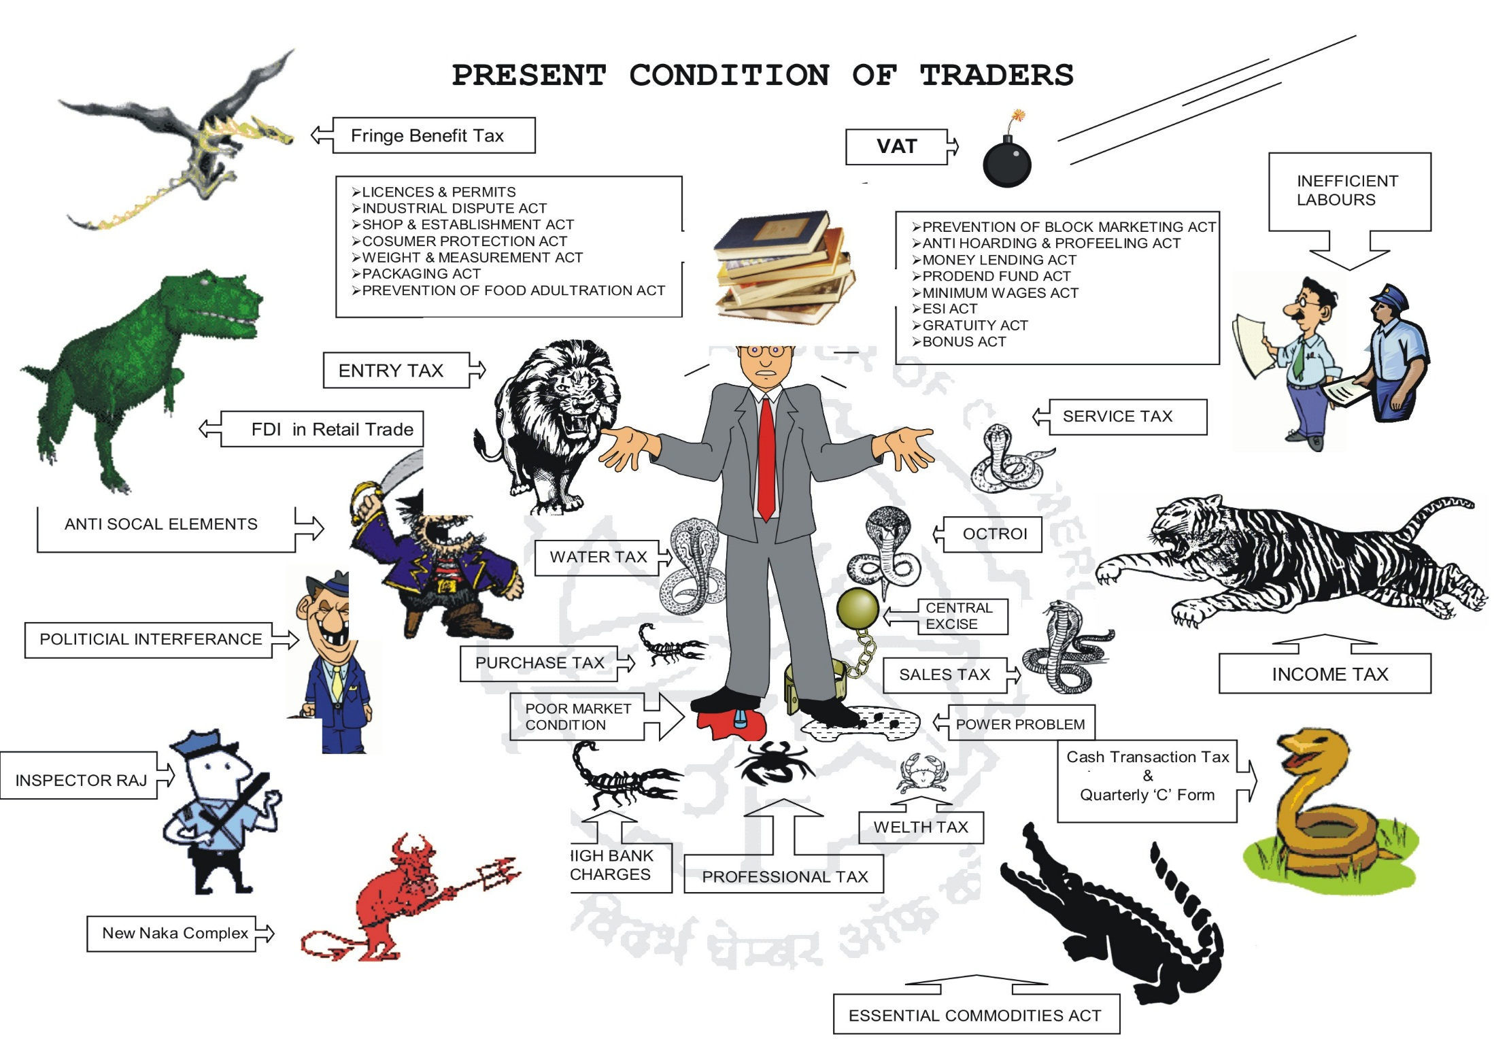

Slide 6
TASK FORCE FOR TAX REFORMS
A ‘Grand Bargain’. One VAT – The Goods and Services Tax (GST)
The Kelkar Task Force was constituted with the mandate to recommend measures to enable the Government of India to implement the Fiscal Responsibility and Budget Management (FRBM) Act, 2003, which seeks to eliminate revenue deficit by March 31, 2008.
As the main proposal for tax reform, Dr.Vijay Kelkar and his team have recommended a single GST (Goods and Services Tax) – replacing the Cenvat/excise duty, sales tax, service tax, etc. It would use the VAT principle to tax consumption of almost all goods and services – with full tax
Credits for tax paid on purchase of all goods and services will be available.

Slide 7
What is GOODS AND SERVICE TAX
Goods and Service Tax is a tax on goods and services.
It is leviable at each point of sale or provision of service.
At the time of sale of goods or providing the services the seller or service provider can claim the input credit of tax which he has paid while purchasing the goods or procuring the service
This is simply very similar to VAT.
It can be termed as National level VAT on Goods and Services.
Only difference in this system is that not only goods but also services are involved.
The rate of tax on goods and services are generally the same.

Slide 8
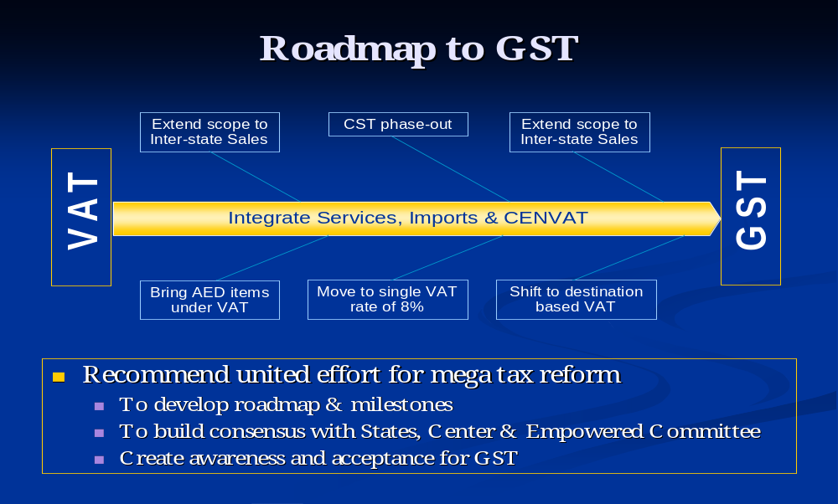
GST-AT A GLANCE

Slide 9
GST: A UNIFICATION OF TAXES
A GST classically entails unification of all levies on goods and services. In the Indian context, this would mean merging the following:
Tax on manufacture of goods (excise duty levied by the Centre).
Tax on sale of goods (CST / VAT levied by both Centre and states).
Tax on services (levied by Centre and to some extent by states such as Entertainment tax, electricity cess, etc).

Slide 10
GST WORLD WIDE
In most countries of the world, a single VAT exist which covers both goods and services
All sectors are taxed with very few exceptions/ exemptions.
Full tax credits on inputs –100% set off
Canada and Brazil alone have a dual VAT
India also likely to adopt dual GST Model based on GST model of Canada w.e.f. 1st April 2010.

Slide 11
GST-KNOW TAXES PAID BY YOU
We all will pay GST on every product or service we buy.
Since all indirect taxes levied by the States and the Centre will be merged into one GST, we would exactly know how much tax we pay which at present is difficult to understand.
No distinction would be made between imported or Indian goods and they would be taxed at the same rate.
The sellers or service providers collect the tax from their customer.
Before depositing the same to the exchequer, they deduct the tax they have already paid.
The success of GST would rest upon efficiency, equity and simplicity.

Slide 12
Why do we need GST today
In Indian economy the service sector contributes over 55%.
Separate taxation of goods and services is neither viable nor desirable
Value added in manufacture and sale of goods require inputs of both — goods and services and vice versa, which is often not separable

Slide 13
GST In India – A REALITY
The stage looks all set for the introduction of unified Goods and Services Tax (GST) from 2010.
The Empowered Committee of State Finance Ministers has proposed a dual GST — both at Central and State level.

Slide 14
GST- HOW IT WORKS
The dealers registered under GST (Manufacturers, Wholesalers and retailers and service providers) will charge GST on the price of goods and services from their customers.
They will claim credits for the GST included in the price of their own purchases of goods and services used by them.
The sellers or service providers collect the tax from their customer, who may or may not be the ultimate customer, and before depositing the same to the exchequer, they deduct the tax they have already paid.

Slide 15
GST- WHAT ALL IT INCLUDES
A sale or supply includes a sale of goods
Lease of premises
Hire of equipment
Giving advice
Export of goods and supply of other things.
A purchase includes an acquisition of goods or services such as trading stock a lease, consumables and other things.

Slide 16
GST- HOW IT WORKS
If a business is registered for GST it must include GST in the price of goods, services and other things they sell to others in the course of business. These are called ‘taxable sales’.
There are other types of sales where GST is not included in the price.
These are either ‘input taxed’ sales or ‘GST-free’ sales.
GST may be included in the price of purchases (including importations) made by a business, and it’s a good idea to allow for it when setting prices.
When a business is registered for GST, they can generally claim a credit for any GST included in the price they pay for things purchased by the business. This is called a GST credit.

Slide 17
GST- RATES WORLD WIDE
No. of Countries : 140
China - 17%
Indonesia - 10%
Philippines -10%
Taiwan (Chinese Taipei) - 5%
UK -17.5%
Australia -10%
France -19.6%
Germany -16%
Denmark -25%

Slide 18
TAXES Proposed TO BE
SUBSUMED IN GST
Central Taxes
Excise Duty
Additional Excise duty
Service Tax
CVD, SAD
Surcharge
State Taxes
VAT
Entertainment tax levied by states
Luxury Tax
Tax on Lottery
Entry tax other than for local bodies

Slide 19
TAXES NOT BE INCLUDED
IN GST
Central Taxes
Specific Cess
Excise duty on tobacco products
State Taxes
Items containing alcohol
Entertainment tax (Local Bodies)
Entry tax for local bodies
Electricity duty

Slide 20
GST : KEY FEATURES
Dual GST : Central GST & State GST
Destination based State GST
Common Base
Uniform Classification
Uniform Forms – Returns, Challans etc
No cascading of Central and State taxes
Cross credit between Centre and State not allowed
Tax levied from production to consumption

Slide 21
PROPOSED GST RATES
2 Rate Structure : Lower and Standard Rate
Precious metals and stones very low rate
GST Exemption for some times
Some Goods at lower rate (excludes Ind. Inputs)
Petroleum products, liquor and narcotics excluded from GST regime

Slide 22
INDICATIVE GST RATES
Exempted products :
  Food Grains, Bread, Salt, Milk, Vegetable, Meat, Fish
Goods at Lower Rate :
  Tea, Milk Powder, Coffee beans, Toy, Beedi, Bicycles
Govt. aided public health and education exempted

Slide 23
Likely Rate – 16 percent Total
User Charges likely to be out of GST
It has also suggested keeping levies like the toll tax, environment tax and road tax outside the GST ambit, as these are user charges
It is envisaged that the framework of dual GST would embody multiple rate of taxes for goods , but a single rate for services within a state . There are indications that the rate could be in the range of 16-20 per cent. The government is expected to come out with a white paper on the transition to GST shortly .

Slide 24
GST : KEY FEATURES
HSN to be applied for goods
Uniform return & collection procedure for central and state GST
13 digit PAN based common TIN Registration
TINXSYS to track transactions

Slide 25
GST : AUTHORITIES
CGST – To be administered by Central Government.
SGST – To be administered by State VAT Department
Inter State Transaction – To be administered by A common Centralized Authority

Slide 26
GST- AS WE LOOK AT
India to have only two indirect taxes namely GST, both Central GST & State GST, and Customs duty.
Central GST to include central excise, service tax and education cess.
State GST to include a combination of all taxes presently levied by the state and octroi by municipalities. CST needs to be phased out before introduction of GST.
Both Central GST and State GST to be levied on the common base price from manufacturing stage to retail stage on goods and similarly on services.
Tax on sale of property to be levied on the value addition under state GST and not on the total amount as applicable presently

Slide 27
GST- AS WE LOOK AT
Input tax credit to be available for Central GST as well as State GST paid irrespective of the collecting agency.
Selection of services for imposing GST should continue with the Central Government. States can be allowed to collect dual GST on certain services, which are directly consumed like beauty treatment, health club etc. State should Choose and not the Centre should impose such services on them?
Dual GST should be levied on imports also with facility of credit for the tax paid.
9. Exports must be zero rated i.e. there should be no tax element in the price of goods exported.

Slide 28
TAXING OF INTER STATE TRANSACTION
Tax payment by exporting dealer to the account of receiving state
Credit allowed to the buying dealer by receiving state on verification
Retention by receiving state on sale to non dealer
Declaration form to be discontinued

Slide 29
SEAMLESS CREDIT…
It will also end the distortion in differential tax treatment of various goods and services. GST is going to be pinnacle of achieving an integration of excise duties, service tax, State value added tax and other local taxes. With GST, uniformity of levy of indirect taxes will be ensured across the country.

Slide 30
SEAMLESS CREDIT MECHANISM
Input tax credit to be available for Central GST as well as State GST paid irrespective of the collecting agency
Create a nationwide clearinghouse mechanism to facilitate transfer of Central and State GST and allow credit for tax paid

Slide 31
Imports could be taxed?
Dual GST should be levied on imports also with facility of credit for the tax paid
Exports must be zero rated i.e. there should be no tax element in the price of goods exported

Slide 32
TAX EXEMPTIONS
Area Based
To be discontinued after current eligibility period
Product Based
To be converted in to refund route
Limited Flexibility
  To Centre & States barring few exceptions

Slide 33
GST- IT’S SYSTEM
Invoice System:
In this system, the credit of GST paid is claimed on the basis of invoice.
It is claimed when the invoice is received.
It is immaterial whether payment is made or not.
The GST (Output) is accounted for when invoice is raised.
The time of receipt of payment is immaterial.
The advantage of invoice system is that the input credit can be claimed without making the payment.
The disadvantage of the invoice system is that the GST has to be paid without receiving the payment.

Slide 34
GST-HOW OTHER COUNTRIES DO
More than 130 countries have introduced GST in some form.
It has been a part of the tax landscape in Europe for the past 50 years.
It is fast becoming the preferred form of indirect tax in the Asia-Pacific region.
It is interesting to note that there are over 40 models of GST currently in force, each with its own peculiarities.
While countries such as Singapore and New Zealand tax virtually everything at a single rate, Indonesia has five positive rates, a zero rate and over 30 categories of exemptions.
In China, GST applies only to goods and the provision of repairs, replacement and processing services.
It is only recoverable on goods used in the production process, and GST on fixed assets is not recoverable.
There is a separate business tax in the form of VAT.

Slide 35
GST-CAN WE ADOPT IT
An information network allowing states to cross-check payment information (TINXSYS) has been put to trial and is expected to improve compliance and reduce evasion.
What is needed is an IT system like the Tax Information Network (TIN), where the TDS or the VAT credit is recorded in a central database.
Through this, paper bills and fraud are largely eliminated.
It is unfair to expect such an initiative to come from the committee working on state VAT, given the lack of sustained organisational capacity required.

Slide 36
ISSUES FROM TRADER’S PERSPECTIVE
Dialogue with Trade & Industry and all other stake holders
GST code to be made public atleast 6-9 months before implementation.
Industrial inputs, Capital goods at lowest rate, say 1%
List of exempted goods – specific/common across states
Stock transfers should be exempted monitors thru system based controls

Slide 37
ISSUES FROM TRADER’S PERSPECTIVE
All declaration forms (Form F, C) should be abolished
Monitoring through system based controls
Full set of Input tax credit to the assesses/entity, based on principle of business cost and expenditure.
Immediate credit of stock transfers, without one-to-one co-relation
Set-off should be on entity/concern basis.
Refunds, if any, should be automatic through system based controls.

Slide 38
GST-NO TAX EVASION
To check tax evasion, the Task Force has proposed an IT-intensive 'Risk Intelligence Network' (RIN).
This would put three sets of databases together – what the firm tells CBDT, what it tells CBEC and what it puts forth to the public, including shareholders.

Slide 39
ISSUES YET TO BE DECIDED
Constitutional amendment authorizing state to collect and retain tax on services.
Integration of certain Central & State taxes (Various Cess, Electricity duty, Entertainment tax etc.)
Taxation of inter state services and their method of taxation
Stock transfer
Road permits and check posts

Slide 40
ADMINISTATIVE ISSUES / Bottlenecks
Grant of ITC for inter-state transactions by receiving state depends on efficient banking and related mechanism
Lack of IT preparedness of certain States is a key bottleneck
Success of the proposed GST structure critically depends on operation of the effective IT system
Getting tax refunds for exempted goods based on budgetary allocation may delay refunds

Slide 41
WHAT CAIT DEMANDS
Traders are tax collectors & not the tax payers. Therefore they should be correctly defined as Tax Collectors under GST Taxation System.
Traders should be reimbursed by the Govt. for expenses incurred on collection of GST.
Some sort of effective mechanism has to be developed to ensure that benefit of reduction in cost must be passed to end consumer. The large manufacturers & companies may be advised by virtue of law to declare their Pre-GST & Post-GST cost of production to the respective State taxation department.

Slide 42
WHAT CAIT DEMANDS
Beside central & state taxes, the local Governing bodies like Municipal Corporation etc are also levying several commercial taxes. Either such taxes may also be amalgamated in GST or a lowest uniform tax structure may be levied to avoid any kind of disparity in taxes & rates between local bodies of different states.
The VAT registration Number should itself be construed as GST no. & traders should not be asked to apply afresh. Further, the procedure of obtaining new GST registration numbers should be made simple & easy.
The refund procedure in GST should be made quite simple & it is to be ensured that within much reasonable time, the traders should get back their refund and in case of delay, the traders should be compensated with interest by the department.

Slide 43
WHAT CAIT DEMANDS
In order to make the stakeholders aware about modalities of GST and other related issues, an intensive nationwide publicity campaign inclusive of workshops, seminars etc may also be planned with the active assistance of trade associations.
A special working group on GST may be formed both at Centre & state levels with representatives of trade & industry for preparing final roadmap of GST & its implementation.
Since GST will be based on computerization system, it is suggested that computer may be made available to traders on subsidy to be provided by the Government.
It is also suggested that GST software may be made available to all traders & others section of the society free of cost.

Slide 44
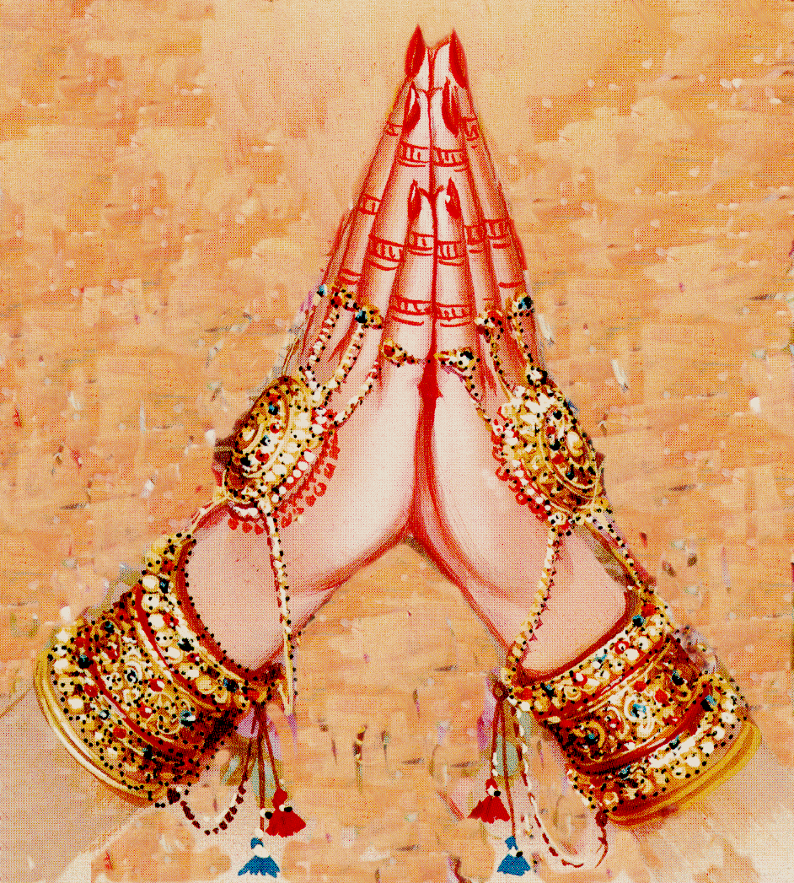
THANK YOU
You were good audience

