Slide 1

JUNIT FRAMEWORK
Vijay Anand

Slide 2
Unit Testing
Why every developer should perform some type of test to see if code actually works?
Developers who use automatic unit tests can repeat these tests on demand to ensure that new code works and does not break existing tests.
Automated tests are not just about verifying that the code works now
The point is to verify on an ongoing basis that the code continues to work in the future
Unit tests often focus on testing whether a method is following the terms of its API contract.
Like a written contract between people who agree to exchange certain goods or services under specific conditions, an API contract is a formal agreement made by the signature of a method.
If the method cannot fulfill the contract, the test should throw an exception, and we say that the method has broken its contract.

Slide 3
Junit Framework
JUnit is the de facto standard for unit testing Java applications.
Though writing simple unit tests are not difficult to create without Junit, as tests are added and become more complex, writing and maintaining tests becomes more difficult.
Junit testing framework that makes it easier to create, run, and revise unit tests. It provides a reliable, repeatable way to test programs.
The framework also supports discovering methods. It also supports using a different class instance and class loader instance for each test and reports all errors on a test-by-test basis.
The framework has three discrete goals:
The framework must help us write useful tests.
The framework must help us create tests that retain their value over time.
The framework must help us lower the cost of writing tests by reusing code.

Slide 4
History
In 1997, Erich Gamma and Kent Beck created a simple but effective unit testing framework for Java called JUnit: they were on a long plane trip, and it gave them something interesting to do.
JUnit quickly became the de facto standard framework for developing unit tests in Java.
Today, JUnit (https://junit.org) is open source software hosted on GitHub, with an Eclipse Public License.
And the underlying testing model, known as xUnit, is on its way to becoming the standard framework for any language. xUnit frameworks are available for ASP, C++, C#, Eiffel, Delphi, Perl, PHP, Python, Rebol, Smalltalk, and Visual Basic—to name just a few.

Slide 5
Junit versions
JUnit 4 has been here for over a decade and there are numerous tests written in junit 4
In between, JDK 8 brought very exciting features in java and most notably lambda expressions.
JUnit 5 aims to adapt java 8 style of coding and several other features as well, that’s why java 8 is required to create and execute tests in JUnit 5 (though it is possible to execute tests written with JUnit 3 or JUnit 4 for backward compatibility).

Slide 6
Junit 5
JUnit 5 is the latest version of the framework
Version 5 of the testing framework is a modular one i.e. the architecture is no longer monolithic and you’ll be able to build tests modularly and hierarchically
It uses the programming capabilities introduced starting with Java 8
JUnit 5 is heavily based on annotations—a contrast with the idea of extending a base class for all testing classes and using naming conventions for all testing methods to match the textXYZ pattern, as done in previous versions.

Slide 7
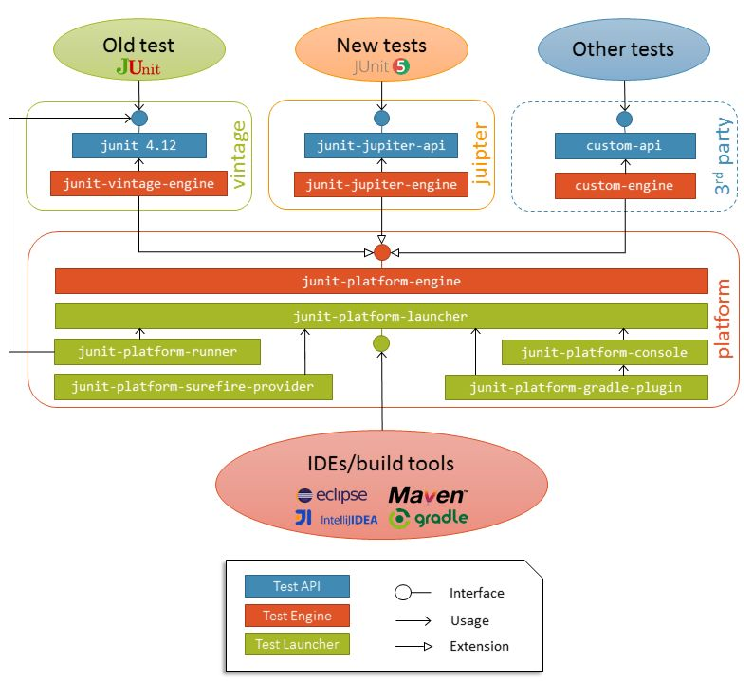
JUnit 5 Architecture
Unlike previous versions of JUnit, JUnit 5 is composed of several different modules from three different sub-projects.
JUnit 5 = JUnit Platform + JUnit Jupiter + JUnit Vintage

Slide 8
JUnit 5 Architecture
JUnit Platform
The JUnit Platform serves as a foundation for launching testing frameworks on the JVM.
It also defines the TestEngine API for developing a testing framework that runs on the platform.
Furthermore, the platform provides a Console Launcher to launch the platform from the command line and a JUnit 4 based Runner for running any TestEngine on the platform in a JUnit 4 based environment.
JUnit Jupiter
JUnit Jupiter is the combination of the new programming model and extension model for writing tests and extensions in JUnit 5.
The Jupiter sub-project provides a TestEngine for running Jupiter based tests on the platform.
JUnit Vintage
JUnit Vintage provides a TestEngine for running JUnit 3 and JUnit 4 based tests on the platform.

Slide 9
Test-driven development
Test-driven development (TDD) is a software development process that interweaves coding, testing, and design.
It is a test-first approach that aims to improve the quality of your applications.
Write test first, then code.
Basically stub a method, write your test case as final state. Run it make it fail. Iteratively work on your actual code under test.
When all your test cases are passed, your development is completed.
Agile user stories -> Write your test cases for the expected behavior

Slide 10
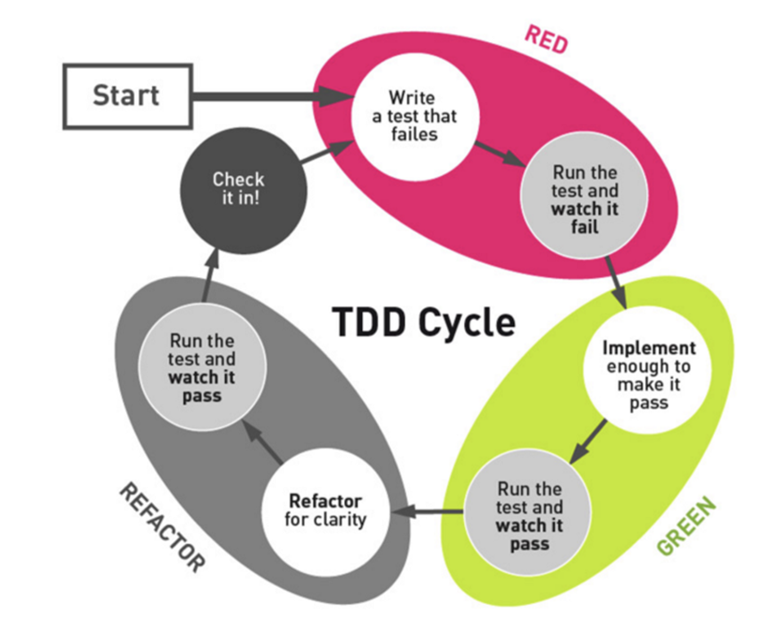
TDD Lifecycle
Test-driven development is defined by the following lifecycle:
Add a test.
Run all of your tests and observe the new test failing.
Implement the code.
Run all of your tests and observe the new test succeeding.
Refactor the code.

Slide 11
Maven Dependencies
<dependency>
<groupId>org.junit.jupiter</groupId>
<artifactId>junit-jupiter-api</artifactId>
<version>5.6.0</version>
<scope>test</scope>
</dependency>
<dependency>
<groupId>org.junit.jupiter</groupId>
<artifactId>junit-jupiter-engine</artifactId>
<version>5.6.0</version>
<scope>test</scope>
</dependency>

Slide 12
Surefire Maven Plugin
Lets you run your junit test using maven commands, in order to facilitate running your junit as maven test
Typically in developer mode, Eclipse IDE calls the testrunner of junit
But in a CI/CD pipeline the build process uses a command line utility(not eclipse)
<build>
<plugins>
<plugin>
<artifactId>maven-surefire-plugin</artifactId>
<version>2.22.2</version>
</plugin>
</plugins>
</build>

Slide 13
Junit features
Separate test class instances and class loaders for each unit test to prevent side-effects
JUnit annotations to provide resource initialization and cleanup methods: @BeforeEach, @BeforeAll, @AfterEach, and @AfterAll (starting from version 5); and @Before, @BeforeClass, @After, and @AfterClass (up to version 4)
A variety of assert methods that make it easy to check the results of your tests
Integration with popular tools such as Maven and Gradle, as well as popular integrated development environments (IDEs) such as Eclipse, NetBeans, and IntelliJ

Slide 14
@Test
By using this annotation, JUnit knows it needs to run this test
Marks a method as a test
Informs the JUnit engine what methods need to run
At high level if you run junit test, it will scan all test class and run them
No failures mean success
@Test
public void testAdd() {
Calculator calculator = new Calculator();
double result = calculator.add(10, 50);
assertEquals(60, result, 0);
}

Slide 15
Asserts
assertEquals(expected , actual) -> Asserts that expected and actual are equal
assertArrayEquals(expectedArray , actualArray) -> Verifies each item in the arrays are equals in the right position
assertIterableEquals(expectedArray , actualArray) -> Verifies each item in the iterable are equals in the corresponding positions
assertNotEquals(expected , actual) -> Asserts that expected and actual are not equal
assertFalse(boolean condition, String message) -> Assert that the supplied condition is false
assertEquals(expected , actual, message) -> Asserts that expected and actual are equal, additionally providing message as a clue

Slide 16
Exception
In some situations, you expect a test to be executed and to throw an exception, so you may force the rest to run under inappropriate conditions or to receive inappropriate input.
@Test
@DisplayName("An exception is caught")
void testCatchException() {
Throwable throwable = assertThrows(NoJobException.class,
() -> systemUnderTest.run(1000));
assertEquals("No jobs on the execution list!",
throwable.getMessage());
}

Slide 17
Lifecycle hooks
Process in which the test instance is created, managed and destroyed
Junit gives you hooks through which you can execute code at certain points in the lifecycle from the creation of the class till termination
Junit has an order annotation @order
Junit creates a new class instance for every method run
@BeforeAll - Initialize before anything in this class runs
@BeforeEach - initialize before each method
@AfterEach - Teardown after each method
@AfterAll - Teardown after all methods are run
Note : @BeforeAll / @AfterAll methods have to be static

Slide 18
Assumptions
Sometimes tests fail due to an external environment configuration
Assumptions verify the fulfillment of preconditions that are essential for running the tests.
You can use assumptions when it does not make sense to continue the execution of a given test method.
In the test report, these tests are marked as aborted.
assumeTrue(environment.isAmd64Architecture());

Slide 19
@DisplayName
The @DisplayName annotation can be used over classes and test methods.
The string argument of the @DisplayName annotation may contain spaces, special characters, and even emojis.
Typically, this annotation is used for test reporting in IDEs and build tools.
The name that’s displayed is usually a full phrase that provides significant information about the purpose of the test.
@Test
@DisplayName("Our system under test says hello.")
void testHello() {
assertEquals("Hello", systemUnderTest.hello());
}

Slide 20
@Disabled
The @Disabled annotation can be used over classes and test methods.
It signals that the annotated test class or test method is disabled and should not be executed.
If this annotation is applied to a class, it disables all the methods of the test
@Disabled("Feature is still under construction.")
class DisabledClassTest {
--
}

Slide 21
Conditional Test Execution
Handling External Factors using Conditional Execution
Controls whether a test should be run
If scenarios are not being met, it is equivalent to disabled
@EnabledOnOs(OS.LINUX)
@EnabledOnJre(JRE.JAVA_11)
@EnabledIf
@EnabledIfSystemProperty
@EnabledIfEnvironmentVariable

Slide 22
assertAll
The assertAll method will always check all the assertions that are provided to it, even if some of them fail
if any of the executables fail, the remaining ones will still be run.
assertAll(() -> {
assertEquals(Gender.MALE, customer.getGender());
assertEquals(FIRST_NAME, customer.getFirstName());
assertEquals(LAST_NAME, customer.getLastName());
assertEquals(MIDDLE_NAME, customer.getMiddleName());
assertEquals(customerDate, customer.getBecomeCustomer());
});

Slide 23
@Nested
A test class may be a top-level class, a static member class, or an inner class annotated as @Nested that contains one or more test methods.
Nested tests give the test writer more capabilities to express the relationships among several groups of tests.
@Nested
class AddTest{
@Test
@DisplayName("Add positive numbers")
void testAddPositive() {}
@Test
@DisplayName("Add negative numbers")
void testAddNegative() {}
}

Slide 24
@RepeatedTest
JUnit 5 allows us to repeat a test a specified number of times using the @Repeated-Test annotation
It has as a parameter the required number of repetitions.
This feature can be particularly useful when conditions may change from one execution of a test to another.
@RepeatedTest(3)
@DisplayName("This is Add")
void testAdd() {}

Slide 25
@Tag
@Tag annotation can be used over classes and test methods.
You can use tags to filter test discovery and execution.
Helps to focus on particular tests rather than spend time with the entire suite
@Tag("individual")
public class CustomerTest {}
<plugin>
<artifactId>maven-surefire-plugin</artifactId>
<version>2.22.2</version>
<configuration>
<groups>individual</groups>
<excludedGroups>repository</excludedGroups>
</configuration>
</plugin>

Slide 26
TestInfo and TestReporter
TestInfo contains information about the test. TestInfo is a class whose objects are used to inject information about the currently executed test or container into the @Test, @BeforeEach, @AfterEach, @BeforeAll, and @AfterAll methods.
TestInfoTest(TestInfo testInfo) {
assertEquals("TestInfoTest", testInfo.getDisplayName());
}
TestReporter provides ability to report TestInfo. TestReporter is a functional interface and therefore can be used as the assignment target for a lambda expression or method reference.
@Test
void testReportSingleValue(TestReporter testReporter) {
testReporter.publishEntry("Single value");
}

