Slide 1
Fault model based Validation for board HW and PSV
Exec Summary
Author: Vijay Kirpalani

Slide 2
Vijay Kirpalani Contact – 9739175785 e-mail – vijaykirpalani@gmail.com
24 Years of Industry experience in the HW/system software/networking/telecom domain
Driven HW ( Board ) validation and ASIC (Post silicon validation) projects from conception to customer delivery (FCS).
Interacted closely with HW qualification teams and the manufacturing teams.
Developed/lead networking products/features for Access Routers, Core Routers, Line Cards
Hardware busses – I2C, PCI, SPI, High speed serdes.
Board validation involving Ethernet PHY devices (1G/10G/ 100G) from Vitesse, Broadcom NPUs ARAD /QMX.
Device Drivers for SONET, Ethernet, T1/E1 and HDLC devices.
CPU – Intel Broadwell, Freescale/NXP P2020, T1042, IBM PowerPC 740-710, and ARM based.
Operating Systems – Linux, VxWorks 5.x, and Windows NT.
Education
B.E. Electrical Engineering R.E.C. Tiruchirapalli (1991)
MS Computer Engineering Louisiana State University (1993)
Research Paper Published in IEEE Transactions on Computers http://ieeexplore.ieee.org/xpl/freeabs_all.jsp?tp=&arnumber=536239&isnumber=11374

Slide 3
The motivation behind fault model based validation
While working on Board Diagnostics/Validation software, I found that:
We had no deterministic way to arrive at test coverage for a given HW design and its associated faults
In the course of validation of the board, issues show up that the test case did not intend to find.
The Diagnostics validation found an I2C rise time fault on a proto board, 18 months after PON.
Intermittent Traffic /packet drops and (CAUI4) link flaps show up after several days of run in the regression setup during our testing of the proto HW.
The motivation behind fault model based validation is to
have a predictable method or process which generates tests with intent to catch all the possible faults that can occur in a design, rather than finding it by accident.

Slide 4
What is a fault model ?
Real defects are too numerous ( at transistor level itself there could be so many possible defects).
A fault model is an abstraction, for example a stuck-at-1 fault. There could be so many defects at the electrical layer, but functionally they can be represented as a stuck-at fault.
This kind of abstraction makes it easier to analyze and
Makes it possible to identify specific targets for testing.
It makes it possible to build test algorithms to sensitize the faults.

Slide 5
Methodology
Creation of HW models (functional, behavioral, timing) or HW design abstractions
Fault modeling based on the HW model.
Fault insertion in the system verilog environment
Test algorithm development to detect the faults inserted in system verilog environment
The test algorithms are then ported to the target board.

Slide 6
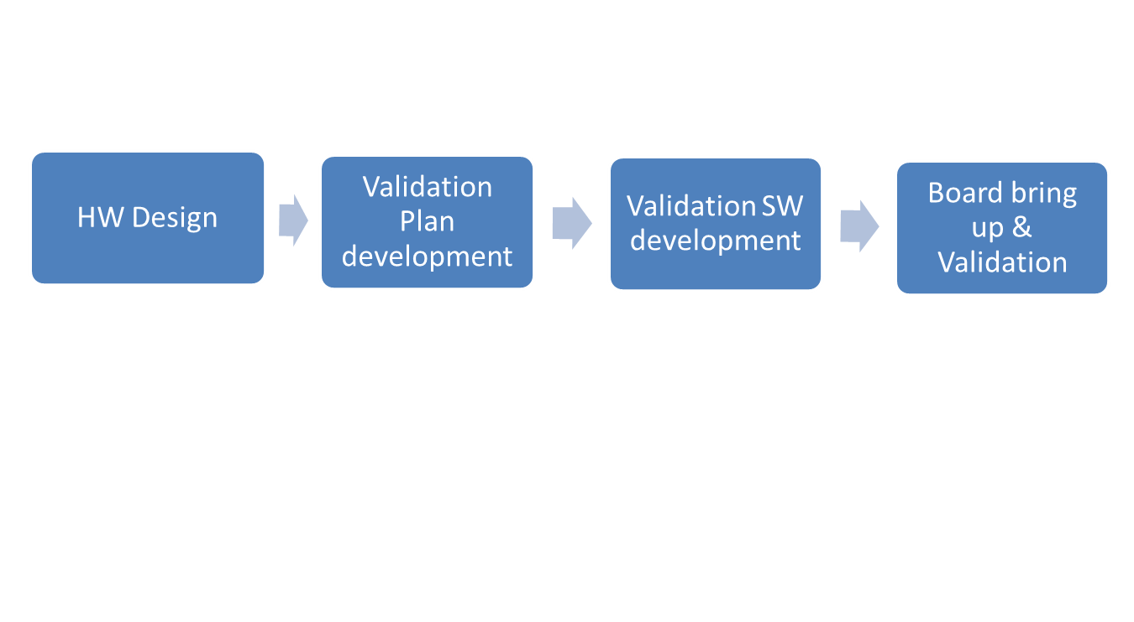
Typical board/hardware validation flow
The typical process flow for hardware/board validation is illustrated above. The next slide provides information on the enhanced work flow which includes fault modelling.

Slide 7
Enhanced Work flow
Fault Model development for key interfaces
Test algorithm development
Test algorithm implementation
HW Design
Validation Plan development
Validation SW development
Board bring up & Validation
Integration into board validation code

Slide 8
Summary - benefits of fault model based validation
Predictable method to arrive at possible faults and test to sensitize them
Helps find HW design issues early in the cycle
Avoid last minute surprises.
This helps keep the overall hardware development schedule and cost under control
Fault models once developed can be re used across designs.
Usage of simulation environment for test algorithm development
Faults can be inserted easily in simulation environment. This would be difficult and complex to do on the real board.
Tests and test algorithms are proven prior to board arrival in a Verilog simulation environment.
Prevents time consuming debug cycles for unit testing and debugging the test code.

Slide 9
Summary of benefits (continued)
Attribute/Metric | Fault model based validation | Traditional methods of validation
Validation coverage of design faults | High | low
Timeliness in finding design faults | Early findings | Not predictable
Debug time | Low | High
Cost | Initial cost – fault model development. Balanced by savings due to finding issues early. Re use of fault models across products | Cost appreciation due to delays caused by late findings of design issues and elongated debug cycles

Slide 10
Fault model for I2C interface
I have created
behavioral model based on the I2C specification
Functional model based on open source I2C implementation
Structural analysis based on the I2C specification
Timing model is leveraged from the specification.
I have created Fault models based on the above HW models

Slide 11
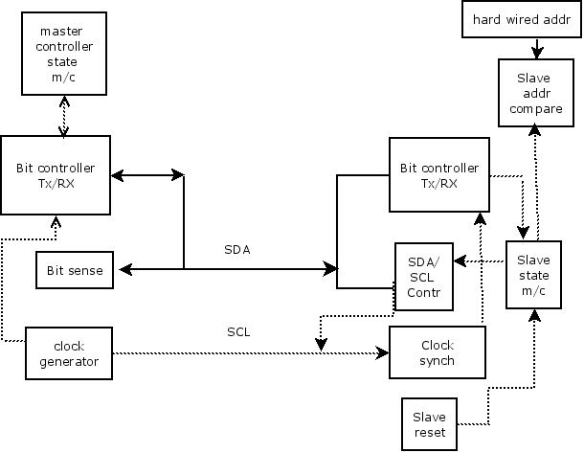
I2C functional model

Slide 12
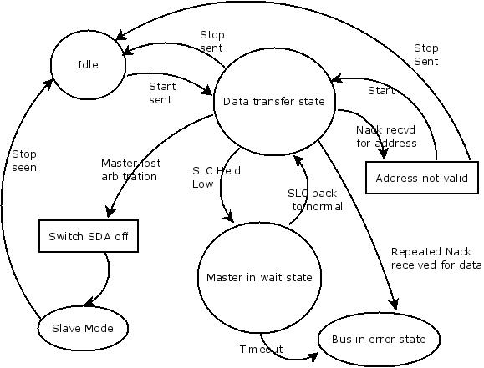
I2C bus state at the master

Slide 13
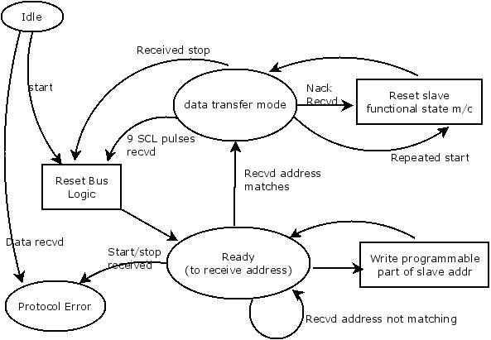
I2C bus state at the slave

Slide 14
Test algorithms developed
The following faults have been inserted in the system Verilog environment, and test algorithms to detect them have been developed. [ I2C fault model developed]
Reset line fault – The reset line that is used to reset the master could have a fault
Duplicate slave fault – Mistakes in the hardware hookups could result in duplicate slave
Jitter fault – The deviation of the time interval edge of the SCL clock from its ideal position Is the fault under consideration here.
Rise time fault – The SDA has a rise time violation.
Setup time fault – The setup time for the repeated START is violated.
Propagation delay fault – The time taken to traverse the path is such that the signals crosses the clock period.

