Slide 1
Trajectory Planning and System dynamics
Eric Feron
Laboratory for Information and Decision Systems (LIDS)
Dept Aeronautics and Astronautics

Slide 2
Point of this lecture
System dynamics is very important for robotic systems which aim at moving fast - anything that flies in particular.

Slide 3
Outline
Motivation: ground, space and air vehicles
Trajectory planning: fundamental requirements
System dynamics: introduction / reminder
Some approaches to integrate system dynamics and trajectory planning:
  Frequency separation
  Inverse control
  “Intuitive control”
  Recent approaches
Conclusions

Slide 4
Ground, space and air vehicles
Egg on the ground
Egg in
outer space
Egg that
was up in the air
Full mastery of dynamics is entry level for aerobotics
Simulated eggs are OK for a while.

Slide 5
From Dynamics to Trajectory Planning
"Robotics"
Towards Mission Planning
Interaction with Surrounding Environment: Other vehicles, obstacles
Trajectory Generation
"GN&C"
Inner loop control
Inner loop, physical model

Slide 6



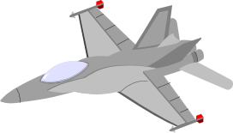


Trajectory Planning Today
Probabilistic Roadmap Methods
Probabilistic Completeness
Latombe, Kavraki - Overmars, Svestka
Time-optimality
Reif, Zefran
Potential field methods
Khatib, Latombe, Barraquand
Complexity analysis
Canny, Donald, Reif, Xavier
Kinodynamic Trajectory Planning
Latombe, LaValle, Kuffner, INRIA
Moving Obstacles
Fiorini, Shiller

Slide 7
Trajectory Planning
B
B
B
B
A
A
A
A
Configuration space (Lozano- Peres)
Potential field approaches, dynamic programming
Randomization schemes (Latombe, Motwani)
Randomly exploring trees (LaValle)

Slide 8
Fundamentals of vehicle dynamics:
Notion of State
Vehicle system:
Vehicle state: All variables that are necessary to know at instant t to predict behavior of vehicle in the future (given future inputs to the system). Example: Cart sliding on a surface:
Inputs
(accelerations, steering
wheel angle, etc)
Outputs
(vehicle position, attitude,
health).
F
State?

Slide 9
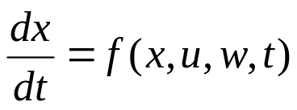
State and Equations of Motion
Implicit in notion of state is that of equation of motion
  Continuous:
  x is state (position, attitude, speeds of all sorts), u is control, w is perturbation.
  Discrete:
  We’ll see both brands
  in this course. CS seems to like
  second brand better. ODEs must
  also be accounted for.
  Fancy buzzword: hybrid systems.

Slide 10
Beating the complexity hurdle in trajectory planning
Trajectory planning is very complex, for very many reasons: environment complexity (obstacles, vehicle shape), dynamics complexity: Equations of motion with many, many states.
Makes straight application of standard planning paradigms (e.g. Dynamic Programming) computationally intractable on initial models
Need for complexity reduction.
Hierarchical decomposition of the control tasks:
  Maneuver sequencing (guidance, trajectory planning
  Maneuver execution (control, trajectory tracking)

Slide 11
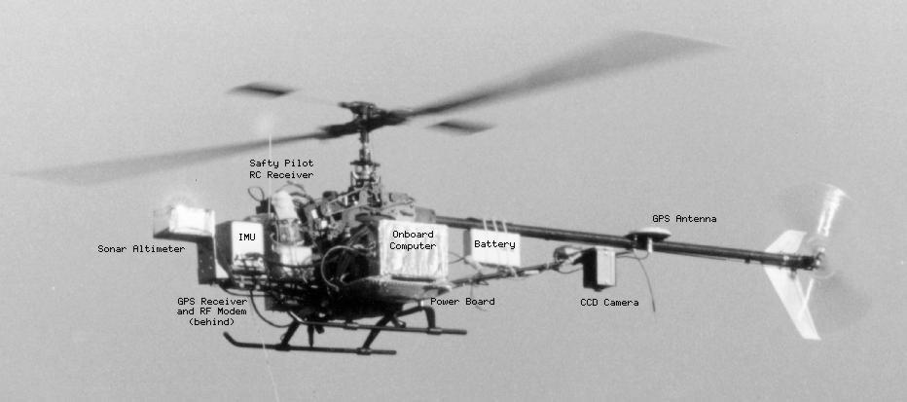
Complexity Reduction via frequency separation
Basic axiom: the “dynamics” of the trajectory is very slow, thus uncoupled
from the dynamics of the vehicle: path planning for jetliner.
Waypoints
Trajectory represented by piecewise linear functions, although system cannot
physically make sharp turns: no one cares. Also applied for many current
flying robots:
Draper-MIT-BU 1996. TSK Base.
Can’t always do that.

Slide 12
Trajectory regulation/tracking
Once a trajectory is given, must be able to track it:
Nominal trajectory yd==> nominal inputs (trim values) ud
==> (+perturbations, unmodeled dynamics) yields actual trajectory y ==> use y-yd to generate a correction signal du, which will make sure it stays close to zero.
ud
+
System
y
+
+
yd
du
-
Logic
(usually PID)

Slide 13
Complexity reduction from fundamental insight
Map vehicle dynamics onto achievable trajectories
Inverse Control
Feedback Linearization
Differential Flatness
Trajectory specification in output space (geometrical coordinates) is enough for trajectory specification in control space.

Slide 14
Trajectory Generation Example
Inverse Control and Feedback Control of a Cart
Protoype problem: Steering a cart on a plane to follow a given trajectory.
Also applies to many types of airplanes, helicopters, etc.
Fliess, Rouchon, Sastry, Murray.

Slide 15
Steering a cart: Interface between Trajectory Planning and Control
A cart: Two controls
Reference Trajectory: Two variables
One problem: If use steering wheel position as
reference for trajectory following, then not only need
to know trajectory, but also initial position/oientation
of cart to find out controls. e.g. May have to steer or left
(and of course apply opposite sign moments) to follow
reference trajectory. A control systems nightmare if
inertial effects are significant.

Slide 16
Steering a cart: Appropriate Interfacing through “Differential flatness”
r(t)
One elegant solution: The middle of
rear axle tracks the reference trajectory.
Named Flat Output: The reference trajectory
unambiguously specifies the controls to be
applied to the cart.
Notice: the trajectory r(t) must be
continuously differentiable at least a
few times with respect to time (also assume
no geometrical singularities to make matters simpler)

Slide 17
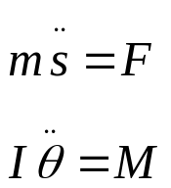
Steering a cart: Technical details
r(t)
Parameterize trajectory by curvilinear coordinates:
s(t): Curvilinear abscissa.
θ(t): Cart angular speed.
Cart equations of motion:
F: Forward force, directly proportional to (algebraic)
sum of torques applied to rear wheels (for example).
M: Torque, directly proportional to (algebraic) difference
of torques applied to rear wheels.
Can convert these into other combinations like
torque/direction of front wheel or direction of
front wheel + torque on rear axle for rear wheel drives.
For a given r(t), the derivatives of s(t) and those of θ(t) are unambiguously determined.
So the controls on the vehicle (force and torque) are uniquely determined as a function
of r(t).

Slide 18
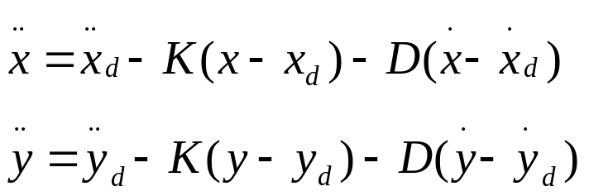

A Feedback control strategy / tracking system for cart steering
Step 1: Given (x,y) and (xd,yd)
(desired trajectory), design a proportional,
derivative, tracking system, that is design
(x,y) such that
(x,y)
(xd,yd)
These behaviors are “stable” for positive K and D, and (x,y) converge towards
desired trajectory.
Step 2: Extract from (x,y) and apply corresponding force, moment to cart.
It works. You show it in HW.

Slide 19
Complexity reduction via dynamics discretization
A reduction in the complexity of the problem comes from the
decomposition of feasible trajectories into trajectory primitives

Slide 20
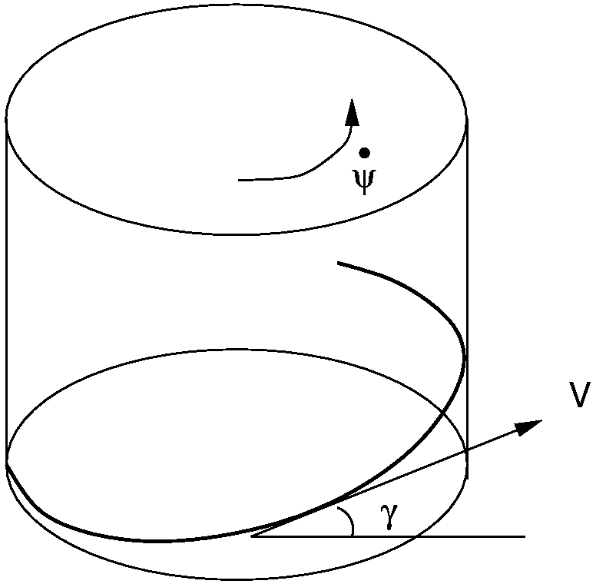
Trajectory Primitives –
Trim Trajectories
Trim trajectories: trajectories along which velocities in body axes and control inputs are constant
  Symmetry⇒trim trajectories are the composition of a constant rotation g₀∈{0} × SO(3) and a screw motion h(t)=exp(ηt), where η ∈h ⊂se(3)
  h(t) in the physical space can be visualized as a helix flown at a constant sideslip angle
  Trim trajectories can be parameterized by η, or equivalently by:
Usual parametrization:
V: velocity
γ: fligt path angle
dψ/dt: turning rate
β: sideslip angle

Slide 21
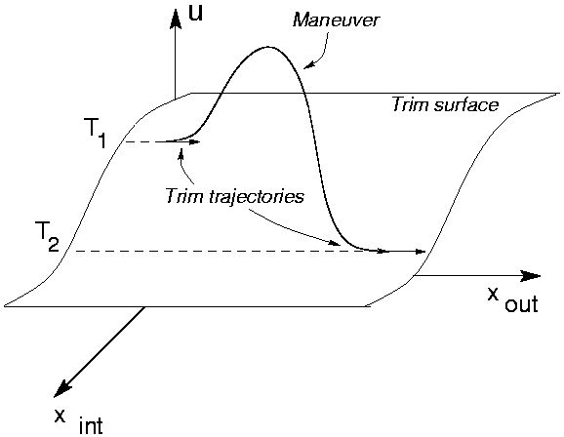
Trajectory Primitives - Maneuvers
Maneuver:
(Finite time) (Fast) transition between trim points
Transitions to and from:
  hover
  forward flight
  turning flight
  climbs/dives
“Aerobatics”:
  loop
  barrel roll
  flip
  split-s ...
g
ξ

Slide 22
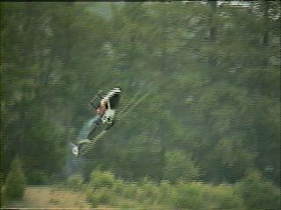
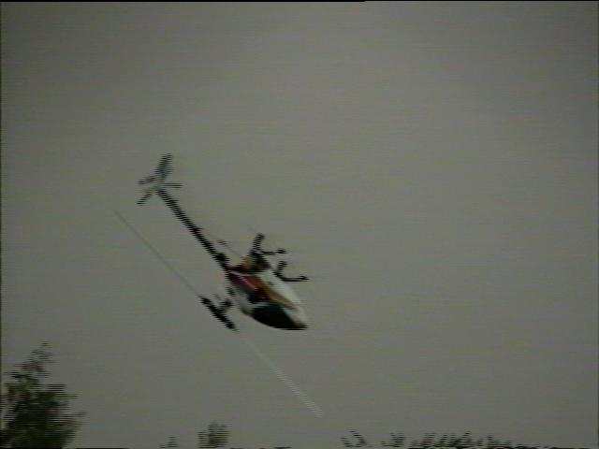
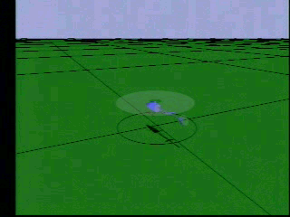
Vehicle maneuvers

Slide 23
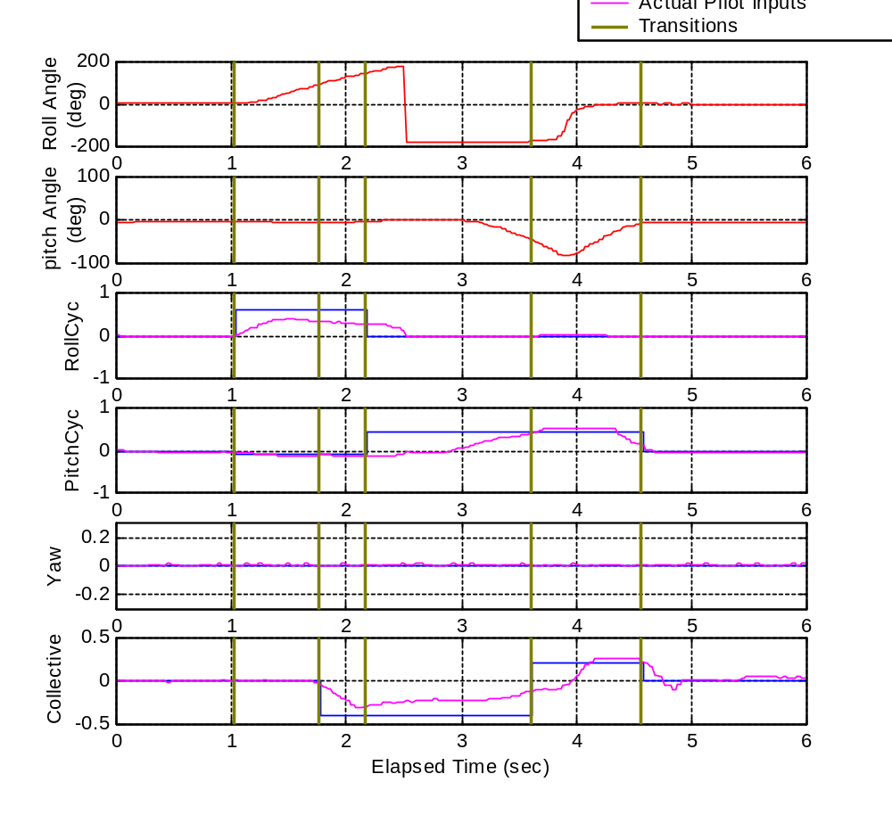
Split-S I/O Observations
Trimmed
forward
flight
Roll
cyclic
Maneuver
Initiation
Roll Angle=
90 deg
Pitch angle
=0deg
Pitch cyclic
Collective
Pitch angle
=45deg
Pitch cyclic
Rev. Coll.
Rev. Coll.
Roll cyclic
Roll
angle
=145deg
"Intuitive control" Pratt & Raibert

Slide 24
Maneuver Automaton
The state of the system is fully described by:
  trajectory primitive being executed (q ∈ Q ⊂ N)
  inception time (t₀ ∈R) and “position” (h₀ ∈R⁴)
  Current time (t ∈R)
Maneuvers have a time duration, while trim trajectories can be followed indefinitely
The hybrid controller must provide:
  jump destination (q’ ∈ Q, which maneuver to execute)
  coasting time (t’-t₀, how long should we wait in the trim trajectory before initiating the maneuver)

Slide 25
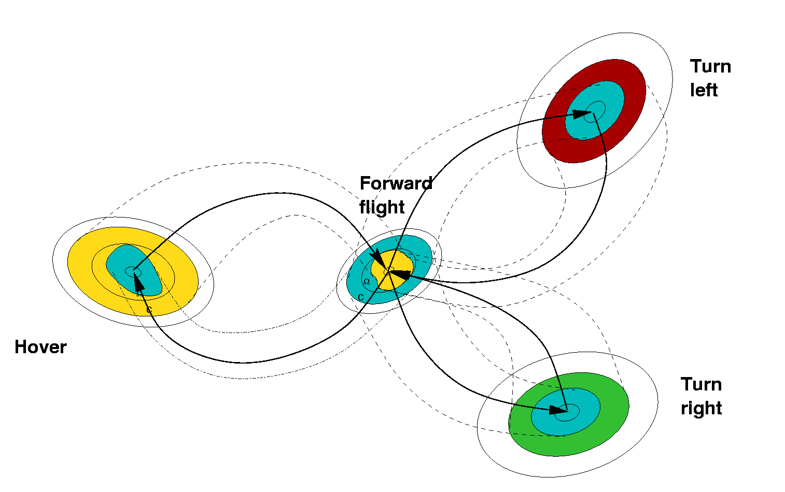
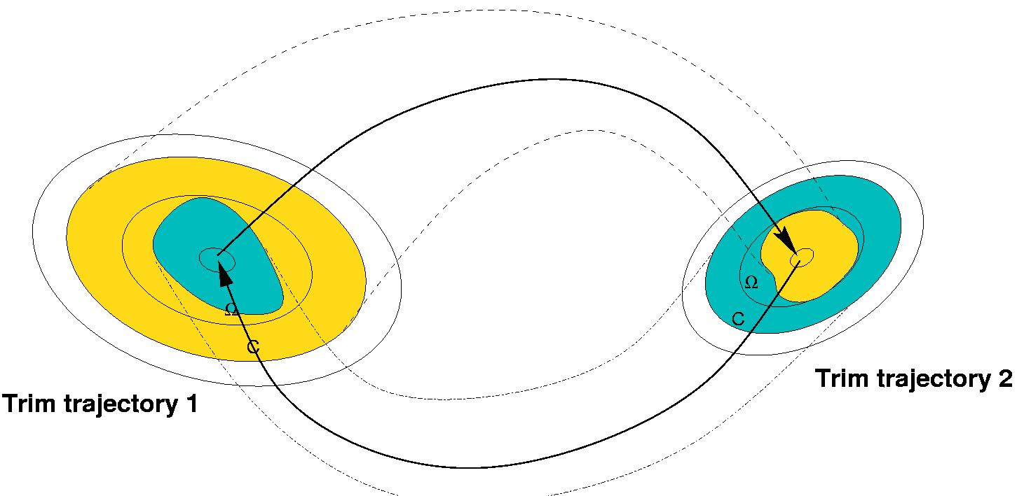
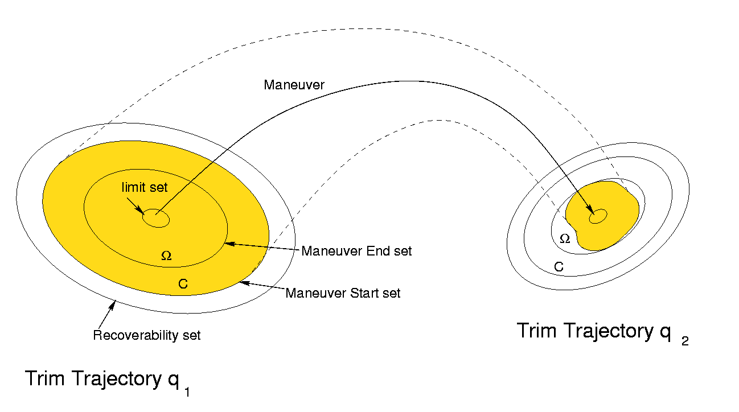
Robust Hybrid Automaton
For each trim trajectory, define the following:
  L_{q}: limit set
  R_{q}: recoverability set
  C_{q}: maneuver start set
  Ω_{q}: maneuver end set

Slide 26


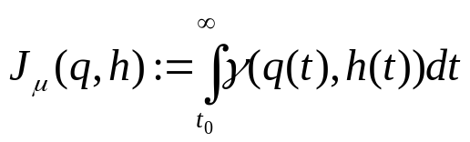

Optimal Control Problem
Given - Running cost:
Find a Control policy:
To minimize the Total cost:
Subject to the System dynamics:
Optimal cost satisfies the HJB eq.:
Solving the HJB equation is still difficult, however we have reduced the dimension of the state to 4 continuous dimension + 1 discrete dimension ⇒ solvable through approximation architectures

Slide 27
Neuro-Dynamic Programming Formulation
Assume we know a proper policy μ₀, that is a policy that for all possible initial states results in a finite cost J₀ (e.g. from heuristics, or other considerations)
A no worse policy is given by
The iteration converges; technical conditions for convergence to optimal cost
In general, we have some approximate representation of J_{i}
(look-up tables, approximation architectures)
J_{i} depends on a “small” number of parameters, and has to be computed only on compact sets (computational tractability)
The optimal control is computed by an optimization over time, and a discrete set (applicability to real-time systems)

Slide 28
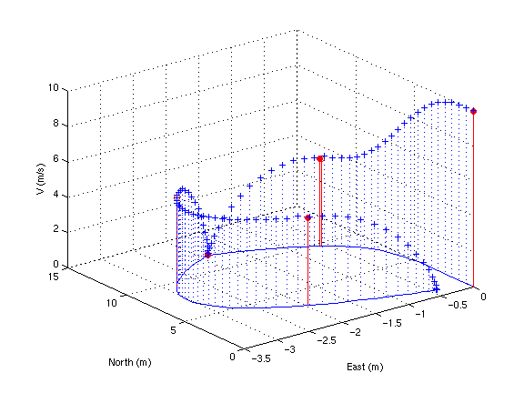

Simulation Example
Initial conditions:
High speed flight over target

Slide 29
Motion planning with obstacles
Traditional path planning
  techniques based on the configuration space (Lozano-Perez), e.g. A* searches
  does not deal with system dynamics - deals with complex geometric environmnets
Kinodynamic planning
  state space
  Potential field techniques: can get stuck in local minima
  Randomized techniques, e.g. randomized roadmap (Latombe 96), Rapidly-exploring Random Trees (LaValle 99): probabilistic completeness
An attractive alternative to the full state space is the maneuver space

Slide 30
Motion Planning algorithm
Based on Rapidly-exploring Random Trees algorithm (LaValle, 99)
Optimal cost function in the free workspace case provides:
  pseudo-metric on the hybrid space
  Fast and efficient computation of “optimal” control

Slide 31
Maneuver Tree - Threat avoidance

Slide 32

Motion planning demo: threat avoidance

Slide 33
Maneuver Tree - “Maze”

Slide 34

Maneuver Tree - “Sliding doors”

