Slide 1
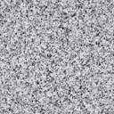
Geometric properties
N
P
W
Height (H)
A
A
L
Elevation
Cross Section (AA)

Slide 2

Moment (M) – Curvature ($φ$) Evaluation

Slide 3
Flowchart
Note:
Neutral axis may fall outside the section, if the whole section is in compression
NA Depth
(Trial)
Calculate strains in all steel and concrete fibers, using similar triangles
Trial with new NA Depth
Calculate stress in all steel and concrete fibers using constitutive relation ships of steel and concrete
Moment Capacity (M_{Cap})
And Curvature (Phi) calculation
Comp – Tension = N
No
Yes

Slide 4
Evaluation of $M_{cap}$ and $φ$ When Neutral Axis is Inside the Cross Section
F_{C}
NA
N
F_{t}

Slide 5
Evaluation of $M_{cap}$ and $φ$ When Neutral Axis is Outside the Cross Section
F_{C}
N
NA

Slide 6

Moment (M) – Curvature ($φ$) Diagram

Slide 7
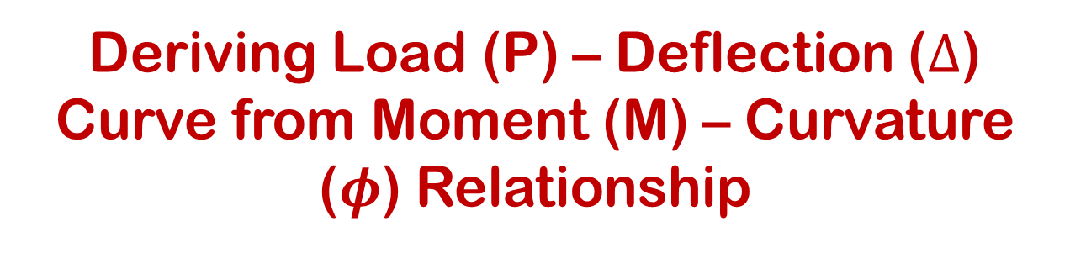
Deriving Load (P) – Deflection ($Δ$)
Curve from Moment (M) – Curvature ($φ$) Relationship

Slide 8


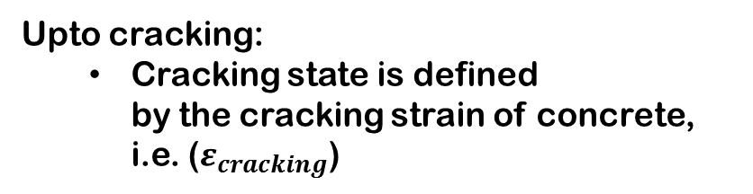
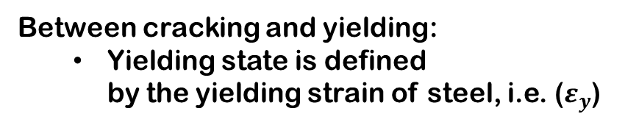
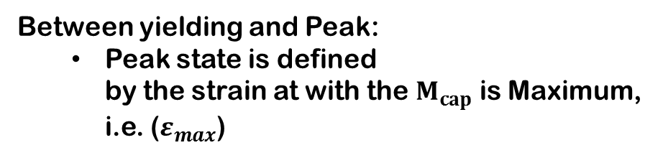
Load (P) – Deflection ($Δ$)
Between cracking and yielding:
Yielding state is defined by the yielding strain of steel, i.e. ($ε_{y}$)
Upto cracking:
Cracking state is defined by the cracking strain of concrete, i.e. ($ε_{cracking}$)
2
1
Between yielding and Peak:
Peak state is defined by the strain at with the $M_{cap}$ is Maximum, i.e. ($ε_{max}$)
3
Post Peak:
Beyond ($ε_max$)
4

Slide 9
Load (P) – Deflection ($Δ$)
Before Cracking
1
Upto Cracking
At Cracking

Slide 10
Load (P) – Deflection ($Δ$)
After Cracking
2
Between Cracking and yielding
After Cracking at yielding
L₃ and L₄ are the distances from free end to respective area CG

Slide 11
Load (P) – Deflection ($Δ$)
After yielding
3
Between yielding and peak
After yielding at peak
L₄ , L₅ and L₆ are the distances from free end to respective area CG

Slide 12
Load (P) – Deflection ($Δ$)
After yielding at elastic restoration curvature
4
Post peak
L₄ , L₅ and L₆ are the distances from free end to respective area CG

Slide 13
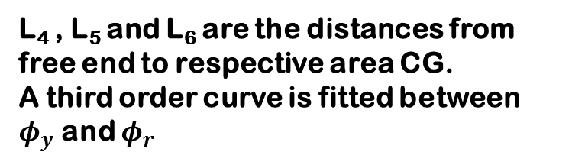
Load (P) – Deflection ($Δ$)
After yielding at elastic restoration curvature
4
Post peak
L₄ , L₅ and L₆ are the distances from free end to respective area CG.
A third order curve is fitted between $φ_{y}$ and $φ_{r}$

Slide 14


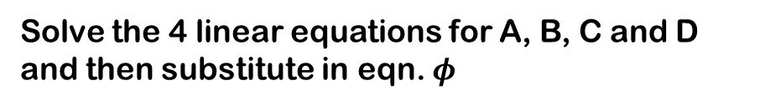
Load (P) – Deflection ($Δ$)
At $x=0$
At $x=L_{P}$
4
Post peak
Solve the 4 linear equations for A, B, C and D and then substitute in eqn. $φ$
Use the $Δ_{max}$ that is calculated in step 3.

Slide 15
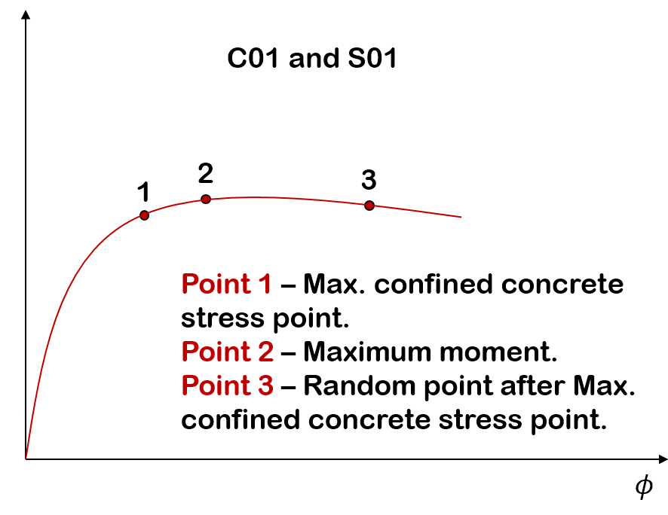


$$P$$
$$Δ$$

