Slide 1
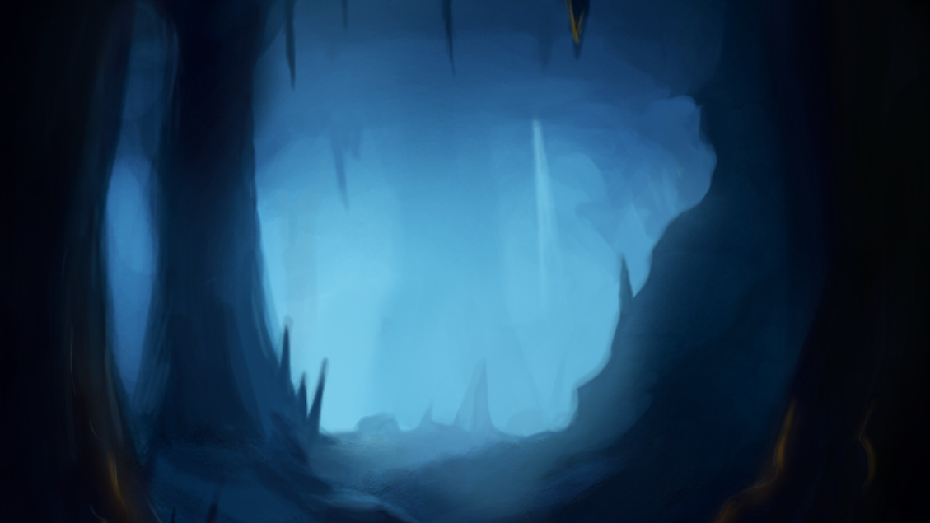
Demon Runner: The Forsaken
Game Pitch
(Camp Half-Blood, n.d.)

Slide 2

Team: Blue Slayer
Jimmie Walker
Philip Anderson

Slide 3
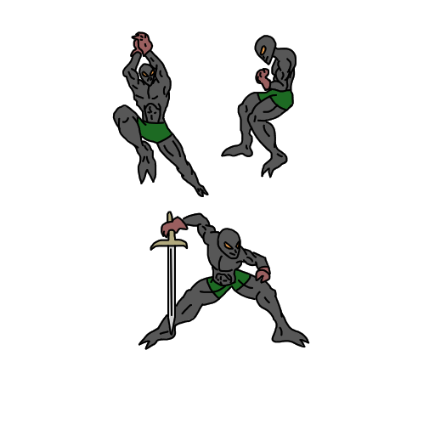
Synopsis & Player Hook
You are a character named Varcasium (Var-kas-see’um) who recently joined the underworld before his time.
After making a deal with the Dark Lord to enter the caves of Damascus (Da-mask-us) to be human again, The Dark Lord transports him deep into the Damascian caverns.
Your goal is to escape the caverns alive through hazards like fire, bottomless pits, acid, and spikes by collecting soul and making it to the end to earn his freedom and second chance at life.

Slide 4



Core Actions
Left/Right movement
Jumping
Collecting
Wall Jumping
Activation
Grappling

Slide 5
Game Goals
Main
Find your way out of the caves alive to beat the Dark Lord.
Sub
Moment-to-moment
Avoid obstacles
Collect powerups to use as abilities
Collect soul large and small to spend on power ups
Release other demons
Activate switches and levers
Make impossible jumps look possible using power ups

Slide 6
Requirement Identification
Player Movement (Left/Right)
Speed Boost
Jumping
Collecting
Wall Jumping
Activation
Magnet
Grappling

Slide 7
Player Movement
The player movement should not feel ‘clunky’ and should not lag.
The player’s ability to move left and right should be fluid and will require a modifier on the character controller for the speed boost powerup ability.
Metrics that are created, will need to be tested using regular player movement and speed boost player movement.

Slide 8
Speed Boost
The Speed boost mechanic is a passive ability that allows the player to move faster.
This allows the player to get a longer jump distance due to the added speed.

Slide 9
Single Jump
The single jump mechanic can only be activated if the player is grounded.
If the player is not grounded and has double jump or triple jump. Then the player may perform another jump.

Slide 10
Double Jump
The double jump mechanic can only be activated if the player is grounded or in the air.
If the player is not grounded and has double jump. Then the player may perform one more jump.

Slide 11
Triple Jump
The triple jump mechanic can only be activated if the player is grounded or in the air.
If the player is not grounded and has triple. Then the player may perform two more jumps.

Slide 12
Collecting
This feature is what allows the player to purchase new abilities.
The purpose of this feature, is to make the last 3 levels of difficulty even harder.
Collecting also encourages exploration.

Slide 13
Wall Jump
The wall jump mechanic can only be activated if the player is next to a wall.
If the player is performing wall jump and has double jump or triple jump, then the player’s jumps will reset. This will allow the player to perform a double jump or triple jump after a wall jump.

Slide 14
Activating
This mechanic is for levels and triggers.
The primary purpose of this mechanic is to open doors, double doors, and end the current level by completion or by death.

Slide 15
Magnet
The magnet mechanic is a passive ability and is always active.
The magnet only becomes active when the ability is purchased from an entity and is given the ability.
If the player is within distance of a soul, then the soul will automatically be drawn to the player.

Slide 16
Grapple
The grapple mechanic can only be activated if the player is within grapple distance of a torch.
If the player is performing grapple and has double jump or triple jump, then the player’s jumps will reset. This will allow the player to perform a double jump or triple jump after a grapple.

Slide 17
Features/Requirements
Almost all abilities in this game are required to beat the game. If the player is playing on Hard difficulty or higher. Then the Magnet ability is required to get the good ending.
Adding these features in the game is what allowed us to create a game that has extremely challenging sections.
The features also allowed the team to create secret areas in the level to encourage player exploration.

Slide 18
Q & A
How does the player acquire powerups?
Powerups are purchased with soul from entities that are in certain levels. Once purchase, the player has the ability throughout the game.
How many levels are there?
There are 30 levels in total.
If I die in the game, do I lose my soul or powerup I just acquired?
You only lose the soul that you collected in that level. If you have just purchased a powerup, then the game will “save” your stats up to that point.

Slide 19
Reference(s)
Camp Half-Blood. (n.d.). Forest/Entrance To Dark Cave [Photograph]. Retrieved from
https://camphalfbloodroleplay.fandom.com/wiki/Forest/Entrance_To_Dark_Cave

