Slide 1

Exploratory Data Analysis of Facebook data

Slide 2
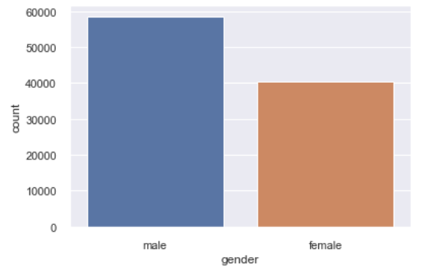
Which type of user are more on Facebook, male or female?
As we can see from count plot, male users are more on Facebook.

Slide 3
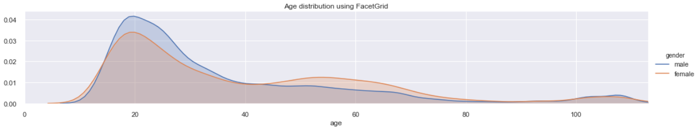
Users of which age are more on Facebook?
From the facet grid above we can see
Most of the users are of age around 20 years.
Between age group 13 to 40 years, male are more in number and between 40 to 60 years female are more.
It means more young males are there as compared to young females.
In case of mid-aged group more females are there on Facebook as compared to males.

Slide 4
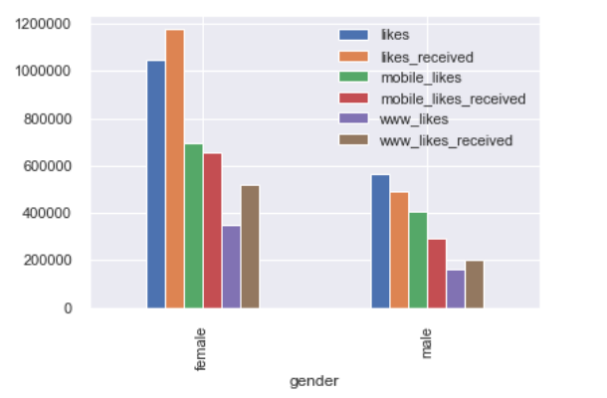
Who gets more likes, male of female?
As we can see in the group bar chart
Females get much more like as compared to males.
Females receive more likes than they give where as males get less like than they give.
Interesting observation is people using web browsers give more likes than they receive.

Slide 5
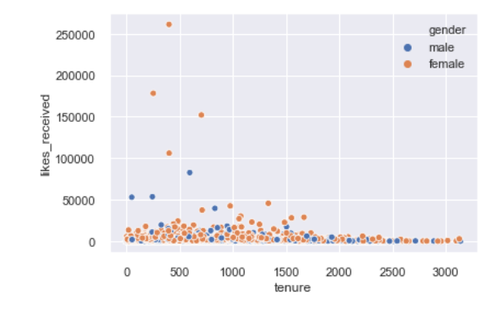
Does tenure affects the numbers if likes received?
As we can see from the scatter plot tenure of the user does not affect the likes received

Slide 6
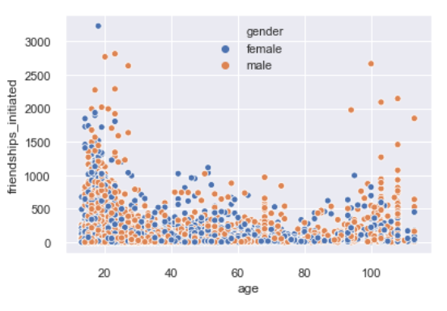
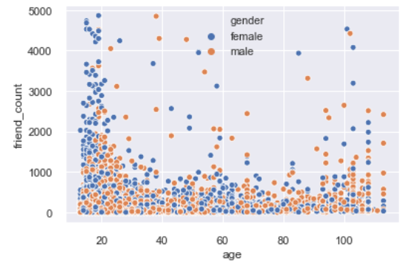
How does age affects friends count and likes of an user?

Slide 7
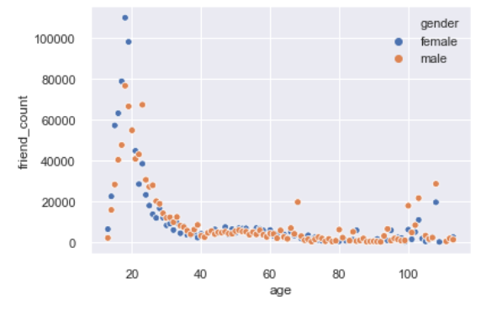
When ‘friend count’ is grouped by age, as we can see, for age between 18 to 24 friend count are very high

