Slide 1
Functions

Slide 2
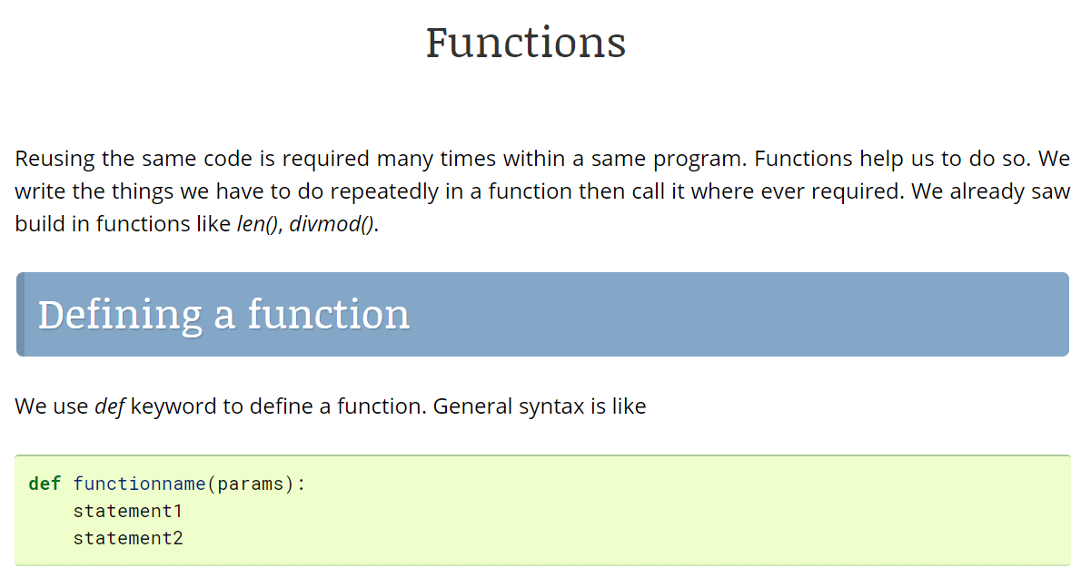

Slide 3
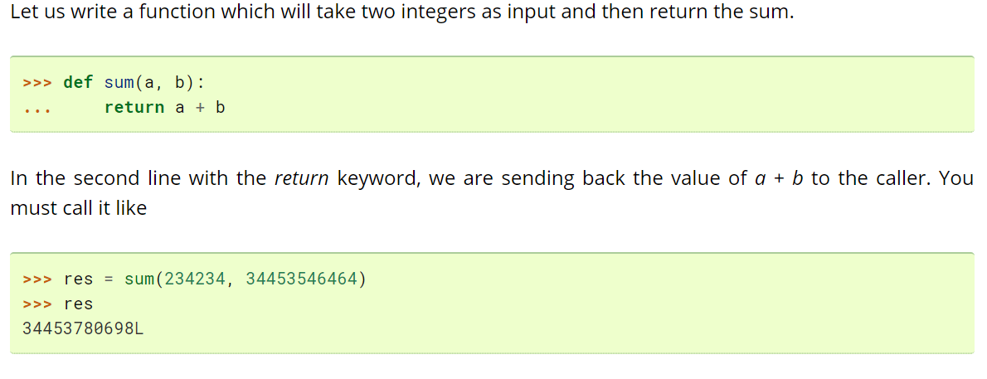
Sample program

Slide 4
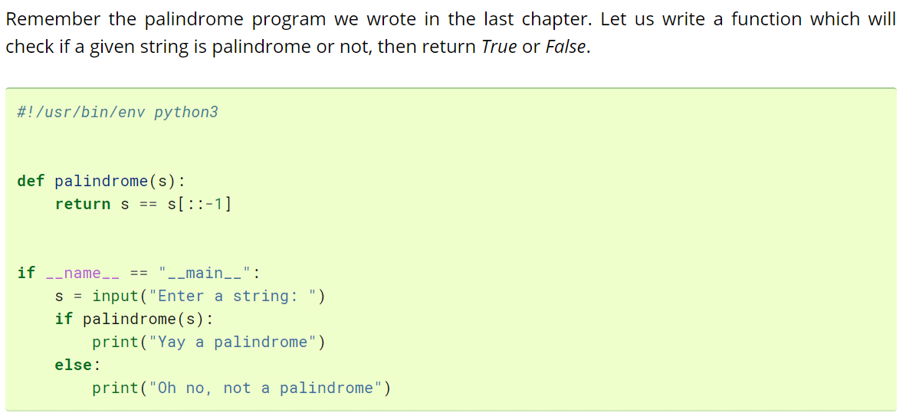
palindrome program

Slide 5
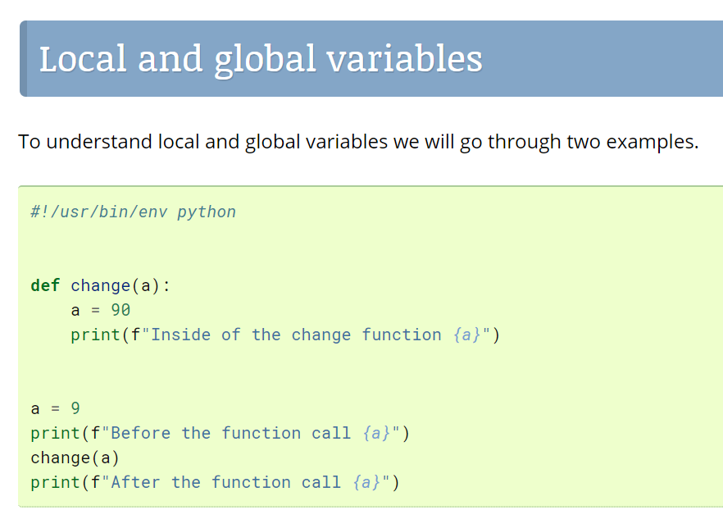
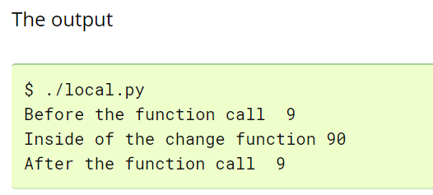

Slide 6
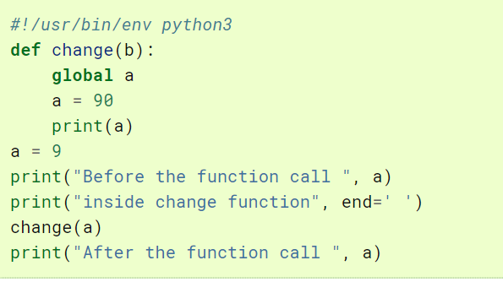
First we are assigning 9 to a, then calling change function, inside of that we are assigning 90 to a and printing a. After the function call we are again printing the value of a. When we are writing a = 90 inside the function, it is actually creating a new variable called a, which is only available inside the function and will be destroyed after the function finished. So though the name is same for the variable a but they are different in and out side of the function.

Slide 7
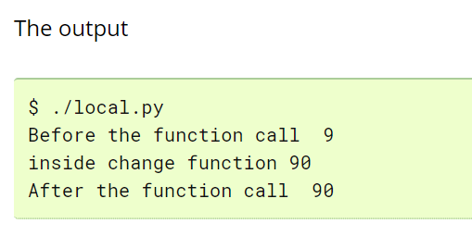
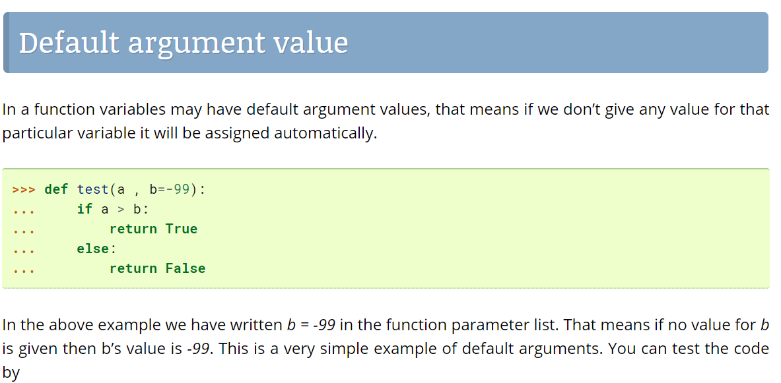

Slide 8
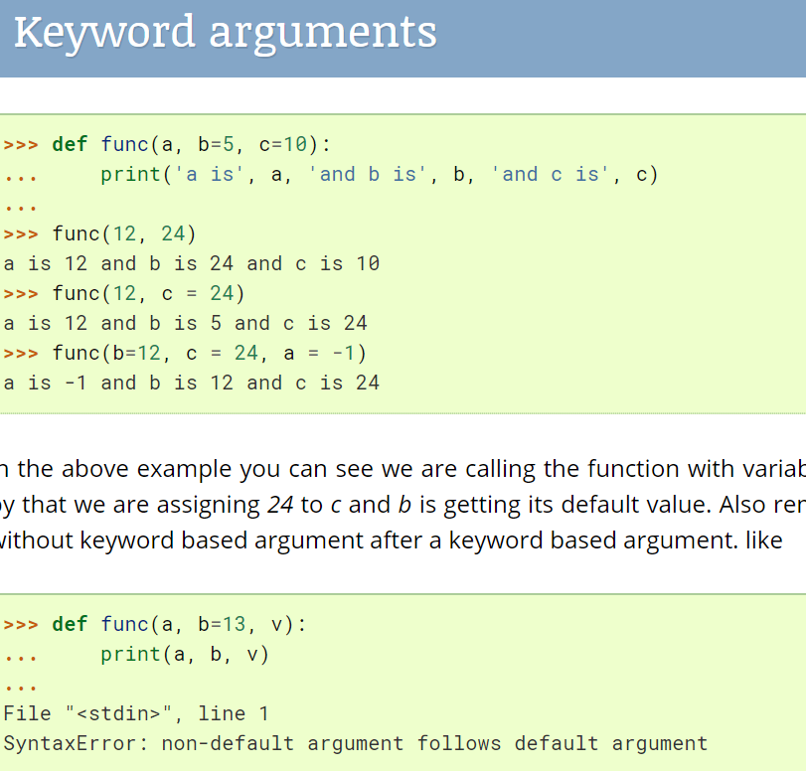

Slide 9
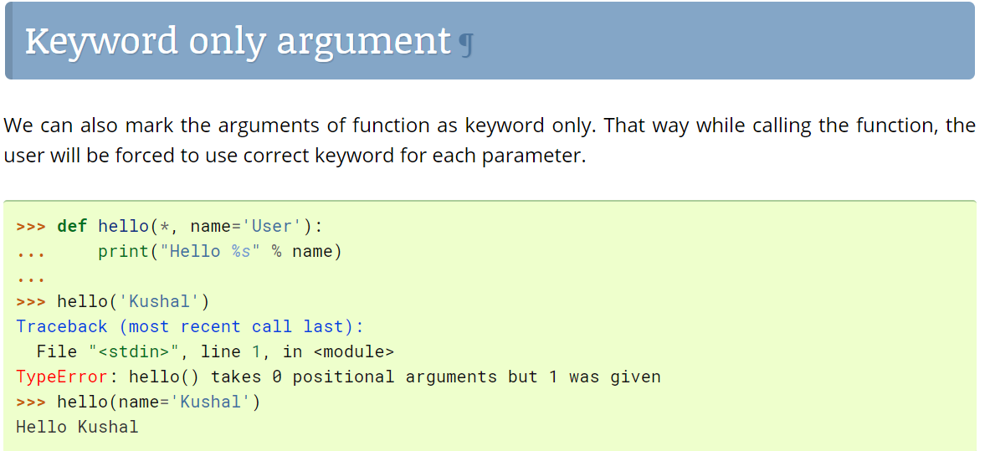

Slide 10
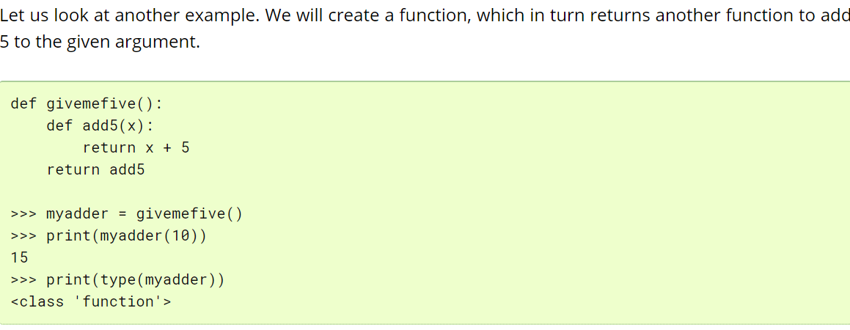
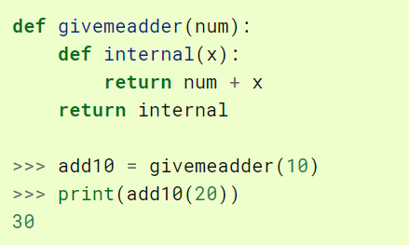

Slide 11
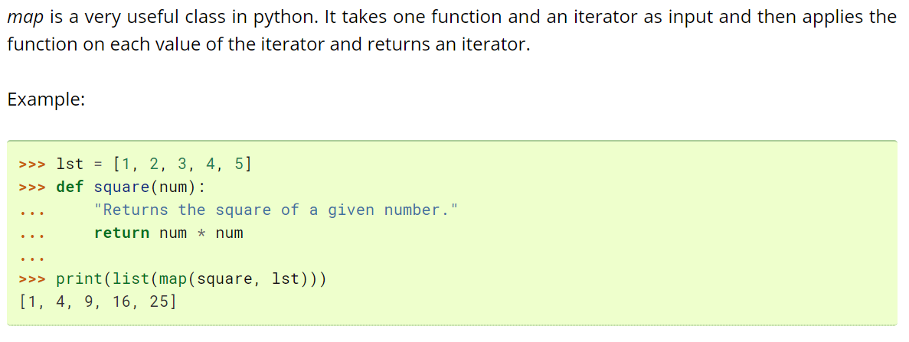
Map Function

Slide 12
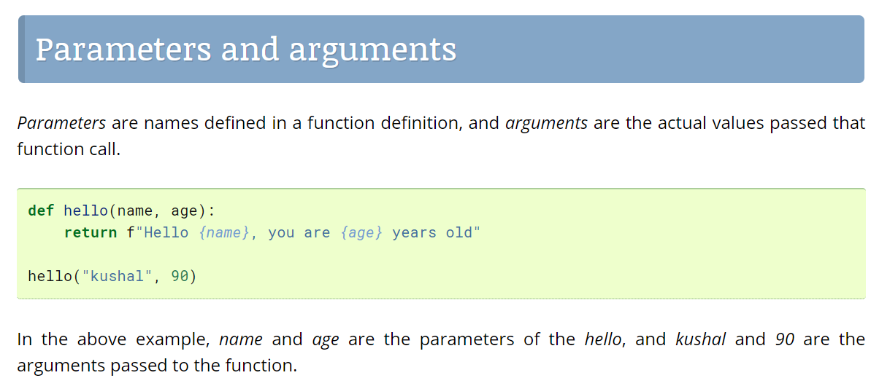

Slide 13
