Slide 1
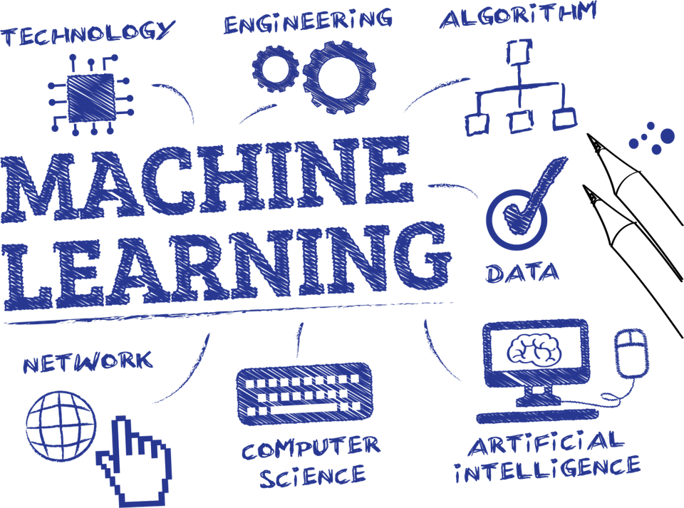
Basic of Machine learning
What is machine learning?
Introduction to machine learning algorithms
Introduction to machine learning languages

Slide 2
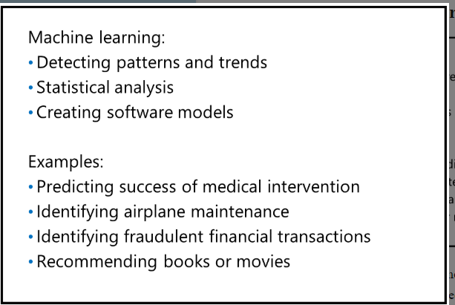
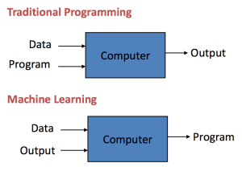
What is Machine learning?
Machine learning is an application of artificial intelligence (AI) that provides systems the ability to automatically learn and improve from experience without being explicitly programmed. Machine learning focuses on the development of computer programs that can access data and use it learn for themselves.

Slide 3
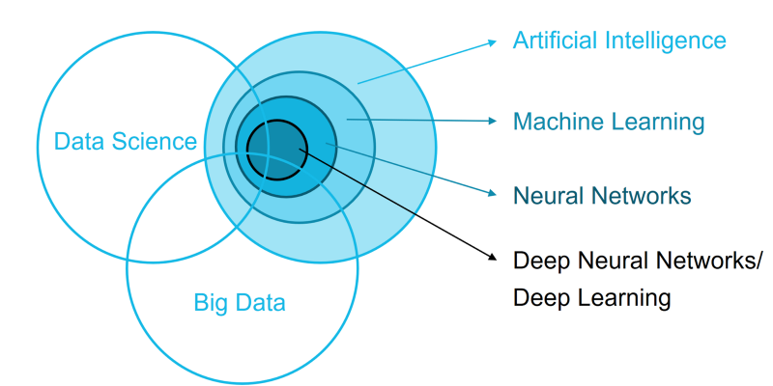
How machine learning fits into data science?
Is something X or Y?
What is likely to be the numerical value of X or Y?
Is something out of the ordinary or unexpected?
How is this data structured?

Slide 4
The key steps in using and building machine learning models:
Obtain raw data
Preprocess the data
Prepare the data
Apply one or more machine learning algorithms to the data
Determine the best model to use
Deploy the model

Slide 5
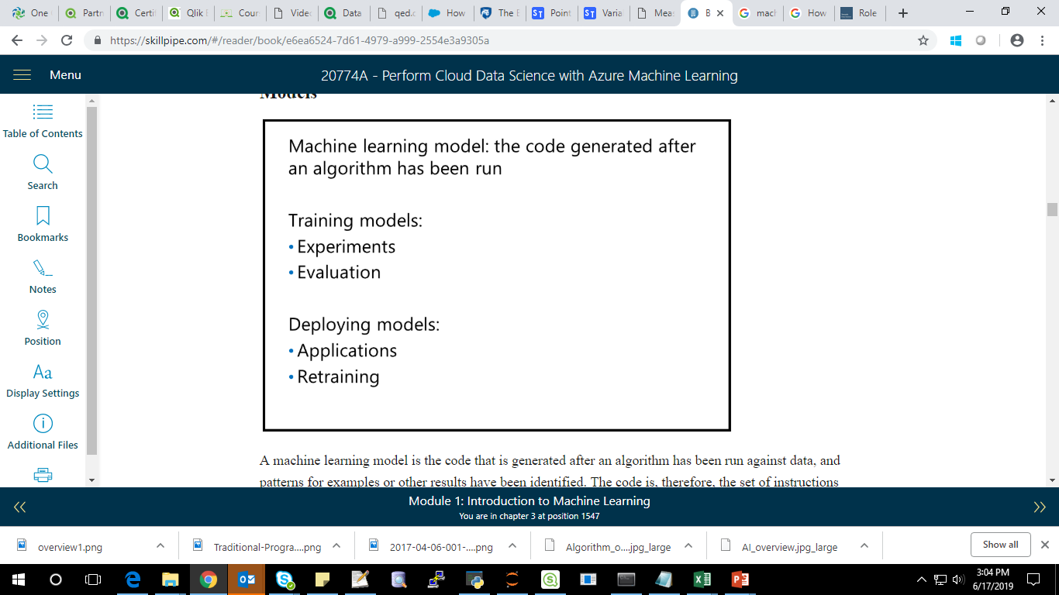
Models:

Slide 6
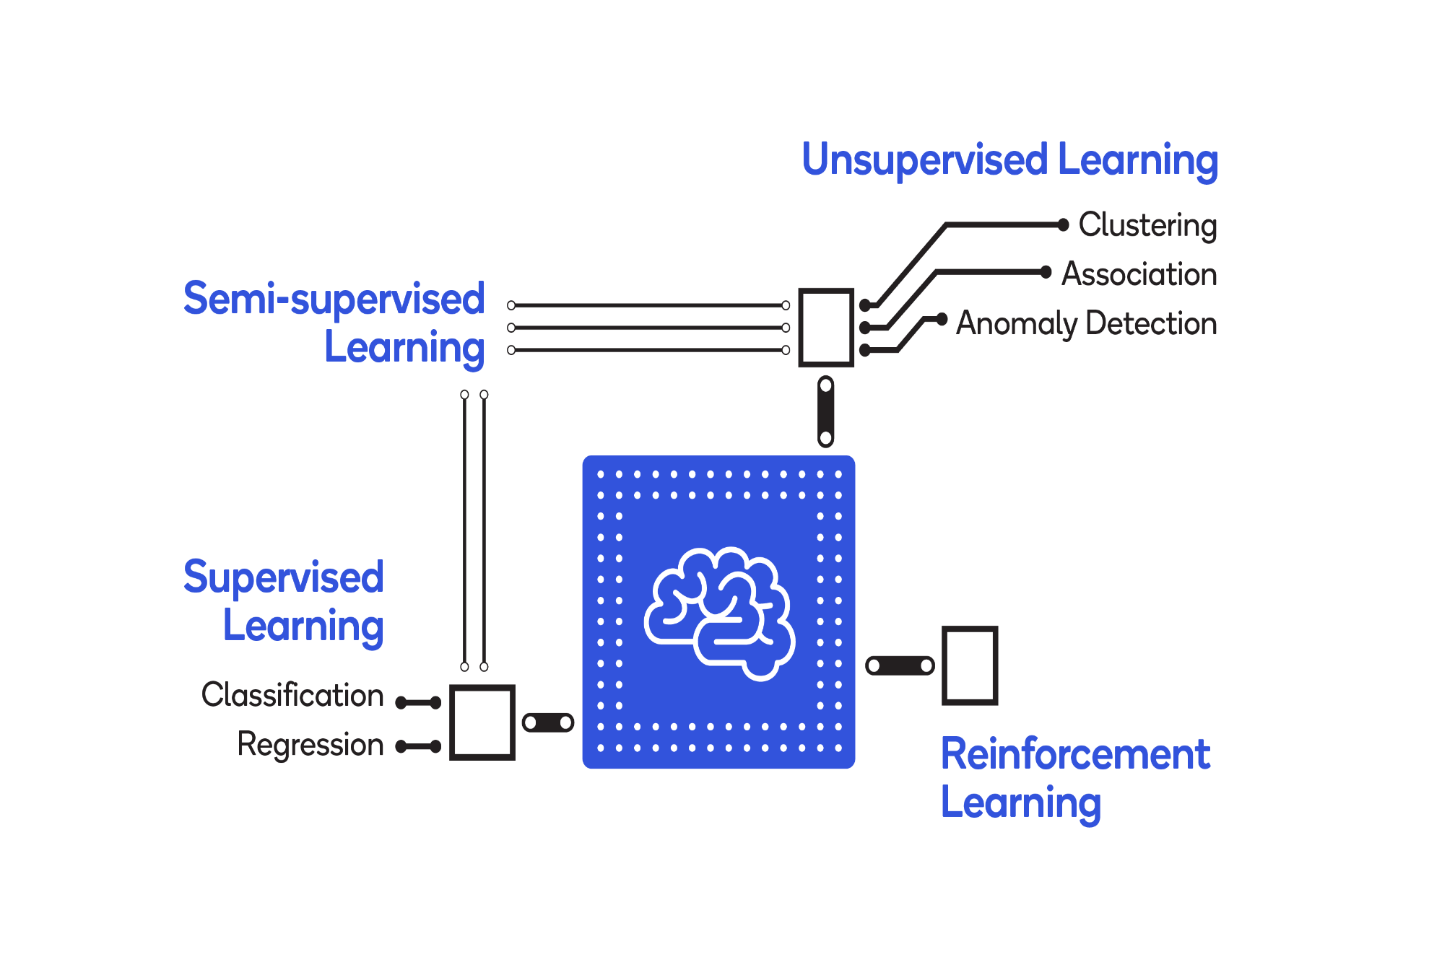
Introduction to machine learning algorithms:

Slide 7
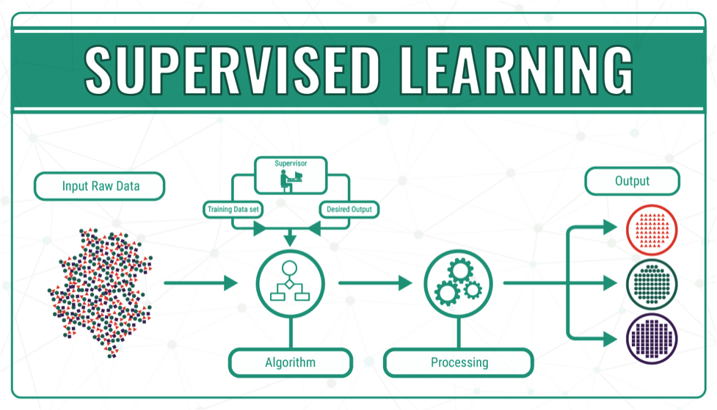
Supervised Learning:
Supervised learning as the name indicates the presence of a supervisor as a teacher. Basically supervised learning is a learning in which we teach or train the machine using data which is well labeled that means some data is already tagged with the correct answer. After that, the machine is provided with a new set of examples(data) so that supervised learning algorithm analyses the training data(set of training examples) and produces a correct outcome from labeled data.

Slide 8
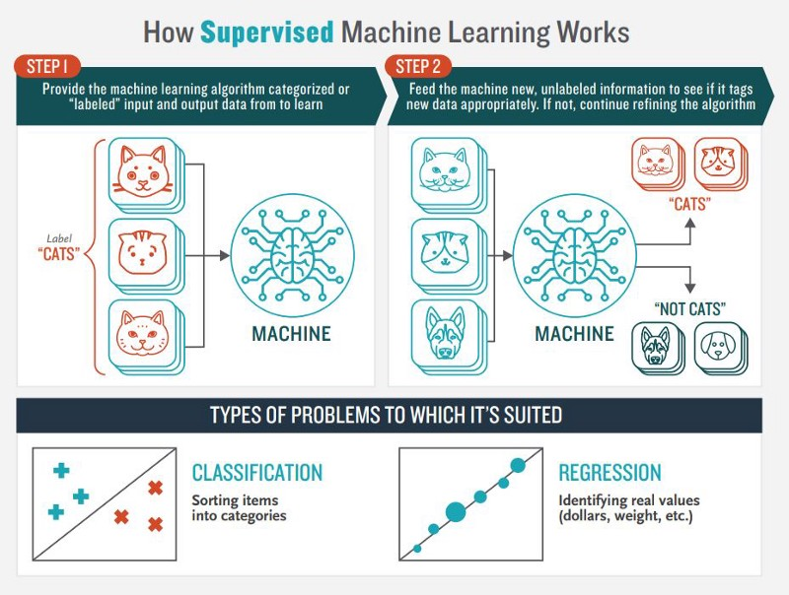
Types of Supervised learning:
Classification: A classification problem is when the output variable is a category, such as “Red” or “blue” or “disease” and “no disease”.
Regression: A regression problem is when the output variable is a real value, such as “dollars” or “weight”.

Slide 9
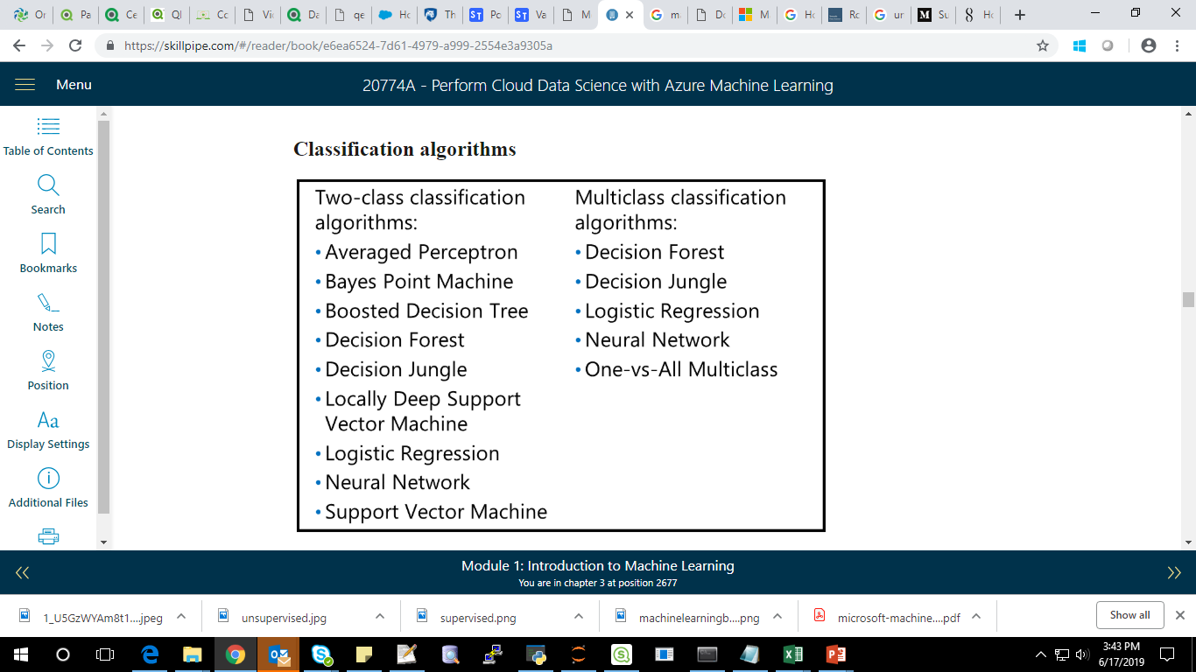
Algorithms used for supervised learning:

Slide 10
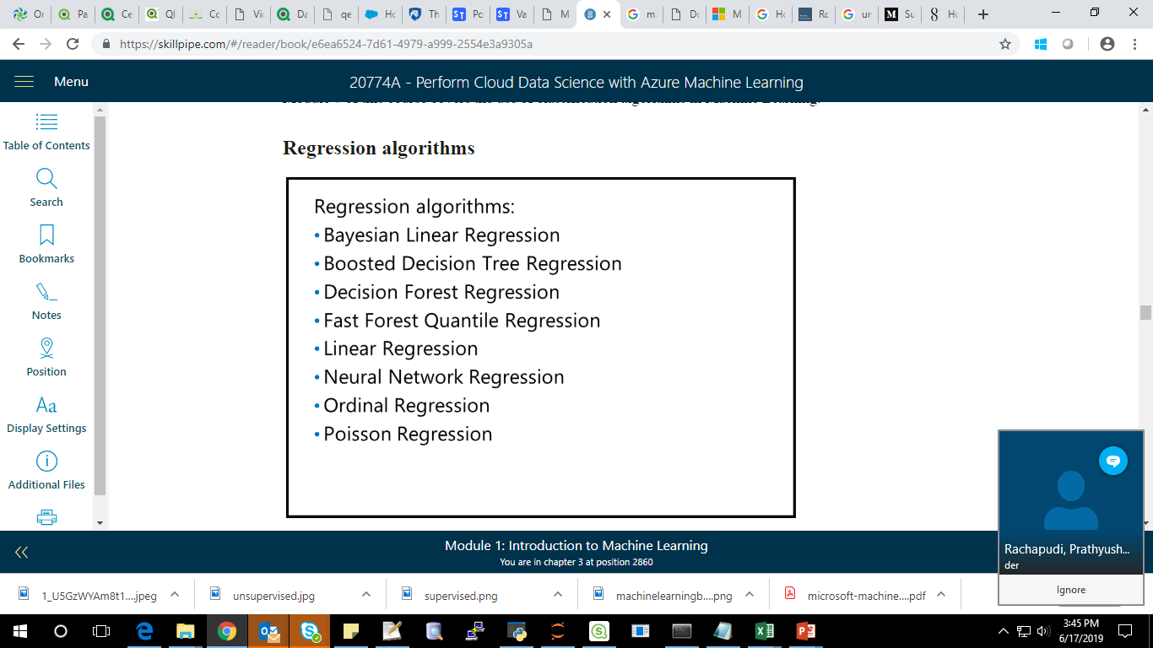

Slide 11
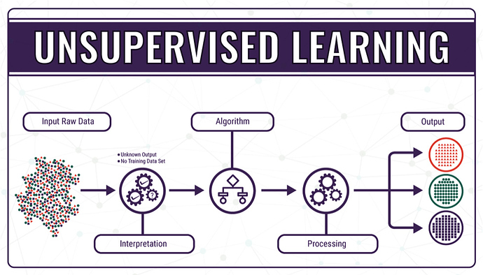
Unsupervised learning:
Unsupervised learning is the training of machine using information that is neither classified nor labeled and allowing the algorithm to act on that information without guidance. Here the task of machine is to group unsorted information according to similarities, patterns and differences without any prior training of data.
Unlike supervised learning, no teacher is provided that means no training will be given to the machine. Therefore machine is restricted to find the hidden structure in unlabeled data by our-self.

Slide 12
Clustering:
Algorithms used for Unsupervised learning in Azure is :
K-means clustering.
Kindly find the Machine learning algorithm Cheat sheet in below link:
https://docs.microsoft.com/en-us/azure/machine-learning/studio/algorithm-cheat-sheet

Slide 13
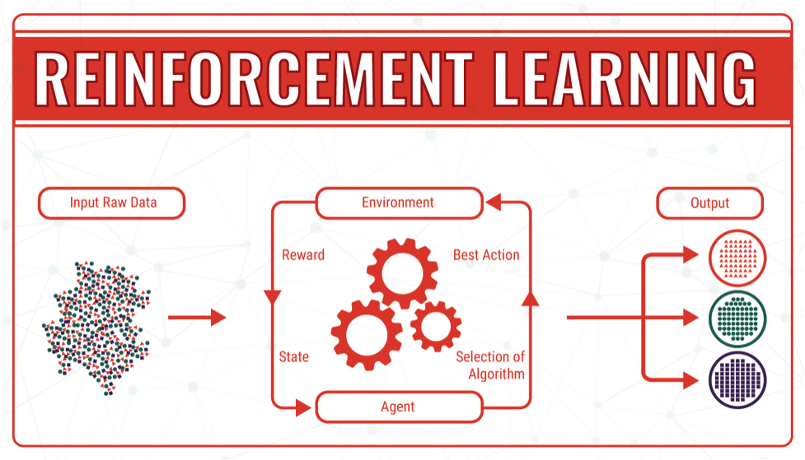
Reinforcement Learning:
Unlike supervised learning , the model self learn through feedback.

Slide 14
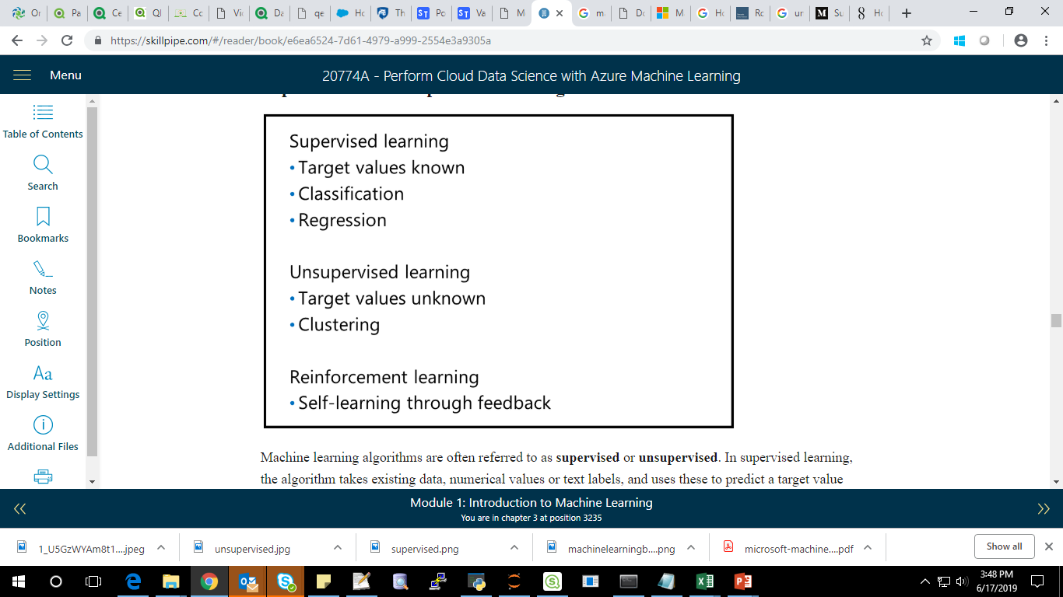
Summary:

Slide 15
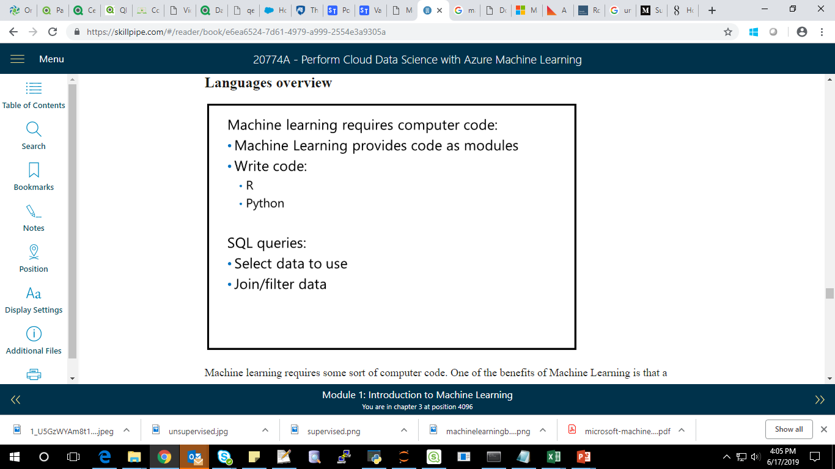
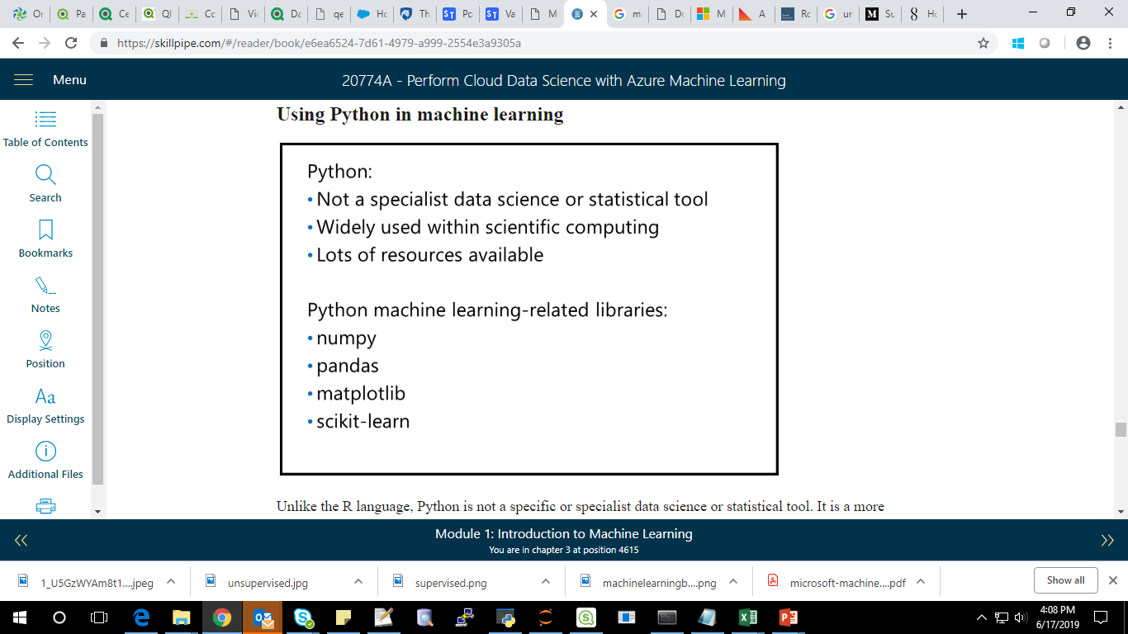
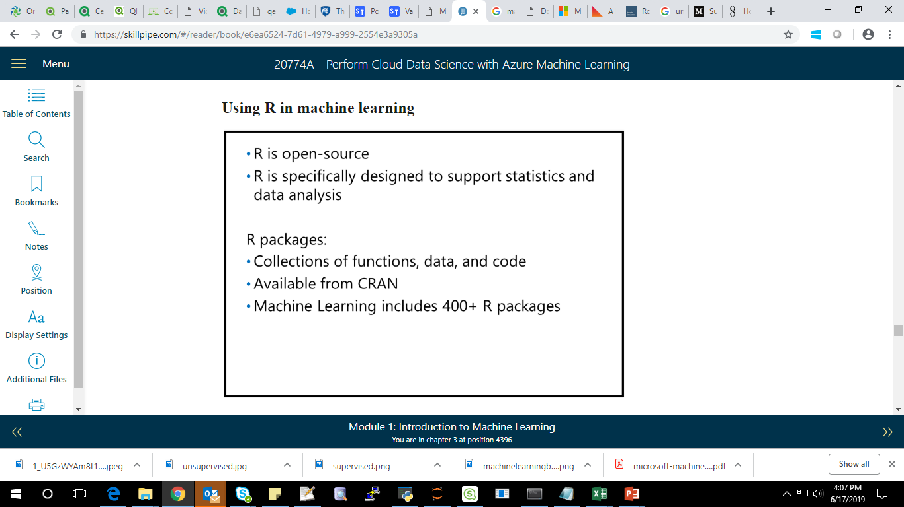
Introduction to machine learning languages:

