Slide 1
* RECOMMENDER SYSTEM ANALYSIS FOR MOVIELENS DATASET
A study of Recommender Algorithms for MovieLens dataset – Prepared for Springboard ‘Foundations of Data Science’ course Capstone project
PREPARED BY - VIJAY RAGHUNATH
MENTORED BY – AMIT DHINGARE

Slide 2
The Problem Statement
Analyze and recommend best suited algorithms for implementing a recommendation engine to MovieLens dataset.
The proposed framework for recommendation engine can be expanded to large variety of practical problems where real-time recommendations can play a big role in increasing customer base and impact sales.

Slide 3
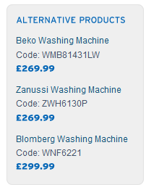
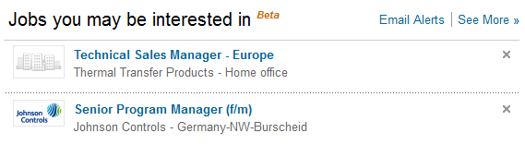
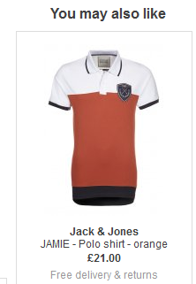

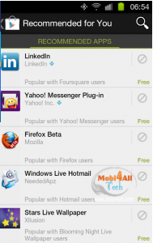

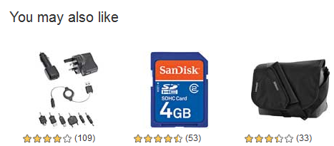
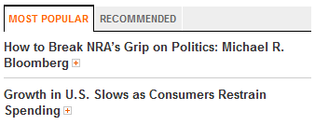
The Problem Statement (2)
Some of the practical applications –

Slide 4
Dataset being analyzed
As recommendation engines have been successfully implemented to recommend movies. For this project we analyze the MovieLens dataset.
The MovieLens dataset The MovieLens datasets are widely used in education, research, and industry.

Slide 5
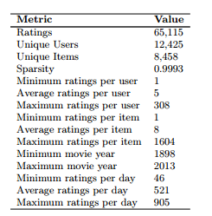
Dataset being analyzed (2)
These datasets are a product of member activity in the MovieLens movie recommendation system, an active research platform for building super efficient recommendation engines.
Some dataset metric of the MovieLens dataset is tabulated below.

Slide 6
Software used for the Recommender
We choose R – Statistical programming language as it provides a package, ‘RecommenderLab’ that helps in fast prototyping of recommendation algorithms.
By using the algorithms available in Recommenderlab package, we can achieve 2-fold purpose:
Predict the ratings for the movies that the user has not seen.
After having predicted all the ratings for the user, we can make a top-N recommendation for the users. This top-N recommendation list can be further drilled down for the genre preferred by the user.

Slide 7
Approaches to Recommender Engine
Basically there are approaches for recommendation engines
Collaborative Filtering (a.k.a. social filtering)
Content-based

Slide 8
Approaches to Recommender Engine (2)
Collaborative Filtering -
Maintain a database of many users’ ratings of a variety of items.
For a given user, find other similar users whose ratings strongly correlate with the current user.
Recommend items rated highly by these similar users, but not rated by the current user.
Almost all existing commercial recommenders use this approach (e.g. Amazon).

Slide 9
Approaches to Recommender Engine (3)
Problems with Collaborative Filtering -
Cold Start: There needs to be enough other users already in the system to find a match.
Sparsity: If there are many items to be recommended, even if there are many users, the user/ratings matrix is sparse, and it is hard to find users that have rated the same items.
First Rater: Cannot recommend an item that has not been previously rated.
New items
Esoteric items

Slide 10
Approaches to Recommender Engine (3)
Popularity Bias: Cannot recommend items to someone with unique tastes.
Tends to recommend popular items.

Slide 11
Approaches to Recommender Engine (4)
Content-based Filtering -
Recommendations are based on information on the content of items rather than on other users’ opinions.
Uses a machine learning algorithm to induce a profile of the users preferences from examples based on a featural description of content
Some previous applications:
Newsweeder (Lang)
Syskill and Webert (Pazzani et al.,)

Slide 12
Approaches to Recommender Engine (5)
Advantages with Content-based Filtering –
No need for data on other users.
No cold-start or sparsity problems.
Able to recommend to users with unique tastes.
Able to recommend new and unpopular items.
No first-rater problem.
Can provide explanations of recommended items by listing content-features that caused an item to be recommended..

Slide 13
Approaches to Recommender Engine (6)
Problems with Content-based Filtering -
Requires content that can be encoded as meaningful features.
Users’ tastes must be represented as a learnable function of these content features.
Unable to exploit quality judgments of other users. Unless these are somehow included in the content features.

Slide 14
Implementing the Recommender algorithms
Data Pre-processing stage -
Select the relevant data - In order to select the most relevant data, the minimum number of users per rated movie is defined as 50 and the minimum views number per movie as 50.
Normalize the data - Having users who give high (or low) ratings to all their movies might bias the results. In order to remove this effect, we normalize the data in such a way that the average rating of each user is 0.

Slide 15
Implementing the Recommender algorithms (2)
Binarize the data - Some recommendation models work on binary data, so it might be useful to binarize the data, that is, define a table containing only 0s and 1s. The 0s will be either treated as missing values or as bad ratings. We can either:
Define a matrix having 1 if the user rated the movie, and 0 otherwise. In this case, the information about the rating is lost.
Define a matrix having 1 if the rating is above or equal to a definite threshold (for example, 3), and 0 otherwise. In this case, giving a bad rating to a movie is equivalent to not having rated it.

Slide 16
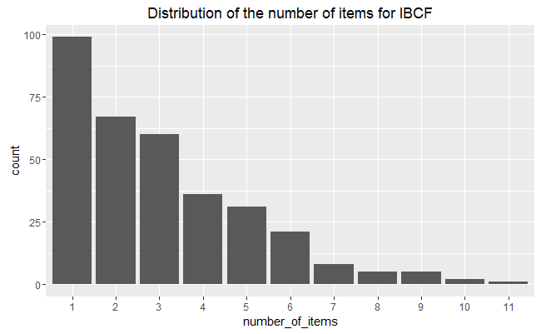
Recommender Algorithm 1 -ITEM-based Collaborative Filtering Model
We build the model using 80% of the whole dataset as a training set and 20% as a test.
Most of the movies have been recommended only a few times, and a few movies have been recommended more than 5 times.

Slide 17
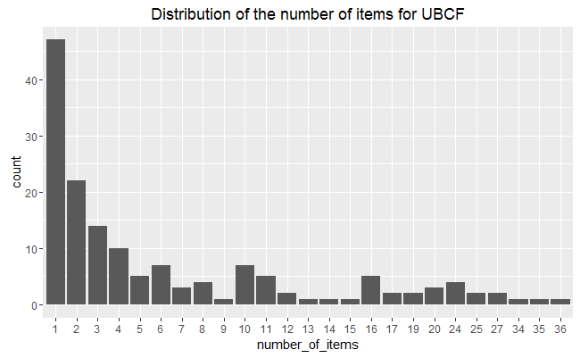
Recommender Algorithm 2 -USER-based Collaborative Filtering Model
Compared with the IBCF, the distribution has a longer tail. This means that there are some movies that are recommended much more often than the others. The maximum is more than 30, compared to 10-ish for IBCF.

Slide 18
Comparing the results of IBCF and UBCF
UBCF needs to access the initial data. Since it needs to keep the entire database in memory, it doesn’t work well in the presence of a big rating matrix. Also, building the similarity matrix requires a lot of computing power and time.
However, UBCF’s accuracy is proven to be slightly more accurate than IBCF so it’s a good option if the dataset is not too big

Slide 19
Evaluating the Recommender Systems
In order to compare different models, we define them as a following list –
Item-based collaborative filtering, using the Cosine as the distance function
Item-based collaborative filtering, using the Pearson correlation as the distance function
User-based collaborative filtering, using the Cosine as the distance function
User-based collaborative filtering, using the Pearson correlation as the distance function
Random recommendations to have a base line

Slide 20
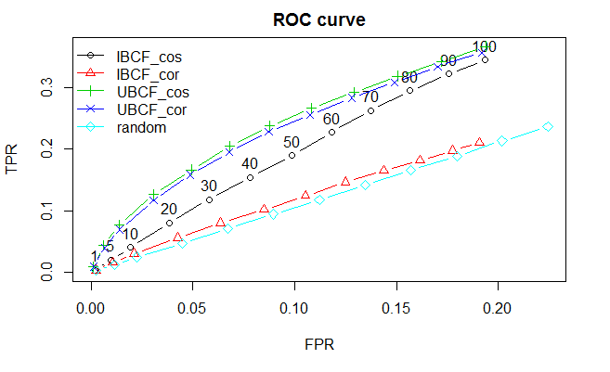
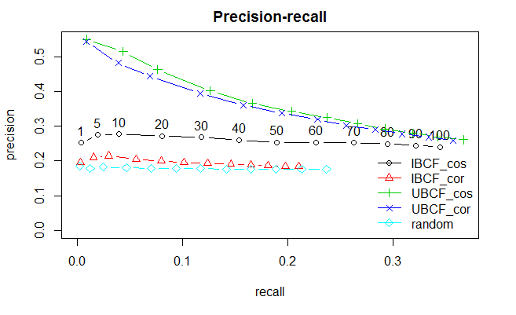
Identifying the right model
A good performance index is the area under the curve (AUC), that is, the area under the ROC curve. The chart shows that the highest is UBCF with cosine distance, so it’s the top model. Depending on what is the main purpose of the system, an appropriate number of items to recommend should be defined

Slide 21
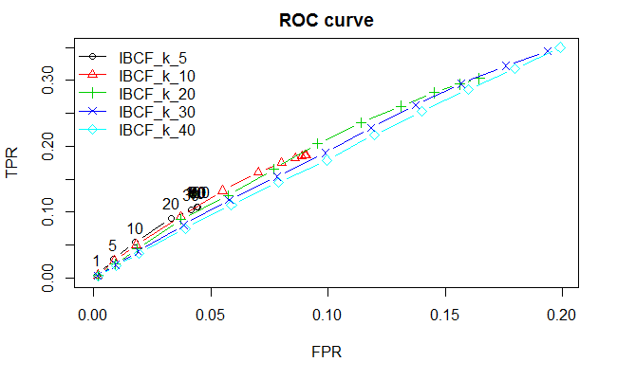
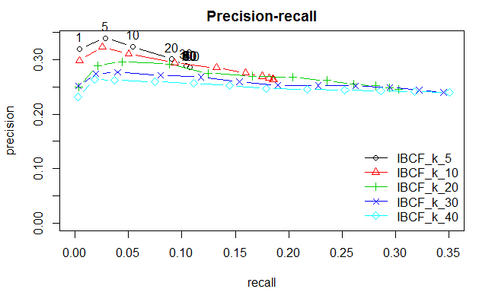
Identifying the right model
IBCF takes account of the k-closest items. I will explore more values, ranging between 5 and 40, in order to tune this parameter:
Based on the ROC curve’s plot, the k having the biggest AUC is 10.
Another good candidate is 5, but it can never have a high TPR. This means that, even if we set a very high n value, the algorithm won’t be able to recommend a big percentage of items that the user liked. The IBCF with k = 5 recommends only a few items similar to the purchases. Therefore, it can’t be used to recommend many items.
Based on the precision/recall plot, k should be set to 10 to achieve the highest recall. If we are more interested in the precision, we set k to 5.

Slide 22
Identifying the right model
Based on the ROC curve’s plot, the k having the biggest AUC is 10.
Another good candidate is 5, but it can never have a high TPR. This means that, even if we set a very high n value, the algorithm won’t be able to recommend a big percentage of items that the user liked. The IBCF with k = 5 recommends only a few items similar to the purchases. Therefore, it can’t be used to recommend many items.
Based on the precision/recall plot, k should be set to 10 to achieve the highest recall. If we are more interested in the precision, we set k to 5.

Slide 23
The Road Ahead!
Hybrid Recommender Systems –
A major problem with the item based approach is its accuracy and narrow focus. The recommendations may not be very interesting or unique. Many of the recommendations are already known to the user.
A major problem with the user based approach filtering is that it suffers from cold start problems. Many users who are just starting out won’t receive accurate recommendations or any recommendations at all – until enough data is gathered from the community of users.

Slide 24
The Road Ahead (2)!
By combining the item-based and user-based collaborative filtering, a hybrid recommender system can overcome each ones’ shortcoming.
It can start by using the item-based approach to avoid the cold-start problem. Once enough data is collected from the community of users, the system can use the collaborative filtering approach to produce more interesting and personalized recommendations.

Slide 25
The Road Ahead! (3)
Improving precision with constant feedback –
One way to improve the precision of the systems’ recommendations is to ask for customer feedback. We can build a web server that implements the recommendation algorithms. When the customer browses the movie set, the recommendation engine can give its recommendations to the user and ask for user feedback on the recommendations. Also it can ask for the viewers to rate the movies, they have already seen. The recommendation engines can use this data to make more precise recommendations.

Slide 26
The Road Ahead! (4)
Uplifting the Recommender Model –
Uplift modeling, also called true lift modeling and net modeling among other terms, aims to fine tune recommender models that target only the viewers who can be persuaded to watch the movie.
This approach can be used to develop a focused target marketing model that can maximize the revenues by personalized contacts and promotions to the viewer.

Slide 27
Thank you!

