Slide 1


A WEB BASED APPLICATON FOR PREDICTING LIVER DISEASE USING MACHINE LEARNING
PRESENTED BY
SWETHA M (921317104219)
SRI HARINI G J (921317104212)
VARNAMALYA G (921317104234)
VIJAY RAJ K (921317104241)
GUIDE NAME
Dr. N. UMA MAHESWARI, M.E., Ph.D.,
PROFESSOR,
DEPARTMENT OF CSE,
PSNACET.

Slide 2
Introduction
Liver cancer is a life‐threatening malignant disease, and the number of new cases of liver cancer increased by 75% between 1990 and 2015 according to the Global Burden of Disease Study (GBD 2015).
In 2015, 854 000 new cases of liver cancer and 810 000 deaths were reported worldwide, making liver cancer the fourth leading cause of cancer‐related death, amounting to a disease burden of 20 578 000 disability‐adjusted life‐years.
Hepatocellular carcinoma (HCC) accounts for 75%‐80% of all cases of liver cancer. The 5‐year overall survival (OS) of HCC patients is 3%‐5% across all countries. Patients with stage A HCC (BCLC) have a 5‐year OS rate of 50%–75%, with different comorbidities.

Slide 3
Abstract
The proposed system will predict the HCC affected patients with Low risk or High risk of disease using Machine Learning.
The proposed system will use the dataset provided by EASL-EORTC (European Association for the Study of the Liver - European Organization for Research and Treatment of Cancer)
Build Model will be able to predict the risk of the patients about their survival.

Slide 4
Literature Survey
Title | Year of publication | Description
Developing an expert system for diagnosing liver diseases | 2019 | The three categories of disease diagnostic factors, questions corresponding sub-sections, and the response range are determined on Mockler chart, and finally, the tables are designed to express the system inference according to the user's answers to the questions.
Comparison of Machine Learning Approaches for Prediction of Advanced Liver Fibrosis in Chronic Hepatitis C Patients | 2017 | Age, platelet count, AST, and albumin were found to be statistically significant to advanced fibrosis. The machine learning algorithms under study were able to predict advanced fibrosis in patients with HCC with AUROC ranging between 0.73 and 0.76 and accuracy between 66.3% and 84.4%

Slide 5
Literature Survey
Title | Year of Publication | Description
Hepatocellular carcinoma: current trends in worldwide epidemiology, risk factors, diagnosis, and therapeutics | 2012 | Liver transplantation and surgical resection remains the cornerstone of curative treatment. But major advances in locoregional therapies and molecular-targeted therapies for the treatment of advanced HCC have occurred recently. In this review, current trends in the worldwide epidemiology, surveillance, diagnosis, standard treatments, and the emerging therapies for HCC are discussed.
Computer aided diagnosis system developed for ultrasound diagnosis of liver lesions using deep learning | 2019 | The accuracy of this 2-class classification CADx was 94.8%, the sensitivity was 93.8%, and the specificity was 95.2%. Both 4-class classification and 2-class classification CADx had relatively high accuracy. However, in this study, we used only a small amount data collected from a single facility. In the future, we plan to verify our results using a larger amount of data collected from multiple facilities. In addition, we prototyped CAD software and are currently developing it with feedback from doctors.

Slide 6
Existing System
Hepatocellular carcinoma (HCC) is closely associated with abnormal DNA methylation.
In this study, our model is used to analyze 450K methylation chip data from 377 HCC samples and 50 adjacent normal samples in the TCGA database.
Our model screened 47,099 differentially methylated sites using Cox regression as well as SVM‐RFE and FW‐SVM algorithms, and constructed a model using three risk categories to predict the overall survival based on 134 methylation sites.
The model showed a 10‐fold cross‐validation score of 0.95 and satisfactory predictive power, and correctly classified 26 of 33 samples in testing set obtained by stratified sampling from high, intermediate and low risk groups.

Slide 7
Proposed System
The proposed system will predict the risk factor of the HCC affected patients using Machine Learning.
Logistic Classification will be used to classify the processed dataset.
Challenge of the work is only 8 percent of data has fully filled data.
Pre-processing and correct replacement of missing value with different attribute type will improve the model.

Slide 8
Architecture Diagram

Slide 9
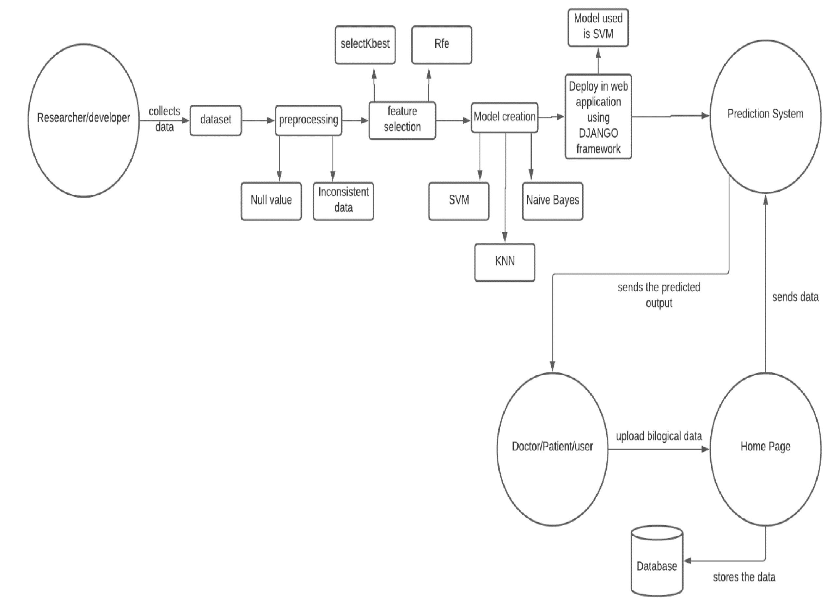

Slide 10
Module Split UP
Module 1:Data Collection
To achieve the goal, Data Engineering is the first step. Data Engineering consists of two processes, they are Data Collection and Data Pre-processing. Data Collection will be collected with meaningful parameters like age, blood test and so on.
Module 2:Data Pre-processing
Collected data will be pre-processed which means encoding the categorical information in the data. Dropping unwanted parameters, scaling the parameter values to achieve normal distribution (Zero mean and Standard Deviation as one), handling missing values and so on.
Module 3: Feature Engineering
After the Data Engineering process, Feature Engineering will be done. Feature Engineering is an important step to predict our output. The advantage of Feature Engineering is minimizing the parameter. For example, if our whole dataset contains 10 parameters, after feature engineering only three-parameter enough to predict the output with high efficiency. Feature Engineering based on correlation, co-variance, co-linearity and etc. Feature Engineering has many algorithms to predict correct correlated parameters.

Slide 11
Module 4: Machine Learning Algorithm
After the Feature engineering process, with selected features several Machine Learning Algorithm will be tested. Machine Learning Algorithms are Support Vector Machine, K-NN, Random Forest, Decision Tree, and Logistic. Accuracy of the model calculated by the confusion matrix.
Module 5: Selection Of best Model
The final model will be optimized by selecting the best accuracy of the algorithm. This model helps to find the prediction of liver disease.
Module 6:Web Development
The trained model will be saved and loaded for web development. With the help of a built model and with a selected feature our model can be able to predict the liver disease. Web development will have an input variable of selected features, by submitting the answer of the selected feature, the prediction will be done.

Slide 12
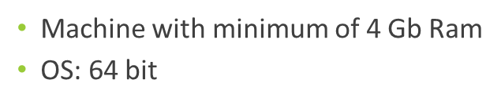
Software Requirement
Programming Language : Python
Web development:
Framework: Django
Front-End: Bootstrap, HTML, CSS
Hardware Requirement

Slide 13
Data Pre-processing: Feature input data type
Dataset contains= 49 feature input +1 output class
Nominal data type feature input=23
Ordinal data type feature input= 3
Continuous data type feature input= 22
Integer=1
Output class type= Nominal

Slide 14
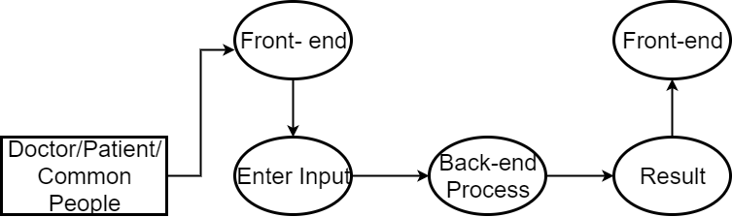
Data Flow Diagram

Slide 15
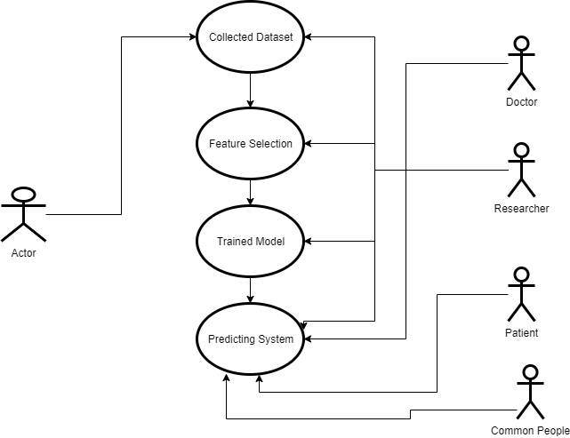
Use Case Diagram

Slide 16
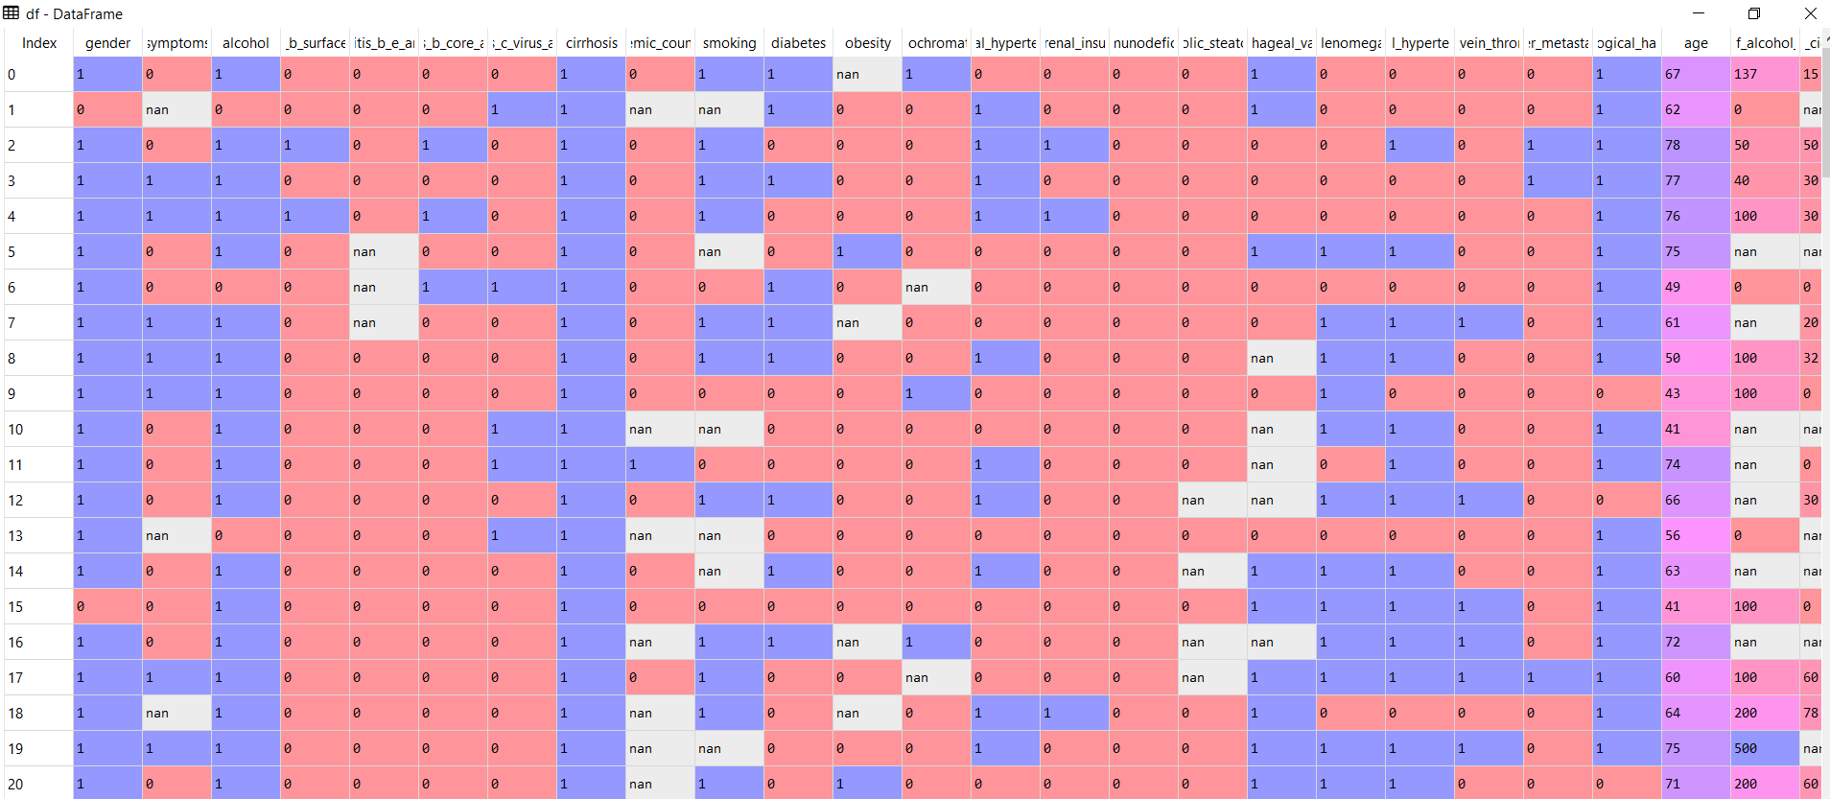
Data Pre-processing: Raw Data

Slide 17
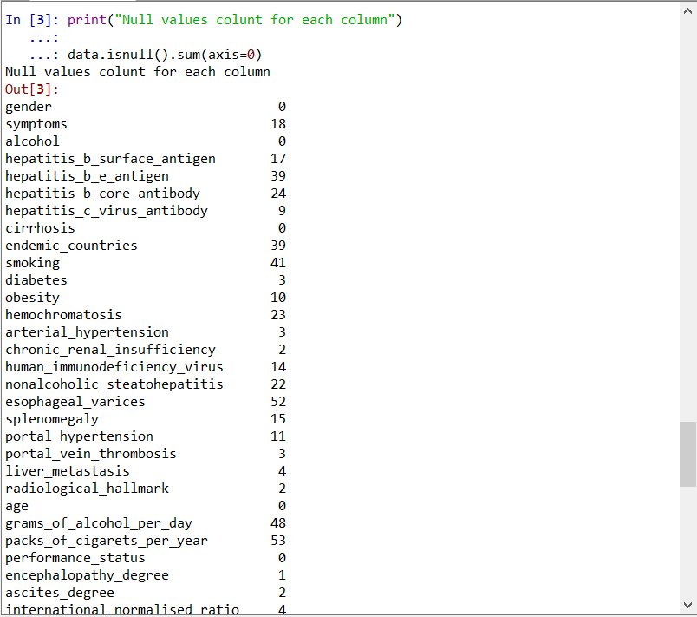
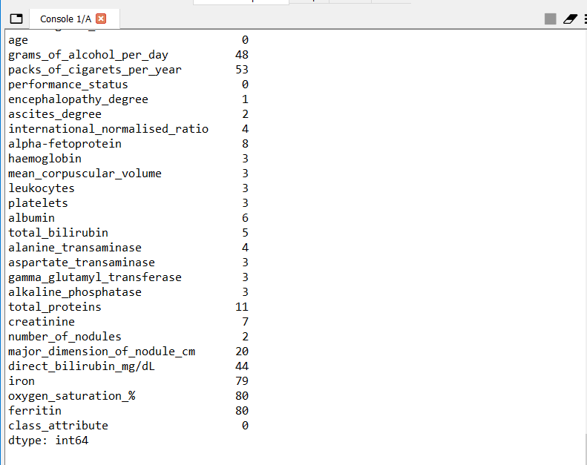
Data Pre-processing: Null value count in each feature input

Slide 18
Data Pre-processing Technique for each data type
Nominal Data type | Continuous Data type | Ordinal Data type | Integer
Using class output value finding out maximum used feature value | Using Knn algorithm missed values are filled | Using class output value finding out maximum used feature value | Using mean, missed value are filled.
- | - | Ordinal Data type was binarized which remove dummies variable | -

Slide 19
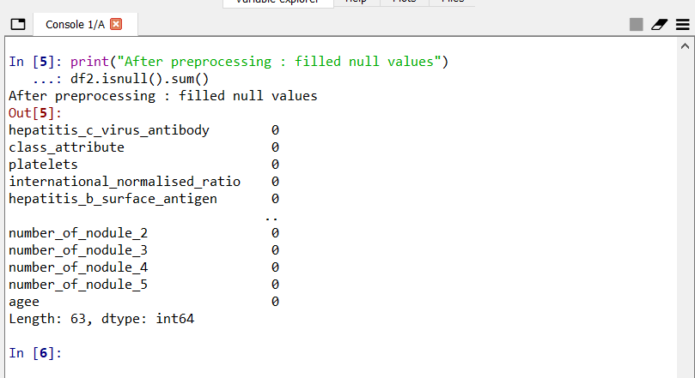
Data Pre-processing: After pre-processing

Slide 20
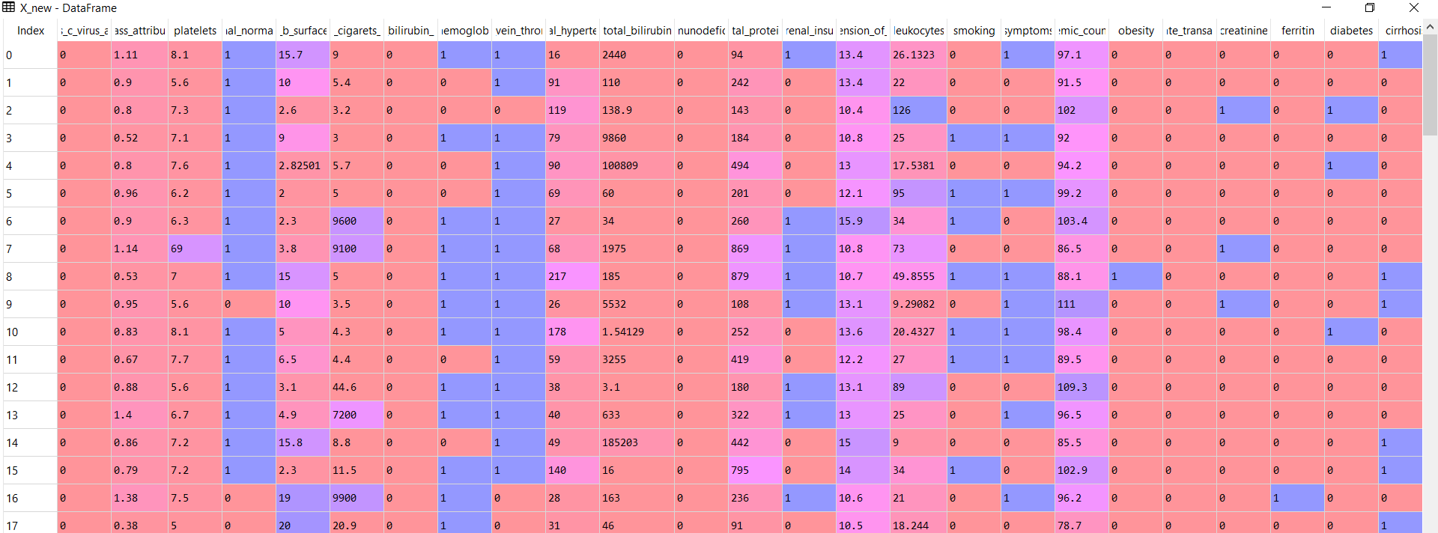
Data Pre-processing: After pre-processing

Slide 21
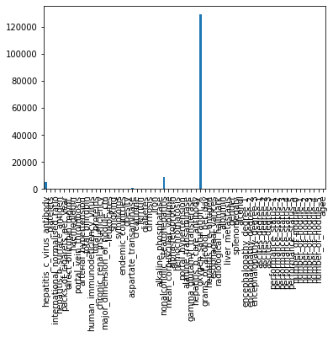
Feature Select

Slide 22
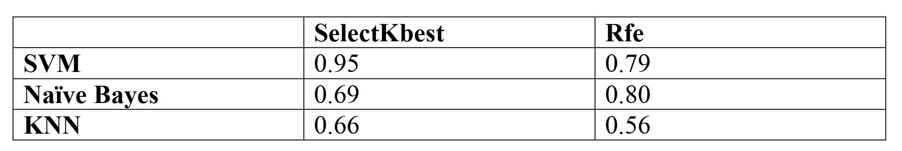
Comparison Table

Slide 23
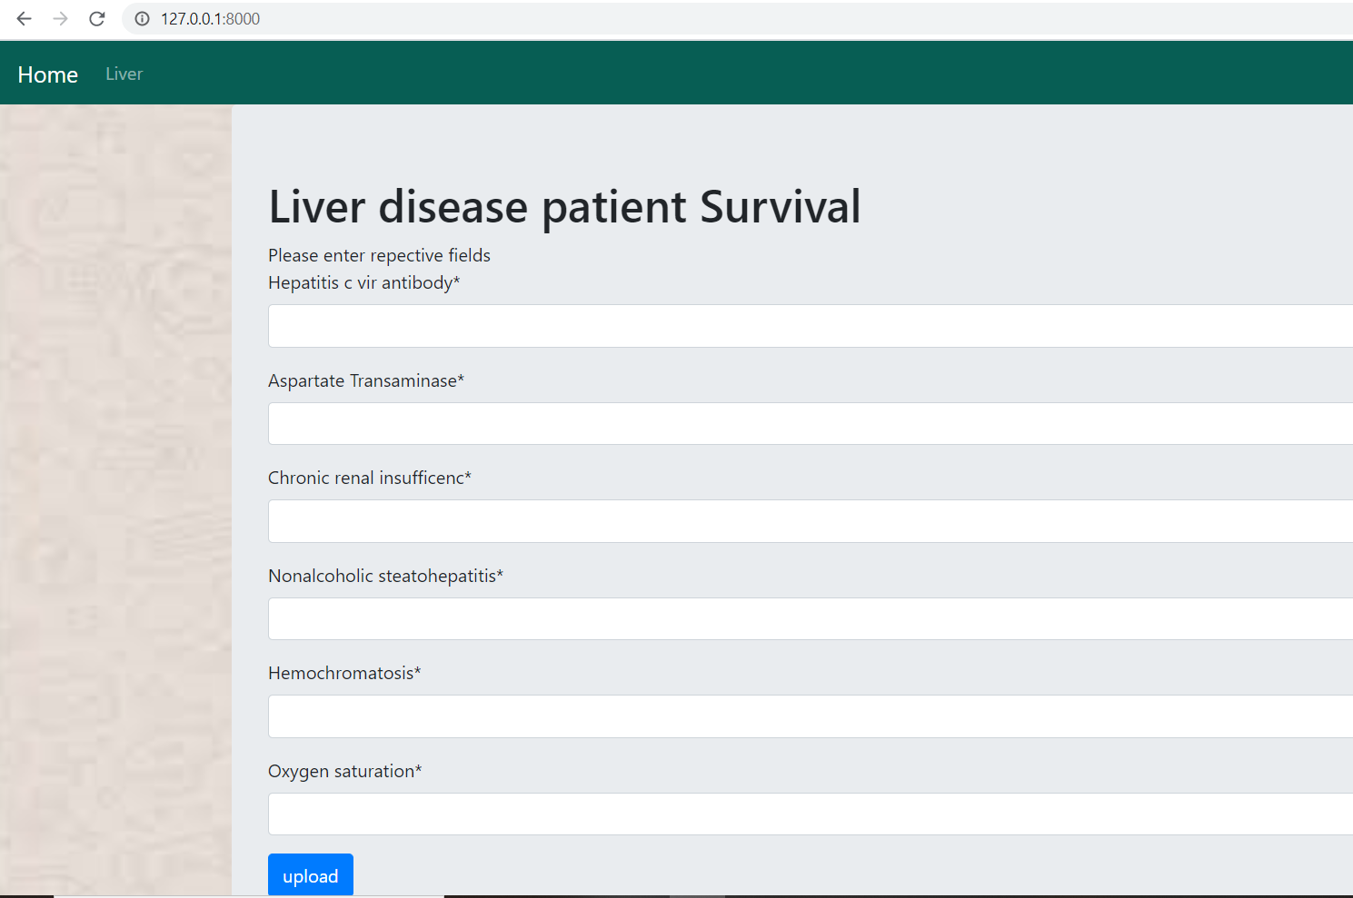
Input UI

Slide 24
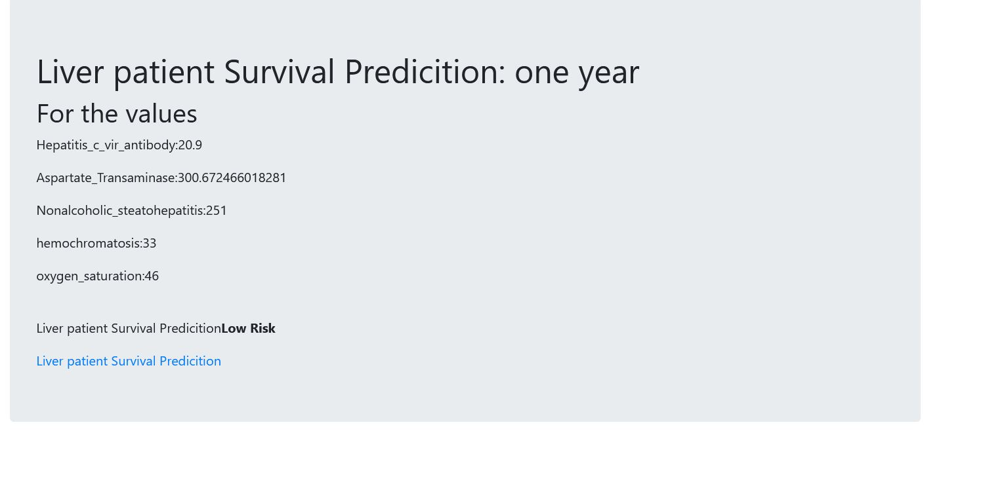
Output UI

Slide 25
Conclusion
The HCC affected person’s risk factor was classified with Support Vector Machine .
This was achieved with feature selection method select-K parameter with chi square. The effective five features was selected from 50 features using feature selection method. The result achieved was 95% accuracy.
The trained model with SVM for 5 feature input are able to predict the low risk or high risk.
Advantage of using feature selection has eliminated the unwanted feature which may increase the blood test cost of the person.

Slide 26
Reference
[1] O. A. Gashteroodkhani, M. Majidi, M. Etezadi-Amoli, A. F. Nematollahi, B. Vahidi "A hybrid SVM-TT transform-based method for fault location in hybrid transmission lines with underground cables" Electric Power Systems Research, vol. 170, pp. 205-214, 2019.
[2] S. Aznavi, P. Fajri and A. Asrari, "Smart Home Energy Management Considering Real-Time Energy Pricing of Plug-in Electric Vehicles," in 2018 IEEE Energy Conversion Congress and Exposition (ECCE), Portland, OR, USA, 2018, pp. 67-72.
[3] O. A. Gashteroodkhani, M. Majidi, M. Etezadi-Amoli, "A Fuzzy-based Control Scheme for Recapturing Waste Energy in Water Pressure Reducing Valves" IEEE Power and Energy Society General Meeting (PESGM), pp. 1-5, Portland, OR, Aug 2018.
[4] S. Aznavi, P. Fajri and M. Rasheduzzaman, "Hierarchical Energy Management Strategy for a Community of Multi Smart Homes," in IECON 2018 - 44th Annual Conference of the IEEE Industrial Electronics Society, Washington, DC, USA, 2018, pp. 176-181.
[5] V. E. Ekong., E.A. Onibere., and A.A Imianvan A.A. (2011), Fuzzy Cluster Means System for the Diagnosis of Liver Diseases.

Slide 27
Thank you
/ˈθæŋkjuː/

