Slide 1
W06 – Desired State Configuration for IT Ops
Jason Helmick
Pluralsight,
Level: Intermediate

Slide 2
Here’s your take away
You will know what it is…
You will know how to get started…
You will know how to get advanced…

Slide 3
Goals
Architecture
Configurations
Local Configuration Manager
Resources
Custom Resources
Advanced Configurations – a present for you.

Slide 4
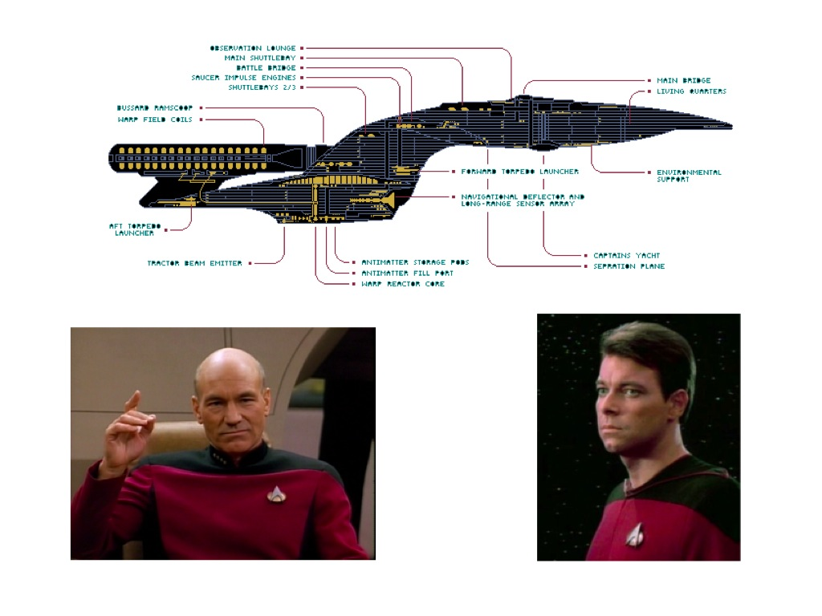
Make it so…

Slide 5
The purpose for DSC
In the words of our father…
And now Technical Fellow at MS
Distributed Heterogeneous Configuration Management Platform

Slide 6
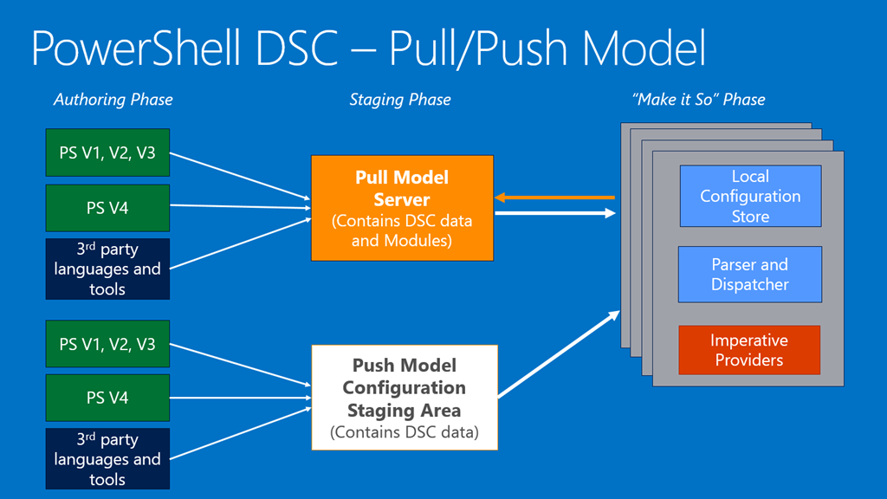
The Picture

Slide 7
THANK YOU FOR ATTENDING!!!
Additional Resources:
https://leanpub.com/the-dsc-book
Follow me on Twitter! @theJasonHelmick
https://github.com/theJasonHelmick/TechMentor2017
Don’t forget evaluations!

