Slide 1
Case Study : Humanoids
Presented by :
23BAI10917 – Vijay Rajesh R

Slide 2
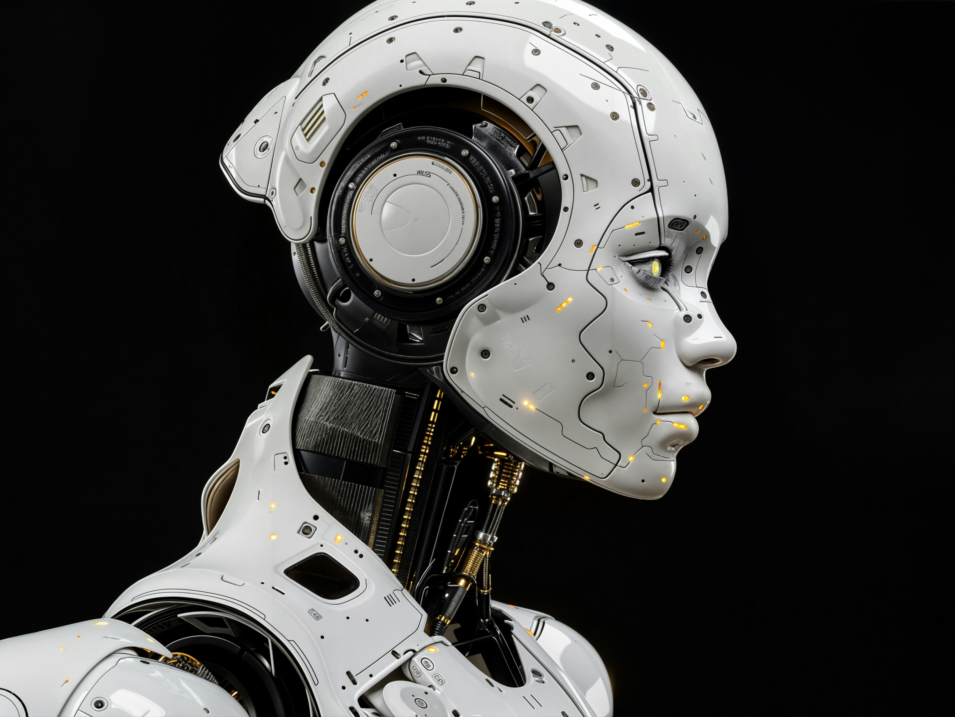
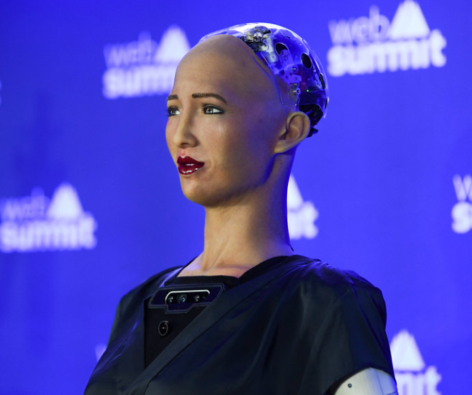
Humanoids: From Science Fiction to Factory Floor
A Case Study in the Most Transformative Technology of Our Time Speaker note: Hook the audience — "By 2035, your coworker might not be human."

Slide 3
WHAT IS A HUMANOID ROBOT?
A robot built to mimic the human body — bipedal, dexterous, sensor-equipped.
Powered by AI, actuators, cameras, LiDAR, force sensors & LLMs.
Can perceive surroundings, make decisions, and carry out complex tasks autonomously.
The key differentiator from traditional robots: human-designed environments don't need to be redesigned.

Slide 4
TIMELINE: HUMANOIDS THROUGH THE AGES
1973 — WABOT-1 (Japan) — first full-scale humanoid.
2000 — Honda's ASIMO debuts.
2013 — DARPA funds Boston Dynamics Atlas.
2021 — Tesla announces Optimus.
2024 — Figure AI raises $675M; Atlas goes fully electric.
2025 — Humanoid robots compete in the inaugural 2025 Robot Olympics in Beijing Recorded Future.
2026 — Boston Dynamics begins commercial production of Atlas; Hyundai commits tens of thousands of units

Slide 5
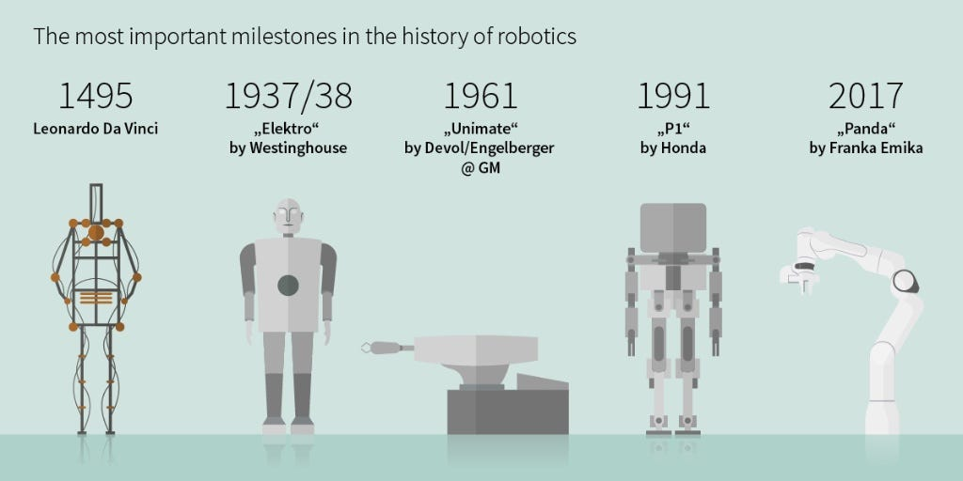

Slide 6
THE TECHNOLOGY STACK
Locomotion: Actuators + IMUs maintaining balance at 500–1000 Hz control loops.
Vision: Cameras, LiDAR, radar for 360° environmental awareness.
Touch: Tactile sensors — e.g., the Shadow Hand uses 34 sensors per fingertip to prevent crushing or dropping objects.
ArticsledgeBrain: Large Language Models (LLMs) + Large Behavior Models (LBMs) for task understanding.
Training: Simulation-to-reality via platforms like NVIDIA Isaac Sim.

Slide 7
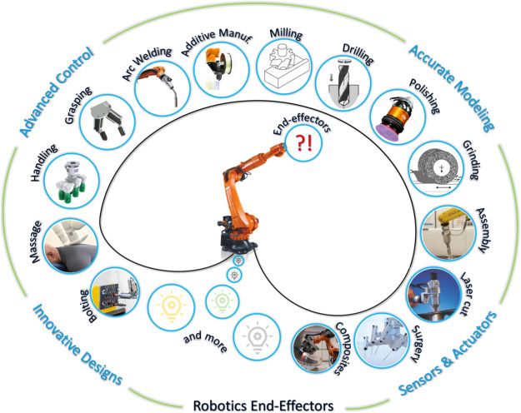

Slide 8
STUDY #1: BOSTON DYNAMICS — ATLAS
30+ years of R&D; now fully electric (2024)56 degrees of freedom, 50 kg lift capacity; partners with Google DeepMind on foundation models.
Robozaps Autonomous capability: Atlas can learn from its environment and push knowledge to other units in a fleet.
The Register Killer feature: Autonomous battery swapping = 24/7 industrial uptime.
Deployed at Hyundai's Georgia facility; estimated ~$140,000/unit

Slide 9
STUDY #2: TESLA — OPTIMUS
Built on Tesla's FSD (Full Self-Driving) neural networks + xAI's Grok LLM.
Gen 3 hands feature 25 actuators per arm — a 4.5x increase from Gen 2 — enabling precision grip BotinfoTarget price: $20,000–$30,000 — "less than a car" (Elon Musk).
Reality check: Manufacturing costs dropped 40% year-over-year per Goldman Sachs, far exceeding expected 15–20% annual decline.
AwesomerobotsConsumer sales targeted: End of 2027.

Slide 10
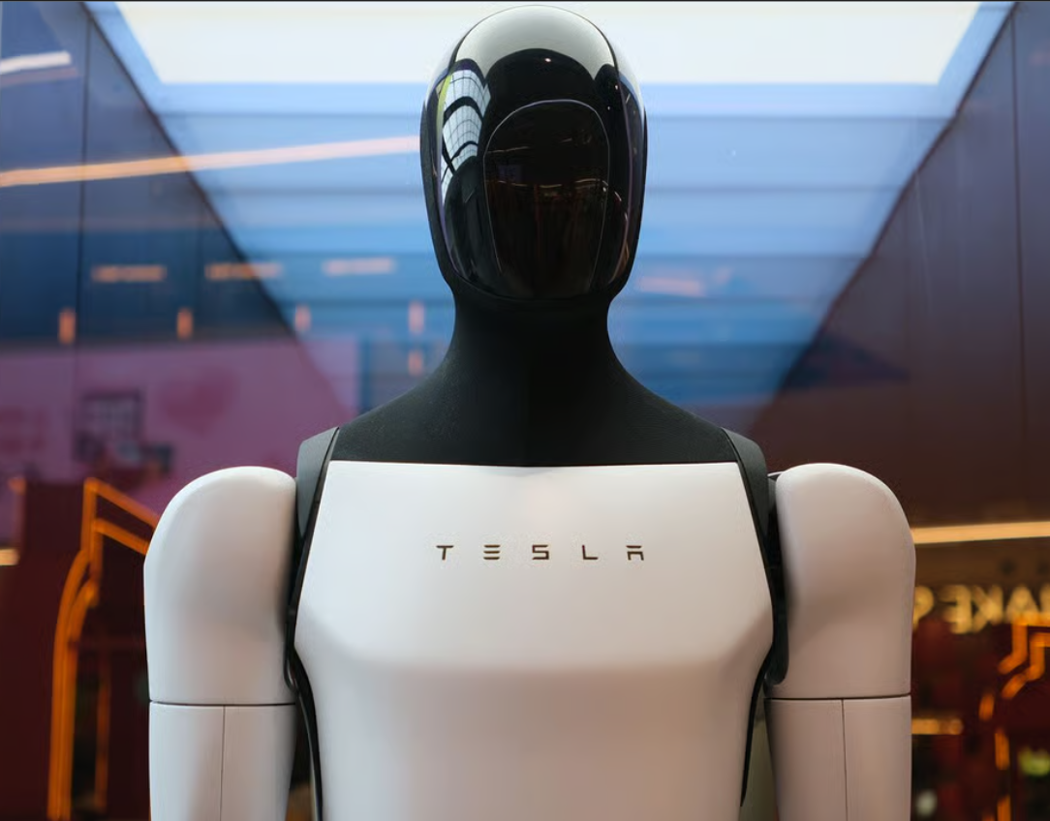
Tesla’s Optimus Project

Slide 11
STUDY #3: AGILITY ROBOTICS
Agility positions Digit as "the world's first commercially deployed humanoid robot," with a dedicated RoboFab factory in Oregon targeting 10,000+ units annually.
Deployed with Amazon for tote handling, bin moving, container unloading.
Not a sci-fi android — purpose-built for logistics, not general purpose.
Proven real-world work in structured warehouse environments today

Slide 12
STUDY #4: UNITREE - THE AFFORDABLE DISRUPTOR
Unitree achieved unicorn status ($1.3B valuation) after a funding round backed by ByteDance, Alibaba, and Tencent.
H1 humanoid robots performed live at China's primetime Spring Festival Gala 2025 — watched by billions.
Open-source alternatives like K-Scale's K-Bot are priced at $8,000, while Z-Bot starts under $1,000 - democratizing robotics.
China's strategy: volume + affordability (mirroring its EV playbook)

Slide 13
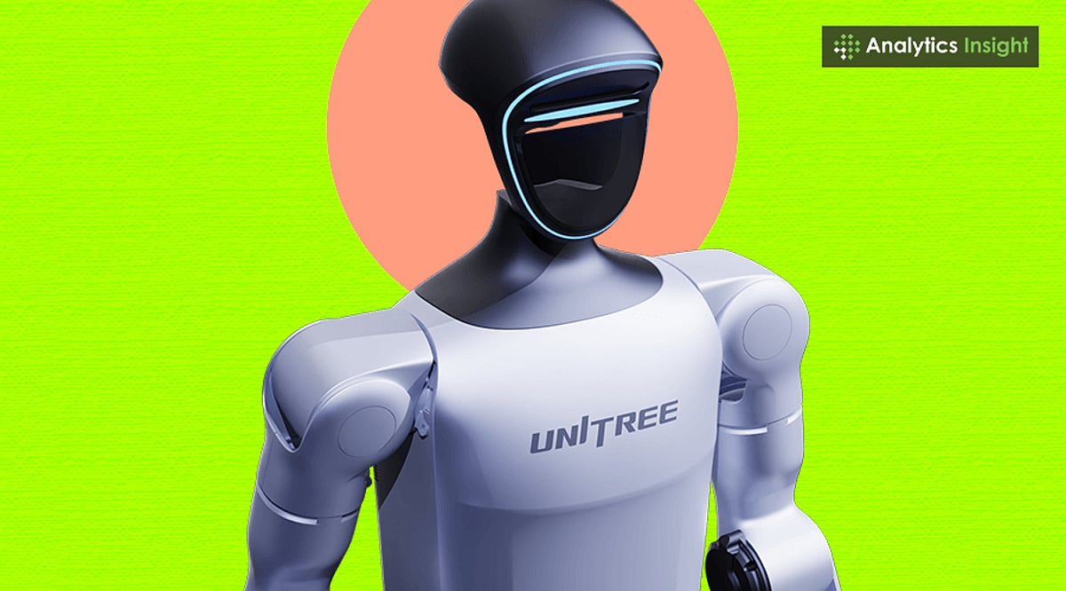
UniTree’s Humanoid Bot

Slide 14
INDUSTRY APPLICATIONS: WHERE ARE THEY WORKING?
Manufacturing — BMW (Apptronik Apollo), Hyundai (Atlas), BYD (in-house robots).
Logistics/Warehousing — Amazon (Digit), tote picking, palletizing
Healthcare — Elder care, patient assistance (emerging).
Heavy Industry — Persona AI deploying welding robots in shipyards (HD Hyundai partnership).
Consumer/Home — 1X NEO testing in homes; target price ~cost of a non-luxury car.

Slide 15
MARKET SIZE & GROWTH
Market in 2025: $2.92 Billion → projected $15.26 Billion by 2030 (CAGR: 39.2%).
Yole Group projects the market reaching $51 billion by 2035, with shipments exceeding 2 million units.
Goldman Sachs estimates $38B by 2035;
Fortune Business Insights projects nearly 50% annual growth to $66B by 2032 World Economic Forum.
VC funding in 2024 alone: $2.5 Billion.

Slide 16
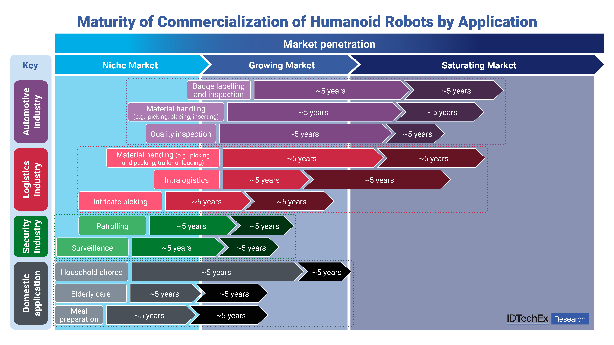

Slide 17
THE CHINA FACTOR
China has filed 5,688 humanoid robotics patents in five years — nearly four times the US total of 1,483.
Government-backed 2023–2025 plan to build a complete humanoid innovation ecosystem.
China faces acute labor shortages due to population decline — humanoids are a national economic strategy, not just a tech trend.
BYD plans to scale to 20,000 humanoid robots by 2026; Unitree expanding factories across China.
Likely trajectory: Low-cost Chinese robots dominate developing markets (just like EVs)

Slide 18
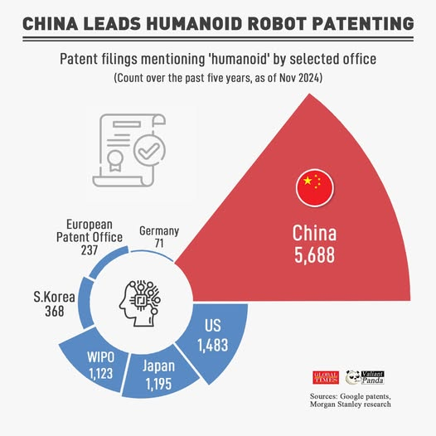

Slide 19
ETHICS, JOBS & SOCIETY
Workers stand to benefit as robots handle hazardous tasks — but the workforce faces disruption and displacement simultaneously World Economic Forum.
New roles emerging: robot trainers, supervisors, fleet managers, AI-human coordinators.
By 2060, studies project up to 3 billion humanoid robots could coexist with humans mostly in household/personal roles.
Key societal questions: Who owns the robot's labor? Who is liable when it fails?
Public trust = the most underrated bottleneck.

Slide 20
CONCLUSION
Humanoids are real, deployed, and improving fast.
Also that hype still runs ahead of reality.
The winners will be companies that pilot early, build workforce trust, and solve energy + dexterity.
Companies that invest in infrastructure and build workforce acceptance now will be well positioned when robots are truly read.

Slide 21
Now A Little About me …

Slide 22
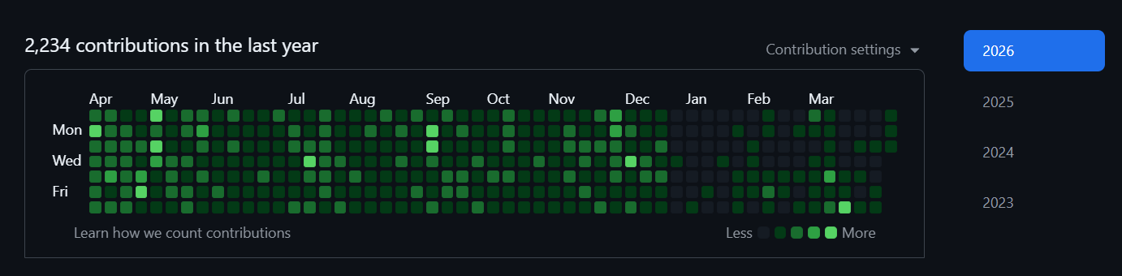


About Myself 😊

Slide 23

My LinkedIn Profile
My Github Profile
My Portfolio
My HuggingFace Repo

Slide 24
Thank You ✨ - Vijay Rajesh R ( 23BAI10917 )

