Slide 1
PRINCIPLES OF COMMUNICATION
-VIJAY RAJESH R

Slide 2
COMMUNICATION

Slide 3
What Is Communication?
Communication is the exchange of information, ideas, or feelings between individuals or groups using various methods such as speech, writing, body language, or technology. It serves to convey thoughts, establish connections, share knowledge, express emotions, and facilitate cooperation, enabling effective interaction and understanding in human society.

Slide 4
Why Communication?
Communication can be answered humorously to foster a lighthearted atmosphere, connect with others, and ease tension. Humor often breaks down barriers, making interactions more enjoyable and memorable. It's a social lubricant that encourages engagement and bonding, making communication more effective and enjoyable.

Slide 5
What is Effective Communication
Effective communication is the clear, thoughtful exchange of ideas, information, or emotions between individuals or groups. It involves active listening, empathy, clarity, and the use of appropriate language and channels to ensure that the intended message is understood and achieves its desired outcome. Effective communication is crucial in personal relationships, workplaces, and society as a whole.

Slide 6
TYPES OF COMMUNICATION

Slide 7
COMMUNICATION
NON-VERBAL
VERBAL

Slide 8
VERBAL COMMUNICATION
Verbal communication is the process of conveying information, thoughts, and emotions through spoken language. It involves words, tone, and delivery to effectively express ideas. Effective verbal communication requires clarity, active listening, and adapting one's communication style to the audience, ensuring a shared understanding of the message.

Slide 9
NON-VERBAL COMMUNICATION
Nonverbal communication involves conveying information and emotions without words, using body language, facial expressions, gestures, posture, and tone of voice. It complements verbal communication, often revealing true feelings and attitudes. Nonverbal cues can impact relationships, as they influence how messages are interpreted and play a significant role in effective communication.

Slide 10
BARRIERS
OF
COMMUNICATION

Slide 11
COMM--BARRIERS
PHYSICAL
SEMANTIC AND LANGUAGE
CROSS-CULTURAL
SOCIAL / PSYCHOLOGICAL

Slide 12
BEHAVIOURS OF COMMUNICATION
RURAL
BEHAVIOURS
URBAN

Slide 13
URBAN RURAL
Advanced technology and infrastructure.
High population density.
Varied, including digital and in-person.
Fast-paced, often rushed.
More formal and structured.
Highly connected, internet access.
Limited technology and infrastructure.
Low population density.
Often face-to-face and limited digital.
Slower, more leisurely.
Often informal and personal
Limited connectivity in remote areas.

Slide 14
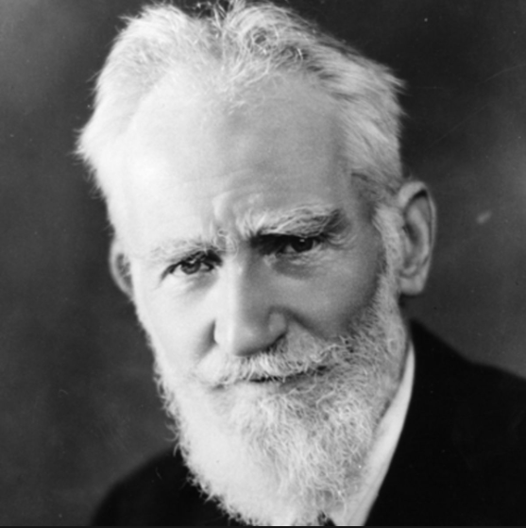
George Benard Shaw (1856-1950)
"The single biggest problem in communication is the illusion that it has taken place."

Slide 15
THANK YOU

