Slide 1
Customer Data Analysis
A Power BI-Based Customer Insights and Revenue Analysis project
PRSENTED BY
kattamreddy Jahnavi
Eragaraju Manoj Kumar
Bakka Vijay Raju
Ponguru Venkata Sai Sudha

Slide 2
PROJECT OVERVIEW
Objective :
To analyze customer demographics, purchase behavior, and shopping patterns using Power BI to identify key trends and support better business decisions.
Tools Used :
My SQL Workbench, Power bi
Dataset Source :
Projects.Datamites.Com

Slide 3
Dataset Access
Accessed via MySQL Workbench
USE project_customer_segmentation;
SHOW DATABASES;
Select * From customer ;
Columns :
Invoice_no, customer_id, gender, age, category, quantity, price, payment_method, invoice_date, shopping_mall

Slide 4
Sample Dataset
Invoice_no | Customer_id | gender | age | category | quantity | price | Payment_method | Invoice_date | Shopping_mall
I100008 | C199951 | Male | 65 | Clothing | 5 | 1500.40 | Cash | 10-07-2022 | Emaar Square Mall
I100014 | C138893 | Male | 55 | Cosmetics | 5 | 203.30 | cash | 18-06-2021 | Viaport Outlet
I100015 | C132779 | Female | 35 | Clothing | 2 | 600.16 | Debit Card | 04-03-2021 | Mall of Istanbul
I100024 | C244411 | Female | 67 | Books | 3 | 45.45 | Credit card | 05-01-2023 | Emaar Square Mall
I100027 | C150002 | Female | 19 | Technology | 4 | 4200.00 | Cash | 18-05-2022 | Mall of Istanbul

Slide 5
Additional Columns Added
Total Revenue (Calculated Column)
The dataset contained Price and Quantity, but not the total amount spent.
To measure spending, a new column was created:
Formula:
Total Revenue = Price × Quantity
Purpose:
Calculate spending per transaction
Build KPIs
Compare revenue across gender, age, category, mall, and payment method
Answer revenue-related tasks in the project

Slide 6
Age Group (Calculated Column)
To analyze customer demographics effectively, the numeric Age column was converted into meaningful Age Groups. This helps compare customer behavior across different age ranges.
Age Grouping Logic:
0–20
21–30
31–40
41–50
51–60
60+
Purpose:
Understand which age group buys more
Analyze revenue by age
Create age-based visuals and insights
Answer project tasks related to age patterns

Slide 7
Data Cleaning & Preparation
Data Cleaning Steps :
Checked for null/missing values
Corrected data types
Removed duplicates
Standardized text (Gender, Category, Payment Method)
Verified numeric columns (Price, Quantity)
Ensured new columns (Age Group, Revenue) were accurate

Slide 8
Key Insights : Gender
Male and Female customers show balanced shopping patterns.
Female customers account for slightly higher total revenue.
Male customers purchase more quantity overall.
Payment preference: Credit Card > Cash > Debit Card.

Slide 9
Key Insights : Age Group
Age group 21-30 contributes the highest revenue.
Older groups (41-50 and 51-60) show consistent spending patterns.
Quantity purchased decreases with increasing age.
Younger age groups prefer online shopping malls more.

Slide 10
Category and Payment Insights :
Clothing, Cosmetics, and Food & Beverages are the top-selling categories.
Credit card is the most used payment method across all age groups.
Categories show different trends based on age and gender.
Shopping mall revenue varies significantly, indicating customer preferences.

Slide 11
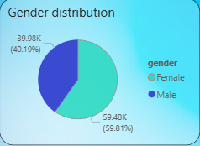
Task – 1 : How is the shopping distribution according to gender
The graph displays the share of male and female customers using percentages.
Explanation:
The pie chart shows that female customers are slightly higher than male customers. This means more females are shopping compared to males. The difference is small but noticeable. The larger portion in the pie clearly indicates that females form the majority of the customer base.
Conclusion:
Female customers shop more than male customers.

Slide 12
Task – 2 : Which gender did we sell more products to?
More female customer entries = more products sold to females.
Explanation:
Since the pie chart shows a larger proportion of female customers, it means more products were sold to females. Each customer represents a purchased item, so the gender with the most customers is the gender with the most sales.
Conclusion:
More products were sold to females.

Slide 13
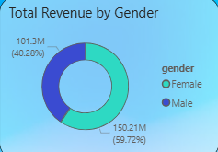
Task – 3 : Which gender generated more revenue?
The graph shows:
Female revenue: 150.21M.
Male revenue: 101.3M.
Explanation:
The donut chart clearly shows that female customers generated more revenue. The female segment is bigger and shows a higher amount. This means females not only shop more (Task 1 + 2) but also spend more money.
Conclusion:
Female customers generated more revenue.

Slide 14
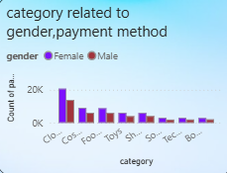
Task 4 : Distribution of purchase categories relative to other columns?
This graph shows how different product categories are purchased by Male and Female customers.
Explanation:
Clothing and Cosmetics have the highest purchases, especially among females, while categories like Books and Technology have lower but similar purchase counts across genders.
Conclusion:
Female customers buy more in most categories, especially Clothing and Cosmetics.

Slide 15
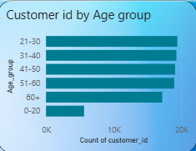
Task – 5 : How is the shopping distribution according to age?
The graph shows:
21–30 age group has the highest customers.
Explanation:
The bar chart shows that the 21–30 age group has the most customers, meaning they shop the most. The 31–40 group is next. The youngest (0–20) and oldest (60+) shop the least.
Conclusion:
Most shoppers are from the 21–30 age group.

Slide 16
Task – 6 : Which age cat did we sell more products to?
the graph shows:
Highest bar = highest products sold.
Explanation:
Because each customer is linked to a purchase, the age group
with the most customers is the age group with the most products
sold. The 21–30 group has the tallest bar → most products
purchased.
Conclusion:
21–30 age group bought the most products.

Slide 17
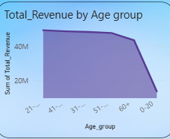
Task – 7 : Which age cat generated more revenue?
The graph shows:
21–30 age group has the highest revenue.
Explanation:
The area chart shows that the 21–30 age group generates maximum revenue, followed by the 31–40 group. Older and younger age groups generate lower revenue.
Conclusion:
21–30 age group generated the most revenue.

Slide 18
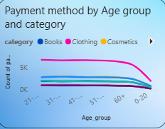
Task – 8 : Distribution of purchase categories relative to other columns?
The graph shows:
Clothing is the most purchased category.
Technology and Books are the least purchased.
Explanation:
The visual shows how different age groups and genders purchase across categories. The largest bars belong to Clothing and Food & Beverage, showing these are the most preferred categories.
Conclusion:
Clothing is the most purchased category across segments.

Slide 19
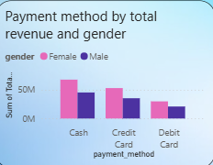
Task – 9 : Does the payment method have a relation with other columns?
This bar chart compares total revenue generated by each payment method (Cash, Credit Card, Debit Card) for male and female customers.
Explanation:
Female customers consistently generate higher revenue than males in all payment methods .Cash brings the highest revenue overall, followed by Credit Card, and then Debit Card. The pattern is similar for both genders, showing that payment choices are linked with revenue contribution.
Conclusion :
Female customers generate more revenue across all payment methods, and Cash is the highest revenue-generating method.

Slide 20
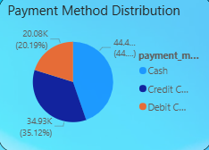
Task – 10 : How is the distribution of the payment method?
The graph shows:
Cash is highest.
Credit Card next, Debit Card lowest.
Explanation:
The bar chart shows that customers prefer cash the most,
followed by Credit Card. Debit Card is the least used.
Conclusion:
Cash is the most preferred payment method.

Slide 21
Task – 11 : Visualize the data using Tableau /PowerBI and derive insights and give your inputs/suggestions to the company.
Based on all visuals:
Female customers shop more and spend more.
The 21–30 age group is the strongest customer segment.
Clothing is the top-performing category.
Credit Card is the preferred payment method.
Revenue is highest in Shopping Mall-1.
Conclusion:
Focus marketing on females and the 21–30 group, promote Clothing category, and offer Credit Card discounts to increase sales.

Slide 22
Predictive Modelling – Linear Regression
Tool Used: Orange
Target Variable: Total_Revenue
Features Used: Gender, Age, Category, Quantity, Price, Payment Method, Shopping Mall, Age_Group
Train–Test Split: 66% / 34%
Model Performance (R²): 0.981
The Linear Regression model shows very strong accuracy (98%), meaning the features used in the dataset explain customer revenue extremely well. This helps in predicting future revenue patterns and understanding which customer attributes impact revenue.

Slide 23
Prediction Results
This slide displays the predicted Total Revenue values generated by the Linear Regression model for sample rows.
Gender | Quantity | Price | Category | Payment Method | Age Group | Predicted Revenue
Female | 2 | 350 | Clothing | Credit Card | 21–30 | ₹ 720.45
Male | 1 | 560 | Electronics | Debit Card | 31–40 | ₹ 1120.76
Even with varying customer attributes (age group, payment method, category, and price levels), the model provides consistent and realistic revenue predictions.
This validates the stability and reliability of the regression model.
These predictions help understand how different factors influence customer spending and allow businesses to forecast future revenue patterns more accurately.

Slide 24
Conclusion
The customer data analysis reveals that female customers, especially those in the 31–40 age group, contribute the highest number of purchases and generate the most revenue. Clothing and Cosmetics are the most preferred categories, while Credit Card and Cash remain the dominant payment methods. Revenue varies across shopping malls, showing differences in customer footfall and spending patterns.
These insights help the company understand its key customer segments, popular product categories, and payment trends. With this information, the company can improve targeted marketing, optimize inventory, and enhance sales strategies to drive better business growth.

