Slide 1

shared-home-kerberos
How krb-credd gives every Slurm job Active Directory Kerberos tickets — with one broker key, constrained delegation and the shared home directory
Version 2.2.0 · a walkthrough of the code for new engineers · companion to the line-by-line Word guide
Notes:
Purpose: explain the shared-home-kerberos repository (krbhpc 2.2.0) to recent graduates. This deck tells the story; the Word document has every line of code explained with line numbers. Suggested pace: about 1.5 minutes per slide, roughly 35 minutes plus questions.

Slide 2





Why jobs can't just “log in” to Kerberos
CAC login only
No forwarding
Numbers, not names
Narrow delegation only
Multi-day jobs
Smartcard can't get a Kerberos ticket on the cluster
Sending the PC's ticket over SSH is blocked
Cluster knows users only by UID/GID
AD allows constrained, not unconstrained
Tickets must refresh with nobody present
Yet jobs on every compute node must reach Hive and HDFS, which accept only Kerberos.
Notes:
Walk the five constraints. The punchline: the normal path (user runs kinit, ticket is forwarded to the job) is closed on every side. Doc section 2.

Slide 3



The idea: a trusted concierge buys specific ride tickets
One broker key
Amusement-park analogy
Root daemon holds a single keytab
TGT = all-day wristband. Users never get one.
Service ticket = one ride. That's all users get.
Broker = concierge allowed to buy tickets for approved rides only.
Home directory = a locker every entrance can see into.
Mint per user
AD issues service tickets on the user's behalf
Drop in $HOME
Shared filesystem = every node already has it
Notes:
One sentence to remember: a single trusted root daemon holds one service account's key, asks Active Directory for short-lived service tickets on each user's behalf, and writes them into the user's home directory, which every compute node already shares. Doc 2.1.

Slide 4

Four Kerberos words you need first
Keytab
TGT
A file holding a principal's long-term key. Lets a program authenticate with no password. The broker's keytab is the crown jewel.
Ticket-Granting Ticket: used to get other tickets. Only the broker has one.
Service ticket
Credential cache
Proves identity to one service (one SPN, e.g. hive/host@REALM). Users get only these.
File holding tickets in use. Programs find it via KRB5CCNAME=FILE:…
Notes:
Spend time here if the audience is new to Kerberos. The full glossary table is in doc section 3. Key point: the KDC is Active Directory; the repository runs no KDC.

Slide 5
Constrained delegation in two steps
Broker TGT
S4U2Self
S4U2Proxy
Service tickets
kinit -k -t broker.keytab
“ticket for jdoe, to me”
“trade it for jdoe → Hive”
hive/…, hdfs/… for jdoe
kvno -c FILE:<copy of broker_cc> --out-cache FILE:<tmp> \
-U jdoe -P hive/hiveserver2.corp...@REALM hdfs/namenode.corp...@REALM
-U does S4U2Self, -P does S4U2Proxy. AD only allows SPNs listed in the broker account's msDS-AllowedToDelegateTo — the same list as delegate_targets in credd.conf. No TGT is ever produced for the user.
Notes:
This is _krb.py lines 264-296 (s4u_mint). kvno runs on a throwaway copy of the broker cache because MIT's kvno stores every S4U2Proxy ticket in the cache it is given, even with --out-cache. The end-to-end test now completes this whole step against a KDC that holds an allow-list.

Slide 6
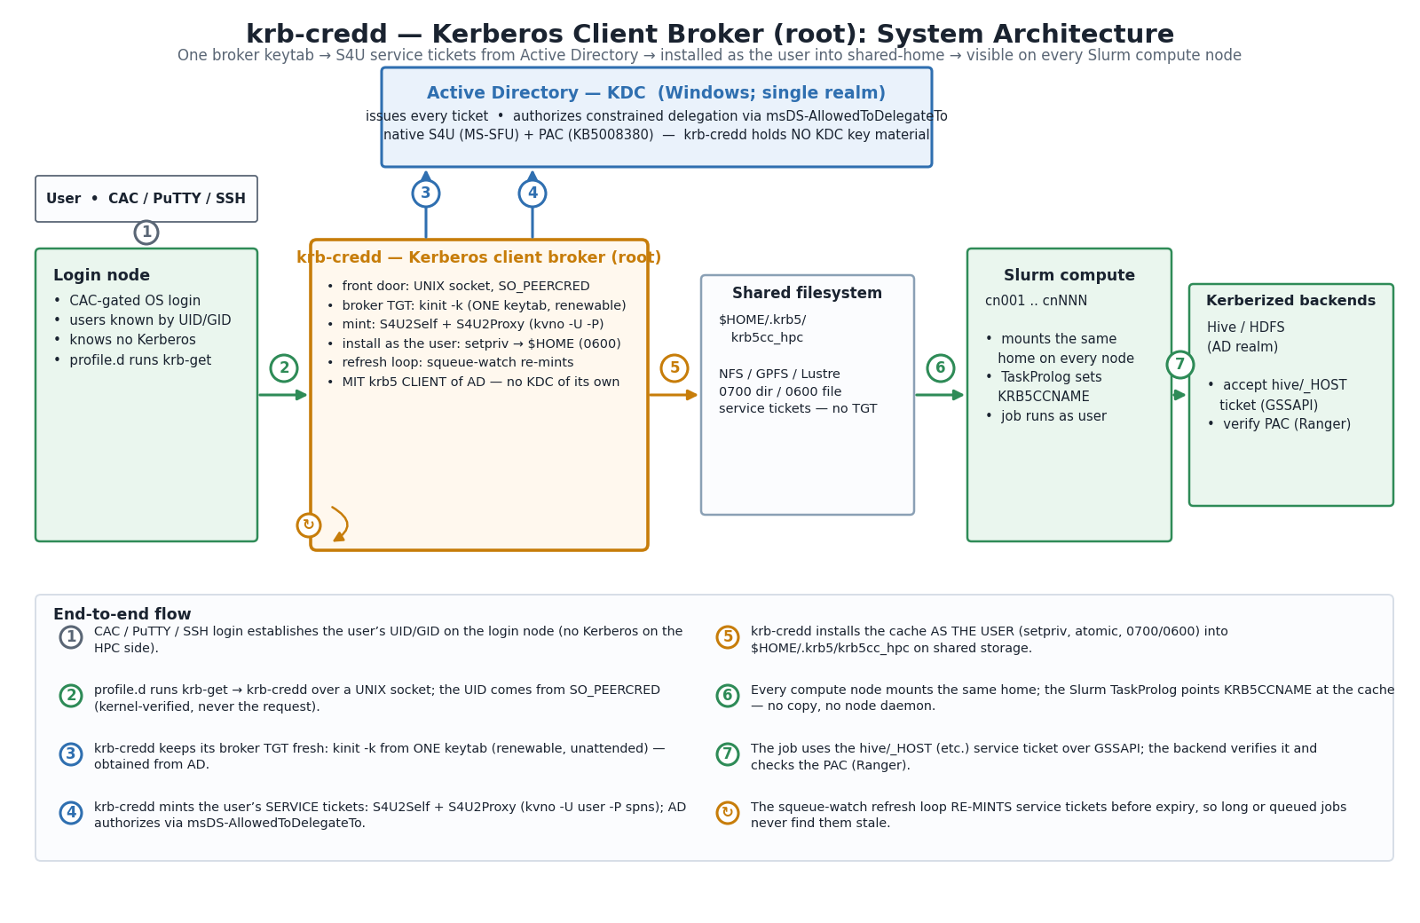
End-to-end architecture
Notes:
Walk the numbers 1 to 7 plus the refresh loop. 1 CAC login. 2 krb-get over the UNIX socket, UID from SO_PEERCRED. 3 broker TGT from one keytab. 4 S4U mint. 5 install as the user into $HOME. 6 TaskProlog sets KRB5CCNAME on every node. 7 job uses the Hive ticket. Refresh loop re-mints before expiry. Doc 4.2.

Slide 7





What changed in 2.1 and 2.2
More correct
Harder to misuse
kvno runs on a broker-cache copy; renewal is atomic; times in UTC
Tools by absolute path, MIT 1.19+ checked, fewer capabilities
Cheaper
Self-healing
klist only when a cache changed; users refreshed in parallel
Deleted caches put back, restarts resume, failures backed off
Easier to support
Better tested
Labelled failures, krb-credd --check, config typos reported
Full S4U path end to end: 28 checks, 33 unit tests
Notes:
Same design, same MIT command-line tools. The details are in CHANGELOG.md and doc section 4.4. A library-based rewrite was tried and rejected; docs/kerberos-library-comparison.xlsx compares the alternatives.

Slide 8
Inside the code
_krb.py · credd.py · get.py · install helper · Slurm hooks
Notes:
Transition: now map each step of the flow to the code that performs it.

Slide 9
Where the code lives
661
lines in the daemon — the heart of the system
0
third-party Python dependencies for the core package
Notes:
The core is small: a daemon, a helper module, a tiny client and an install helper. pyproject.toml declares dependencies = []; kinit, kvno and setpriv are OS tools. Lines include docstrings and comments. Repository map: doc 4.3; what changed since 2.0.0: doc 4.4.

Slide 10
_krb.py: parse text, run tools safely
parse_klist() · earliest_expiry()
Fixed paths, clean environment
Ticket times, read in UTC
kvno = /usr/bin/kvno # never PATH
_SCRUB = ("LD_PRELOAD", "KRB5CCNAME",
"KRB5_CONFIG", "KRB5_TRACE", ... "TZ")
env["LC_ALL"] = "C"
env["TZ"] = "UTC0"
classify_error()
stderr → not_delegable, kdc_unreachable, …
Krb5.version()
Refuses anything but MIT 1.19+
Tools run by absolute path and must be root-owned. Injection and redirect variables are removed; C locale and UTC make klist output predictable. Arguments are lists — no shell.
Krb5._klist_cached()
klist only when the cache file changed
Notes:
Doc section 5. _SCRUB is _krb.py lines 148-151; the klist memo is lines 199-218. Unchanged caches cost a stat() instead of a process. A tool that hangs for 60 s becomes a KrbToolError with category timeout. 14 tests in tests/test_krb_helpers.py.

Slide 11



credd.py: six building blocks
Config
UidMap
TicketManager
Loads credd.conf safely; reports typos and missing options
uidmap.conf: Linux user → real AD user. Reloads when the file changes
Broker TGT, mint, install, parallel refresh, backoff
Handler
Server
main() / check()
One socket request: read UID from kernel, accept only GET
Threaded UNIX-socket server, capped at 32 requests
Start the daemon — or --check a deployment
Notes:
Plus one free function, _assert_secure (lines 90-107): fail closed unless a path is root-owned, not a symlink, the right type, and not group/world writable; strict mode requires 0600 for the keytab. It now also checks kinit/klist/kvno and the uid map. Doc section 6.

Slide 12
Keeping the one broker credential alive
Case 1: Still good
Case 2: Renew
Case 3: Re-acquire
Expires more than 1 hour away (renew_margin)
Near expiry, still renewable
Missing, or renewal impossible or failed
→ do nothing
→ kinit -R on a copy, atomic rename
→ kinit from keytab into temp file, chmod 600, atomic rename
Called before every mint, under a lock — this is the “unattended renewal engine” that makes multi-day jobs possible.
Notes:
credd.py lines 308-328. kinit -R rewrites the file it renews, so it now renews a private copy that is renamed into place — a kvno reading the cache never sees half a file. The refresh pass checks the broker once up front and skips the pass with one log line if it can't be obtained.

Slide 13
One request: ensure, then mint, then install
ensure()
Why write as the user?
1
Enrolled? Lock this user. Near expiry? Home copy deleted?
setpriv --reuid=<uid> --regid=<gid>
--init-groups
--inh-caps=-all --bounding-set=-all
--no-new-privs
krb-install-ccache <dest>
2
_mint()
kvno on a throwaway broker copy, 0600, atomic rename
_install()
Root may be “squashed” on shared homes.
Root writing into a user-controlled folder invites symlink tricks.
Temp file + rename: nodes never see half a file.
3
setpriv as the user; helper fsyncs and renames into place
Notes:
credd.py ensure 362-384, _mint 330-338, _install 340-354. A home cache the user deleted is put back on the next pass without a new mint. There is now one install helper (src/krbhpc/install_ccache.py; bin/krb-install-ccache is a symlink). Doc 6.7-6.8 and 7.2.

Slide 14


The front door: a UNIX socket that can't be fooled
# get.py (the user)
s.connect("/run/krb-hpc/credd.sock")
s.sendall(b"GET\n")
# → "OK /home/jdoe/.krb5/krb5cc_hpc"
print("export KRB5CCNAME=" + shlex.quote(...))
# credd.py Handler (root)
creds = getsockopt(SOL_SOCKET,
SO_PEERCRED, 12)
pid, uid, gid = unpack("3i", creds)
Kernel says who
Own tickets only
Bounded
UID comes from SO_PEERCRED, never the request
Socket is 0666 — anyone may connect, nobody can ask for someone else
32 slots · 10 s per client · krb‑get gives up after 30 s
Notes:
Users run eval "$(krb-get)"; /etc/profile.d runs it at login, so krb-get now times out after 30 s and shell-quotes what it prints. Errors go to stderr so eval never runs them. Handler lines 496-536; main sets socket mode 0666 at line 644. Kerberos failures reach the user as a plain-language reason.

Slide 15
Why tickets never expire mid-job
5 min
1 h
10 h
7 d
refresh loop period
re-mint before expiry
ticket lifetime
active window after krb-get
squeue -h -a -t PD,CF,R,CG -o %U
Service tickets can't be renewed — only replaced. The daemon re-mints them with a fresh S4U call; only the broker's own TGT is renewed.
Every pass refreshes the union of recent krb-get users and everyone with a pending, configuring, running or completing job — so a job submitted from cron, never touching a shell, still gets tickets.
4 users at a time; a failing user is backed off; after a restart, active users are resumed and refreshed at once.
Notes:
refresh_pass/refresh_loop lines 439-480; _slurm_uids 426-434. Idle for 7 days: the master copy is deleted and the copy in $HOME simply expires. Backoff: 1-15 min for transient errors, 15-60 min for ones that need an admin. Values come from config/credd.conf.

Slide 16
Getting tickets to 1,000 nodes: one line
# slurm/taskprolog.krb.sh — runs as the user
home=${HOME:-$(getent passwd $(id -u) | cut -d: -f6)}
cc="${home}/.krb5/krb5cc_hpc"
if [[ -s "$cc" ]]; then
echo "export KRB5CCNAME=FILE:${cc}"
fi
$HOME/.krb5/krb5cc_hpc
slurm.conf: TaskProlog=/etc/slurm/taskprolog.krb.sh
No SPANK plugin, no KCM, no node daemon, no copy step. The home directory is already mounted everywhere; Slurm adds the printed export line to the task's environment.
cn001 … cnNNN read the same file
0700 folder · 0600 file
Notes:
Doc section 9. The optional prolog.krb.sh only logs when a node can't see the cache; it always exits 0. hive_client.py then connects with auth_mechanism GSSAPI and service name hive.

Slide 17
Supporting it: krb-credd --check
# krb-credd --check --user jdoe
PASS config /etc/krb-hpc/credd.conf
PASS trusted files and tools
PASS MIT Kerberos version: 1.20.1
PASS uid map: 2 enrolled
PASS broker TGT from keytab
PASS squeue: 14 user(s) with jobs
PASS constrained delegation for jdoe
all checks passed
Checks a deployment without starting the daemon or touching anyone's home. With ‑‑user it does a real delegation for that user — and names the failure category if it fails.
When something fails, the log says why:
not_delegable · kdc_unreachable · timeout · clock_skew · unknown_principal · broker_key · bad_cache
Users get a plain-language reason, e.g. “your account cannot be delegated; contact the HPC admins”.
Notes:
check() is credd.py lines 545-604; error categories are _krb.py lines 101-111. A typo in credd.conf is logged as an unknown option; missing required options stop start-up with one clear line. Doc sections 6.12 and 10.5.

Slide 18
Defense in depth, line by line
Identity from kernel
Write as the user
SO_PEERCRED · credd.py 512-514
setpriv, no caps, no-new-privs · credd.py 346-348
Fail closed on tampering
Tools by path, clean environment
Config, keytab (0600), uid map, helper and kinit/klist/kvno
absolute paths, MIT 1.19+ · _krb.py 148-162
Atomic everywhere
Four capabilities only
user caches, master copy, broker acquire and renew
SETUID · SETGID · SETPCAP · DAC_READ_SEARCH
Notes:
Central guarantee from SECURITY.md: an unprivileged local user can obtain their own service tickets and nobody else's, and only if enrolled and delegation-eligible. Threat table: doc section 13. The systemd unit dropped DAC_OVERRIDE, CHOWN and FOWNER in 2.2; the end-to-end test runs the daemon with exactly the four remaining capabilities. Hardening tests: tests/test_hardening.py (9 cases, all pass).

Slide 19
The two honest trade-offs
One keytab, concentrated risk
Tickets on shared storage
Risk
Risk
Easier to protect than N per-user keytabs, but a thief could mint allow-listed tickets as any eligible user.
Anyone who can act as that UID on the filesystem (incl. root on NFS sec=sys) can read the cache.
Mitigation
Mitigation
HSM or gMSA key · tight allow-list · monitoring · backend authorization (Ranger)
sec=krb5p · root_squash · short lifetimes · 0700/0600 — and it's service tickets, not a TGT
Notes:
These are stated plainly in the README. If either is unacceptable, the alternative is a node-local KCM design, which this repo deliberately does not implement.

Slide 20
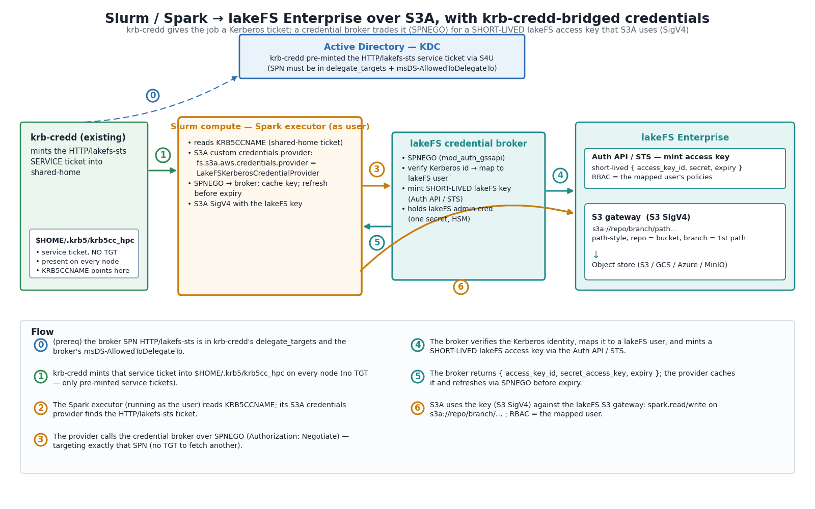
Extension: from Kerberos ticket to lakeFS key
Spark executor's Java provider sends SPNEGO (Negotiate) to the broker
Apache mod_auth_gssapi verifies it, passes the user
Flask broker mints a key via the lakeFS API
S3A signs requests with that key
Check: keys are not deleted by the broker — confirm TTL support in your lakeFS.
Notes:
Doc section 12. Broker trusts the identity header only from trusted proxy IPs and binds to 127.0.0.1. Java provider caches the key and refreshes 60 s before expiry, using -Dsun.security.jgss.native=true so it can read a cache with only a service ticket.

Slide 21

What the tests prove — and what they don't
Verified
Not exercised
Full S4U2Self + S4U2Proxy against a KDC with an allow-list
Install as user, 0600, service tickets only
4 nodes + real GSSAPI accept; refresh, repair, restart
Refusals, hostile environment, --check
Daemon limited to its 4 capabilities
Real Active Directory (PAC, its allow-list checks)
Real Slurm
Real shared FS with root_squash / krb5p
Live HiveServer2
28/28 end-to-end checks and 33/33 unit tests PASS (recorded in tests/*.output.txt)
Notes:
All tests were re-run on 2.2.0 while preparing this deck: 14 helper, 10 daemon and 9 hardening unit tests, and 28 end-to-end checks with both kvno -U and -I. The end-to-end test uses MIT's test KDB module, which can hold a delegation allow-list, so the whole path really runs. Doc section 11.

Slide 22
Known limits to mention
Lab test still needed
Root-squashed homes
Real AD, Slurm, shared storage and Hive haven't been exercised
A deleted cache returns at the next mint, not the next pass
In-memory backoff
-U vs -I
After a restart a failing user is retried once
Enterprise names are the default; check cross-realm users with --check
Notes:
The 2.0.0 review notes (stale wording, symlink check, admin-script matching, unlocked table) are all fixed. Full list in doc section 14, including hive_client's fixed TLS setting and the lakeFS key TTL.

Slide 23
Remember three things
One broker key, not one per user
Users get service tickets only — never a TGT
The shared home is the transport; Slurm just points at it
Notes:
Open the floor. Prepared answers to fourteen likely questions are in doc section 15, including why kvno runs on a copy, how --check helps, and what was tested.

