Slide 1
Overview of Jira

Slide 2
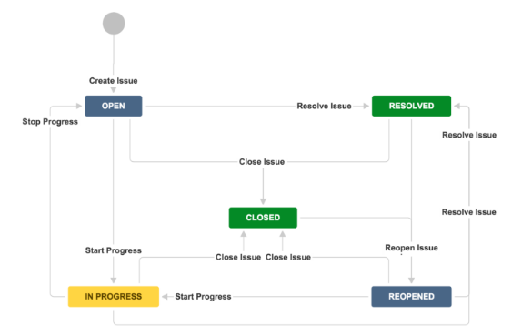
Issues work flow in Jira

Slide 3
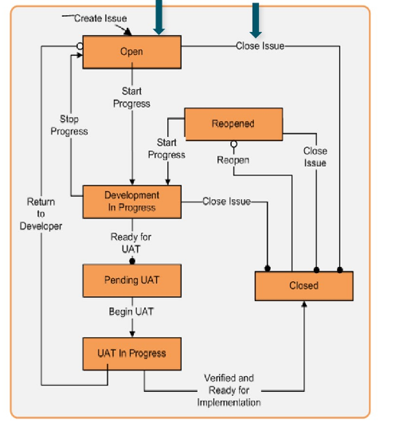
Status represents the current position of an issue in it’s workflow lifecycle.
Transition is a action that moves an issue from one status to another with below optional features.
Workflow transition screen – To get input during transition.
DEPENDENCIES
Conditions – Checks whether given condition is met before starting transition. E.g - who can perform the transition, Value of the field matches.
Validators – Checks that any user-supplied input is valid before performing the transition. E.g - Field value given in transition screen is matched with regular expression.
Post functions - Actions to perform after completing the transition.
• Each Issue Types can use different workflow or same workflow, this behaviors is defined in Workflow scheme.
• Workflow scheme is linked to one or more projects.
Project Workflow
Status
Transition

Slide 4
GitHub
Jenkins
JIRA
Artifactory
Rundeck

