Slide 1
Natural LanguageProcessing

Slide 2
Table of Contents
Business Problem
Base knowledge
Case Solution
Quizes

Slide 3
Case study- Twitter Data

Slide 4
Business Problem
Twitter data (also know as tweets) is a rich source of information on a large set of topics. This data collects from twitter streaming API service and collected tweets for twenty FTSE 100 companies over a week starting from 1st October 2016.
Analytical Problem: This data can be used to find trends related to a specific keyword, measure brand sentiment or gather feedback about new products and services. We will cover the below topics as part of this course:
Stemming
Lammenting
Remove StopWords/Punctuations.
Point of Speech Tagging
Word Cloud
Term Frequency Metrics
Inverse Term Frequency metrics
Latent Dirichlet Allocation
Tokenization
Entity Extraction
Bag of words
Summarization of Block of Text
Sentiment Analysis
Text Mining
Here is the Definitions of the columns of the data:
Tweet
Class- Yes/No

Slide 5
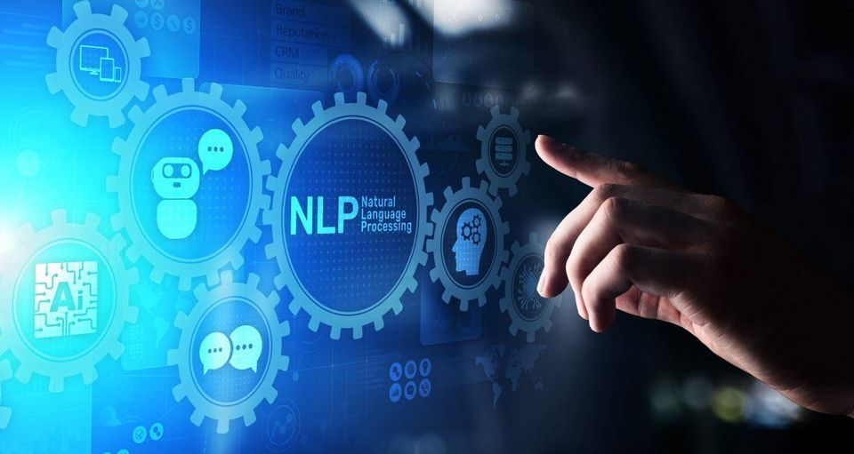
Base knowledge

Slide 6
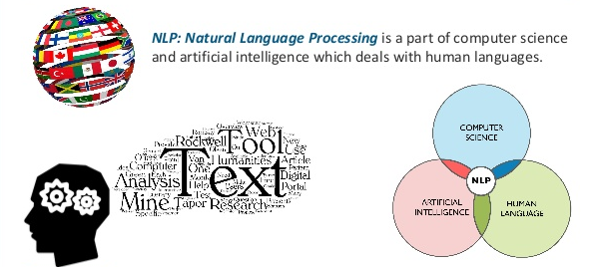
What is NLP
NLP is a field of Artificial intelligence that gives the machines the ability to read, understand and derive meaning from Human Language.
Study of interaction between computers and human languages
NLP = Computer Science + AI + Computational Linguistics

Slide 7
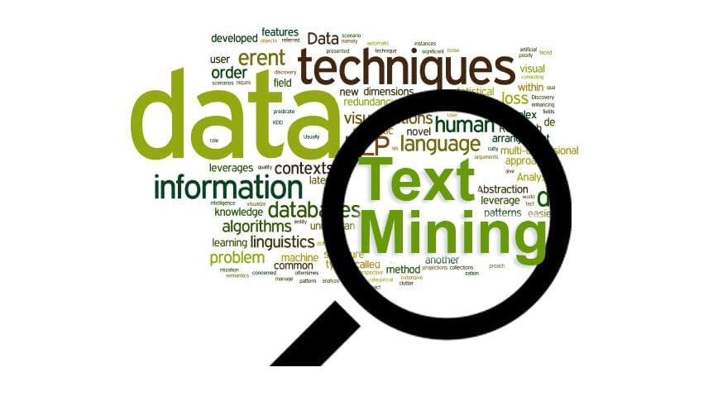
Why NLP
Research has shown that nearly 80% of data exists as unstructured text data.
Text analytics is fundamental in order to analyse the wealth of information available on chat transcripts, social media posts, reviews, news feeds etc
In recent days with the explosion of Big Data there is a large demand for organisations and data scientists to perform information extraction using non-traditional sources of data
What is Text Analytics?
Text analytics is the process of deriving meaningful information from natural language text
Until recent years text analytics had to be performed the old fashioned way i.e. eyeballing and manual categorisation of text, which is inefficient and time consuming.

Slide 8
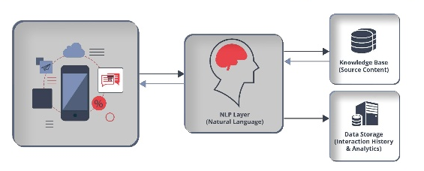
Basic Structure of NLP Application

Slide 9
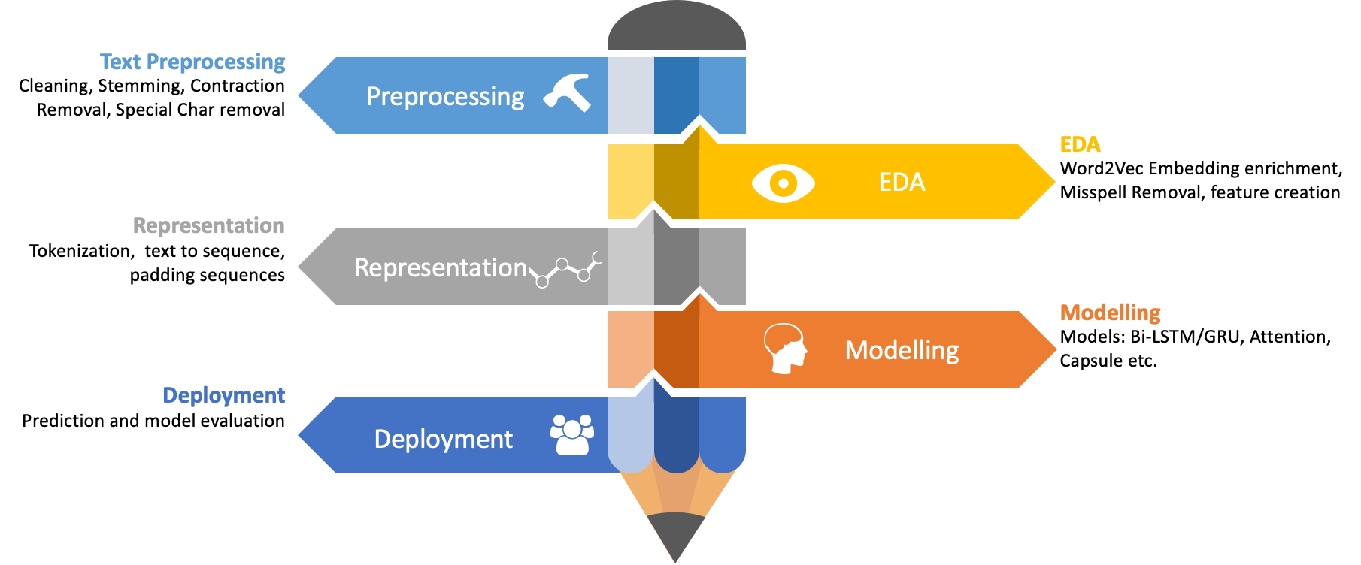
Basic Structure of NLP Application

Slide 10

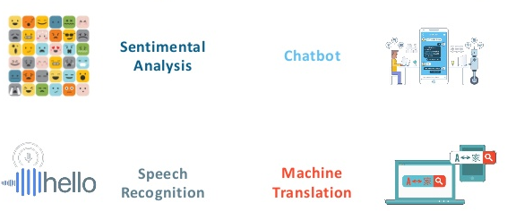
Application of NLP
Machine Translation — to develop computer algorithms to allow automatical translation without any human intervention. The best-known application is probably Google Translate.
Speech Recognition - Today, speech recognition is a hot topic that is part of a large number of products, for example, voice assistants (Cortana, Google Assistant, Siri, …)
Sentiment Analysis- Sentiment analysis helps to check whether customers are satisfied with goods or services.
Chatbots- NLP has become the basis for creating chatbots, and although such systems are not so perfect they easily can handle standard tasks.
Text Classification- NLP, text classifiers can automatically analyze text and then assign a set of pre-defined tags or categories based on its content.
Spell Checking- A spell checker is a software tool that identifies and corrects any spelling mistakes in a text
Question Answering- Question answering (QA) is concerned with building systems that automatically answer questions posed by humans in a natural language. Sounds complicated

Slide 11
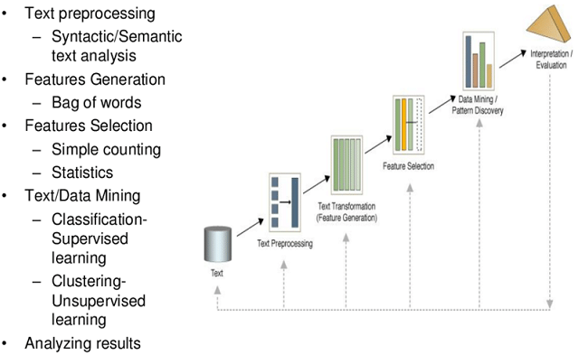
What is Text Mining

Slide 12
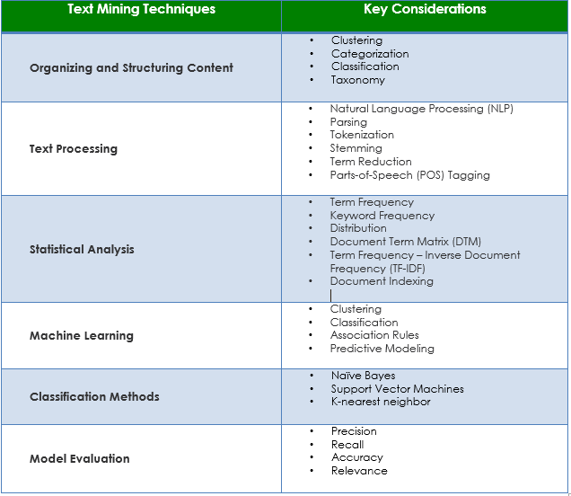
Text Mining Technique

Slide 13
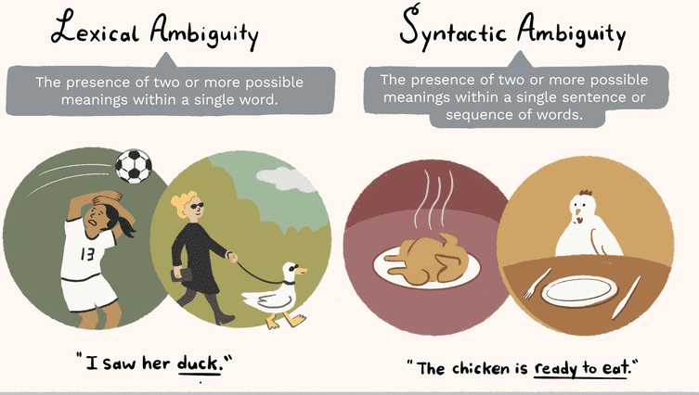
NLP Ambiguity

Slide 14
Five general steps in nlp
Lexical Analysis − It involves identifying and analyzing the structure of words. Lexicon of a language means the collection of words and phrases in a language. Lexical analysis is dividing the whole chunk of txt into paragraphs, sentences, and words.
Syntactic Analysis (Parsing) − It involves analysis of words in the sentence for grammar and arranging words in a manner that shows the relationship among the words. The sentence such as “The school goes to boy” is rejected by English syntactic analyzer.
Semantic Analysis − It draws the exact meaning or the dictionary meaning from the text. The text is checked for meaningfulness. It is done by mapping syntactic structures and objects in the task domain. The semantic analyzer disregards sentence such as “hot ice-cream”.
Discourse Integration − The meaning of any sentence depends upon the meaning of the sentence just before it. In addition, it also brings about the meaning of immediately succeeding sentence.
Pragmatic Analysis − During this, what was said is re-interpreted on what it actually meant. It involves deriving those aspects of language which require real world knowledge.

Slide 15
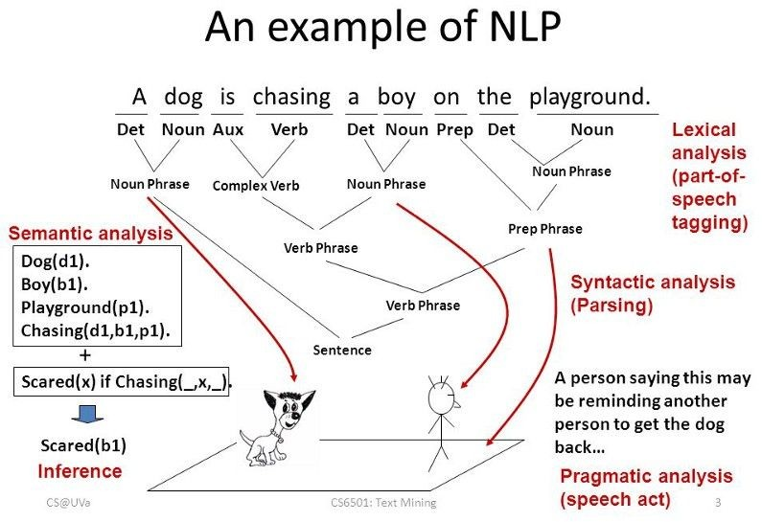
Example to NLP

Slide 16
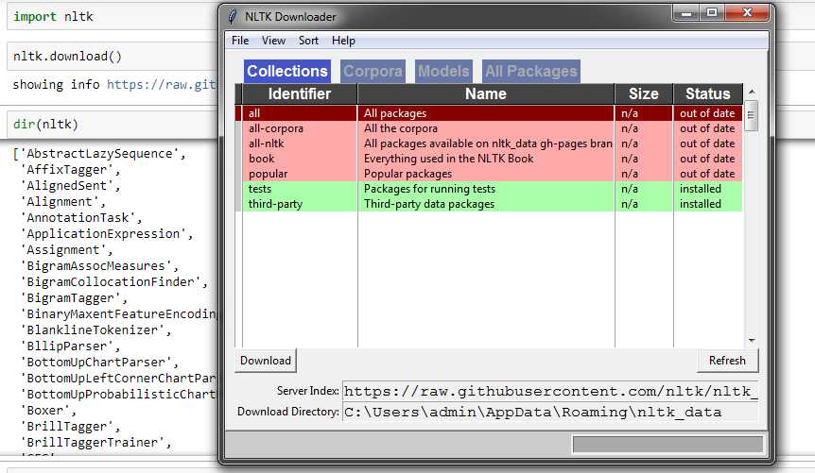
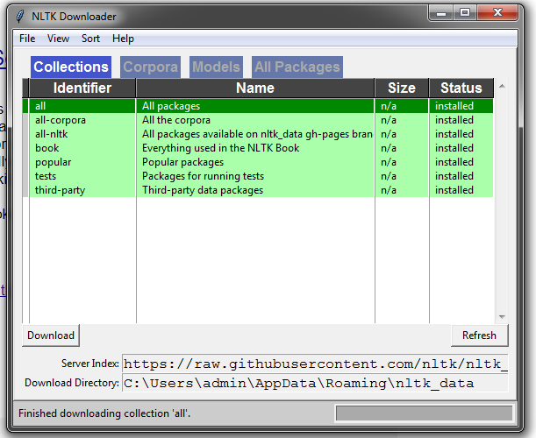
NLTK- Download
NLTK is one of the leading platforms for working with human language data and Python, the module NLTK is used for natural language processing. NLTK is literally an acronym for Natural Language Toolkit.
NLTK will aid you with everything from splitting sentences from paragraphs, splitting up words, recognizing the part of speech of those words, highlighting the main subjects, and then even with helping your machine to understand what the text is all about.

Slide 17
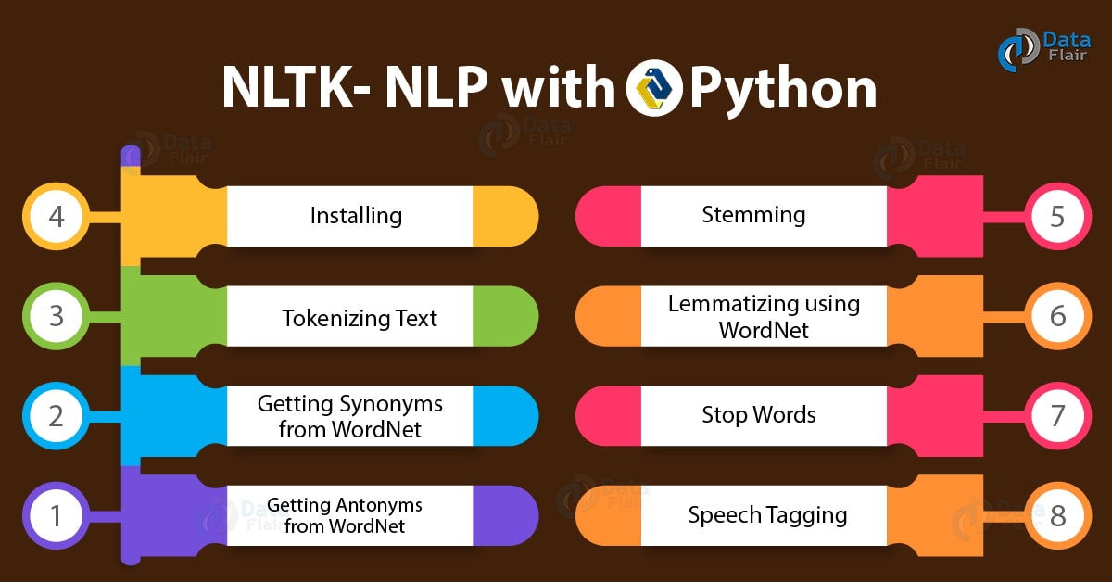
NLTK- Natural Language Tool Kit

Slide 18
NLTK- Tokenization
Tokenization is the process of breaking a stream of text up into words, phrases, symbols and other meaningful elements called tokens. Tokenization can remove punctuation too.
Corpus - Body of text, singular. Corpora is the plural of this. Example: A collection of medical journals.
Lexicon - Words and their meanings. Example: English dictionary. Consider, however, that various fields will have different lexicons. For example: To a financial investor, the first meaning for the word "Bull" is someone who is confident about the market, as compared to the common English lexicon, where the first meaning for the word "Bull" is an animal. As such, there is a special lexicon for financial investors, doctors, children, mechanics, and so on.
Token - Each "entity" that is a part of whatever was split up based on rules. For examples, each word is a token when a sentence is "tokenized" into words. Each sentence can also be a token, if you tokenized the sentences out of a paragraph

Slide 19
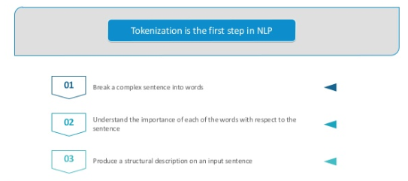
NLTK- Tokenization

Slide 20
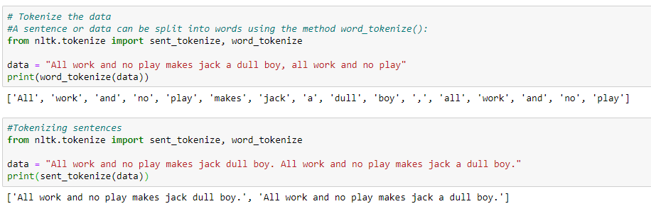
NLTK- Tokenization

Slide 21
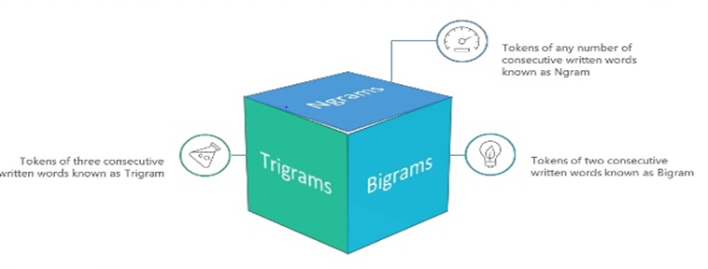
NLTK- N Grams

Slide 22
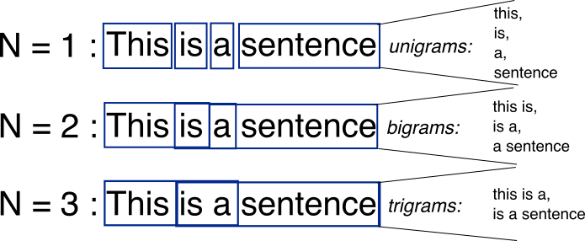
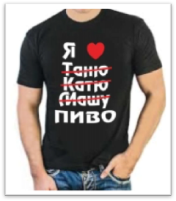
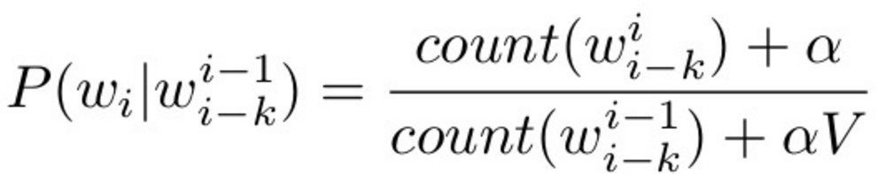
Classical Way: N-Grams
Problem: doesn’t scale well to bigger N. N = 5 is pretty much the limit.

Slide 23
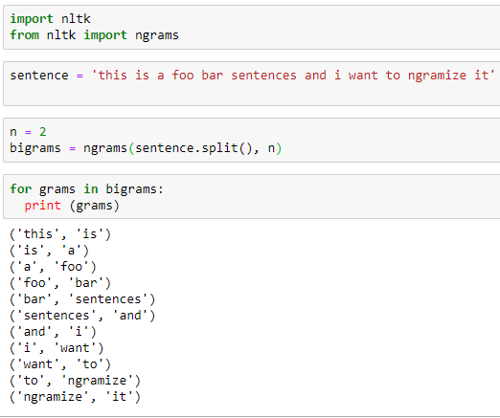
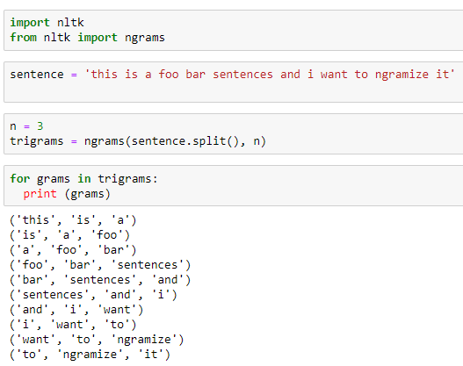
NLTK- N Grams

Slide 24
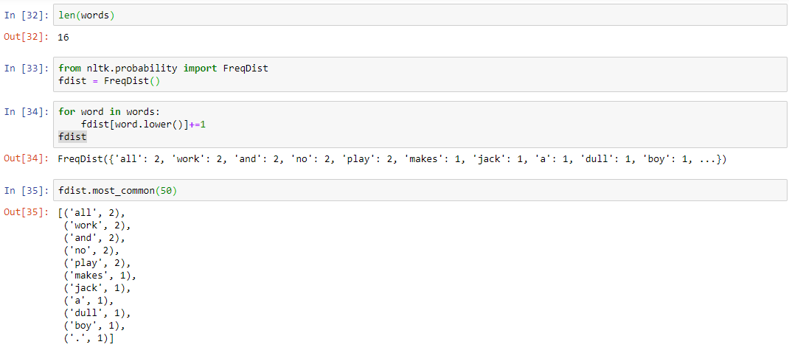
NLTK- Frequency Distribution

Slide 25
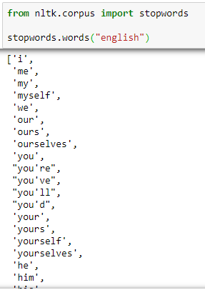
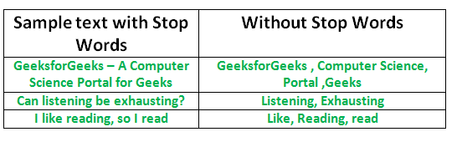
NLTK- Stop Words
In natural language processing, useless words (data), are referred to as stop words.
Text may contain stop words like ‘the’, ‘is’, ‘are’. Stop words can be filtered from the text to be processed. There is no universal list of stop words in nlp research, however the nltk module contains a list of stop words

Slide 26
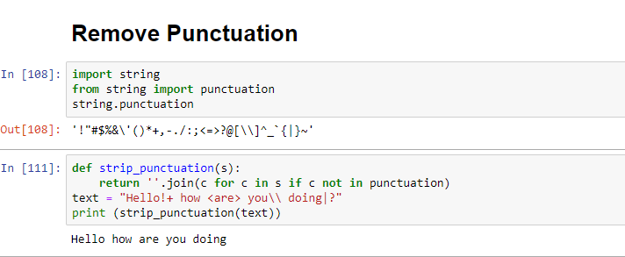
NLTK- Punctuation
One way of doing this is by looping through the Series with list comprehension and keeping everything that is not in string.punctuation, a list of all punctuation we imported at the beginning with import string.
Punctuation - '!"#$%&\'()*+,-./:;<=>?@[\\]^_`{|}~'

Slide 27
Regular Expressions (Regex)
Regular Expression or RegEx is a sequence of characters that forms a search pattern. RegEx is used to search for and replace specific patterns.
Python provides a built-in module, re, which supports regular expressions.
Use of Regex:
Identifying the whitespace b/w words/tokens.
Identifying/creating delimiters or end-of-line escape characters.
Removing punctuations or numbers from the text.
Cleaning HTML tags from text.
Identifying some textual patterns.
Use cases:
Confirming passwords meet criteria.
Searching URL for some substring.
Searching for files on computers.
Document scraping.
Most frequently used functions in regex:
re.split() - function splits the string at every occurrence of the sub-string and returns a list of strings which have been split.
re.findall()- function returns a list of strings containing all matches of the specified pattern.
re.search() - function returns a match object in case a match is found
re.match() - function is used to match the RE pattern to string with optional flags
re.sub()- function is used to replace occurrences of a particular sub-string with
another sub-string.

Slide 28
Quiz 1
N-grams are defined as the combination of N keywords together. How many bi-grams can be generated from given sentence
“Edwisor is a great source to learn data science”
A
7
B
9
C
8
D
10
A
B
C
D
Answer is 2

Slide 29
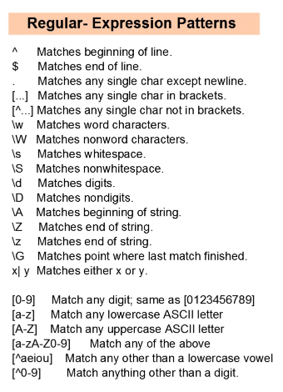
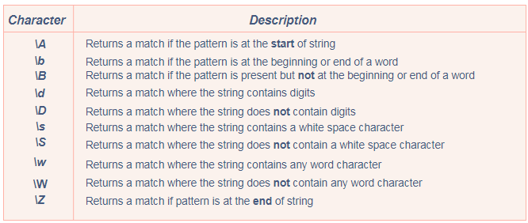
Regular Expressions (Regex)
Meta characters are characters which are interpreted in a particular way. The below table lists down all the meta characters used in RegEx, along with their functionality:
Special sequences are a \ followed by any one of the following characters, based on their particular functionality:

Slide 30
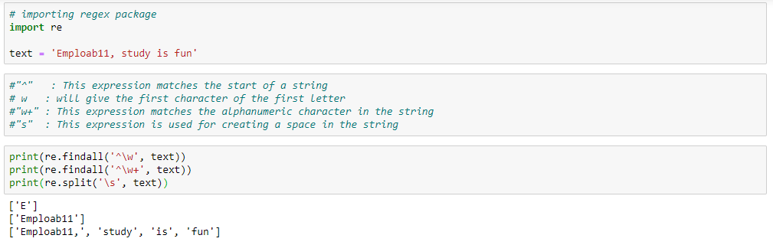
Regular Expressions (Regex)

Slide 31
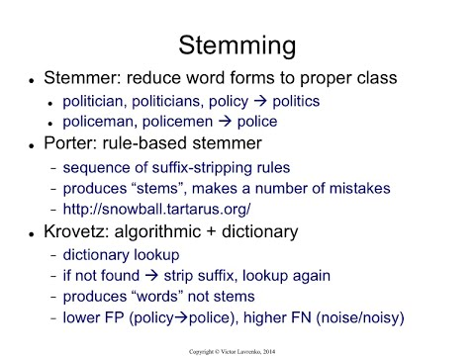
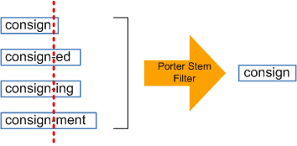
Stemming- Word Normalization
Process of slicing the end or the beginning of words with the intention of removing affixes (lexical additions to the root of the word).
The idea of stemming is a sort of normalizing method. Many variations of words carry the same meaning, other than when tense is involved.

Slide 32
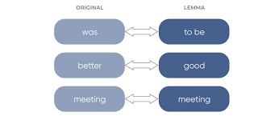
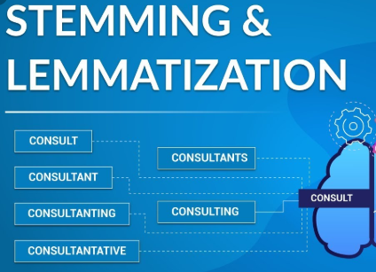
Lemmatization- Word Normalization
Lemmatization resolves words to their dictionary form (known as lemma) for which it requires detailed dictionaries in which the algorithm can look into and link words to their corresponding lemmas.

Slide 33
Quiz 2
Which of the following techniques can be used for the purpose of keyword normalization, the process of converting a keyword into its base form?
A
Lemmatization
B
Levenshtein
C
Stemming
D
Soundex
A and B
B and C
A and D
A and C
Answer is 4

Slide 34
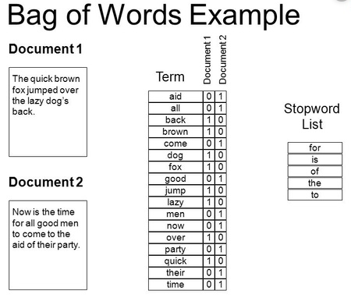
Bag of Words
Count all words in a piece of text. Basically it creates an occurrence matrix for the sentence or document, disregarding grammar and word order. These word frequencies or occurrences are then used as features for training a classifier.

Slide 35
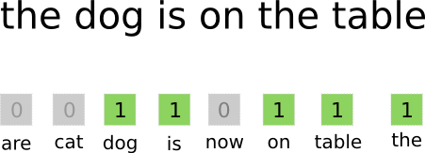
Feature Representation: Bag of Words
A single word is a one-hot encoding vector with the size of the dictionary :(

Slide 36
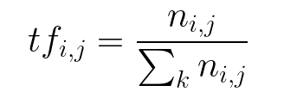
TF-IDF
TF-IDF stands for “Term Frequency — Inverse Document Frequency”. This is a technique to quantify a word in documents, we generally compute a weight to each word which signifies the importance of the word in the document and corpus
Terminology
t — term (word)
d — document (set of words)
N — count of corpus
corpus — the total document set
Vocab - the list of all possible words in the corpus
Term Frequency (tf):
(Frequency of the word in the sentence) / (Total number of words in the sentence)

Slide 37
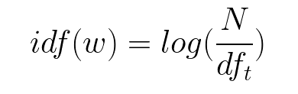
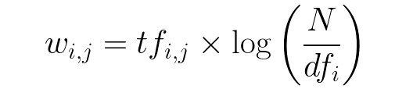

TF-IDF
Inverse Data Frequency (idf): used to calculate the weight of rare words across all documents in the corpus. The words that occur rarely in the corpus have a high IDF score.
IDF = (Total number of sentences (documents))/(Number of sentences (documents) containing the word)
TF-IDF:

Slide 38
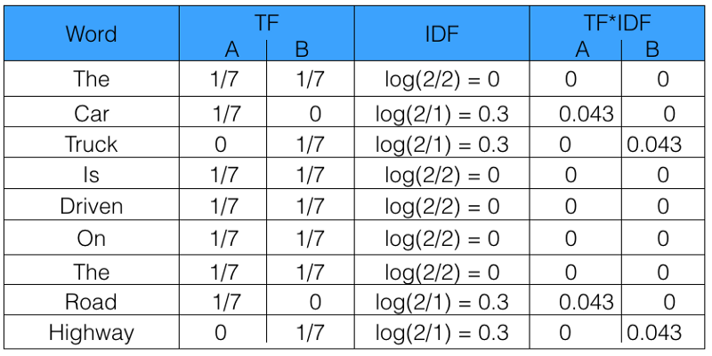
Example TF-IDF
corpus =["The car is driven on the road",
"The truck is driven on the highway"]

Slide 39
Quiz 3
In a corpus of N documents, one document is randomly picked. The document contains a total of T terms and the term “data” appears K times.
What is the correct value for the product of TF (term frequency) and IDF (inverse-document-frequency), if the term “data” appears in approximately one-third of the total documents?
A
KT * Log(3)
B
K * Log(3) / T
C
T * Log(3) / K
D
Log(3) / KT
A
B
C
D
Answer is 2

Slide 40
Solution

Slide 41
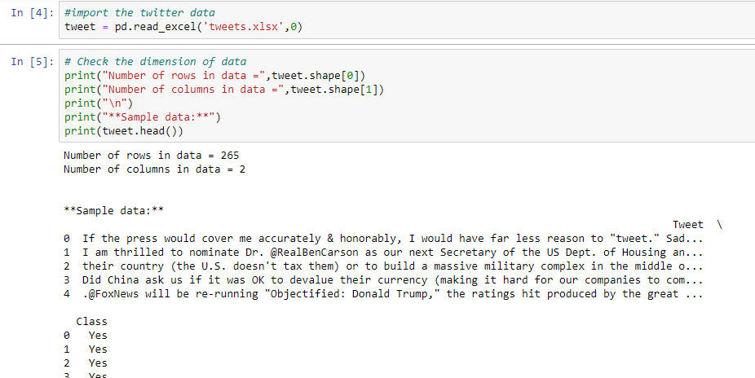
Data Import
Import the twitter data
tweet = pd.read_excel('tweets.xlsx',0)

Slide 42
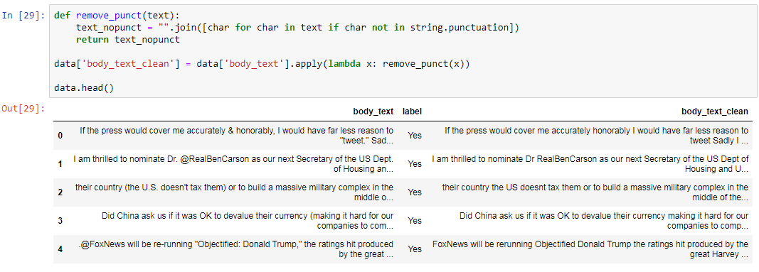
Data Cleaning
Remove punctuation

Slide 43
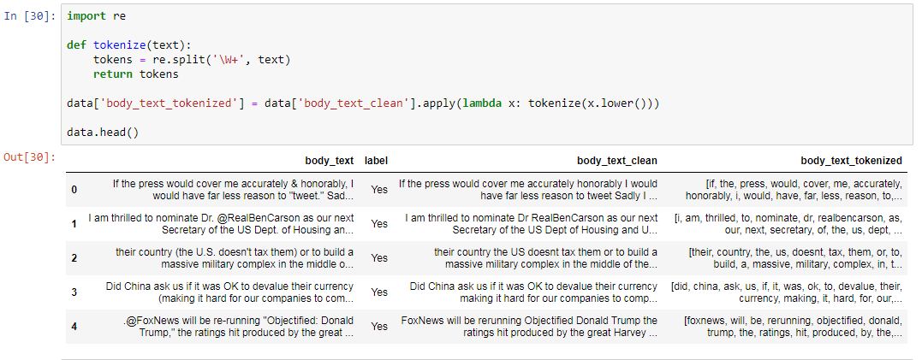
Tokenization

Slide 44
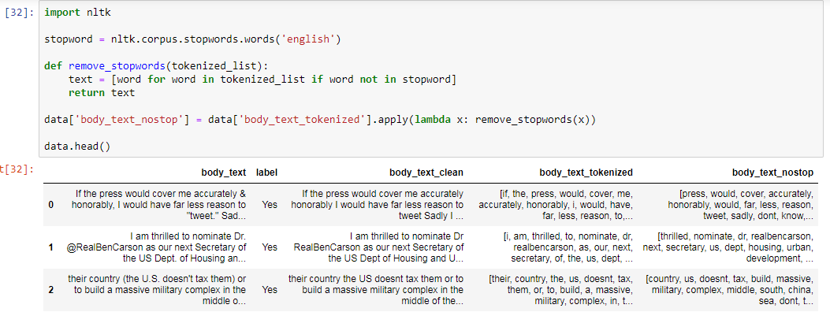
Removal of stop words

Slide 45
Quiz 4
Which of the following models can perform tweet classification with regards to context mentioned above?
A
Naive Bayes
B
SVM
C
Random Forest
D
None of the above
A
B
C
D
Answer is 4

Slide 46
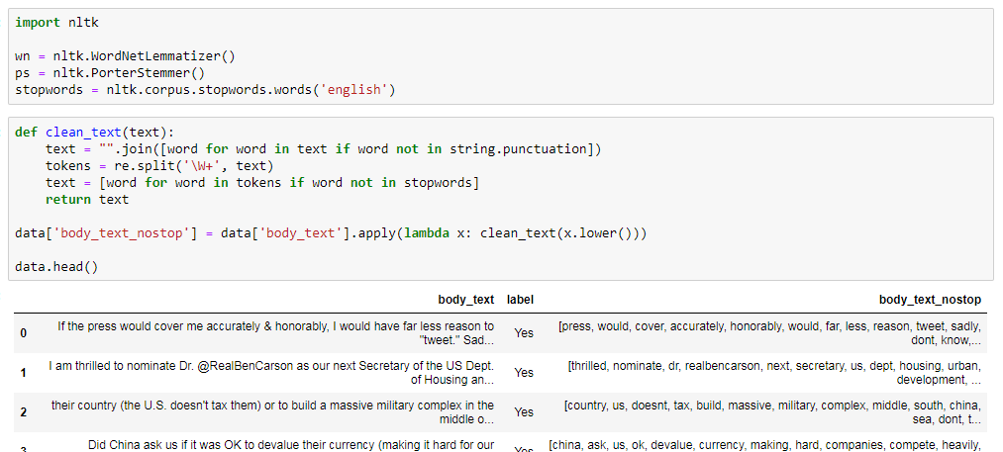
Lemmatization/Stemming

Slide 47
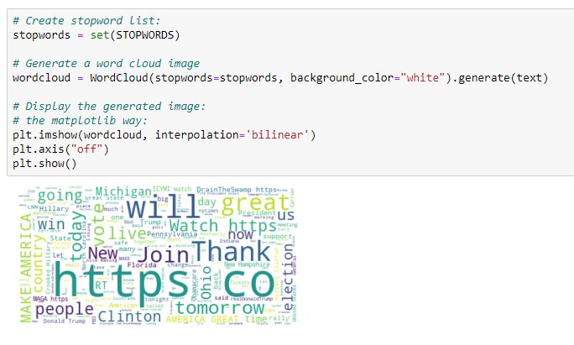
Word cloud

Slide 48
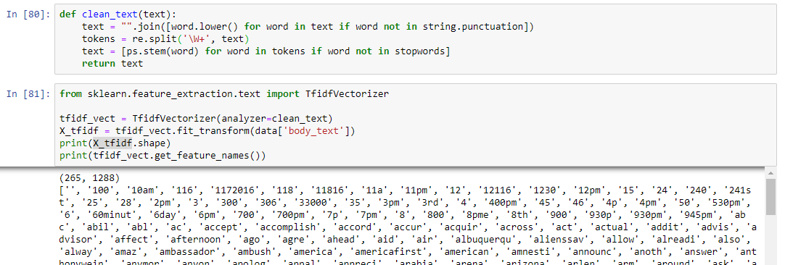
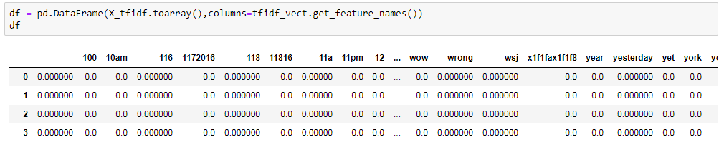
Word cloud

Slide 49
Quiz 5
Which of the following features can be used for accuracy improvement of a classification model?
A
Frequency count of terms
B
Vector Notation of sentence
C
Part of Speech Tag
D
Dependency Grammar
A, B and C
B, C and D
A, C and D
All
Answer is D

Slide 50
Q & A

Slide 51
Thank You

