Slide 1
Data Mining:
Data Preparation

Slide 2
Data Preprocessing
Why preprocess the data?
Data cleaning
Data integration and transformation
Data reduction
Discretization and concept hierarchy generation
Summary

Slide 3
Why Data Preprocessing?
Data in the real world is dirty
  incomplete: lacking attribute values, lacking certain attributes of interest, or containing only aggregate data
  noisy: containing errors or outliers
  inconsistent: containing discrepancies in codes or names
No quality data, no quality mining results!
  Quality decisions must be based on quality data
  Data warehouse needs consistent integration of quality data

Slide 4
Multi-Dimensional Measure of Data Quality
A well-accepted multidimensional view:
  Accuracy
  Completeness
  Consistency
  Timeliness
  Believability
  Value added
  Interpretability
  Accessibility

Slide 5
Major Tasks in Data Preprocessing
Data cleaning
  Fill in missing values, smooth noisy data, identify or remove outliers, and resolve inconsistencies
Data integration
  Integration of multiple databases, data cubes, or files
Data transformation
  Normalization and aggregation
Data reduction
  Obtains reduced representation in volume but produces the same or similar analytical results
Data discretization
  Part of data reduction but with particular importance, especially for numerical data

Slide 6

Forms of data preprocessing

Slide 7
Data Preprocessing
Why preprocess the data?
Data cleaning
Data integration and transformation
Data reduction
Discretization and concept hierarchy generation
Summary

Slide 8
Data Cleaning
Data cleaning tasks
  Fill in missing values
  Identify outliers and smooth out noisy data
  Correct inconsistent data

Slide 9
Missing Data
Data is not always available
  E.g., many tuples have no recorded value for several attributes, such as customer income in sales data
Missing data may be due to
  equipment malfunction
  inconsistent with other recorded data and thus deleted
  data not entered due to misunderstanding
  certain data may not be considered important at the time of entry
  not register history or changes of the data
Missing data may need to be inferred.

Slide 10
How to Handle Missing Data?
Ignore the tuple: usually done when class label is missing (assuming the tasks in classification—not effective when the percentage of missing values per attribute varies considerably)
Fill in the missing value manually: tedious + infeasible?
Use a global constant to fill in the missing value: e.g., “unknown”, a new class?!
Use the attribute mean to fill in the missing value
Use the most probable value to fill in the missing value: inference-based such as Bayesian formula or decision tree

Slide 11
Noisy Data
Noise: random error or variance in a measured variable
Incorrect attribute values may due to
  faulty data collection instruments
  data entry problems
  data transmission problems
  technology limitation
  inconsistency in naming convention
Other data problems which requires data cleaning
  duplicate records
  incomplete data
  inconsistent data

Slide 12
How to Handle Noisy Data?
Binning method:
  first sort data and partition into (equi-depth) bins
  then smooth by bin means, smooth by bin median, smooth by bin boundaries, etc.
Clustering
  detect and remove outliers
Combined computer and human inspection
  detect suspicious values and check by human
Regression
  smooth by fitting the data into regression functions

Slide 13
Simple Discretization Methods: Binning
Equal-width (distance) partitioning:
  It divides the range into N intervals of equal size: uniform grid
  if A and B are the lowest and highest values of the attribute, the width of intervals will be: W = (B-A)/N.
  The most straightforward
  But outliers may dominate presentation
  Skewed data is not handled well.
Equal-depth (frequency) partitioning:
  It divides the range into N intervals, each containing approximately same number of samples
  Good data scaling
  Managing categorical attributes can be tricky.

Slide 14
Binning Methods for Data Smoothing
* Sorted data for price (in dollars): 4, 8, 9, 15, 21, 21, 24, 25, 26, 28, 29, 34
* Partition into (equi-depth) bins:
- Bin 1: 4, 8, 9, 15
- Bin 2: 21, 21, 24, 25
- Bin 3: 26, 28, 29, 34
* Smoothing by bin means:
- Bin 1: 9, 9, 9, 9
- Bin 2: 23, 23, 23, 23
- Bin 3: 29, 29, 29, 29
* Smoothing by bin boundaries:
- Bin 1: 4, 4, 4, 15
- Bin 2: 21, 21, 25, 25
- Bin 3: 26, 26, 26, 34

Slide 15
Data Preprocessing
Why preprocess the data?
Data cleaning
Data integration and transformation
Data reduction
Discretization and concept hierarchy generation
Summary

Slide 16
Data Integration
Data integration:
  combines data from multiple sources into a coherent store
Schema integration
  integrate metadata from different sources
  Entity identification problem: identify real world entities from multiple data sources, e.g., A.cust-id ≡ B.cust-#
Detecting and resolving data value conflicts
  for the same real world entity, attribute values from different sources are different
  possible reasons: different representations, different scales, e.g., metric vs. British units

Slide 17
Handling Redundant Data
Redundant data occur often when integration of multiple databases
  The same attribute may have different names in different databasesCareful integration of the data from multiple sources may help reduce/avoid redundancies and inconsistencies and improve mining speed and quality

Slide 18
Data Transformation
Smoothing: remove noise from data
Aggregation: summarization, data cube construction
Generalization: concept hierarchy climbing
Normalization: scaled to fall within a small, specified range
  min-max normalization
  z-score normalization
  normalization by decimal scaling

Slide 19




Data Transformation: Normalization
min-max normalization
z-score normalization
normalization by decimal scaling
Where j is the smallest integer such that Max(| |)<1

Slide 20
Data Preprocessing
Why preprocess the data?
Data cleaning
Data integration and transformation
Data reduction
Discretization and concept hierarchy generation
Summary

Slide 21
Data Reduction Strategies
Warehouse may store terabytes of data: Complex data analysis/mining may take a very long time to run on the complete data set
Data reduction
  Obtains a reduced representation of the data set that is much smaller in volume but yet produces the same (or almost the same) analytical results
Data reduction strategies
  Data cube aggregation
  Dimensionality reduction
  Numerosity reduction
  Discretization and concept hierarchy generation

Slide 22
Data Cube Aggregation
The lowest level of a data cube
  the aggregated data for an individual entity of interest
  e.g., a customer in a phone calling data warehouse.
Multiple levels of aggregation in data cubes
  Further reduce the size of data to deal with
Reference appropriate levels
  Use the smallest representation which is enough to solve the task

Slide 23
Dimensionality Reduction
Feature selection (i.e., attribute subset selection):
  Select a minimum set of features such that the probability distribution of different classes given the values for those features is as close as possible to the original distribution given the values of all features
  reduce # of patterns in the patterns, easier to understand

Slide 24
Example of Decision Tree Induction
Initial attribute set:
{A1, A2, A3, A4, A5, A6}
A4 ?
A1?
A6?
Class 1
Class 2
Class 1
Class 2
>
Reduced attribute set: {A1, A4, A6}

Slide 25
Heuristic Feature Selection Methods
There are 2^{d} possible sub-features of d features
Several heuristic feature selection methods:
  Best single features under the feature independence assumption: choose by significance tests.
  Best step-wise feature selection:
    The best single-feature is picked first
    Then next best feature condition to the first, ...
  Step-wise feature elimination:
    Repeatedly eliminate the worst feature
  Best combined feature selection and elimination:
  Optimal branch and bound:
    Use feature elimination and backtracking

Slide 26
Regression and Log-Linear Models
Linear regression: Data are modeled to fit a straight line
  Often uses the least-square method to fit the line
Multiple regression: allows a response variable Y to be modeled as a linear function of multidimensional feature vector
Log-linear model: approximates discrete multidimensional probability distributions

Slide 27
Regress Analysis and Log-Linear Models
Linear regression: Y = α + β X
  Two parameters , α and β specify the line and are to be estimated by using the data at hand.
  using the least squares criterion to the known values of Y1, Y2, …, X1, X2, ….
Multiple regression: Y = b0 + b1 X1 + b2 X2.
  Many nonlinear functions can be transformed into the above.
Log-linear models:
  The multi-way table of joint probabilities is approximated by a product of lower-order tables.
  Probability: p(a, b, c, d) = αab βacχad δbcd

Slide 28
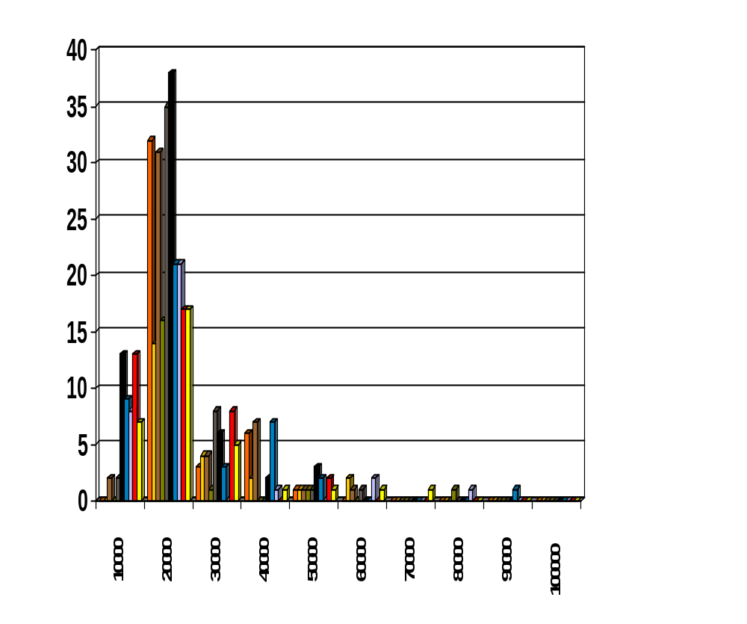
Histograms
A popular data reduction technique
Divide data into buckets and store average (sum) for each bucket
Can be constructed optimally in one dimension using dynamic programming
Related to quantization problems.

Slide 29
Clustering
Partition data set into clusters, and one can store cluster representation only
Can be very effective if data is clustered but not if data is “smeared”
Can have hierarchical clustering and be stored in multi-dimensional index tree structures
There are many choices of clustering definitions and clustering algorithms, further detailed in Chapter 8

Slide 30
Sampling
Allow a mining algorithm to run in complexity that is potentially sub-linear to the size of the data
Choose a representative subset of the data
  Simple random sampling may have very poor performance in the presence of skew
Develop adaptive sampling methods
  Stratified sampling:
    Approximate the percentage of each class (or subpopulation of interest) in the overall database
    Used in conjunction with skewed data

Slide 31
Sampling
SRSWOR
(simple random
sample without
replacement)
SRSWR
Raw Data

Slide 32
Data Preprocessing
Why preprocess the data?
Data cleaning
Data integration and transformation
Data reduction
Discretization and concept hierarchy generation
Summary

Slide 33
Discretization
Three types of attributes:
  Nominal — values from an unordered set
  Ordinal — values from an ordered set
  Continuous — real numbers
Discretization:
  divide the range of a continuous attribute into intervals
  Some classification algorithms only accept categorical attributes.
  Reduce data size by discretization
  Prepare for further analysis

Slide 34
Discretization and Concept hierachy
Discretization
  reduce the number of values for a given continuous attribute by dividing the range of the attribute into intervals. Interval labels can then be used to replace actual data values.
Concept hierarchies
  reduce the data by collecting and replacing low level concepts (such as numeric values for the attribute age) by higher level concepts (such as young, middle-aged, or senior).

Slide 35
Discretization for numeric data
Binning (see sections before)
Histogram analysis (see sections before)
Clustering analysis (see sections before)

Slide 36
Data Preprocessing
Why preprocess the data?
Data cleaning
Data integration and transformation
Data reduction
Discretization and concept hierarchy generation
Summary

Slide 37
Summary
Data preparation is a big issue for both warehousing and mining
Data preparation includes
  Data cleaning and data integration
  Data reduction and feature selection
  Discretization
A lot a methods have been developed but still an active area of research

Slide 38
References
D. P. Ballou and G. K. Tayi. Enhancing data quality in data warehouse environments. Communications of ACM, 42:73-78, 1999.
Jagadish et al., Special Issue on Data Reduction Techniques. Bulletin of the Technical Committee on Data Engineering, 20(4), December 1997.
D. Pyle. Data Preparation for Data Mining. Morgan Kaufmann, 1999.
T. Redman. Data Quality: Management and Technology. Bantam Books, New York, 1992.
Y. Wand and R. Wang. Anchoring data quality dimensions ontological foundations. Communications of ACM, 39:86-95, 1996.
R. Wang, V. Storey, and C. Firth. A framework for analysis of data quality research. IEEE Trans. Knowledge and Data Engineering, 7:623-640, 1995.

