Slide 1
Exploratory Data Analysis
On
AMEO Dataset
Project On

Slide 2

About me
Vijay sada
B-tech in Electronics and Communications Engineering.
Fresher

Slide 3
Data Description:
The dataset was released by Aspiring Minds from the Aspiring Mind Employment Outcome 2015 (AMEO). The study is primarily limited only to students with engineering disciplines. The dataset contains the employment outcomes of engineering graduates as dependent variables (Salary, Job Titles, and Job Locations) along with the standardized scores from three different areas – cognitive skills, technical skills and personality skills.
Objective:
The main focus will be on providing insights based on the target column “salary” using the features like designation, gender, specialization, etc.

Slide 4


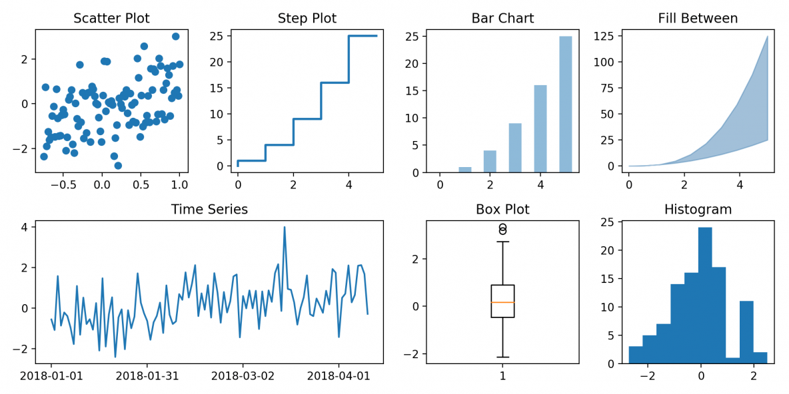
DATA CLEANING:
Libraries Used : pandas, NumPy.
DATA ANALYSIS:
Libraries Used : pandas, NumPy.
DATA VISUALIZATION:
Libraries Used : pandas, matplotlib, seaborn.

Slide 5
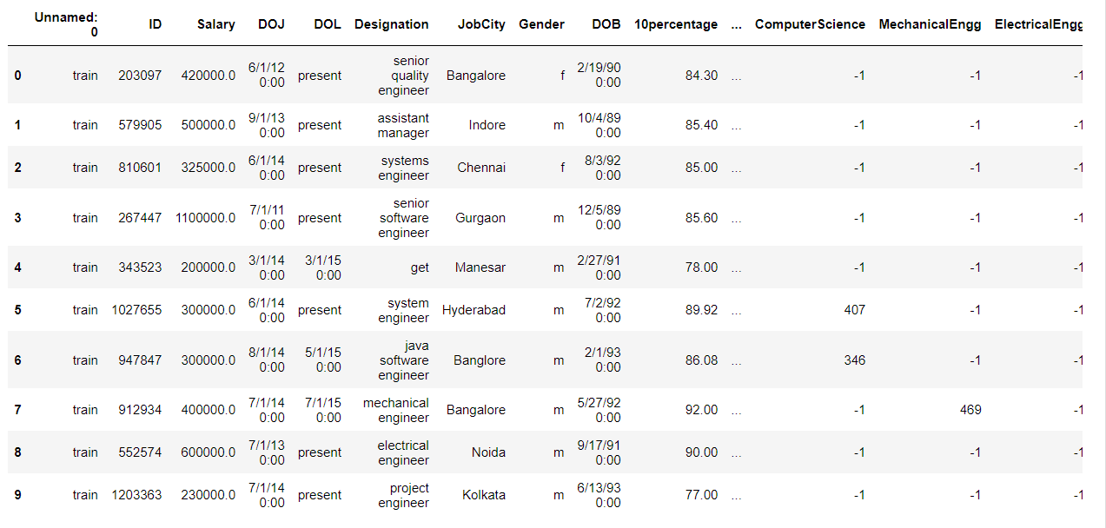
RAW DATA:

Slide 6
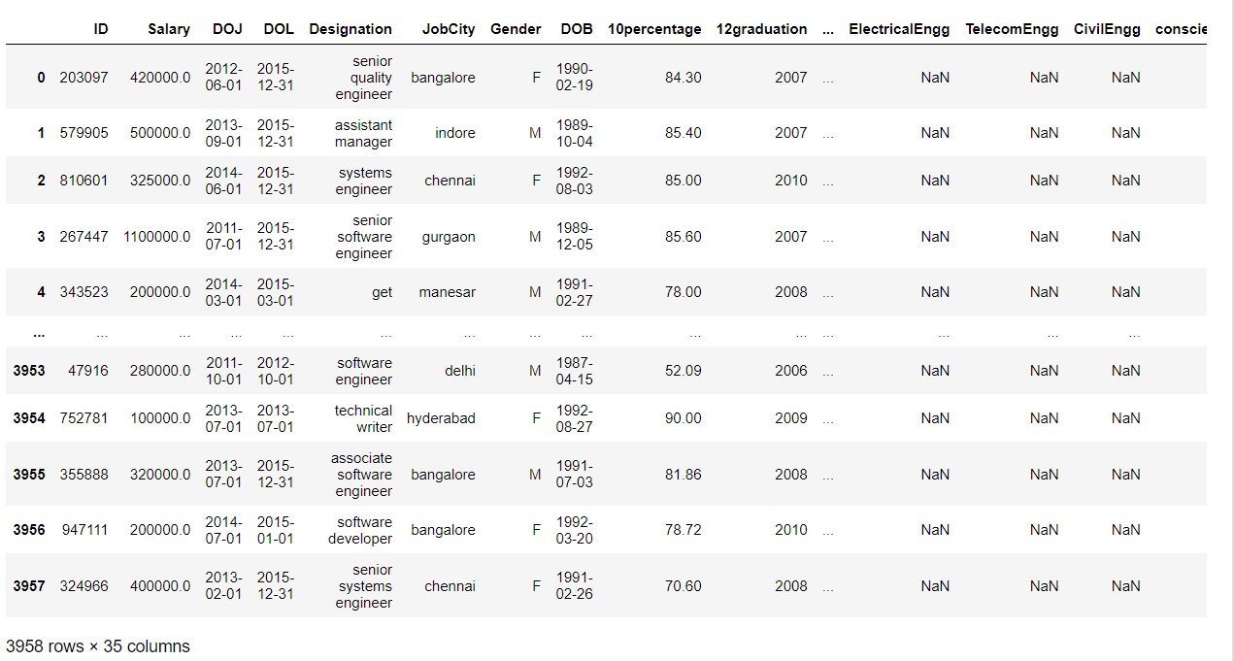
CLEANED DATA:

Slide 7
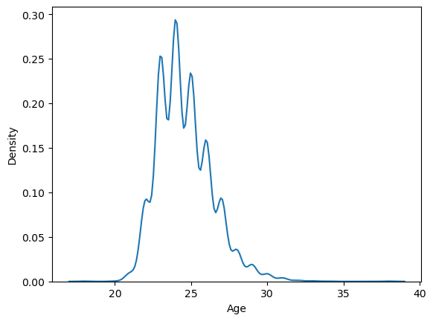
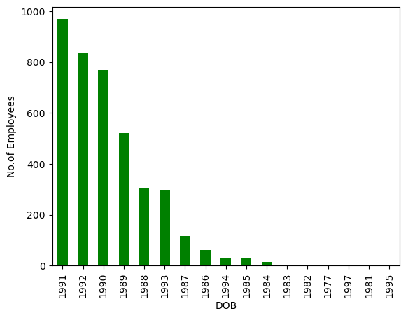
- From the above we can observe that
1. Most of the employees are in an age range of 21 to 28
2. Most of the employees were born in between 1990 to 1992

Slide 8
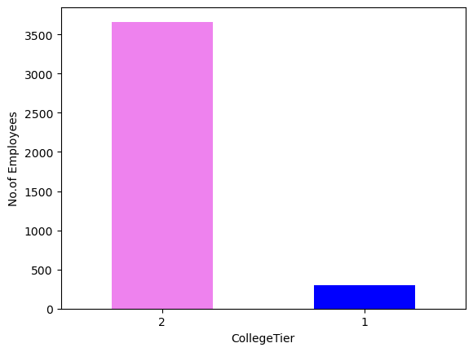
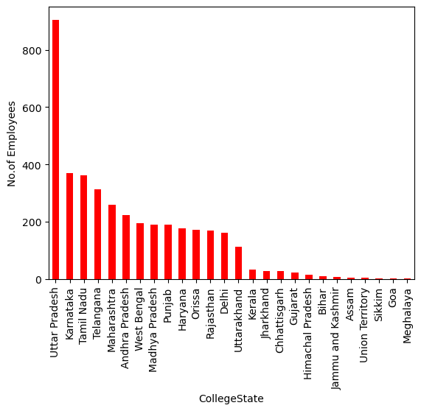
From above we can observe
- Most of the employees are form tier 2 colleges
- Most of the employees are from the state “Uttar Pradesh”

Slide 9
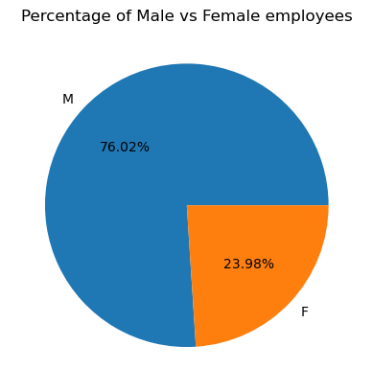
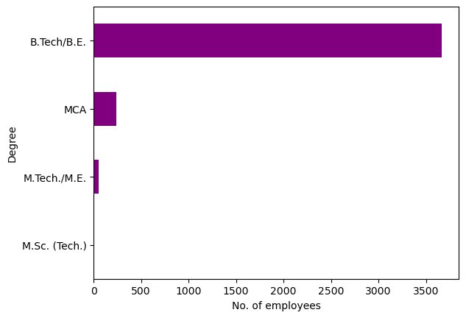
From above we can observe
- Most of the employees are Male
- Most of the employees are from the B.Tech/B.E. background

Slide 10
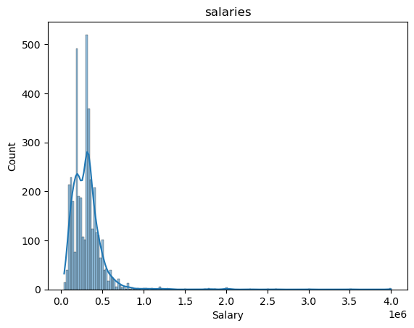
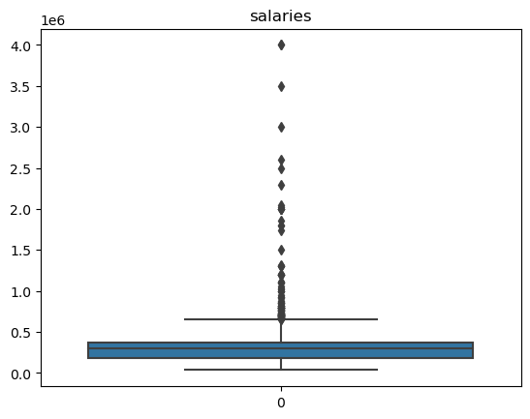
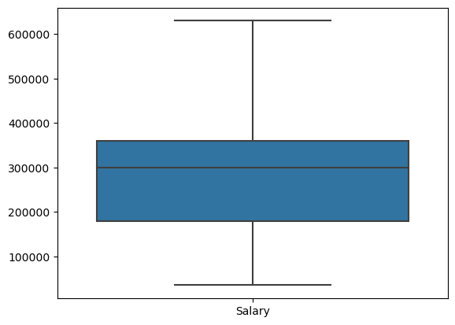
From above we can observe
- Most of the employees are having an salary range of 35000 to 600000
- There exist a lot of outliers in the salary because there might be employees having more experience, skills or higher position in the company.

Slide 11
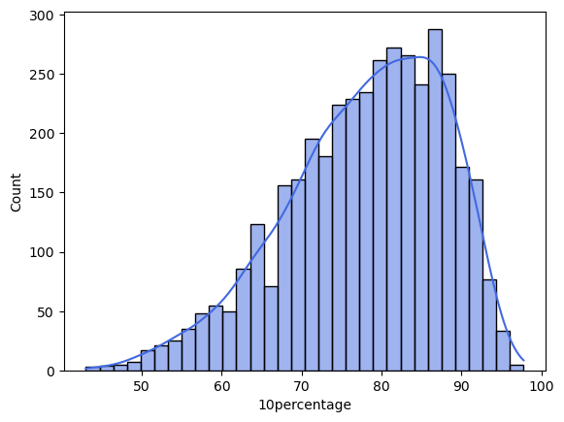
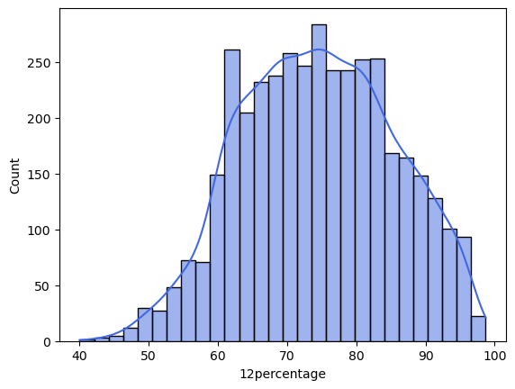
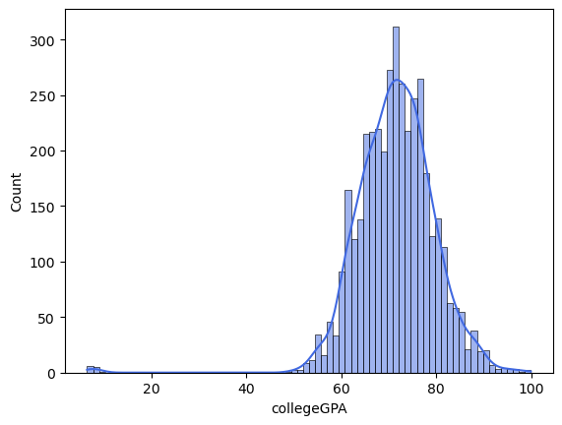
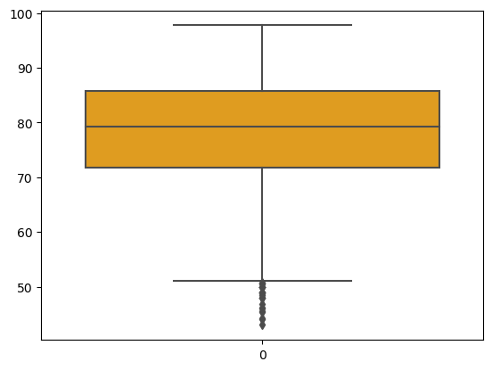
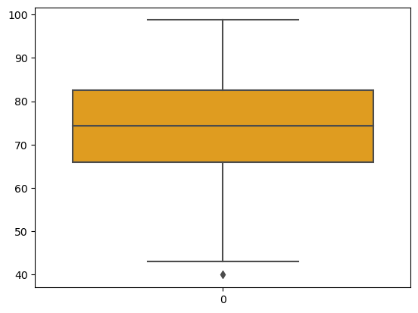
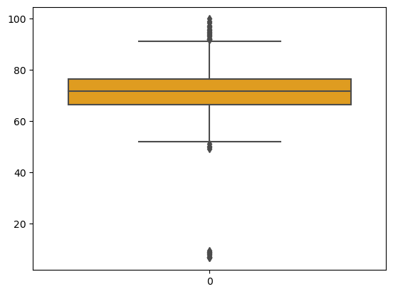
From above we can observe
- Avg of '10percentage', '12percentage', 'collegeGPA’ is around 80,75,70
- There are some outliers in the data due to some low scorers.

Slide 12
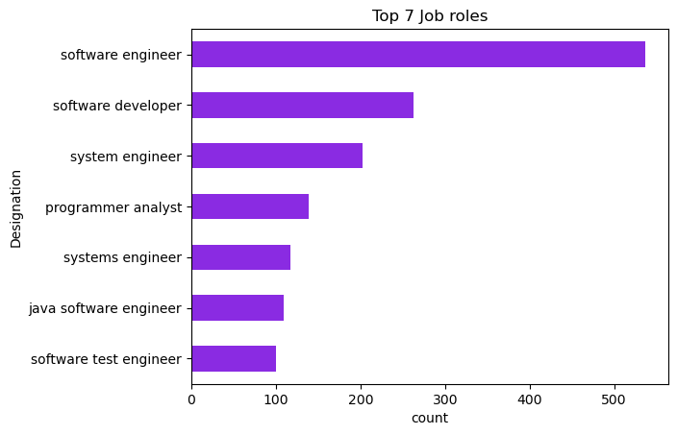
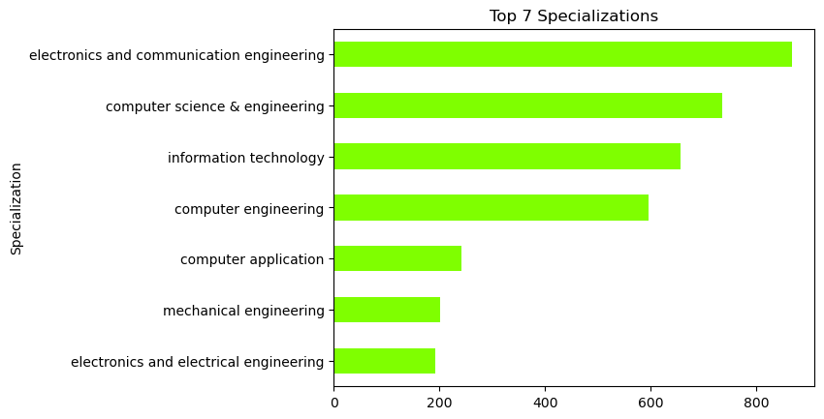
From above we can observe
- Most of the employees are working under the role software engineer
- Most of the employees have specialized their graduation in Electronics and Communication Engg.

Slide 13
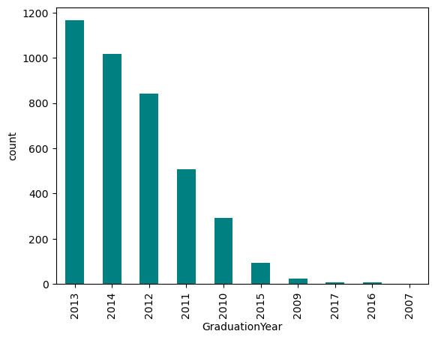
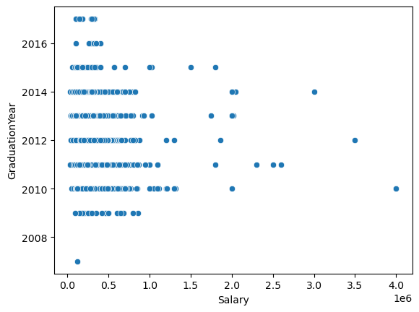
From above we can observe
- Most of the employees have completed their graduation between 2012 to 2014
- Employees who have passed out between 2010 to 2014 seem to have a higher salary as the salary increases along with the expertise and experience.

Slide 14
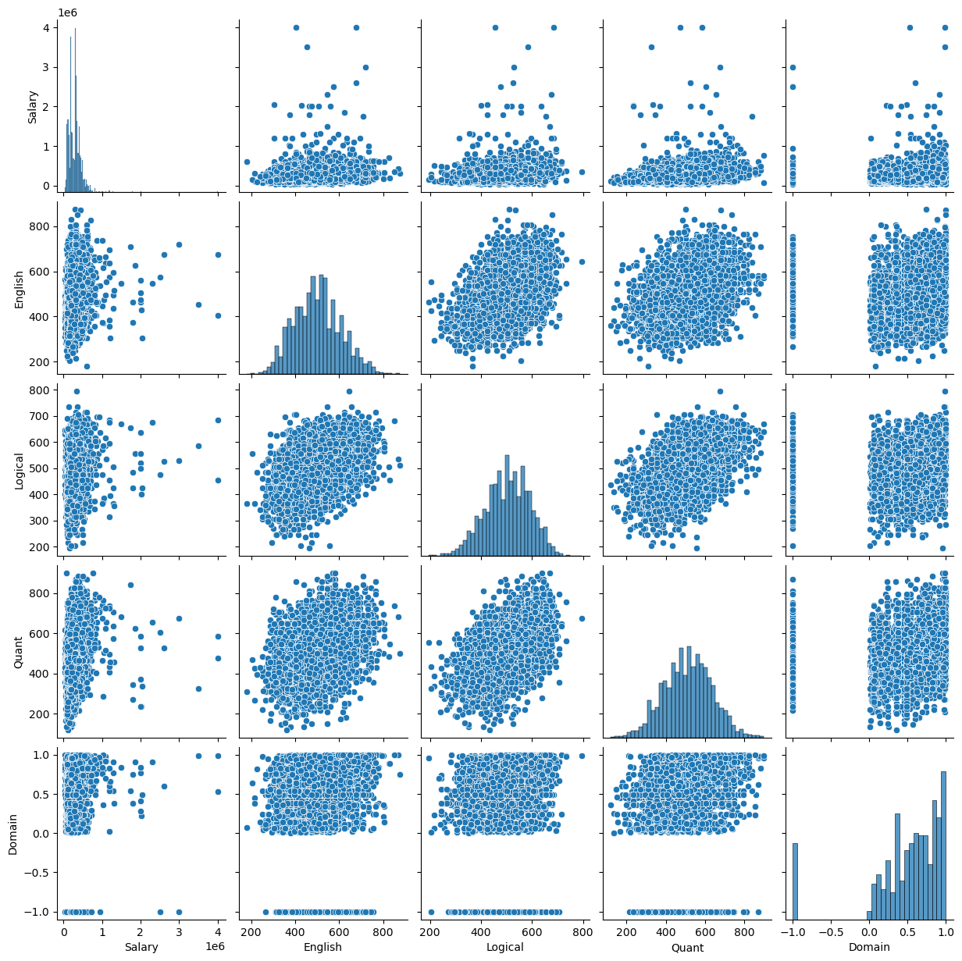
Pair Plot of Salary vs marks
- We can observe that the scores like
Logical and quant ability have a positive co-relation .
- the English and logical skills have a positive co-relation.

Slide 15
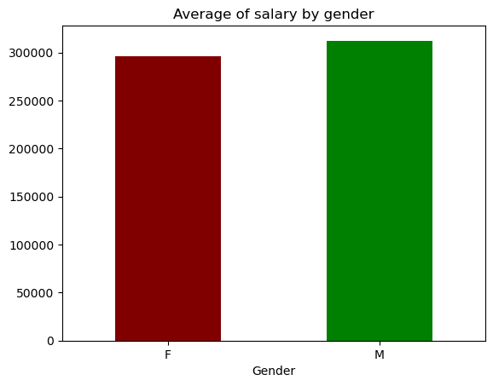
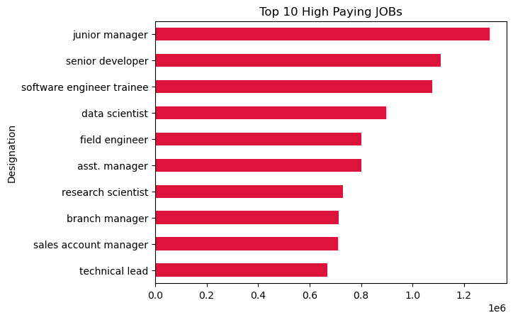
From above we can observe
- The average salaries of male and female differ by around 2k.
- On right we have a graph showing the highest paying roles in the market.

Slide 16
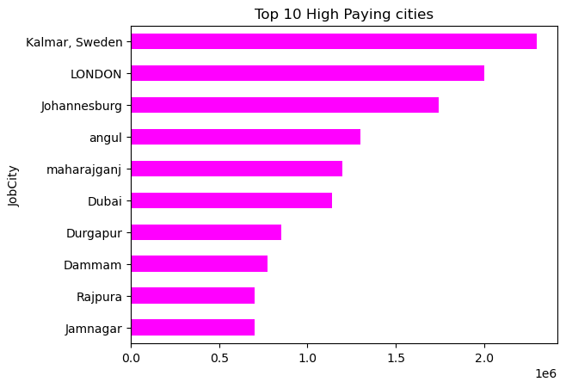
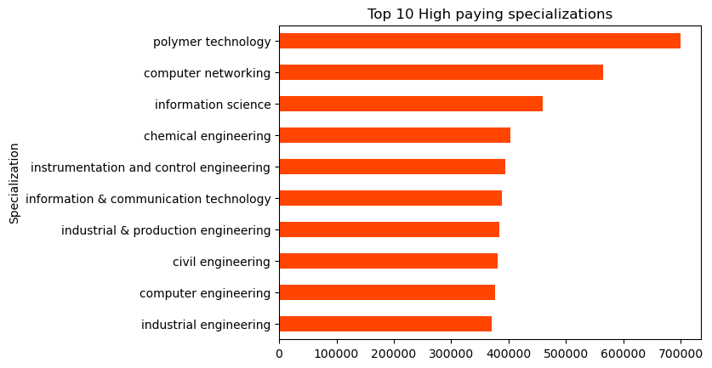
From above we can observe
- Most of the highest paying cities are outside India.
- The specialization fields like polymer technology and computer networking offers a higher salary package.

Slide 17
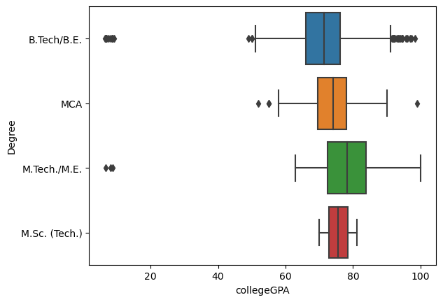
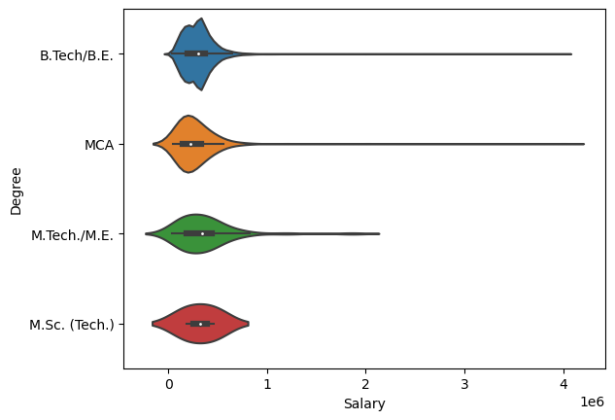
From above we can observe
- From left most of the outliers are in the B.tech degree as there might be a input error or because of different grading system maybe.
- The people from B.tech and MCA have a higher max salary compared to the rest degrees.

Slide 18
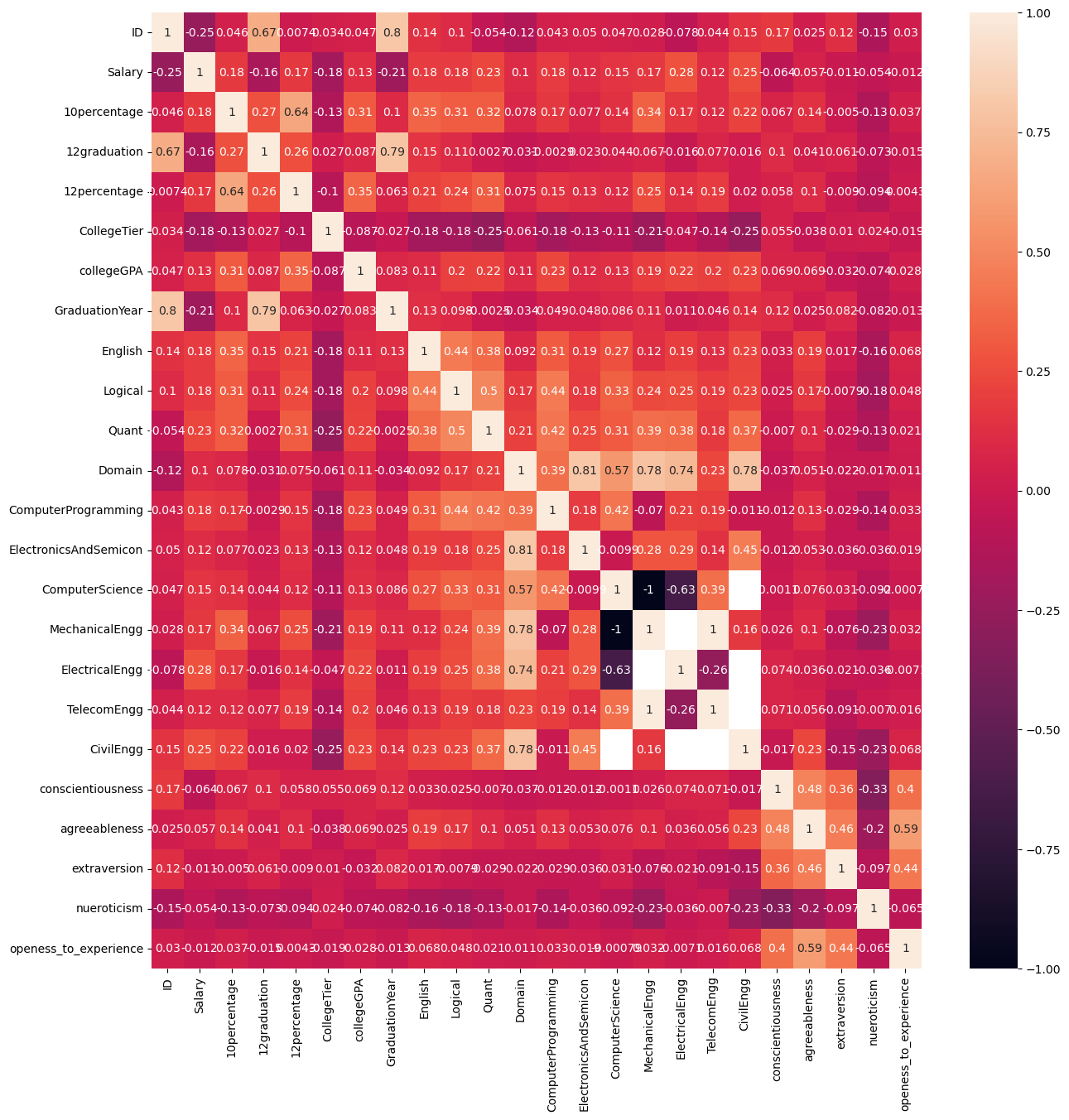
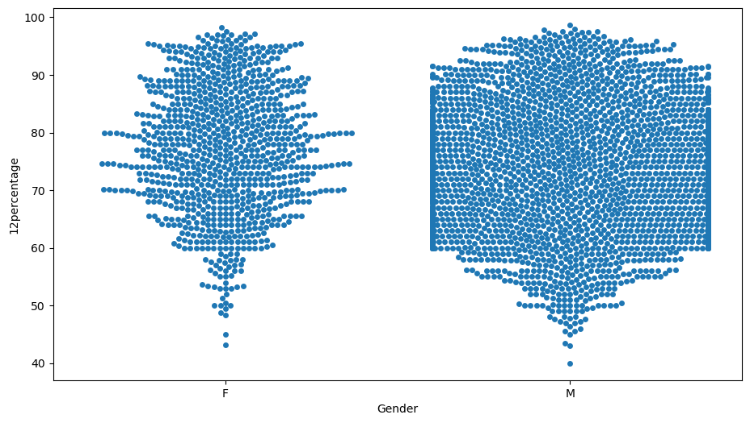
From above we can observe
- Most of the columns are slightly correlated.
- some columns are totally unrelated.
- domain column has strong relation with their exam specialization.
- Most of the marks in the 12percentage are between 60 to 90 range.

Slide 19
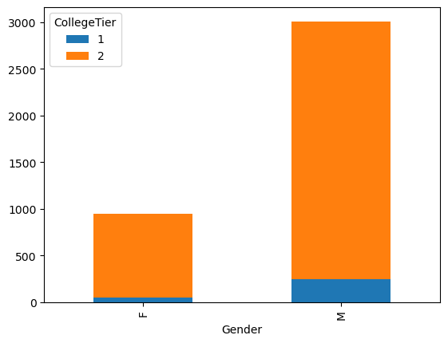
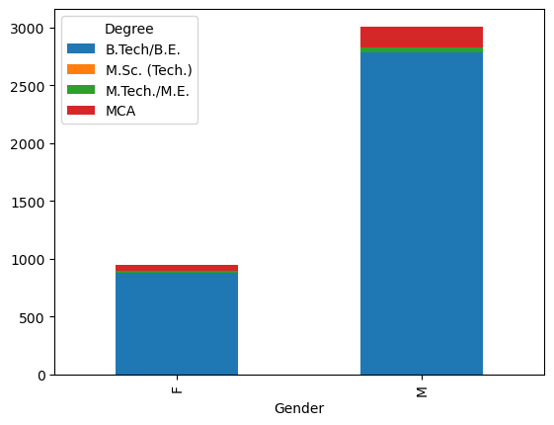
From above we can observe
- Most of the male and female are from tier 2 colleges and most of them are from B.tech background.

Slide 20
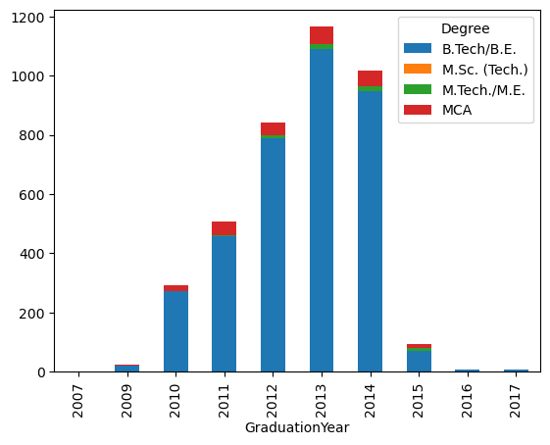
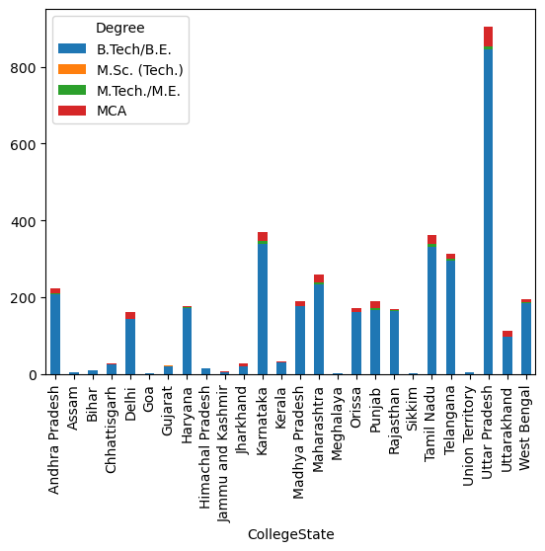
From above we can observe
- Most of the B.tech graduates are from uttar Pradesh and many have graduated in 2013

Slide 21
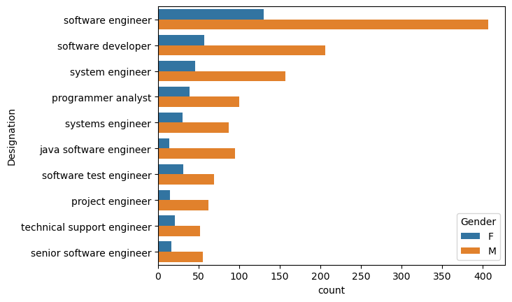
From above we can observe
- Most of the bars show that there are twice the men working in the same field as women.

Slide 22
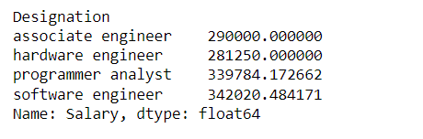
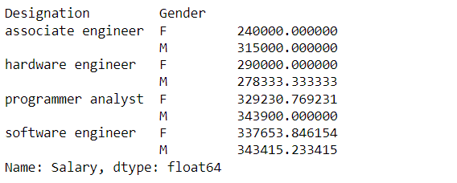
Research Questions
Times of India article dated Jan 18, 2019 states that “After doing your Computer Science Engineering if you take up jobs as a Programming Analyst, Software Engineer, Hardware Engineer and Associate Engineer you can earn up to 2.5-3 lakhs as a fresh graduate.”
From above we can observe that there the given insight was correct.

Slide 23
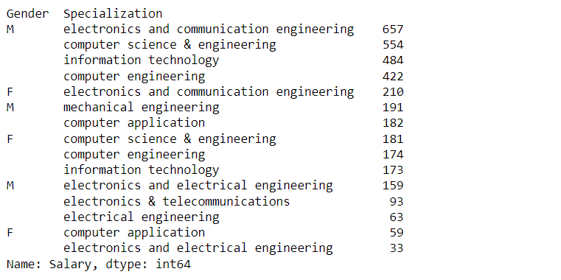
- Is there a relationship between gender and specialization? (i.e. Does the preference of Specialisation depend on the Gender?
From above we can observe
- Most of the men and women choose ECE as first priority and CSE as second priority.

Slide 24
Conclusion:
- Most of the people have done B.Tech
- Most of the employees are male
- We found varying salary trends across various designations.
- We found that most of the high paying jobs are related to computers.

Slide 25

THANK YOU

