Slide 1
Price Analysis On Air Conditioners
Project On

Slide 2

About me
Vijay sada
B-tech in Electronics and Communications Engineering.
Fresher

Slide 3
Problem Statement:
The aim of this project is to provide the customer with insights about the different types of AC products available and to help them in decision-making
Objective:
The main focus will be on providing information about features, benefits, prices, and energy efficiency ratings of popular air conditioner models. We will also help customers to compare and contrast different models based on their individual needs and preferences.

Slide 4
CONTENTS -
Web Scrapping
Data cleaning
Data Analysis
Data Visualization
Conclusion

Slide 5


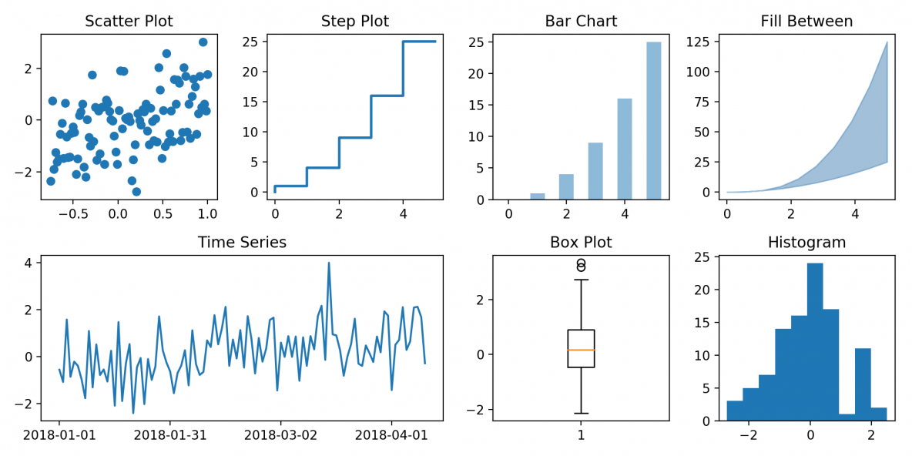
WEB SCRAPING:
Website Used - Flipkart.com
Libraries Used : requests, BeautifulSoup, re
DATA CLEANING:
Libraries Used : pandas, NumPy.
DATA ANALYSIS:
Libraries Used : pandas, NumPy.
DATA VISUALIZATION:
Libraries Used : pandas, matplotlib, seaborn.

Slide 6
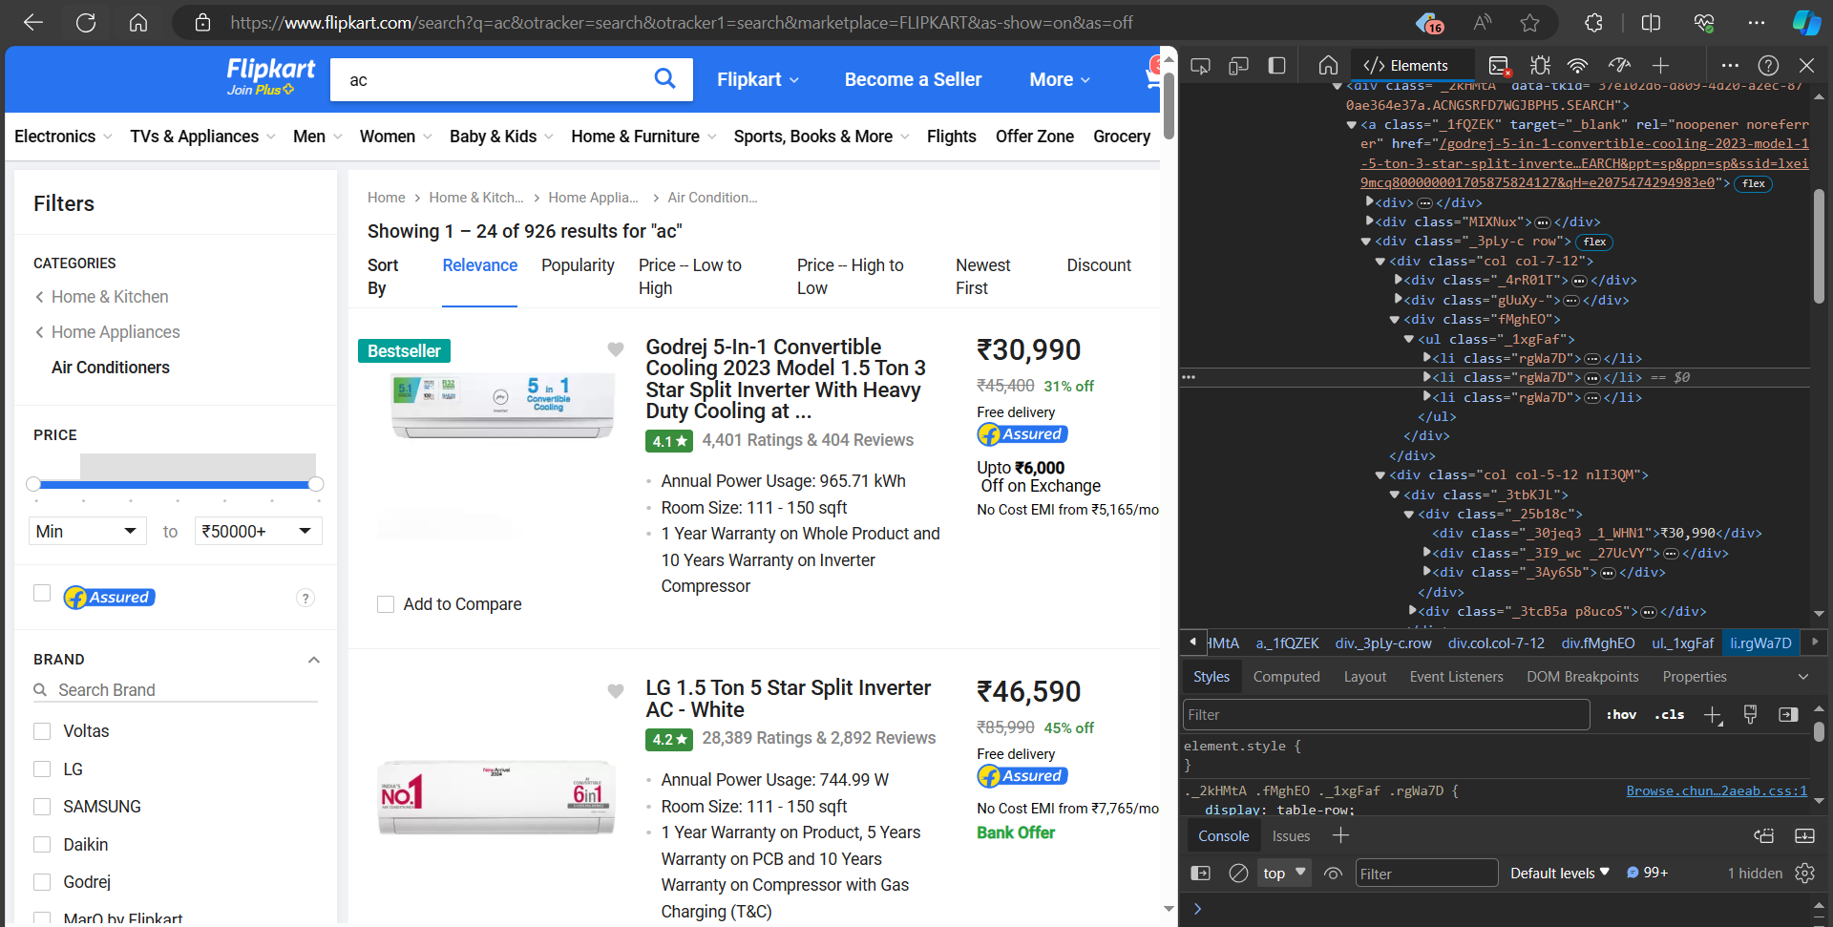
Website - Ac- Buy Products Online at Best Price in India - All Categories | Flipkart.com

Slide 7
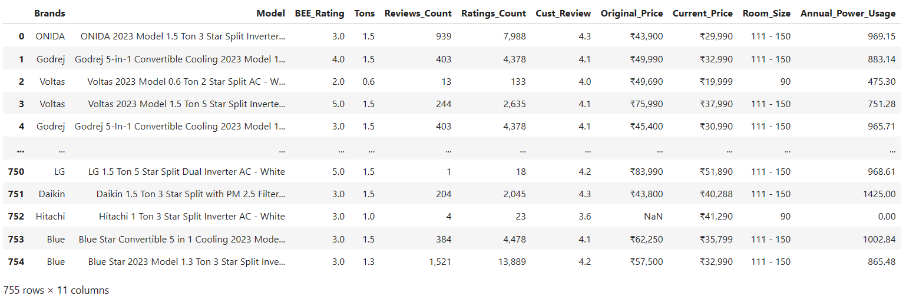
Data Collected -
RAW DATA:

Slide 8
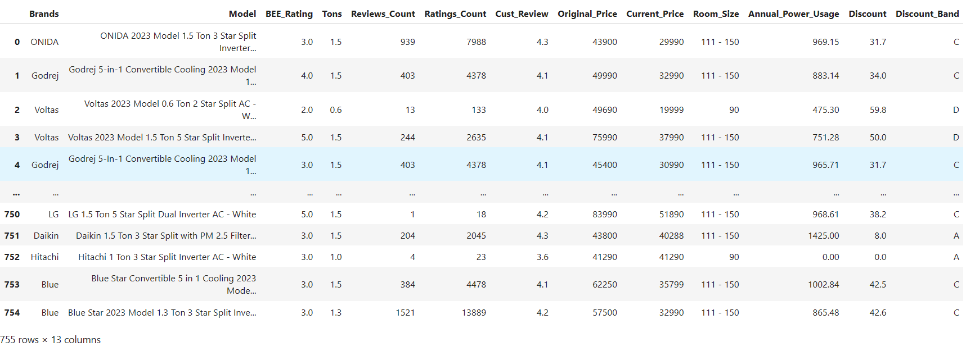
CLEANED DATA:

Slide 9
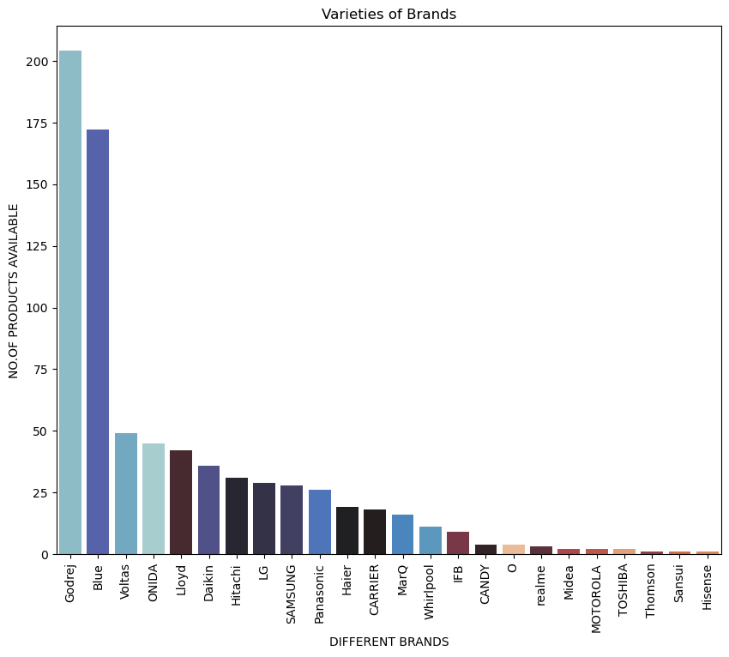
Count Plot of Brands:
- on x-axis: we have different brands.
- on y-axis: we have the count of products available.
Observation :
From the plot we can observe the Brands “Godrej” around 200+ and “Blue” around 160+ have a wide range of AC products available in the market.

Slide 10
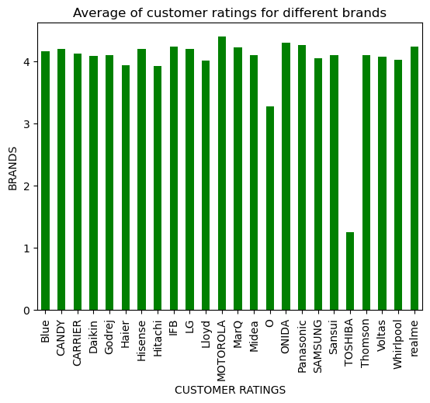
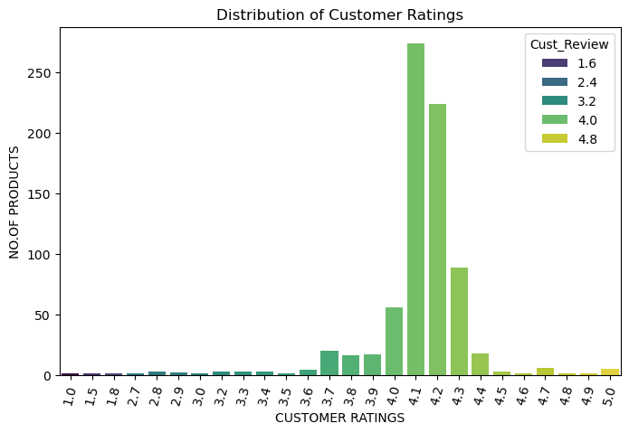
- We can observe that most of the products have an average ratings of around 4.1 to 4.3.

Slide 11
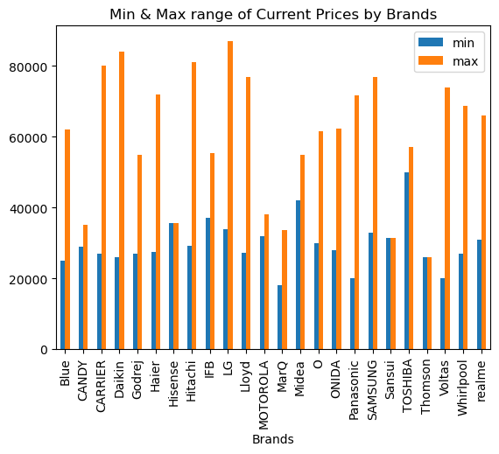
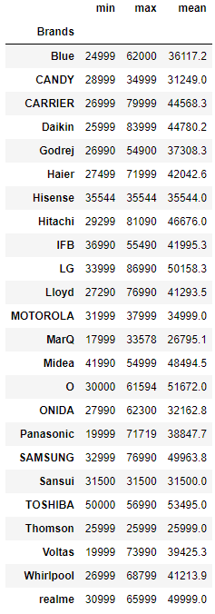
- The product from “MarQ” has the lowest price = 17999
and “LG” has the highest price = 86900

Slide 12
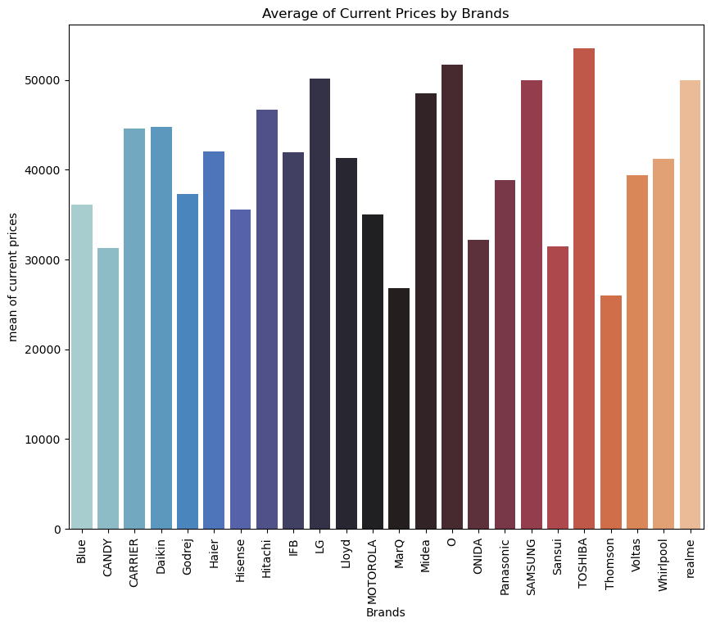
- The product from “Thomson” has the lowest avg price = 25999
and “Toshiba” has the highest avg price = 53495

Slide 13
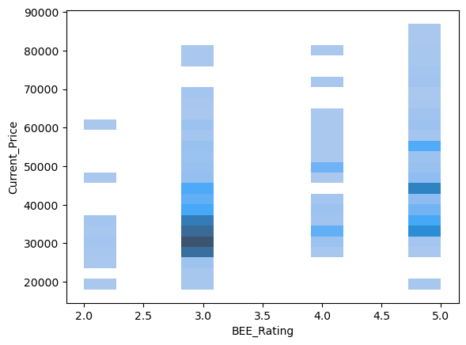
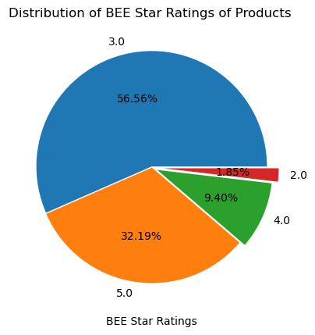
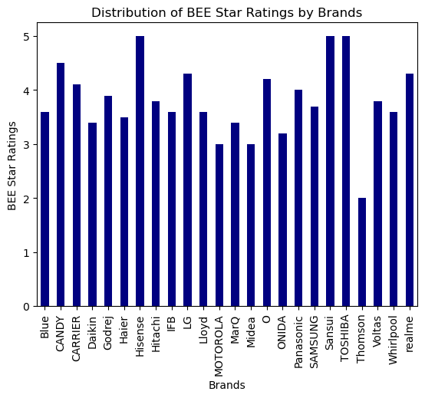
- We can observe that as the BEE_Rating increases the price of the products also increases.
- And most of the products are with a BEE_Rating of 3.0 and 5.0.
- “Sansui”,”Hisense” and “Toshiba” have the highest avg power efficiency ratings.

Slide 14
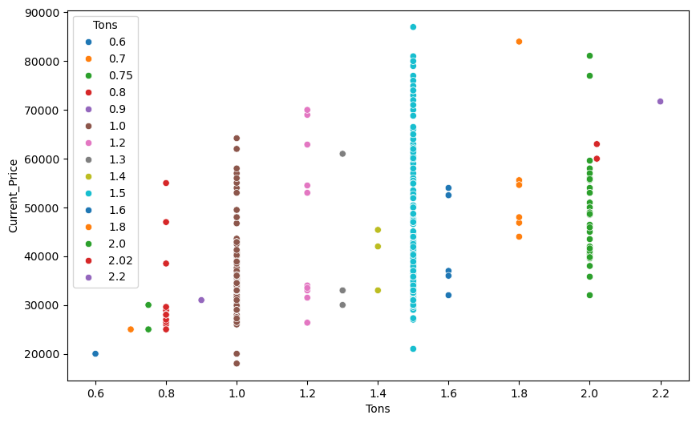
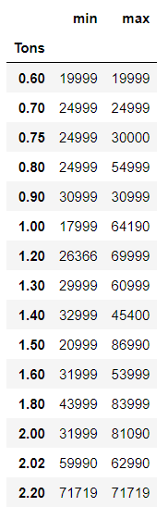
- The price range of products with 1.0 Tons capacity starting from around 17k and goes up to 65k
- The price range of products with 1.5 Tons capacity starting from around 20k and goes up to 87k
- From the plot we can observe that most of the products are with a Tons capacity of 1.0 and 1.5

Slide 15
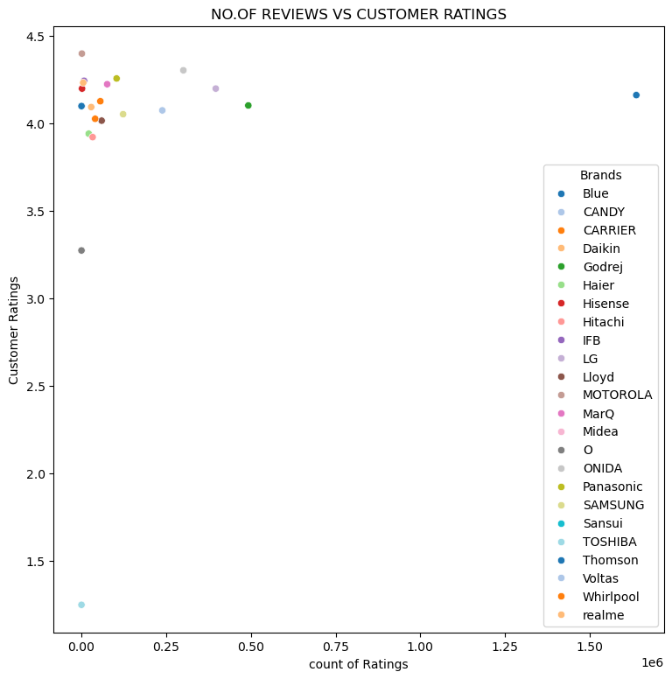
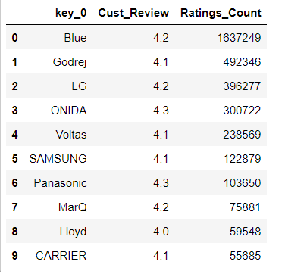
- We can observe that the top brands like “Blue” and “Godrej” have the highest ratings count and an average customer rating of 4.1.
- From the above observations we can say that the best selling brands of AC’s are from “Blue” and “Godrej”

Slide 16
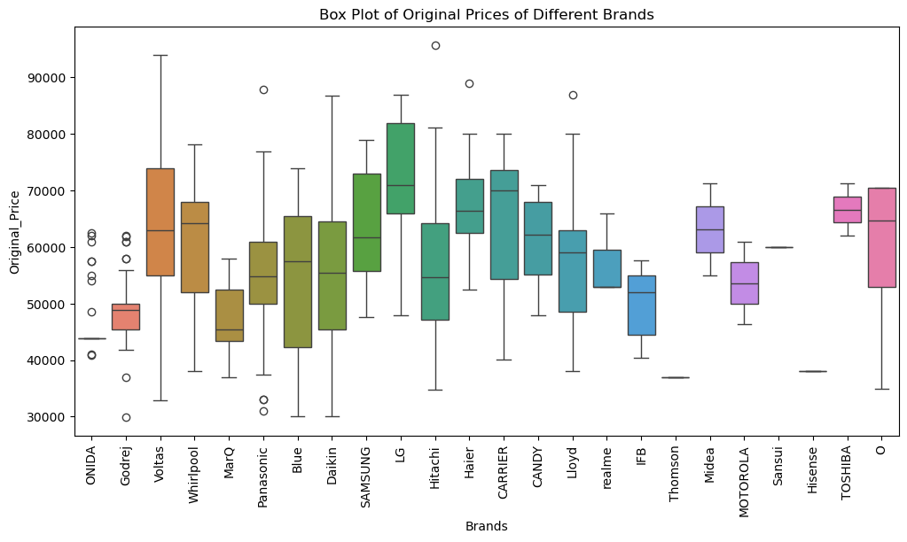
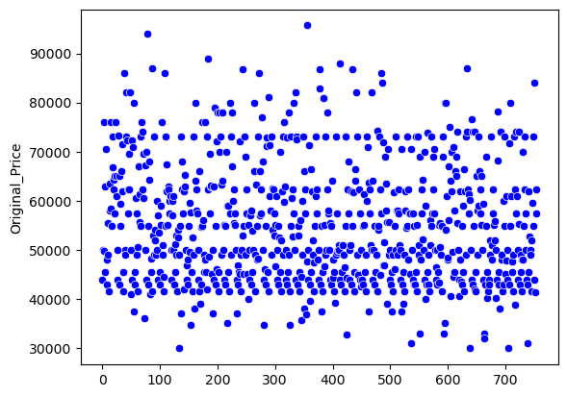
- We can observe that the original prices of most of the products are within a price range of 30K to 80K
- The outliers we observe in some brands are due to some advanced feature that are available in some of it’s products.

Slide 17
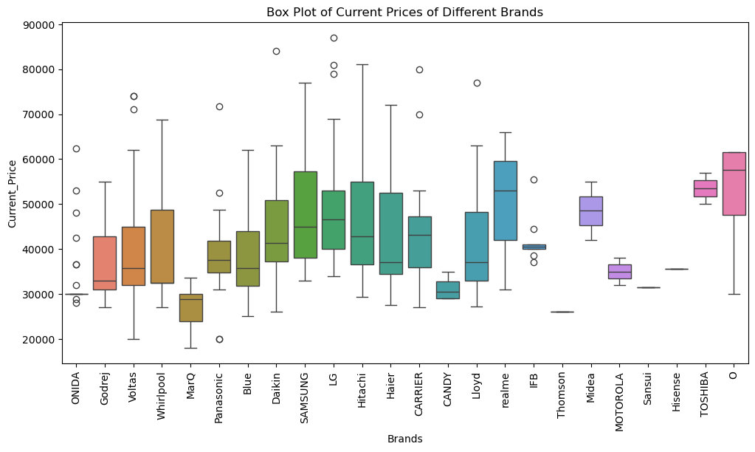
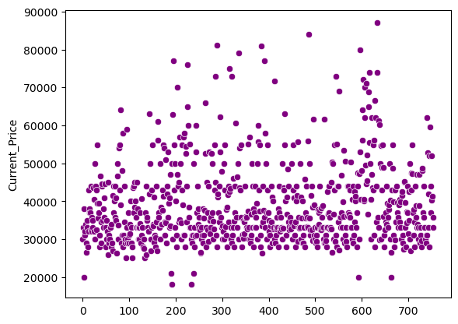
- We can observe that the current prices of most of the products are within a price range of 20K to 65K
- The outliers we observe in some brands are due to some products may not have any discount on them or due to some additional features that are available in some of it’s products.

Slide 18
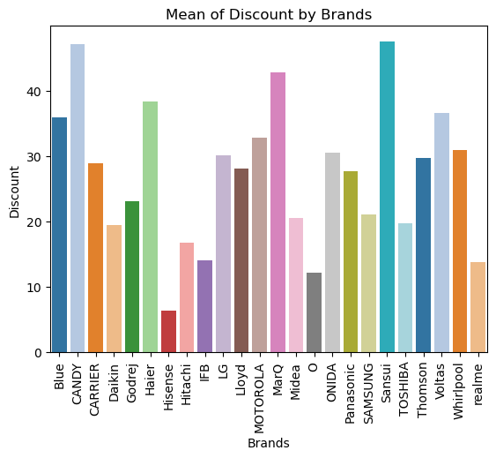
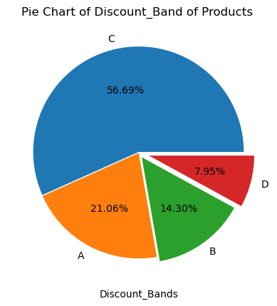
Discount Band:
A – 0 to 15 %
B – 15 to 30 %
C – 30 to 45 %
D – 45 to 60 %
- Brands like “Hisense” and “O” are providing an low range of discount on their products.
- Brands like “CANDY” and “Sansui” are providing an high range of discount on their products.

Slide 19
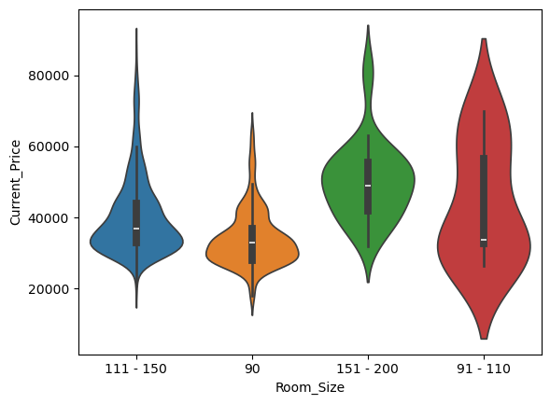
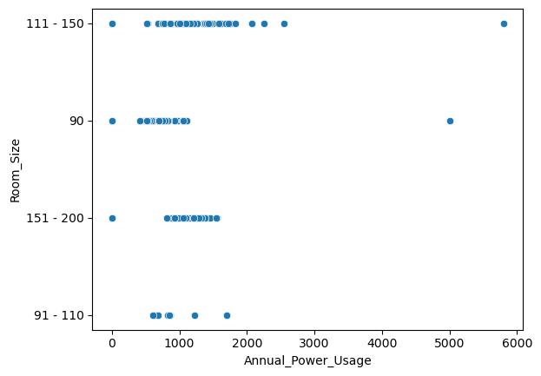
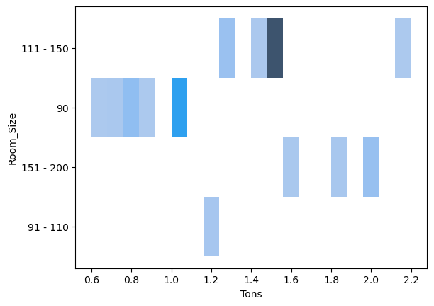
- From the above we can observe that price ranges of products with respect to their room sizes.
- All the AC’s on an average consume 1000Kwh of power per year.
- The distribution of the AC’s Tons varies with the room sizes

Slide 20
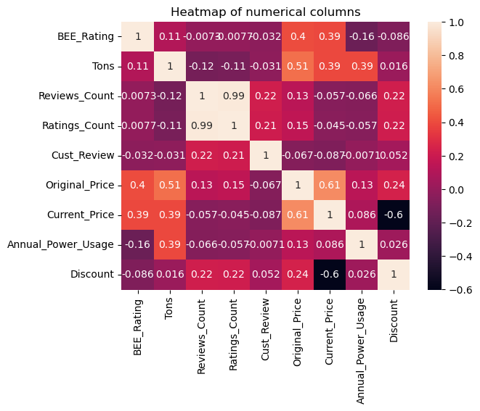
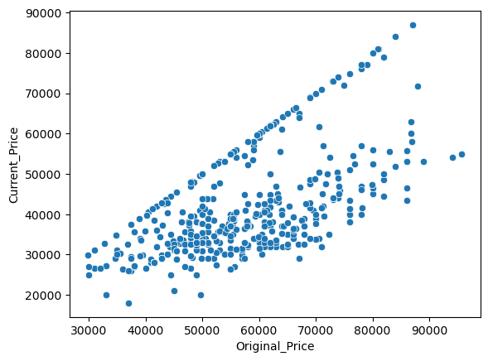
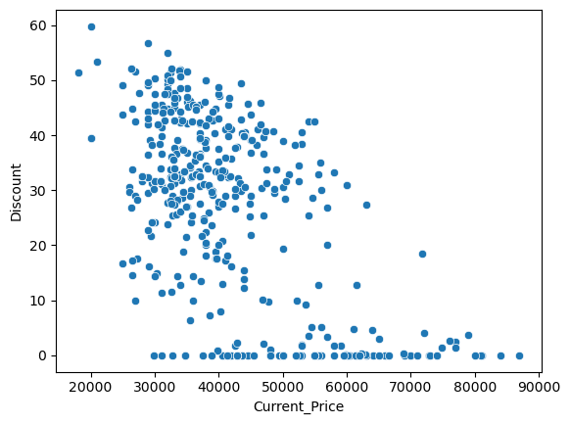
- From the above graphs we can observe the correlation between different numerical columns in the dataset.
The original and current price columns have an + ve correlation
The current price and discount have an – ve correlation

Slide 21
Conclusion:
- The top 3 selling brands in the dataset are “Blue”, “Godrej” and “LG”. “Blue” & “Godrej” offer lots of varieties.
- The products are available from the price of 17k and go up to 87K.
- We can observe that most of the ACs are of 1.5 Tons capacity which is ideal for 130 sqft. room which is avg. size of an Indian bedroom.
- The columns BEE_Rating, Tons have a positive co-relation with current price as BEE_Rating refers to the power efficiency of the product, Tons refer to the cooling capacity of the product and they have an impact on price as the better the rating is the less your electricity charges, similarly higher the Tons capacity the better the cooling capacity are and it’s a huge plus in the long run.

Slide 22

THANK YOU

