Slide 1

PROJECT PLAN
Grid Frequency Control with 5G Communication
TEAM ME
MBERS: Lubna Basha Mohammed & Santhosh Kumar Vijayalakshmi Murugan
TEAM SUPERVISORS: Dr. Rolando Cortés, Riya Mathew
DATE: 7th May 2025

Slide 2

CONTENTS
01
02
03
Introduction
Objective
Subsystems
04
05
06
Overview
Task Organization
Working Plan

Slide 3

01
INTRODUCTION

Slide 4
GRID FREQUENCY CONTROL WITH 5G
COMMUNICATION
Future Grids rely heavily on renewable energy sources (RES) like solar, wind, and hydro, which require flexible and reliable communication for control parameters (voltage/frequency).
Current solutions (e.g., wired Ethernet/optical fiber) are costly and inflexible.
5G technology offers low latency, high reliability, massive device capacity, and network slicing, making it ideal for real-time Grid control.

Slide 5
GRID FREQUENCY CONTROL WITH 5G
COMMUNICATION
Implementing a existing grid frequency control system in distributed energy resources (DERs).
Integrate and utilize 5G communication technology for real-time control.
Demonstrate how 5G enables communication between controllers.
Evaluate system performance with 5G versus Wired Communication.

Slide 6
02
OBJECTIVE

Slide 7
GRID FREQUENCY CONTROL WITH 5G
COMMUNICATION
Integrate 5G communication system into a real-time PHIL (Power Hardware-in-the-Loop) based frequency control testbed.
Evaluate the performance of 5G communication in comparison to traditional wired networks (e.g., Ethernet).
Evaluating the different topologies like Centralized, Localized and Distributed systems.

Slide 8
NOVELTY

Slide 9
GRID FREQUENCY CONTROL WITH 5G
COMMUNICATION
First Integration of 5G in PHIL Lab: Demonstrates real-time 5G-based control for grid frequency stabilization using a Power-Hardware-in-the-Loop (PHIL) setup, unlike traditional wired solutions.
Dynamic Slicing for Grid Resilience: Leverages 5G network slicing to prioritize critical grid signals, ensuring ultra-reliable low-latency communication (URLLC) during frequency fluctuations.

Slide 10
03
SUBSYSTEMS

Slide 11
GRID FREQUENCY CONTROL WITH 5G
COMMUNICATION
Subsystem A
Subsystem B
PHIL Lab Familiarization
5G Communication Setup
SUBSYSTEMS
Subsystem C
Subsystem D
System Integration.
Testing & Analysis

Slide 12
04
OVERVIEW

Slide 13
GRID FREQUENCY CONTROL WITH 5G COMMUNICATION
Subsystem A: PHIL Lab Familiarization
Study the PHIL lab documentation and hardware setup.
Learn Simulink control models.
Test individual DG units and RTC integration.

Slide 14
GRID FREQUENCY CONTROL WITH 5G COMMUNICATION
Demo System Overview (PHIL Testbed)
A PHIL (Power Hardware-in-the-Loop) lab is used to emulate a real-time microgrid environment.
The setup includes four Distributed Generators (DGs): Battery Energy Storage System (BESS) / Fuel Cell / Supercapacitor / Grid-connected source
Each DG is controlled by a dedicated Real-Time Controller (RTC).

Slide 15
GRID FREQUENCY CONTROL WITH 5G COMMUNICATION
Demo System Overview (PHIL Testbed)
Controllers communicate via either wired (Ethernet) or wireless (5G) connections.
PHIL allows high-fidelity simulation of power systems interacting with actual control hardware.
Provides a safe and flexible platform to evaluate 5G in a controlled, repeatable environment.

Slide 16
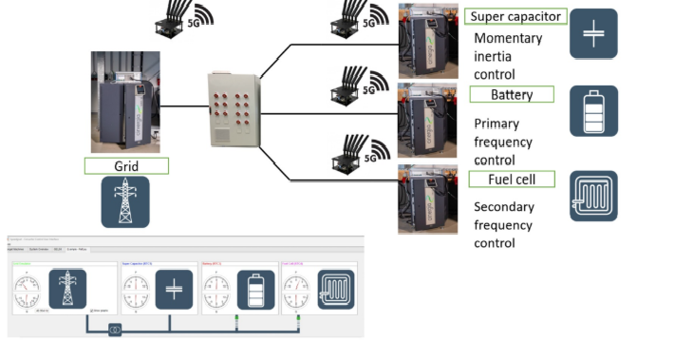
GRID FREQUENCY CONTROL WITH 5G COMMUNICATION
Demo System Overview (PHIL Testbed)

Slide 17
GRID FREQUENCY CONTROL WITH 5G COMMUNICATION
Subsystem B: 5G Communication Setup
Study the 5G module interface and configuration.
Test 5G network slicing setup for communication.
Defining the variable to be communicated from the RTCs by using topics.
Test the 5G network setup after adding delay blocks.

Slide 18
GRID FREQUENCY CONTROL WITH 5G COMMUNICATION
Subsystem C: System Integration
Implement frequency control scheme across distributed RTCs.
Integrate communication and control systems.

Slide 19
GRID FREQUENCY CONTROL WITH 5G COMMUNICATION
Subsystem D: Testing & Analysis
Compare convergence time of frequency regulation under: Wired communication, 5G without slicing, 5G with slicing + delay blocks
Test impact of communication delay using delay blocks in Simulink
Evaluate 3 control topologies:
Centralized – one RTC issues control signals
Localized – each DG responds independently
Distributed – RTCs communicate and coordinate control

Slide 20
05
TASK
ORGANIZATION

Slide 21
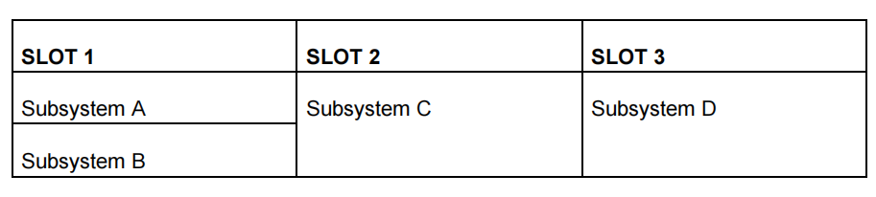
GRID FREQUENCY CONTROL WITH 5G COMMUNICATION
Order in which each subsystem has to be addressed:

Slide 22
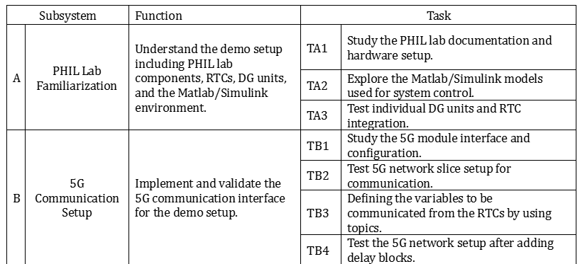
GRID FREQUENCY CONTROL WITH 5G COMMUNICATION
Functions and Tasks associated with subsystems:

Slide 23
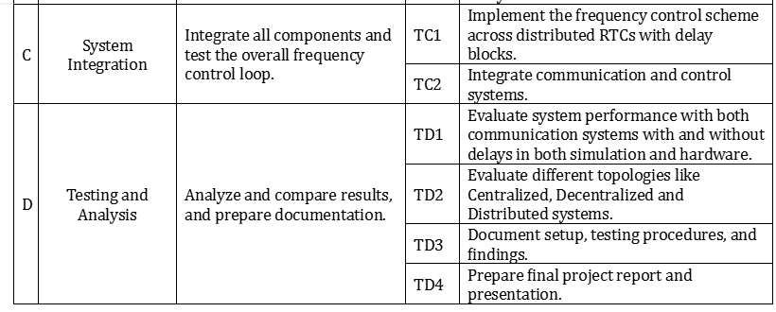
GRID FREQUENCY CONTROL WITH 5G COMMUNICATION

Slide 24
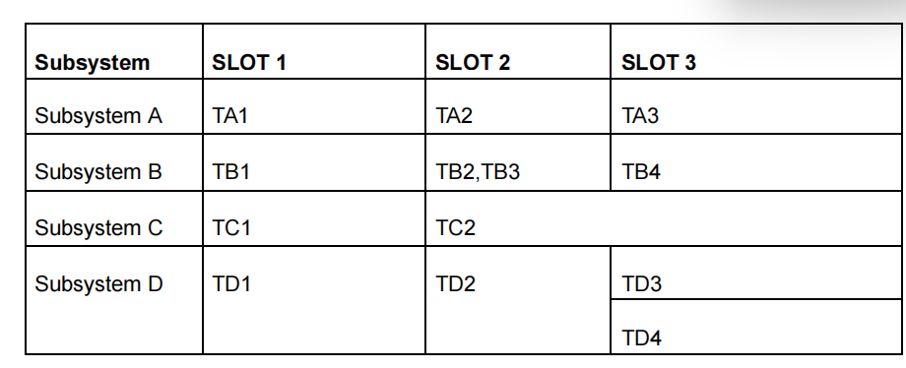
GRID FREQUENCY CONTROL WITH 5G COMMUNICATION
ORDERING FOR DIFFERENT TASKS

Slide 25
06
WORKING PLAN

Slide 26
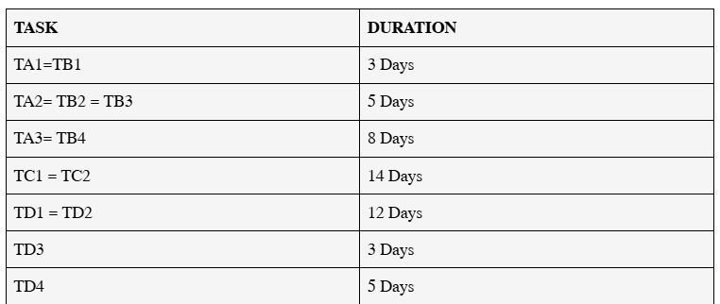
GRID FREQUENCY CONTROL WITH 5G COMMUNICATION
PROPOSED DURATION FOR EACH TASK

Slide 27
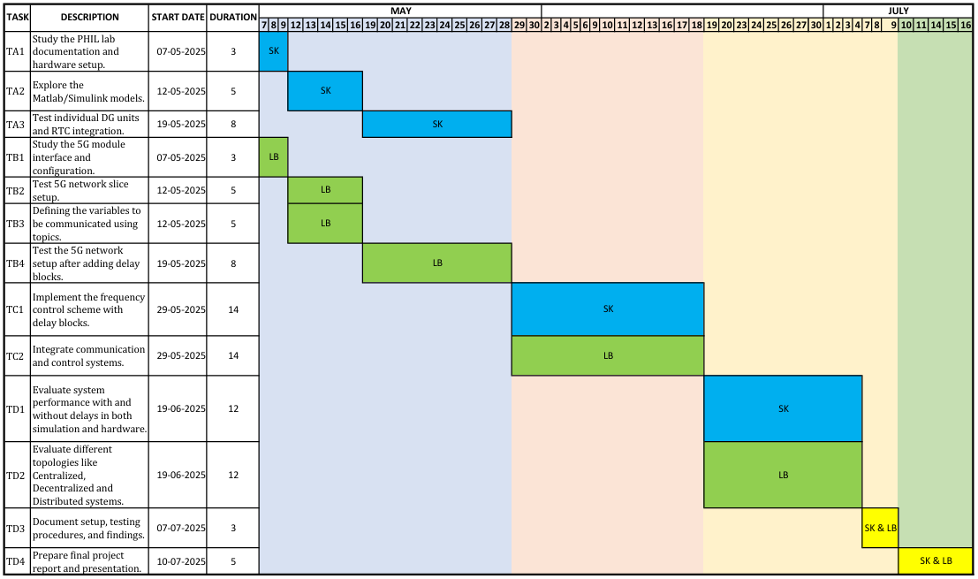
GRID FREQUENCY CONTROL WITH 5G COMMUNICATION
EXAMPLE OF WORKING PLAN

Slide 28
QUESTIONS????

Slide 29
THANK YOU
LUBNA BASHA MOHAMMED
&
SANTHOSH KUMAR VIJAYALAKSHMI MURUGAN

