Slide 1
DG unit
ROS 2 Node
ros2mqtt topic
MQTT topic
Mqtt2ros topic
DG unit
ROS 2 node
MQTT topic
Data Flow in New Version of UDP Communication
Data Flow in Old Version of UDP Communication

Slide 2
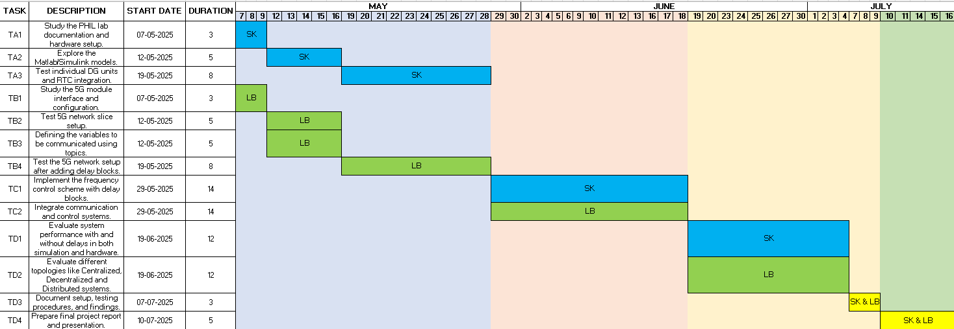

Slide 3
DG unit 1
ROS node 1
ros2mqtt Topic
mqtt Topic
Mqtt2ros node
DG unit 2
ROS node 2
DG unit 1
ROS node 1
mqtt Topic
ROS node 2
DG unit 2

Slide 4
COMPONENTS | PARAMETERS | QoS LEVELS
Grid Emulator | Reference Frequency | 2
 | Measure d Frequency | 2
 | Phase Voltage | 1
Super Capacitor | Mode of operration | 0
 | Phase voltage | 1
Battery | Mode of operration | 0
 | Phase voltage | 1
 | Active power | 1
Fuel cell | Mode of operration | 0
 | Phase voltage | 1
 | Active power | 1
COMPNENT STATUS | Check whether components are working or not | 2
COMPNENT LOGS | Logs the component data | 0
Alert signal | Grid failure | 2
Connectivity status | Confirm the 5g connectivity for every 2mins | 0

Slide 5
