Slide 1
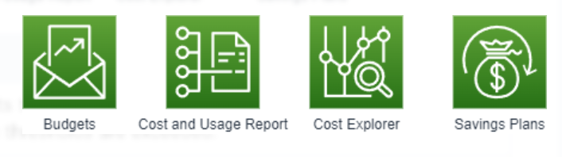
Cost Management
service | feature
Budgets | Set custom budgets to track costs and usage, and email or social media notifications when thresholds are exceeded.
Cost and Usage Report | You can create cost and usage reports.
Cost Explorer | Visualize, understand, and manage AWS costs and usage over time.
Savings Plans | Get a discount by signing up for a one-year or three-year term. EC2, Lambda, Fargate, and SageMaker are eligible.

Slide 2
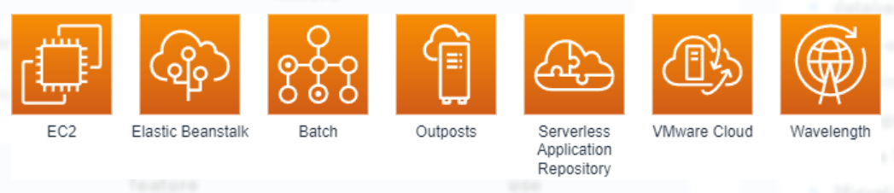
computing
Essential Services | feature
EC2 | virtual machine
Elastic Beanstalk | Automatically build a template environment for your application to run
EC2 Purchasing Options | feature | use
On-Demand Instances | Pay-as-you-go billing for usage time | Development environment and short-term use system
Reserved Instances | You can use it at a low price by signing a long-term contract (1 year or 3 years). | A system that has been decided to be used for a long time
Spot Instances | Low price, but can be disrupted | A system that can be interrupted

Slide 3

container
Essential Services | feature
ECS | There are two types of services for running and managing containers: EC2 type and Fargate type, and Fargate is recommended, as it does not require the construction and management of servers.
ECR | Service for registering and managing container images
EKS | Services that run Kubernetes on AWS or on-premises

Slide 4
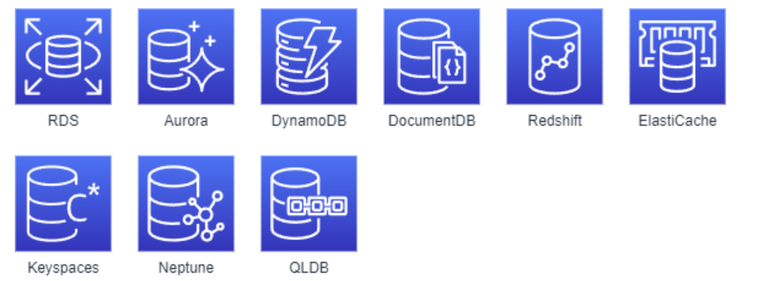
databases
Essential Services | feature
RDS | Provides a common RDB
Aurora | Provides RDB with better performance than RDS, with a choice of MySQL and PostgreSQL
DynamoDB | Provides key-value type NoSQL.
DocumentDB | Compatible with document data in JSON format, compatible with MongoDB
Redshift | Mainly used for DWH
ElastiCache | It can be used for temporary data storage such as caches, and can be accessed at high speed, Redis can persist data, and Memcached is temporary and high-performance.

Slide 5
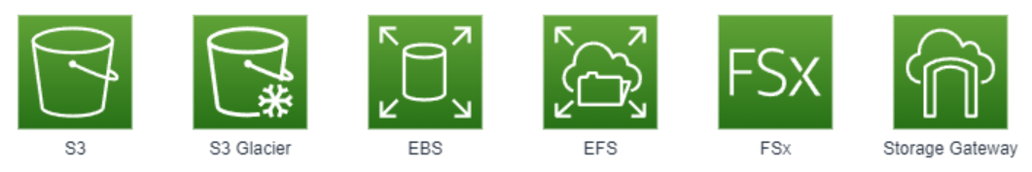
storage
Essential Services | format | capacity | Concurrent access | feature
S3 | object | unlimitedness | passable | Access data via HTTP/HTTPS
EBS | Block Storage | 16TB | bad | Local storage for EC2 instances
EFS | Storage | unlimitedness | passable | Available from multiple EC2 instances
FSx | Storage | 64TB | passable | Windows type that supports CIFS and SMB protocols Lustre for HPC environments

Slide 6
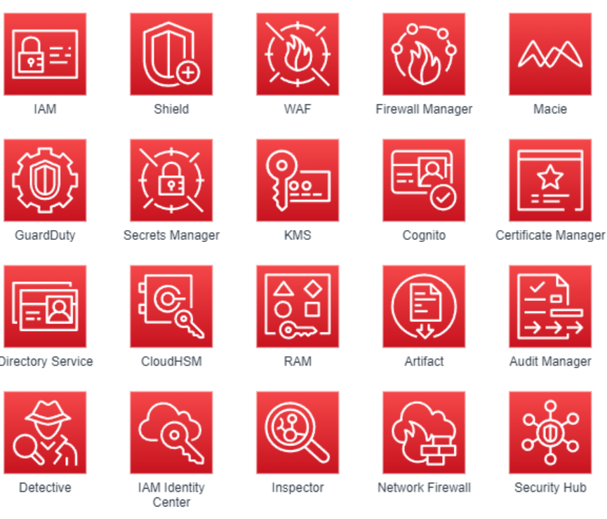
Security, Identity & Compliance

Slide 7
Essential Services | feature
IAM(Identity and Access Management) | Provide fine-grained access control across all of AWS.
Shield | Protect ELB and CloudFront from DDoS attacks. There is a free Standard and an advanced one that provides advanced protection for a fee.
WAF | Protect your web apps from cross-site scripting and SQL injection. You can restrict the regions that can be accessed by Web ACL.
Firewall Manager | Centrally set and manage firewall rules for multiple AWS accounts and services.
Macie | Identify and classify sensitive data using machine learning and pattern matching for objects in S3.
GuardDuty | Detect malicious activity or unauthorized behavior within your AWS account.
Secrets Manager | Manage authentication information when accessing the DB, etc., with automatic update function.
KMS | Create and manage S3 and EBS encryption keys.
Cognito | Provides user authentication capabilities for mobile and web apps.
ACM(AWS Certificate Manager) | Create and manage SSL/TLS certificates.

Slide 8
Cost Management
service | feature
Budgets | Set custom budgets to track costs and usage, and email or social media notifications when thresholds are exceeded.
Cost and Usage Report | You can create cost and usage reports.
Cost Explorer | Visualize, understand, and manage AWS costs and usage over time.
Savings Plans | Get a discount by signing up for a one-year or three-year term. EC2, Lambda, Fargate, and SageMaker are eligible.

Slide 9
Cost Management
service | feature
Budgets | Set custom budgets to track costs and usage, and email or social media notifications when thresholds are exceeded.
Cost and Usage Report | You can create cost and usage reports.
Cost Explorer | Visualize, understand, and manage AWS costs and usage over time.
Savings Plans | Get a discount by signing up for a one-year or three-year term. EC2, Lambda, Fargate, and SageMaker are eligible.

Slide 10
Cost Management
service | feature
Budgets | Set custom budgets to track costs and usage, and email or social media notifications when thresholds are exceeded.
Cost and Usage Report | You can create cost and usage reports.
Cost Explorer | Visualize, understand, and manage AWS costs and usage over time.
Savings Plans | Get a discount by signing up for a one-year or three-year term. EC2, Lambda, Fargate, and SageMaker are eligible.

Slide 11
Cost Management
service | feature
Budgets | Set custom budgets to track costs and usage, and email or social media notifications when thresholds are exceeded.
Cost and Usage Report | You can create cost and usage reports.
Cost Explorer | Visualize, understand, and manage AWS costs and usage over time.
Savings Plans | Get a discount by signing up for a one-year or three-year term. EC2, Lambda, Fargate, and SageMaker are eligible.

