Slide 1
Image-Based Steganography for Secure Message Encryption and Decryption
CAPSTONE PROJECT
Presented By: Vijay Shikhre
Student Name : Vijay Shikhre
College Name & Department : Government College Of Engineering, Jalgaon / Computer Science

Slide 2
OUTLINE
Problem Statement
Technology used
Wow factor
End users
Result
Conclusion
Git-hub Link
Future scope

Slide 3
Problem Statement
With the increasing need for secure communication, traditional encryption methods are vulnerable to detection and attacks. This project presents an image-based steganography approach where secret messages are embedded within an image at the pixel level. By disguising data within an image, unauthorized parties remain unaware of the existence of hidden information, ensuring enhanced security and confidentiality.

Slide 4
Technology used
Programming Language: Python
Libraries:
OpenCV For image processing and manipulation
NumPy for efficient array manipulation
ASCII Encoding to convert characters into numerical values for embedding
Platform: Cross-platform (Windows/Linux)
Tools: Visual Studio Code

Slide 5
Wow factors
Invisible Data Embedding: The message is hidden in an image without altering its visible quality.
Custom Passcode Protection: The decryption process requires a correct passcode, adding a layer of security.
Minimal Data Loss: Ensures message retention without significant impact on image quality.
Simple and Efficient Algorithm: Easy implementation with low computational overhead.

Slide 6
End users
Cybersecurity Enthusiasts & Professionals – To explore new methods of secure communication.
Government & Intelligence Agencies – For confidential data exchange.
Researchers & Students – To study steganography techniques and improve encryption methods.
Journalists & Whistleblowers – To transmit sensitive information securely.

Slide 7
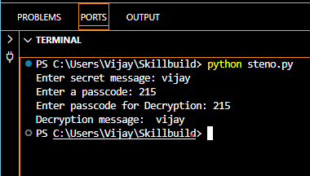
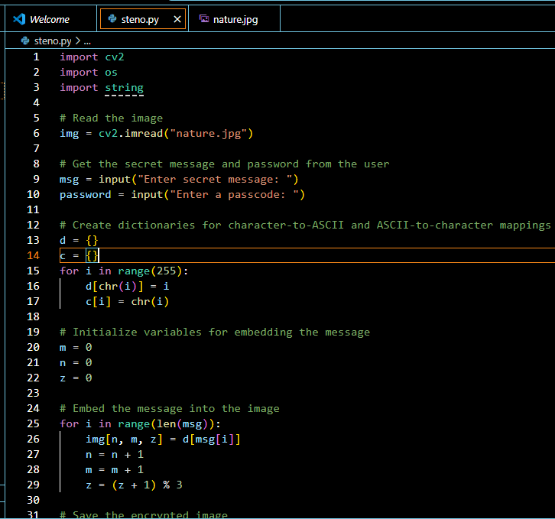
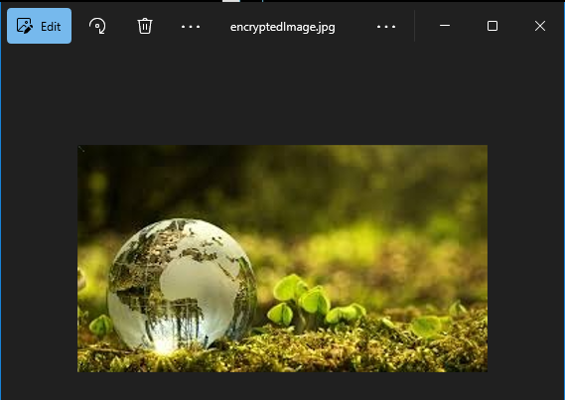
Results

Slide 8
Conclusion
This project successfully demonstrates how steganography can be used to securely hide and retrieve secret messages in an image.
It provides an added security layer by requiring a passcode for decryption, ensuring that only authorized users can access the hidden information.
The user-friendly GUI enhances the accessibility of the method, making it a practical tool for secure communication.
This method is effective for secure communication in various domains where privacy is a priority.

Slide 9
GitHub Link
https://github.com/vijayshikhare/Steganography-Project.git

Slide 10
Future scope(optional)
Improved Embedding Algorithm: Enhancing the algorithm to store larger messages
without affecting image quality.
Multi-layer Encryption: Adding additional cryptographic techniques for stronger security.
Steganalysis Resistance: Implementing methods to resist detection by steganalysis tools.
Cross-Platform Application: Developing a mobile or web-based application for easy use.
AI Integration: Utilizing AI to optimize embedding techniques for higher security and efficiency.

Slide 11
THANK YOU

