Slide 1
DFA which will accept string with even no of zero
Presented by – Vijayshree B. Lokhande(36051)
Saurabh Mahajan(36052)

Slide 2

DEOGIRI INSTIUTE OF ENGINEERING AND MANAGEMENT STUDIES.
Topic
DFA which will accept string with even no of zero
By
Vijayshree Lokhande(36051)
Saurabh Mahajan(36052)
Under the guidence of:
Prof. Sarika Chavan

Slide 3
Intoduction
DFA (Deterministic finite automata)
DFA refers to deterministic finite automata. Deterministic refers to the uniqueness of the computation. The finite automata are called deterministic finite automata if the machine is read an input string one symbol at a time.
In DFA, there is only one path for specific input from the current state to the next state.
DFA does not accept the null move, i.e., the DFA cannot change state without any input character.
DFA can contain multiple final states. It is used in Lexical Analysis in Compiler.

Slide 4
Definition of DFA
A DFA is a collection of 5-tuples same as we described in the definition of FA.
Q: finite set of states
∑: finite set of the input symbol
q0: initial state
F: final state
δ: Transition function

Slide 5
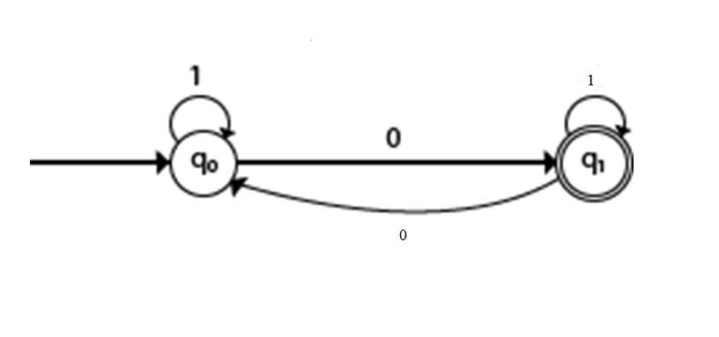
DFA which will accept all the string containing even no of 0’s over an alphabet{0,1}.

Slide 6
Applications
Traffic Lights
Video Games
Text Parsing
Regular Expression Matching
CPU Controllers
Protocol Analysis
Natural Language Processing
Speech Recognition

Slide 7
Conclusion
Hence we can find whether the string is accepted or not using DFA and also it can be applied in above mentioned applications.

Slide 8
THANK YOU

