Slide 1
MINI PROJECT REVIEW DEPARTMENT OF COMPUTER SCIENCE AND ENGINEERING Estimation Of Remaining Range Prediction Of Electric Vehicles.
Team Details : 16
K VIJAYASIMHA(20EG105421)
R CHANDRA VIKAS(20EG105438)
T SAI KUMAR(20EG105445)
Project Supervisor
Name DR B.V.V SIVA PRASAD

Slide 2
Introduction
Electric vehicles (EVs) are regarded to transportation to reduce air pollution and fossil fuel consumptions. However, battery degradation, cell inconsistency, and thermal runaway during overcharge the penetration of EVs worldwide. Lithium-ion batteries suffer from capacity degradation during their service lifetime. The battery state of health (SOH) can be reflected by the variations in the output energy, terminal voltage, temperature, SOC, and etc., which may indicate the state of the battery to some extent.
Due to battery degradation and the difficulty in the estimation of state of charge, it is usually quite challenging to accurately predict the remaining driving range of EVs.
This causes the ''range anxiety'' of drivers, which in turn causes the reduction of power capability and faster battery aging

Slide 3
Problem Statement
To Predict the Remaining Driving Range of Electric Vehicle using machine learning based approach ,the previous approach is stimulation based approach and existing approach is XGBOOST Algorithm.

Slide 4
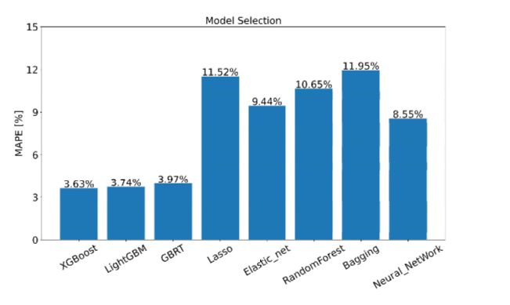
Proposed Method
XGBoost :
It is a popular machine learning algorithm that uses an ensemble of decision trees to make predictions. It is a boosting algorithm, which means it combines many weak base learners in an ensemble to boost its performance. The base learner is usually a regression tree. XGBoost uses an objective function to measure how well the model fits the training data and optimize the objective

Slide 5
Proposed Method
Anchor-Based Strategy: An "anchor based strategy” is introduced to address the issue of an imbalanced dataset. This strategy likely involves defining a baseline or anchor point that helps balance the distribution of data, ensuring that the model is not biased towards any particular range of driving distances. This can lead to more accurate predictions across the entire range of possible driving distances.

Slide 6
Experiment Environment
Programming Language : Python using machine learning
Machine learning Libraries : pandas , openpyxl , numpy , seaborn , matplotlib , statsmodels , graphviz
Data Manipulation and Visualization Tools : seaborn , matplotlib
Code Development Environment : Jupyter Notebook

Slide 7
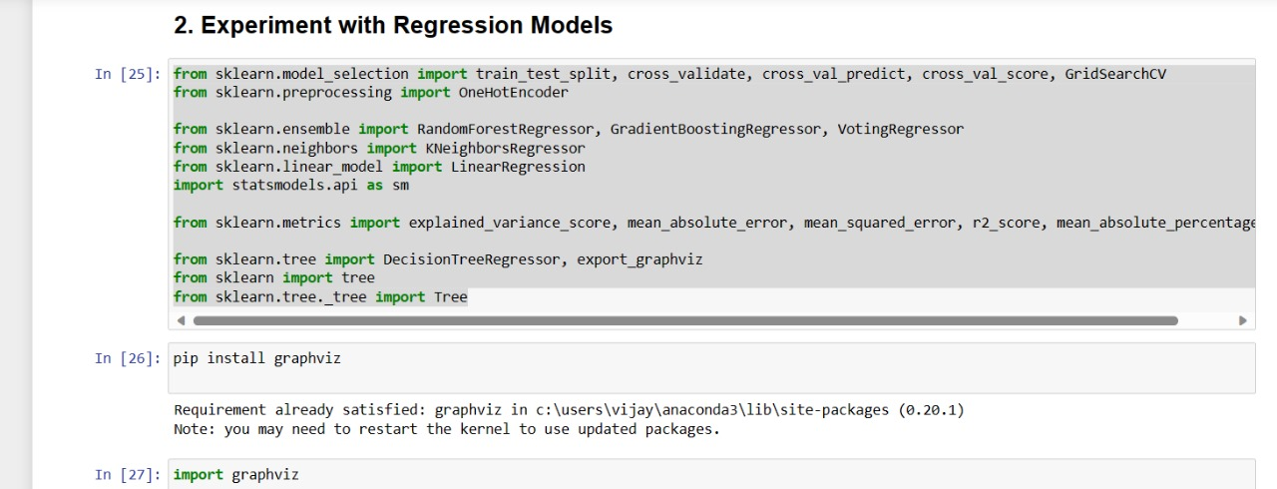
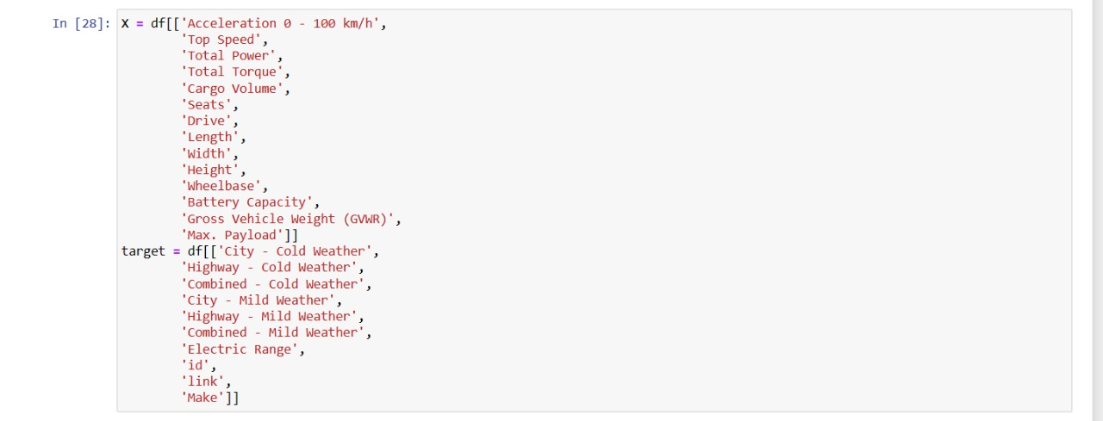
Experiment Screen shorts
.

Slide 8
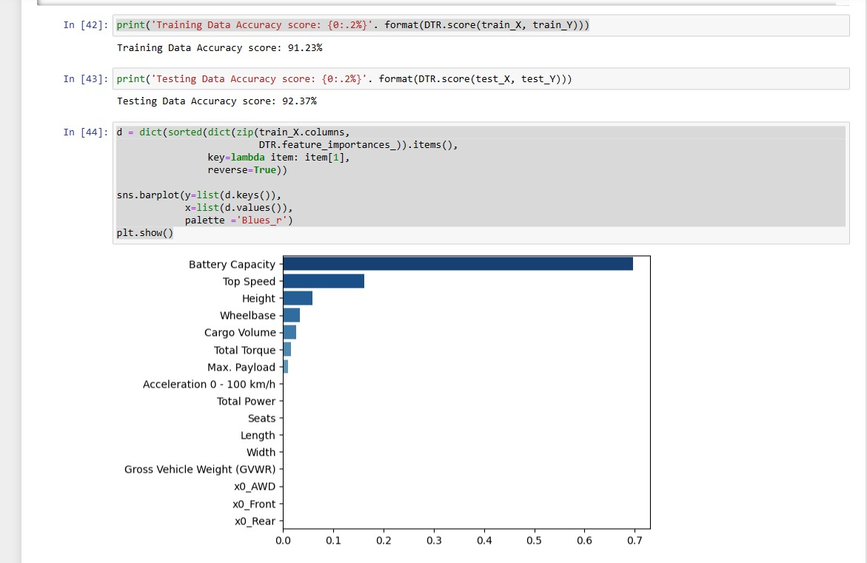
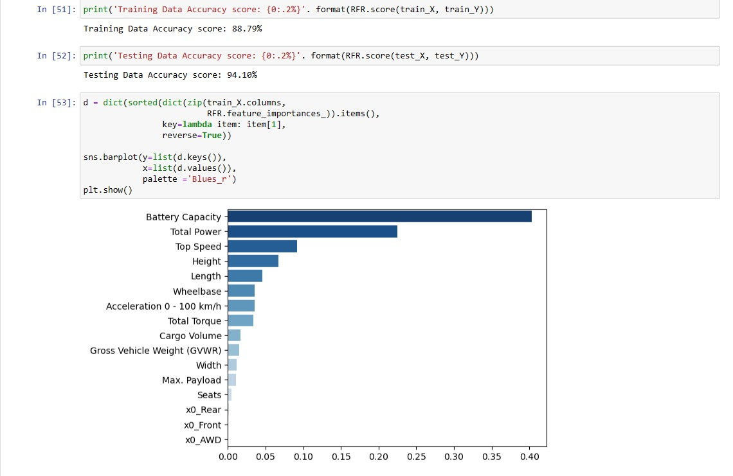
Decision Tree Regressor
Random Forest Regressor

Slide 9
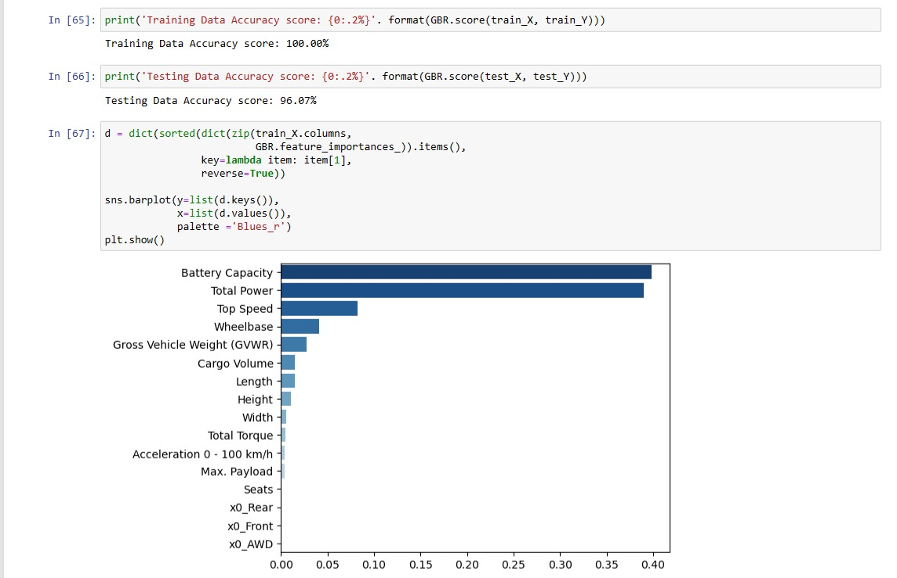
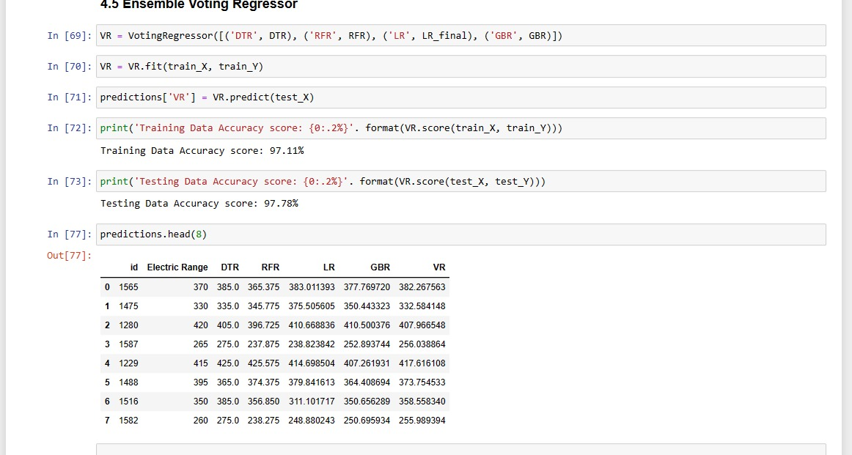
#Xtreme Gradient Boosting Regressor
.

Slide 10
Findings
we have improved the error range ,to give best accurate Target value (Remaining Range) using XGBOOST with anchor based strategy

Slide 11
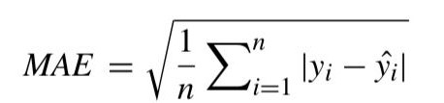

Problem illustration Mean Absolute Error (Decision Tree Regressor)
Data Set
=square root(20/3)=2.58
Absolute differences=Actual value-Predicted value
| [100-95]|+|[150-160]|+|[200-205] |=20
S.NO | ACTUAL VALUES (y) | PREDICTED VALUES (^y)
1 | 100 | 95
2 | 150 | 160
3 | 200 | 205

Slide 12
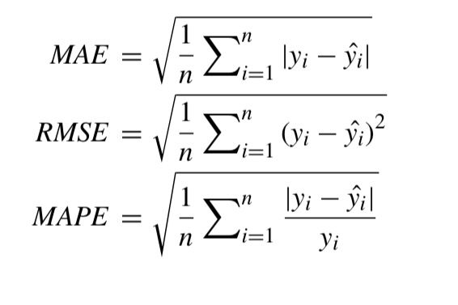
Justification
parameters
Target variable remaining range , and ensemble voting regressor
Formulae:
Mean Absolute Error(MAE)
Root mean squared Error(RMSE)
Mean Absolute Percentage Error(MAPE)
why your parameter values improved?
Ensemble Voting Regressor: It will give the best accurate Target value by comparing all Values in the function.

