Slide 1
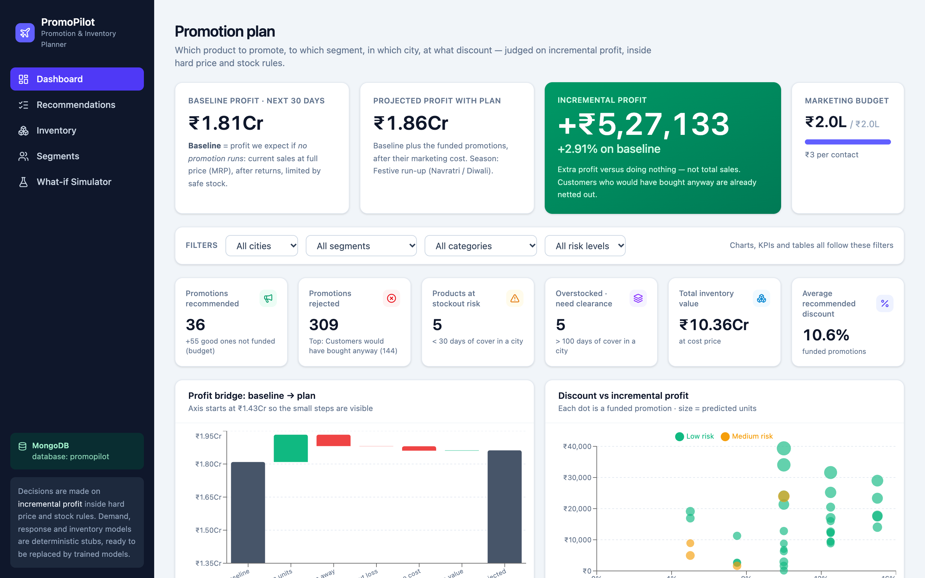
PromoPilot
TCS TECH DAY
localhost:3000/dashboard
Promotion & Inventory Planner
Decide what to promote, to which customer segment, in which city and at what discount. Judged on incremental profit, inside hard price and stock rules.
A walkthrough of the app
Notes:
PromoPilot is a promotion and inventory planner. It answers one question: which product, to which segment, in which city, at what discount, and it judges every answer on incremental profit. Everything you see in this deck is a screenshot of the running app, reading its data from MongoDB.

Slide 2




One question, four decisions
PromoPilot picks the promotion, audience, city and discount that earn the most extra profit
What to promote
Which segment
Which city
What discount
20 products, each with its own cost price and MRP
Students, Professionals, Families and Premium customers
Hyderabad, Bangalore, Mumbai, Delhi and Chennai, each with its own stock
Only offers between cost + 5% and MRP are legal
400
36
55
309
candidates evaluated: 20 products × 4 segments × 5 cities
In the plan
Fit the budget and the stock
Not funded
Good, but budget or stock ran out
Rejected
Each one comes with a reason
Notes:
Four decisions per promotion: what, who, where, how much. The engine scores every combination: 20 products x 4 segments x 5 cities = 400 candidates. Only 36 make the plan; 55 would pay off but run out of budget or stock; 309 are rejected, each with a reason.

Slide 3
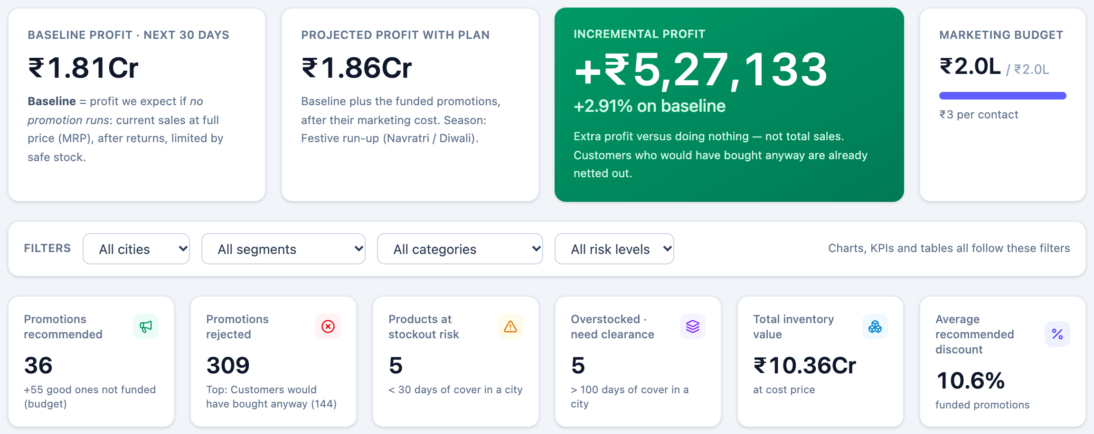
Dashboard: the plan vs doing nothing
Baseline ₹1.81Cr becomes ₹1.86Cr: +₹5,27,133 (+2.91%) inside a ₹2.0L marketing budget
localhost:3000/dashboard
Notes:
Baseline is what we expect if no promotion runs. Projected is baseline plus the funded promotions after their marketing cost. The green card is the number that matters: extra profit versus doing nothing, not total sales. The filters re-cut every card, chart and table on the page. 36 promotions recommended, 309 rejected, 5 products at stockout risk, 5 overstocked.

Slide 4
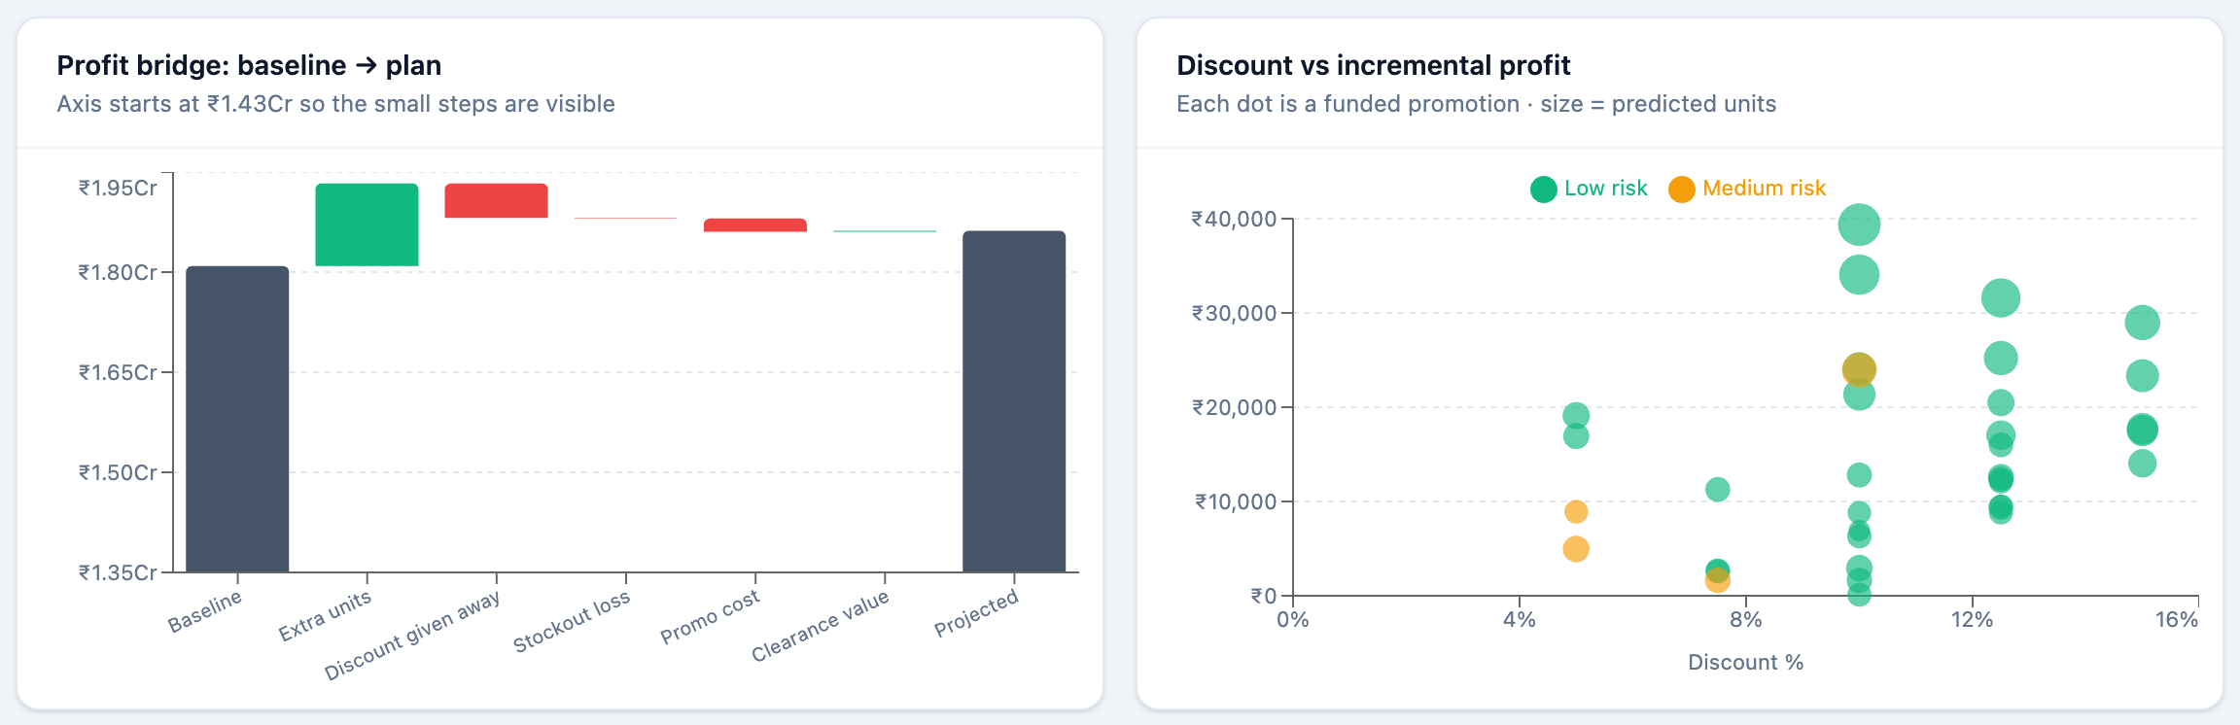


Where the extra profit comes from
A profit bridge from baseline to plan, and every funded promotion plotted by discount and profit
localhost:3000/dashboard
Discount given away and promo cost are subtracted, not ignored. The bridge ends at ₹1.86Cr.
Most funded promotions sit between 5% and 15% off, and most of them are low risk.
Notes:
The waterfall starts at the baseline and adds extra units sold, then subtracts the discount given to customers who would have bought anyway, stockout loss and promo cost, then adds clearance value. The scatter shows each funded promotion: bubble size is predicted units, colour is risk.

Slide 5
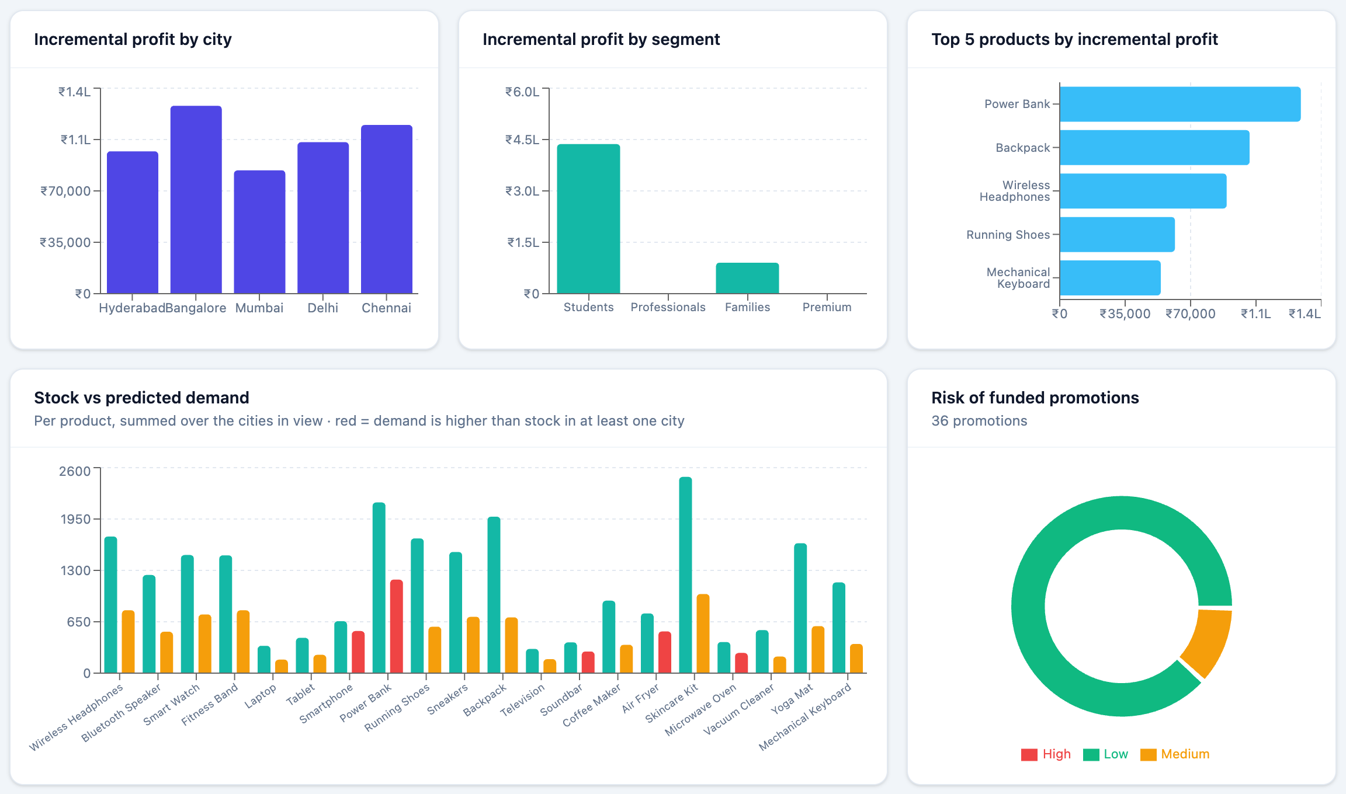
Which segments, cities and products win
The same plan, sliced by segment, city and product, with stock set against demand
localhost:3000/dashboard
1
Price-sensitive segments win
Students (85/100) and Families (75/100) carry the plan. Professionals (50) and Premium (25) add little.
2
Top products
Power Bank, Backpack, Wireless Headphones, Running Shoes and Mechanical Keyboard lead.
3
Stock vs demand
Red bars flag products where demand is higher than stock in at least one city.
Notes:
Incremental profit by city and by segment, the top five products, stock versus predicted demand per product, and the risk mix of the funded promotions. Price-sensitive segments carry the plan because discounts move them most.

Slide 6
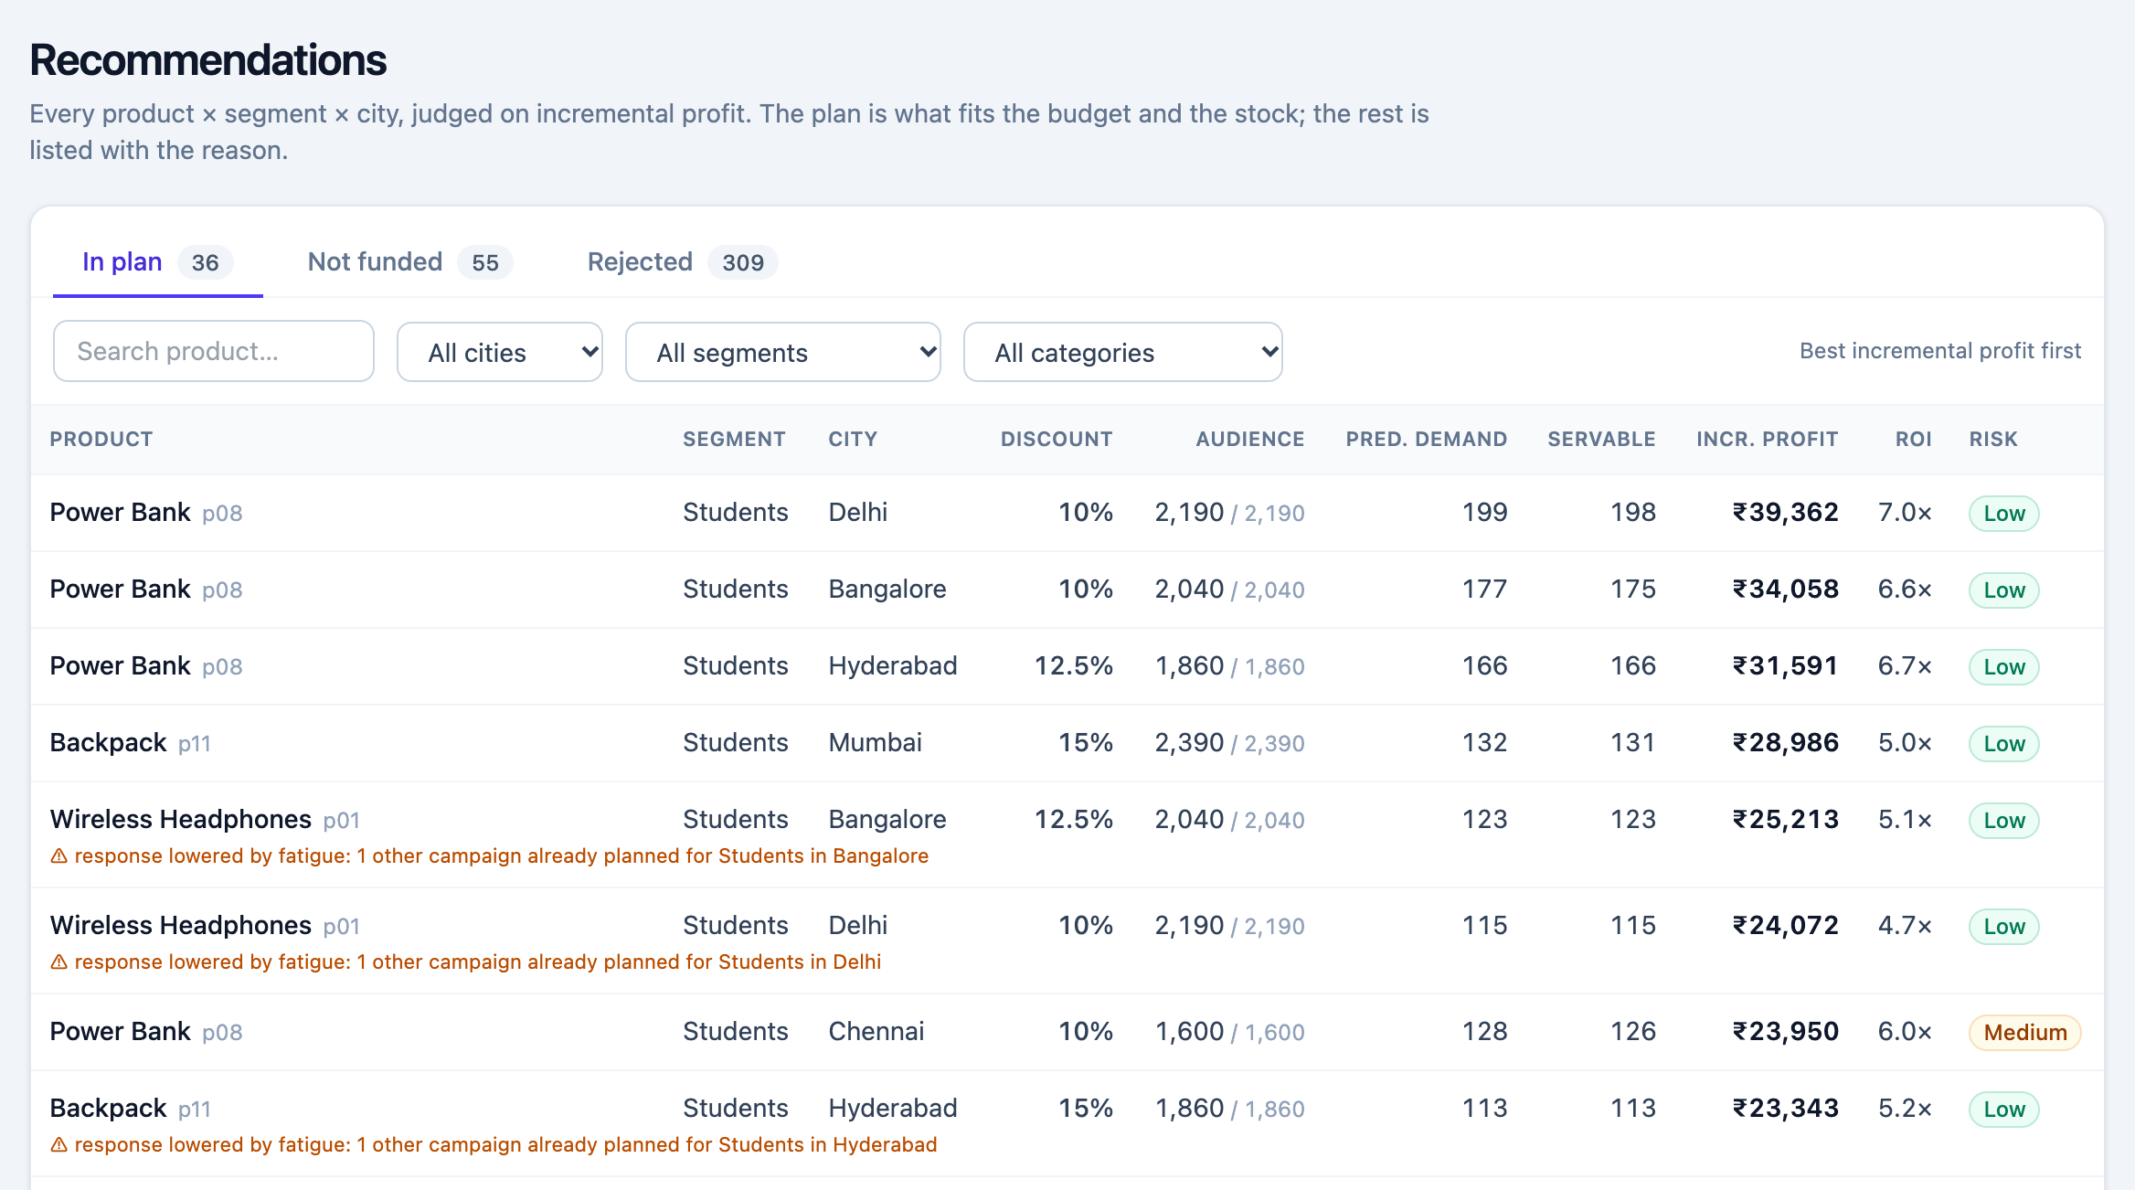
Every candidate gets a clear status
The Recommendations page: three tabs, searchable, filterable by city, segment and category
localhost:3000/recommendations
36
In plan
Fits the budget and the stock
55
Not funded
Would pay off, but budget or stock ran out
309
Rejected
Listed with the reason
Notes:
All 400 candidates live here in three tabs. In plan is what fits the budget and stock. Not funded would have paid off but the budget or stock ran out first. Rejected is everything the engine refused, with the reason. Click any row for the full decision.

Slide 7
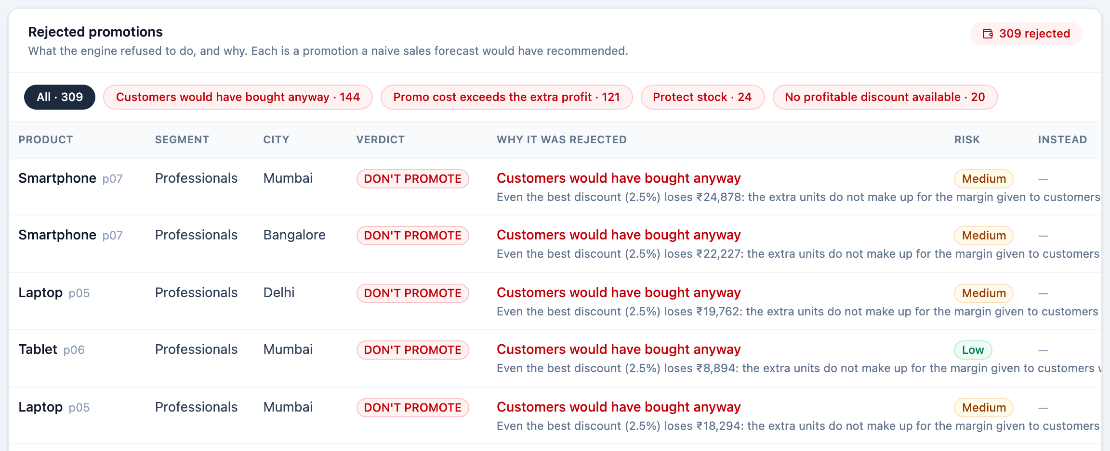

What the engine refuses, and why
Each rejected promotion is one a naive sales forecast would have recommended
localhost:3000/dashboard
144
Customers would have bought anyway
121
Promo cost exceeds the extra profit
24
Protect stock
20
No profitable discount available
Every row says what was tried (the best discount) and what it would have lost.
Notes:
This is the part most planners skip. 309 of 400 candidates are rejected. 144 because customers would have bought anyway: the extra units do not make up for the margin given away. 121 because the promo cost exceeds the extra profit. 24 because the stock has to be protected. 20 because no legal discount exists at all.

Slide 8
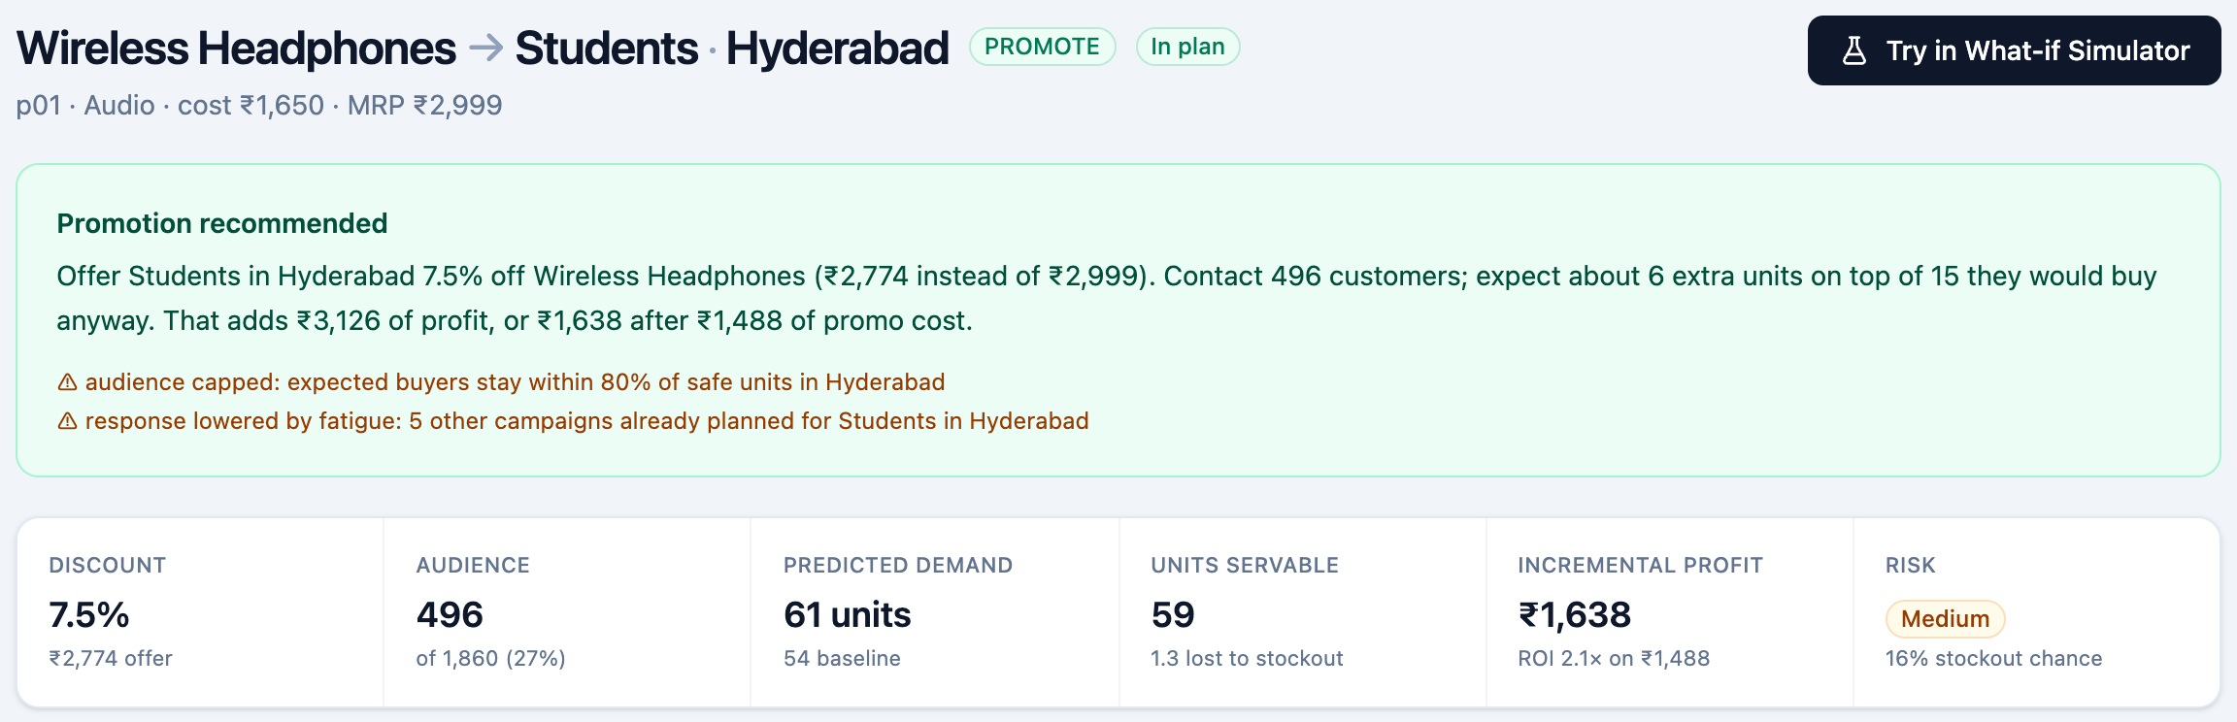



Case A: low stock caps the audience
Wireless Headphones → Students in Hyderabad: 7.5% off to 496 of 1,860 customers adds ₹1,638
localhost:3000/recommendations/p01_students_hyderabad
Audience limited to 27% so buyers stay within 80% of safe units
Fatigue: 5 other campaigns already planned for Students here
16% stockout chance, so the pick is flagged Medium risk
Notes:
High demand, low stock. The engine still promotes, but small: a 7.5% discount, an audience of 496 out of 1,860 students so expected buyers stay within 80 percent of safe units, and two warnings. There is a 16 percent chance demand exceeds safe stock, so the risk is flagged medium.

Slide 9
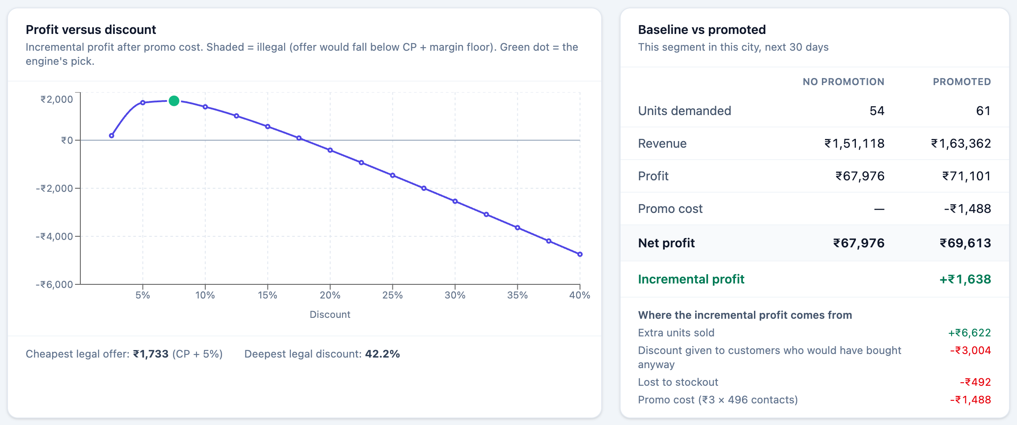
Inside a decision: profit vs discount
The engine tried every legal discount in 2.5-point steps and kept the best risk-adjusted one
localhost:3000/recommendations/p01_students_hyderabad
Notes:
The curve is incremental profit after promo cost for each discount. The green dot is the engine's pick. On the right, baseline versus promoted: units, revenue, profit, promo cost, and where the incremental profit comes from. Extra units sold add 6,622 rupees, the discount given to customers who would have bought anyway takes away 3,004, stockout loss 492 and promo cost 1,488.

Slide 10
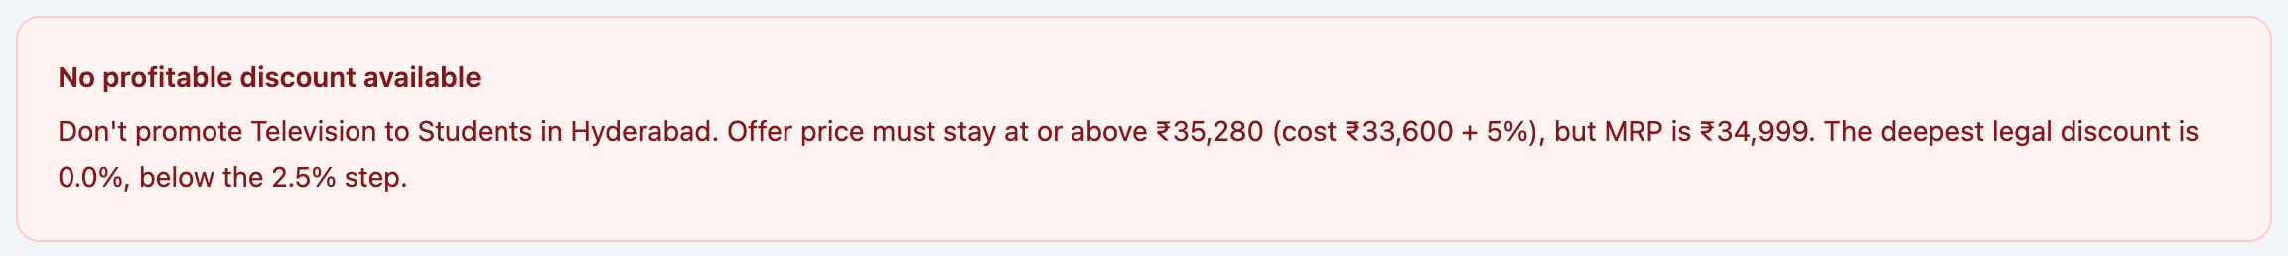
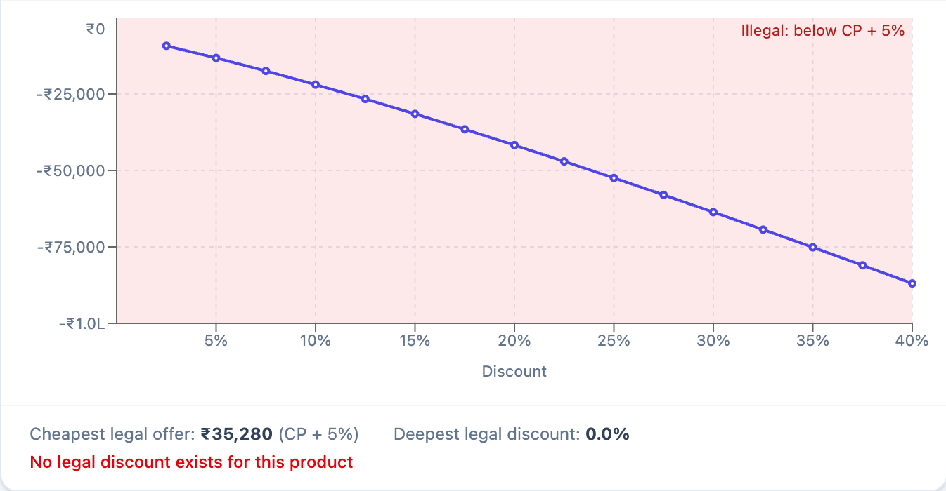
Case B: no legal discount exists
Television → Students in Hyderabad: cost + 5% is already above the MRP, so the engine says no
localhost:3000/recommendations/p12_students_hyderabad
localhost:3000/recommendations/p12_students_hyderabad
₹35,280
Cheapest legal offer
Cost ₹33,600 + 5% floor
₹34,999
MRP
Lower than the cheapest legal offer
4.0%
Margin at MRP
The floor needs 5%, so no room
Notes:
Thin margin. The television costs 33,600 and sells at an MRP of 34,999, a 4 percent margin. The rule says the offer must stay at or above cost plus 5 percent, which is 35,280, above the MRP. So the legal discount band is empty and the whole chart is shaded illegal. No baseline versus promoted comparison is even attempted.

Slide 11
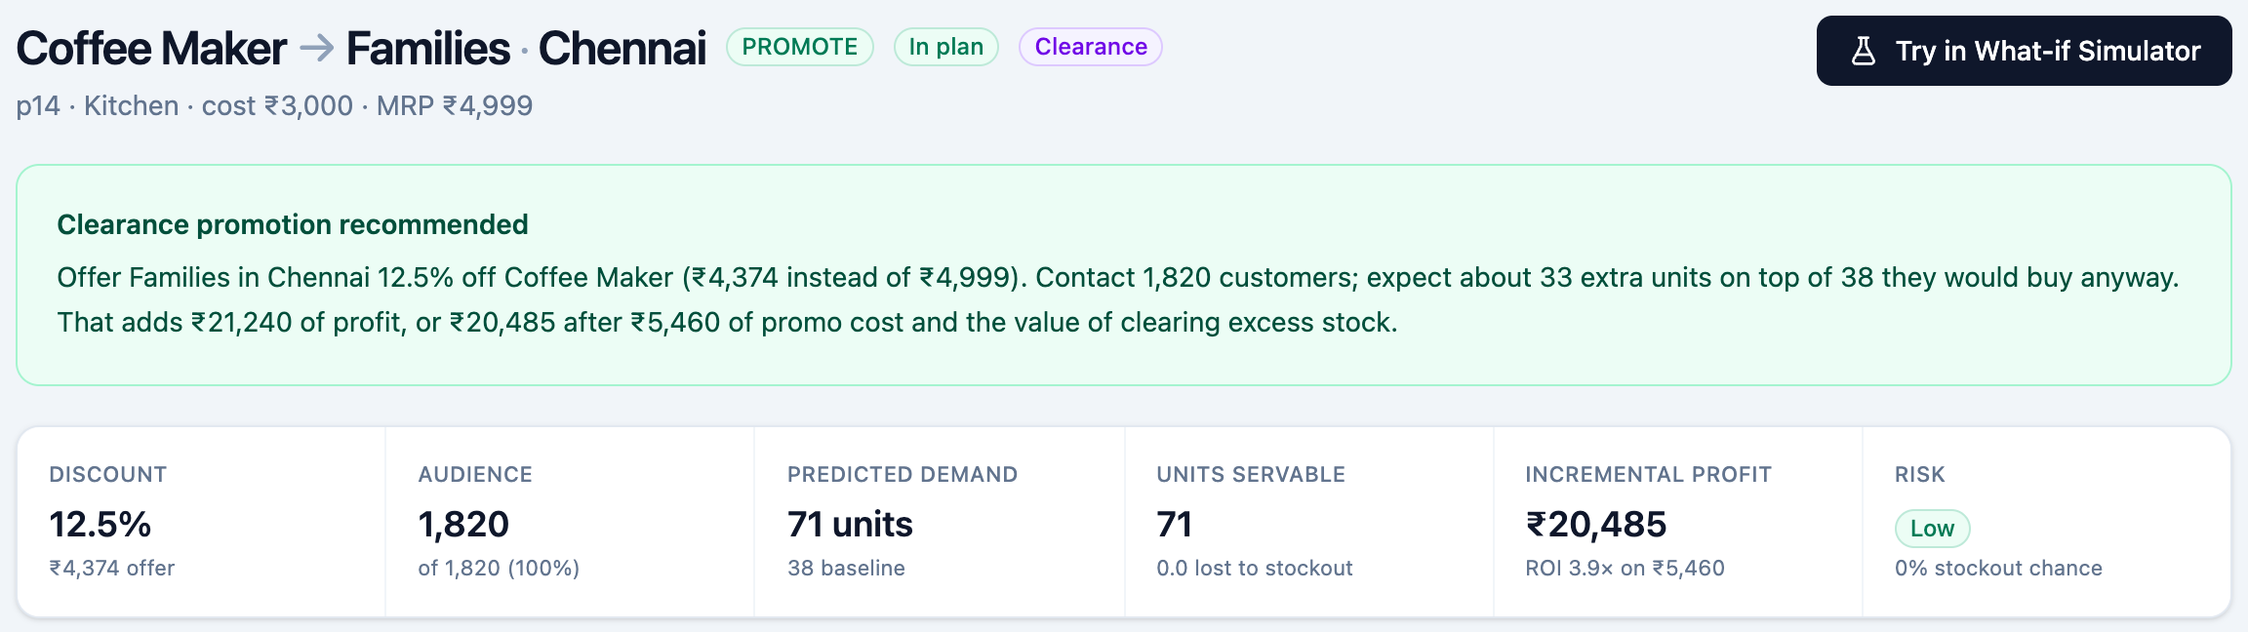

Case C: overstock becomes clearance
Coffee Maker → Families in Chennai: 12.5% off to all 1,820 customers adds ₹20,485
localhost:3000/recommendations/p14_families_chennai
141 days of cover marks it Overstock; clearing releases ₹4,705 of holding cost
Clearance value is counted separately and included in the ₹20,485
Festive run-up: some buyers would pay full price anyway
Notes:
Overstocked slow mover. 141 days of cover in Chennai, well over the 100 day threshold. The engine recommends a clearance promotion and counts the value of freeing that stock separately: 4,705 rupees of holding cost released. There is still a risk flag: it is the festive run-up, so some buyers would pay full price anyway.

Slide 12
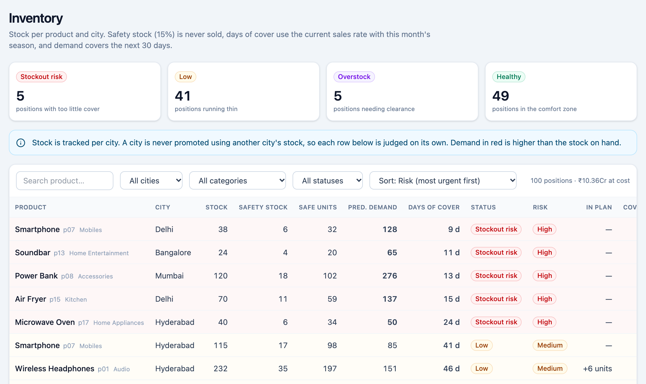
Inventory is judged city by city
Stock per product and city, with safety stock, days of cover and what the plan will use
localhost:3000/inventory
5
Stockout risk
Under 30 days of cover in a city
5
Overstock
Over 100 days of cover: clearance candidates
100
Positions
20 products × 5 cities, each judged alone
Notes:
100 positions: 20 products across 5 cities. 5 are at stockout risk with under 30 days of cover, 41 are running thin, 5 are overstocked and need clearance, 49 are healthy. Stock is tracked per city, and a city is never promoted using another city's stock.

Slide 13
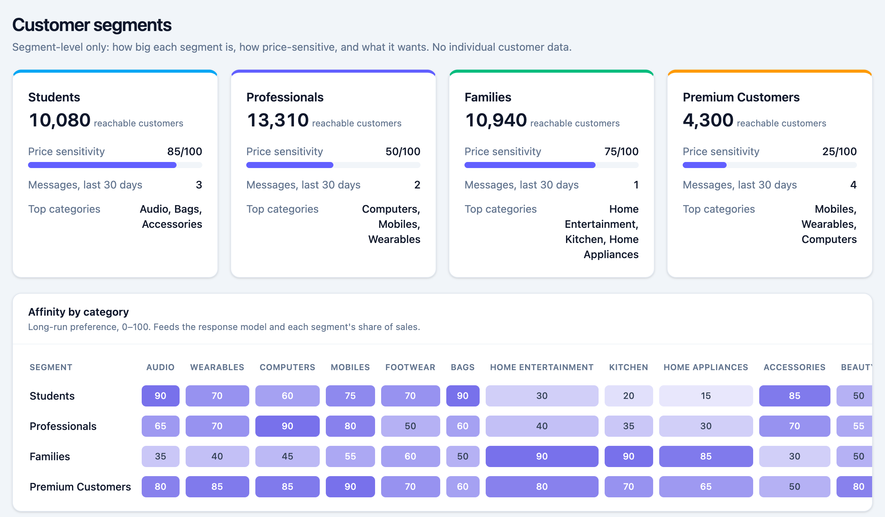
Segments: who responds to what
Segment-level only: size, price sensitivity and what each segment wants. No individual customer data
localhost:3000/customers
1
Segment-level only
Size, price sensitivity, affinity and recent intent. No per-customer targeting.
2
Price sensitivity
Students 85, Families 75, Professionals 50, Premium 25 (out of 100).
3
Feeds the response model
Affinity and recent intent per category set how strongly a segment reacts.
Notes:
Four segments. Students are the most price-sensitive at 85 out of 100, Premium the least at 25. The heat maps show long-run affinity and recent intent per category, and both feed the response model. Audience sizes by city are capped by stock, so a promotion may contact only part of a segment.

Slide 14
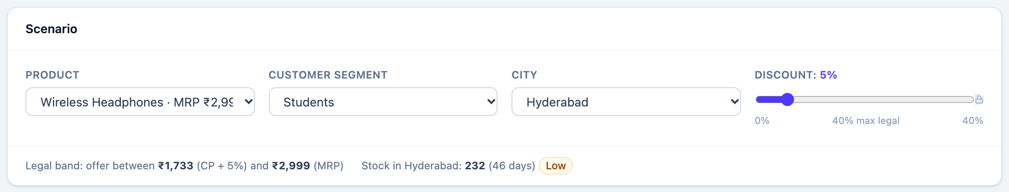
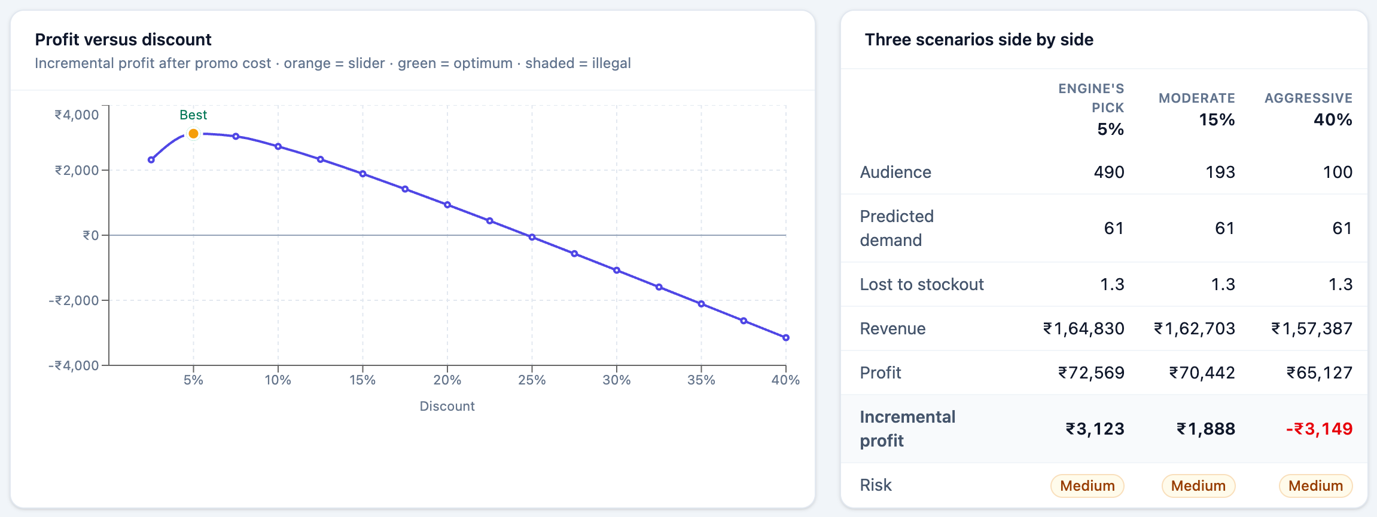
What-if simulator: test before you ship
Pick a product, segment and city, then move the discount and watch profit, stock and risk change
localhost:3000/simulator
1
Stay inside the rules
The slider stops at the deepest legal discount; beyond it is locked.
2
Same engine as the plan
A standalone view of one promotion, so the plan's pick can differ.
3
See the downside
At 40% off this promotion loses ₹3,149. The engine's 5% earns ₹3,123.
Notes:
The simulator runs in the browser against the same engine as the plan. The slider stops at the deepest legal discount. Three scenarios side by side: the engine's pick at 5 percent earns 3,123 rupees, a moderate 15 percent earns 1,888, and an aggressive 40 percent loses 3,149. Note it is a standalone view of one promotion, so the plan, which also accounts for other campaigns, can pick a different discount.

Slide 15


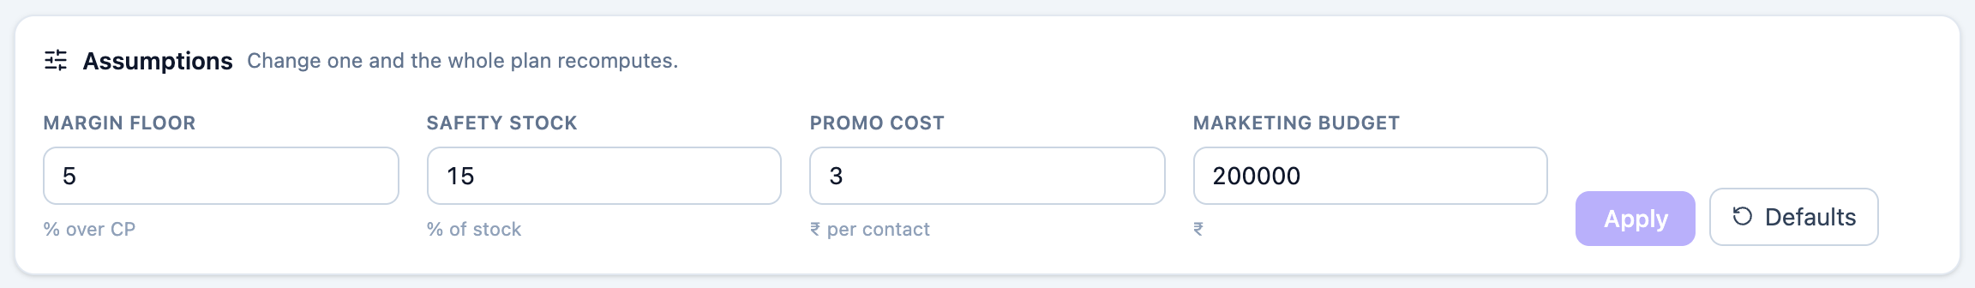
Hard rules the engine never breaks
Margin floor, safety stock, cost per contact and marketing budget are editable on the dashboard
Price band
Stock cap
City stock
Real profit
Budget
Offer stays between cost + 5% and MRP.
Buyers stay within 80% of safe units; safe = stock − 15%.
A city is promoted only from its own stock.
Incremental profit must be positive, or it is not recommended.
Funded promotions never exceed the budget or claim stock twice.
localhost:3000/dashboard
Notes:
These constraints hold for every recommendation. The four tunables live in one config object and are editable in the Assumptions panel on the dashboard. Change one and the whole plan recomputes.

Slide 16

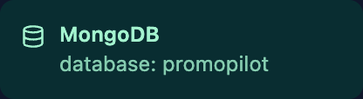
How a decision is made
For every product × segment × city, then a budget allocator picks what to fund
1
2
3
4
5
Legal band
Try each discount
Three models
Incremental profit
Budget allocator
Offer between cost + 5% and MRP; an empty band means reject
2.5-point steps, every one scored
Response, demand and inventory for each discount
Promoted minus baseline, after returns, stock caps and stockout risk
Ranks by profit per ₹ of promo cost, fills the budget, deducts stock
Data
MongoDB database “promopilot”: products, inventory, segments, segment_sizes, promotions and seasonality.
Edit a document in MongoDB and the plan recomputes within about 30 seconds.
If the database is unreachable, empty or malformed, the app keeps working on bundled demo data and shows an amber badge.
The three models are deterministic stubs behind typed functions, ready to be replaced by trained models.
The sidebar badge shows where the numbers came from
Notes:
For each candidate: find the legal discount band, grid-search discounts in 2.5 point steps, call the response, demand and inventory models for each, compare baseline against promoted to get incremental profit with returns netted out, units capped by safe stock and stockout probability priced in, then choose the best risk-adjusted option. The allocator ranks promotions by incremental profit per rupee of promo cost and fills the budget, deducting stock as it goes. Data comes from MongoDB; if it is unreachable the app falls back to bundled demo data and shows an amber badge. The three models are deterministic stubs today, behind typed functions a trained model can replace.

Slide 17



Recommend only what adds profit
PromoPilot says no far more often than yes: 309 of 400 candidates were rejected
Built
Left out on purpose
Next
Dashboard, recommendations, inventory, segments and a what-if simulator, on live MongoDB data.
Per-customer targeting, competitor pricing, multi-warehouse allocation, LLM calls and auth.
Replace the deterministic models with trained ones behind the same typed functions.
Questions?
Notes:
Close on the idea: a planner that refuses unprofitable promotions and explains why is more useful than one that only forecasts sales. Built today: the five screens on live MongoDB data. Left out on purpose: per-customer targeting, competitor pricing, multi-warehouse allocation, LLM calls, auth. Next: swap the deterministic models for trained ones behind the same typed seam. Then questions.

