Slide 1
Online car rental system presented by
Vijay Sisodiya

Slide 2
Problem statement
this is the application where a user can book a car for trip,marriage,office to home and for other work.
This application will save the time of the customer.

Slide 3
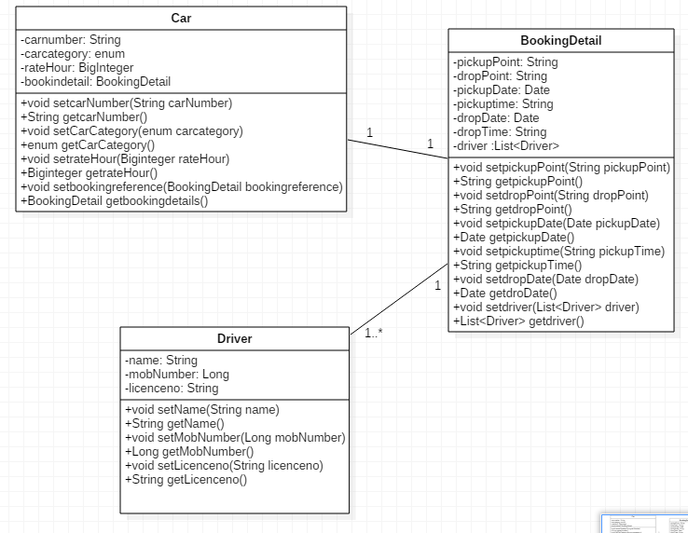
pojo classes

Slide 4
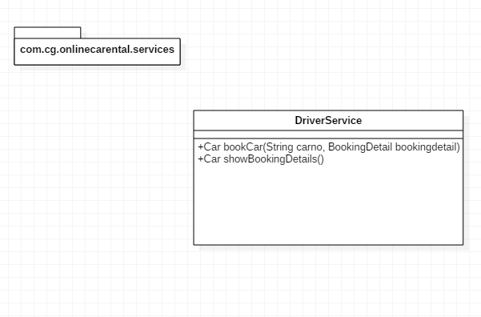
Driver Interface

Slide 5
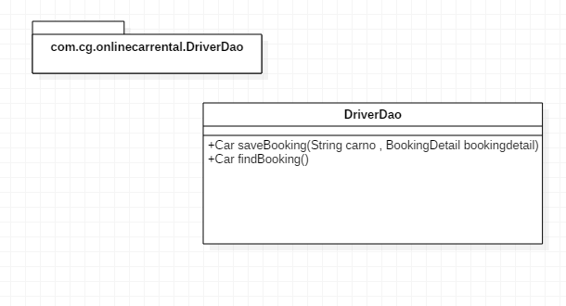
DAO INTERFACE

Slide 6
THANK YOU

