Slide 1

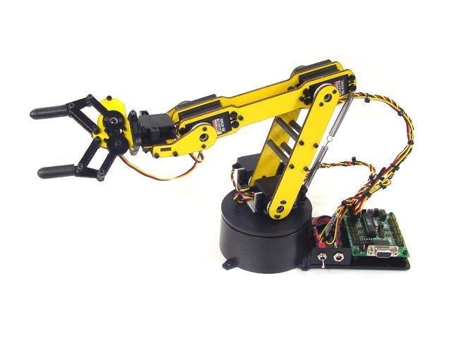
DESIGN of a MULTIMODAL ADAPTIVE WIRELESS CONTROL SYSTEM-MAWCS for DISABLED and ELDER PEOPLE
BATCH NO – 6
ECE - C

Slide 2
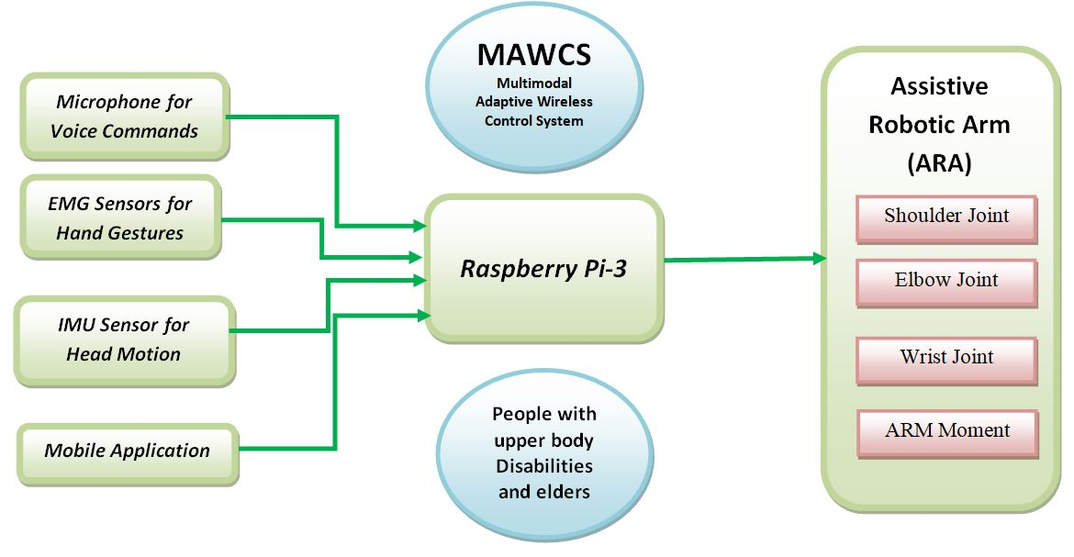
BLOCK DIAGRAM

Slide 3
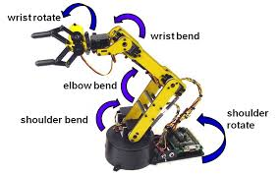
AIMED MOVEMENTS OF THE ARM

Slide 4
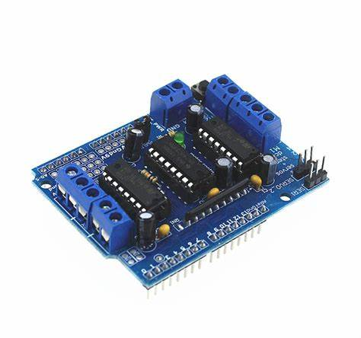
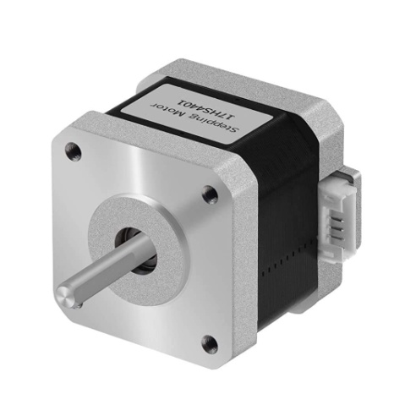
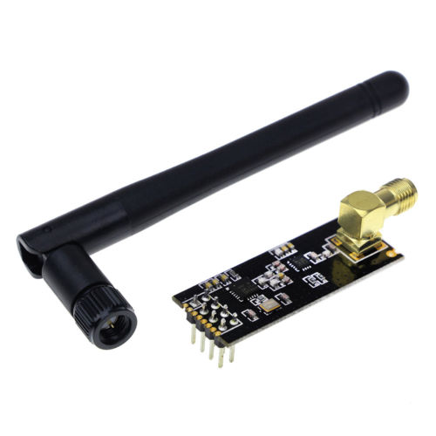
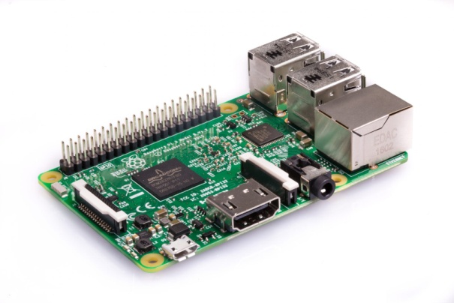
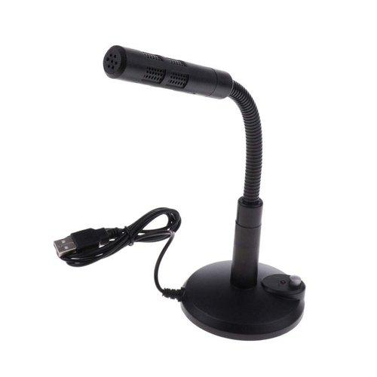
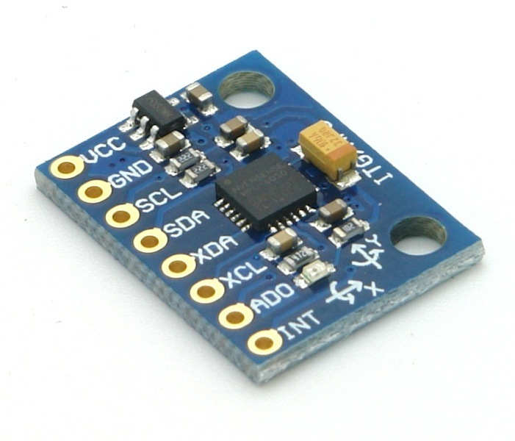
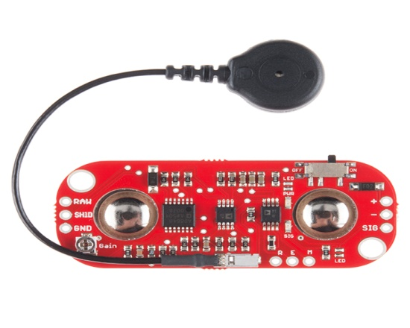
REQUIREMENTS
nRF24L01 2.4GHz

Slide 5
PHASES OF DEVELOPMENT

Slide 6
PHASE-1
Control Using Voice Commands

Slide 7
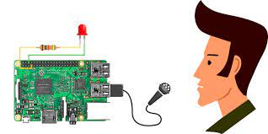

Phase 1

Slide 9
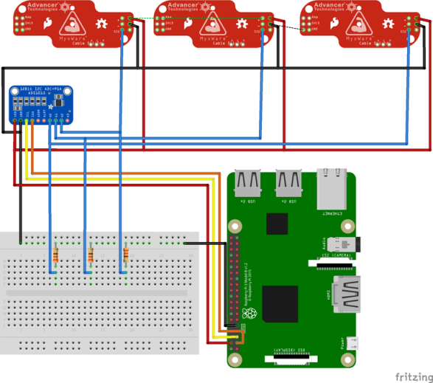
PHASE-2
EMG Sensor

Slide 10
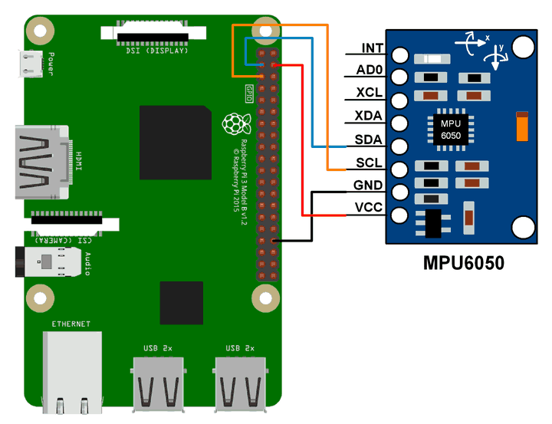
PHASE-3
MPU6050

Slide 11
PHASE-4
Here, we integrate all the above phases and build a body for the arm

Slide 12
Project Guide:
Mr. S.S. Kiran, M.Tech, (PhD)
Batch Members:-
S. Prabath -18KD1A04E9
U. Vijay Teja -18KD1A04F8
P. Sai Surya Teja -18KD1A04C9

