Slide 1
Lending Club Case Study
Data Understanding
The aim is to find the loan applicants that defaulted or not based on the past history.In this case we need to consider “loan_status”
Loan status has 3 values “Current”,”Fully paid” and “Charged off”, since we are not sure on the current status if they will pay up or not , we will ignore them and consider only full paid and charged off statuses
We will also consider “funded_amt” variable to be impacted by “loan_status”(funded_amt_inv can be ignored since its an individual choice)
Drop columns like id,member id , null values,

Slide 2
Data cleaning
Drop columns containing max null value, single value, which doesn’t add any value
Filter rows with missing values
Clean and convert entire column to correct data type eg : date,int64 etc
Convert certain column values to numeric variables for better analysis

Slide 3
Data Analysis
Derived Metrics
Univariate Analysis
Segmented Univariate Analysis
Bivariate Analysis
Multivariate Analysis

Slide 4
Derived Metrics
Derive metrics for Month and Year from column “issue_d”
Derive metrics for “loan_amnt” to “annual_inc” ratio
Create new column loan_status_code with 0 and 1 values based on loan_status column where 0=“Fully Paid” and 1=“Charged off”
Creating different groups for interest rate
Combine “Source Verified” and “Verified” into “Verified”
Create Group annual_income

Slide 5
Univariate Analysis
Categorical variables
Ordered categorical data
Grade
Sub grade
Term (36 / 60 months)
Employment length
Loan issue year
Loan issue month
Un-ordered categorical data
State
Loan purpose
Home Ownership
Loan status
Quantitative
Interest rate group
Annual income group
Loan amount
Funded amount
Loan amount to annual income ratio

Slide 6
Summary of univariate analysis
Grade A and B are given more loans compared to other grades
36 months loans are issued more compared to 60 months loan
Grade A4, B3, A5, B5, B4 are given more loans compared to other grades
Maximum loans were taken in the year 2011. The trend is increasing with the increase in the year
Employees with 10 years and above are given loan compared with lesser experience
There is increasing trend in number of loans with increase in the months. Maximum loans were given in the month of Oct, Nov, Dec.
15 % of the total loans are charged off
States CA, NY, FL and TX are the states for which maximum loans have been issued
Maximum loans are given for debt consolidation, paying off Credit card and 'other' reasons
Education and renewable energy is the least category where loans have been given
People who are in Rented house or Mortgage have availed maximum of the loans
Funded amount is ranging from 5000 to 15000 USD
Installment amount is ranging from 200 to 400 USD
The amount to income ratio median is around 0.18; this is a good indicator
Interest rate range 9 to 13 is the range where maximum loans have been issued
21 - 25% is the range where minimum loans have been issued

Slide 7
Bivariate Analysis
Ordered categorical data
Grade
Sub grade
Term (36 / 60 months)
Employment length
Year
Month
Un-ordered categorical data
State
Loan purpose
Home Ownership
Verified status
Quantitative
Interest rate
Annual income
DTI
Loan amount to annual income ratio

Slide 8
Summary of Bivariate Analysis
36 month loan default is more compared to 60 month
Maximum loans are issued for category 10 years and they are the maximum defaulters
Based on the counts, Grade B, C and D are top three in Charged Off
Based on the counts, Grade B3,B4,B5, C1,C2, D3, D4 top sub grades in Charged Off
Plot of loan issue year shows maximum loans were taken in the year 2011
Also high loans are being Charged Off in 2011
Plot of the loan issue month shows maximum loans were given in the month of Oct, Nov, Dec.
Also high loans are being Charged Off for the loans issued in Sep - Dec months
Loans with purpose debt consolidation, other, credit card and home improvement categories have failed to pay the loan compared with education / renewable energy
Also debt consolidation is the category where maximum loans are issued.
People who are in Rent or Mortgage have failed to pay the loan compared with people in Own house
The amount of Verified loans which are Charged Off is more compared to Not Verified
Employment length of 10 years got more loans and they are the maximum defaulters
Followed by year 6, 7, 8 and 9 where the medians are almost close
Grade F, G and E are the three category which are top three in Charged off
Grade F and G have the median around 20k and Q3 at 25k
Grade A is the least with median at 7.5k
DTI doesn't seem to be contributing because the median is close to each other for Fully Paid and Charged Off
“Amnt_to_int_ratio” is contributing for bad loans

Slide 9
Summary of Multivariate Analysis
Borrowers from sub grade F5, G3 and G5 have maximum tendency to default.
Self employed, 10 years and 7 years categories has maximum tendency to default the loan.
Tendency to default the loan is increasing from Grade A to Grade G
Borrowers from states NV, TN, SD, AK, FL and HI have maximum tendency to default the loan.
Small business category has the highest chances to default the loan
Borrowers from Other category have highest tendency to default the loan.
Borrowers from Other category have highest tendency to default the loan.
The borrowers who are in lower income groups have maximum tendency to default the loan and it generally decreases with the increase in the annual income.
The tendency to default the loan is increasing with increase in the interest rate.
Correlation graph shows variables annaul_inc, installment, issue_m, amnt_to_inc_ratio, loan_amt, funded_amt, issue_y have negative impact on the loan_status variable

Slide 10
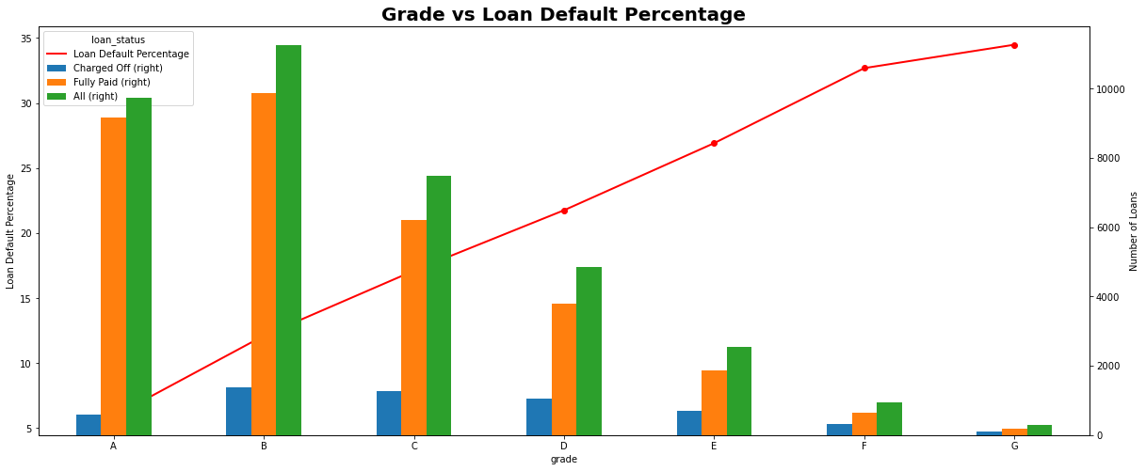

Slide 11
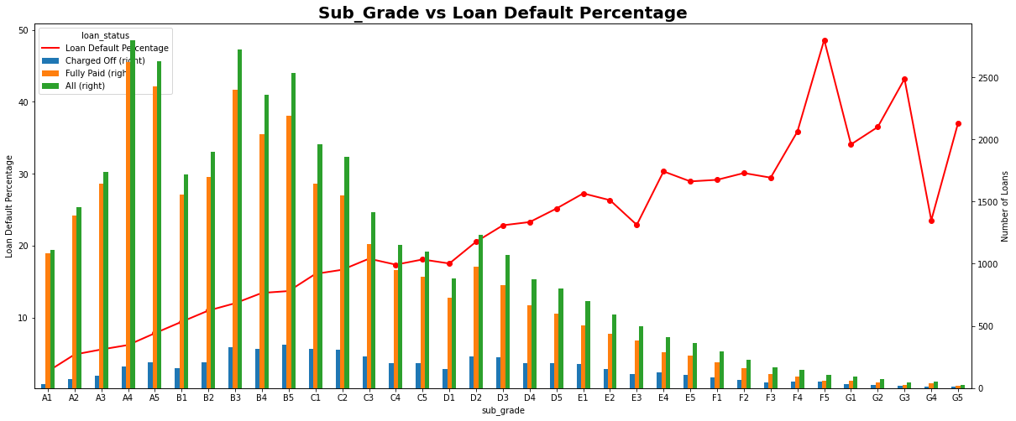

Slide 12
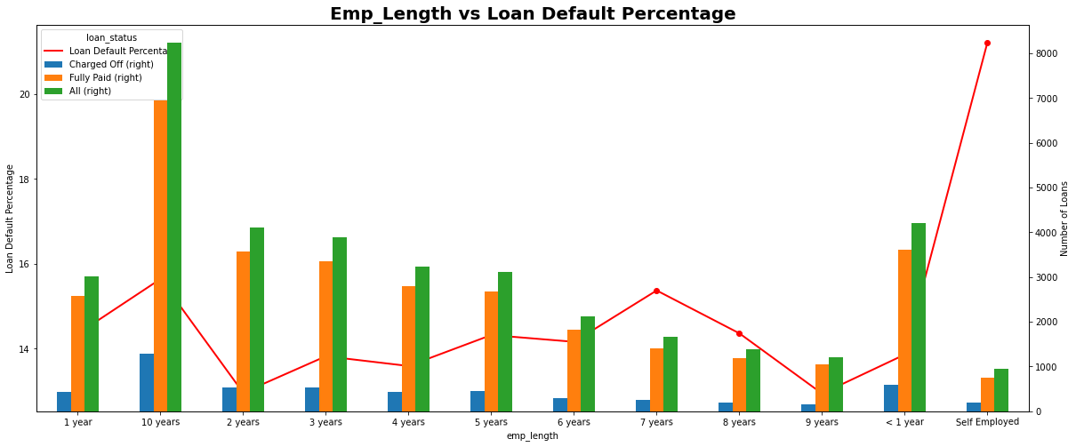

Slide 13
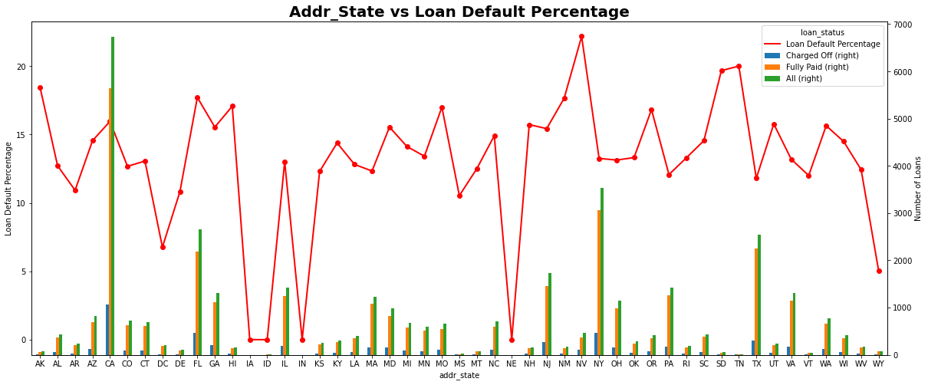

Slide 14
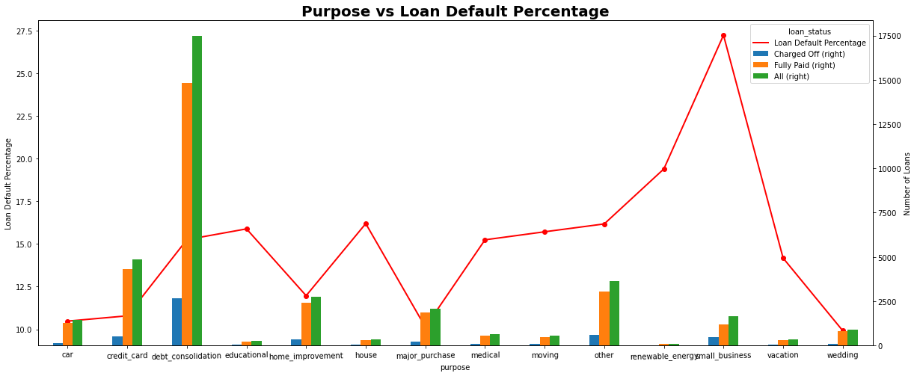

Slide 15
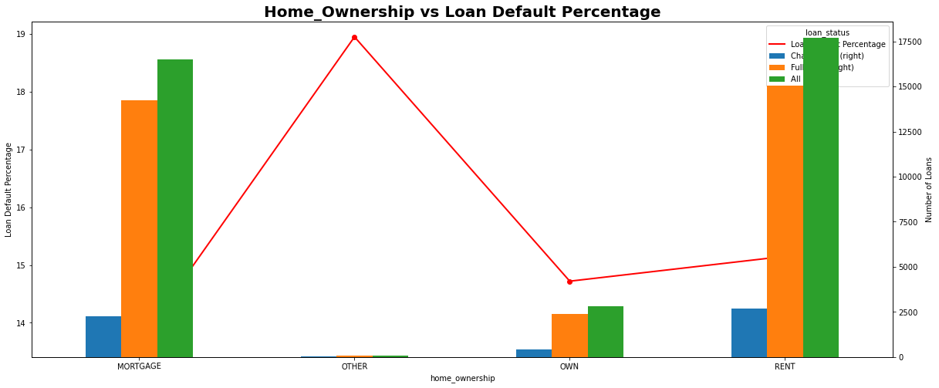

Slide 16
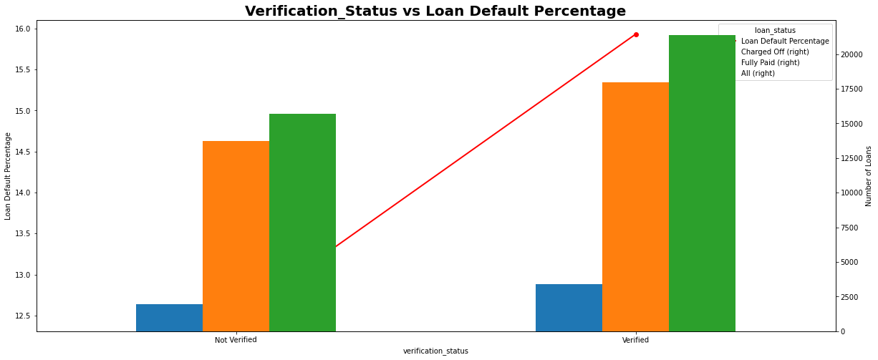

Slide 17
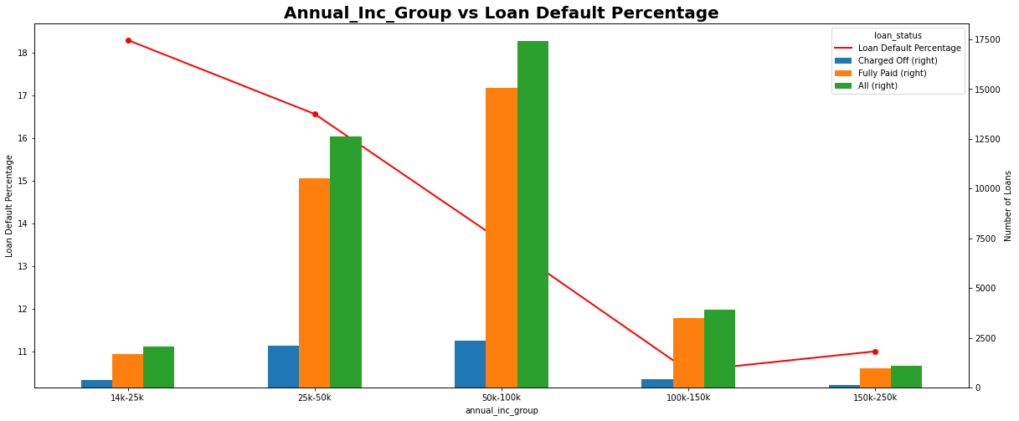

Slide 18
