Slide 1
VCS
Version Control System
Or
SCM(Source Code Management)

Slide 2
What is version control?
A System that keeps records of your changes.
Allows for collaborative development.
Allows you to know Who made What changes and When.
Allows you to Revert any changes and go back to a previous state.
Users keep entire code and history on their Local machines.

Slide 3
Popular Tools
SVN (Subversion)
GIT (GitHub)
Mercurial
CVS (Concurrent version system)
TFS (Team Foundation server)

Slide 4
What is Git?
Started in 2005.
Created to aid Linux Kernel development.
It’s a Version control System.
Free and Open Source.
Largest web based git repository hosting service.
Allows Code collaboration with anyone online.

Slide 5
SETUP GITHUB account
On Web application , you can signup for GitHub at https://git-scm.com/book/en/v2/GitHub-Account-Setup-and-Configuration
Install GitHub to your local machine at (https://git-scm.com/download/win )

Slide 6
GitHub(Use Git in a web browser!)
Create a Repository:
● https://github.com/
● Log in
● Click + to create new repository
● Name it
● Click initialize with README
● Click "Create repository“
Create a commit:
● Click on a file
● Edit in browser
● Scroll down to "Commit changes“
● Fill in the information describing the change
● Click "Commit changes"

Slide 7
Git(Using Shell)
An application that lets you communicate with your operating system using Command-line interface (CLI).
On Windows, Right-click in the Folder which you want to add to repository and select Git Bash.
It will open CLI , where you can use the Git commands.
GIT – Basic commands
$git init // Initialize Local Git Repository.
$git add <file> // Add File(s) To Index.
$git Status // get status of working tree
$git commit – m ‘First commit’ // Commit changes in index
$git remote add origin <Repository path>
$git push –u origin master // Push to remote repository
$git Pull // Pull latest from Remote repository

Slide 8
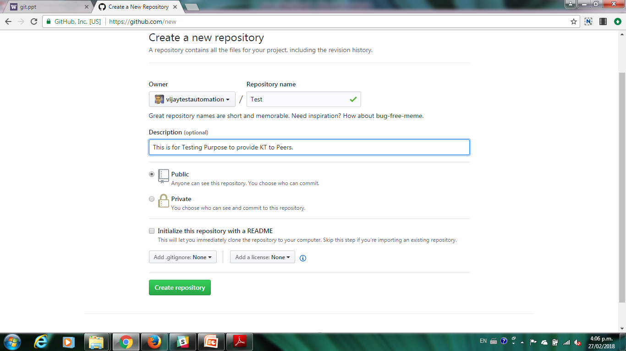
Create Repository on GitHub web

Slide 9
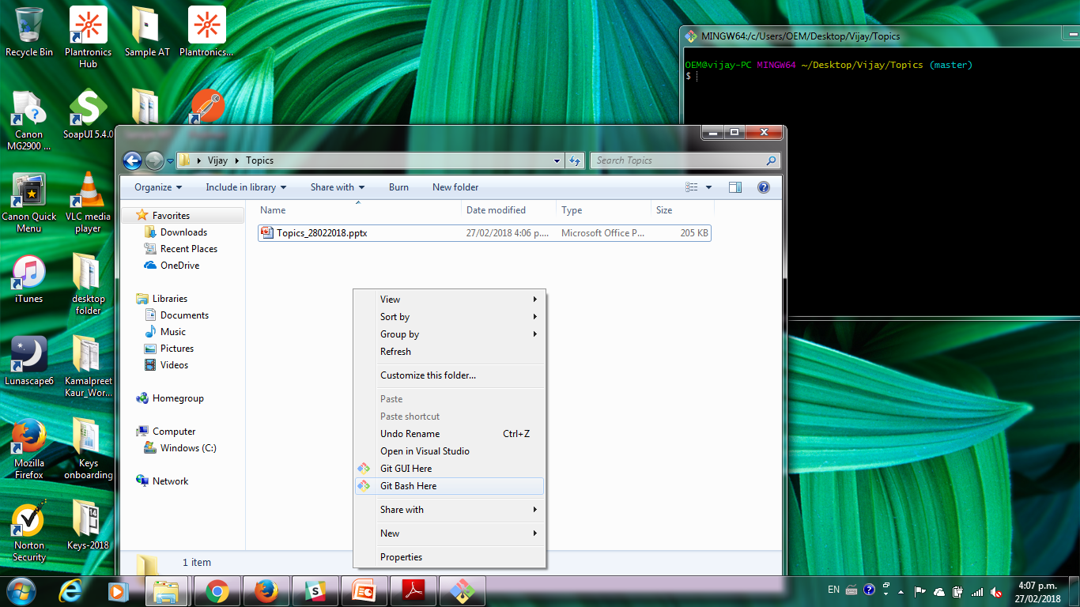
Git Bash Files

Slide 10
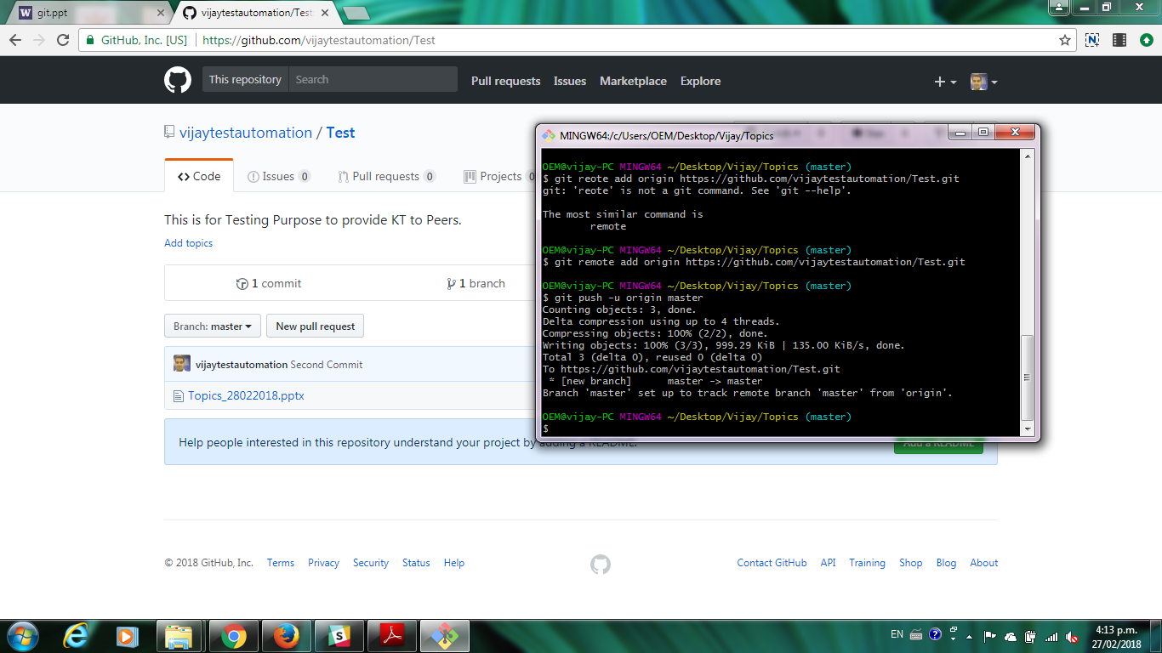
Upload source code to GitHub using commands.

Slide 11
Contribute and Collaborating using GitHub
Fork the Target Repository to your account.
Clone the Repository to your local machine.
Work on your Module or make some changes.
Add your Work to Repository using (git add .)
Commit your work using (git commit –m ‘message’)
Push your work to your fork using (git push origin master)
Create a Pull request from GitHub to your browser.
Finally, Pull request is approved by the owner and added to the master branch.

Slide 12
Thankyou

