Slide 1




Visualizations on Criminal Activities in India Skill-Lync Internship Project
Project Coordinator | Presented By
Kashyap Kushagra | Vijay Tiwari

Slide 2

Contents
Introduction
Methodology
Key words & Insights
Crimes Against Children
Crimes Against Women
Murder Cases
Victims of Murder
IPC Crimes
Kidnapping Abduction
Violent Crimes
Conclusion

Slide 3
Introduction- Crimes in India from 2019-2020
Criminal activities in India from 2019 to 2020 were a matter of concern and analysis. Various forms of criminal activities were reported nationwide during this time frame
According to data from the National Crime Records Bureau, crime rates varied across different states. They encompassed a wide range of offenses, including but not limited to violence, domestic violence, trafficking, and cybercrime
The impact of external factors, such as the COVID-19 pandemic and its associated lockdown phases, also influenced criminal activities in India. Studies have shown that certain criminal activities experienced fluctuations during this period, and the enforcement of lockdown measures had an impact on crime rates

Slide 4
Methodology
Load the datasets into Python
Explore the Dataset
Data Cleaning
Data Transformation
Data Visualization using Tableau
Interpretation and Insights

Slide 5
Keywords for Insights
Rate of Cognizable Crime: Cognizable crimes are those for which the police have the authority to make an arrest without a warrant and initiate an investigation. It provides insights into the overall crime trends and helps law enforcement agencies allocate resources effectively to address and prevent such crimes
Rate of Crime: The Rate of crime refers to the number of crimes reported or recorded per capita (usually per 100,000 people) within a specific time frame. This measure allows for comparisons between different regions or time periods, taking into account population size. It can provide an indication of the prevalence or frequency of crime in a particular area
Total Crimes: This measure represents the absolute number of crimes reported within a given time period. It does not take into account population size, so it may not accurately reflect the prevalence of crime in different areas. However, it can still provide insights into the overall volume of reported criminal activity
Charge Sheeting Rate: The charge sheeting rate refers to the percentage of reported crimes that result in charges being filed against the alleged offenders. This measure can provide insights into the effectiveness of law enforcement and the criminal justice system in processing and prosecuting reported crimes

Slide 6
Crimes Against Children
The Crime rate per Capita against children in Delhi and the Andaman and Nicobar Islands is high, despite having lower total crime values compared to states like Madhya Pradesh, Uttar Pradesh, and Maharashtra, which can be attributed to various factors like:
Population density
Demographic composition
Reporting practices
Socio-economic conditions
Cultural dynamics, and specific local factors.
Ladakh and Nagaland have a lower crime rate as well as lower crime values against children despite its low Mid-population.

Slide 7
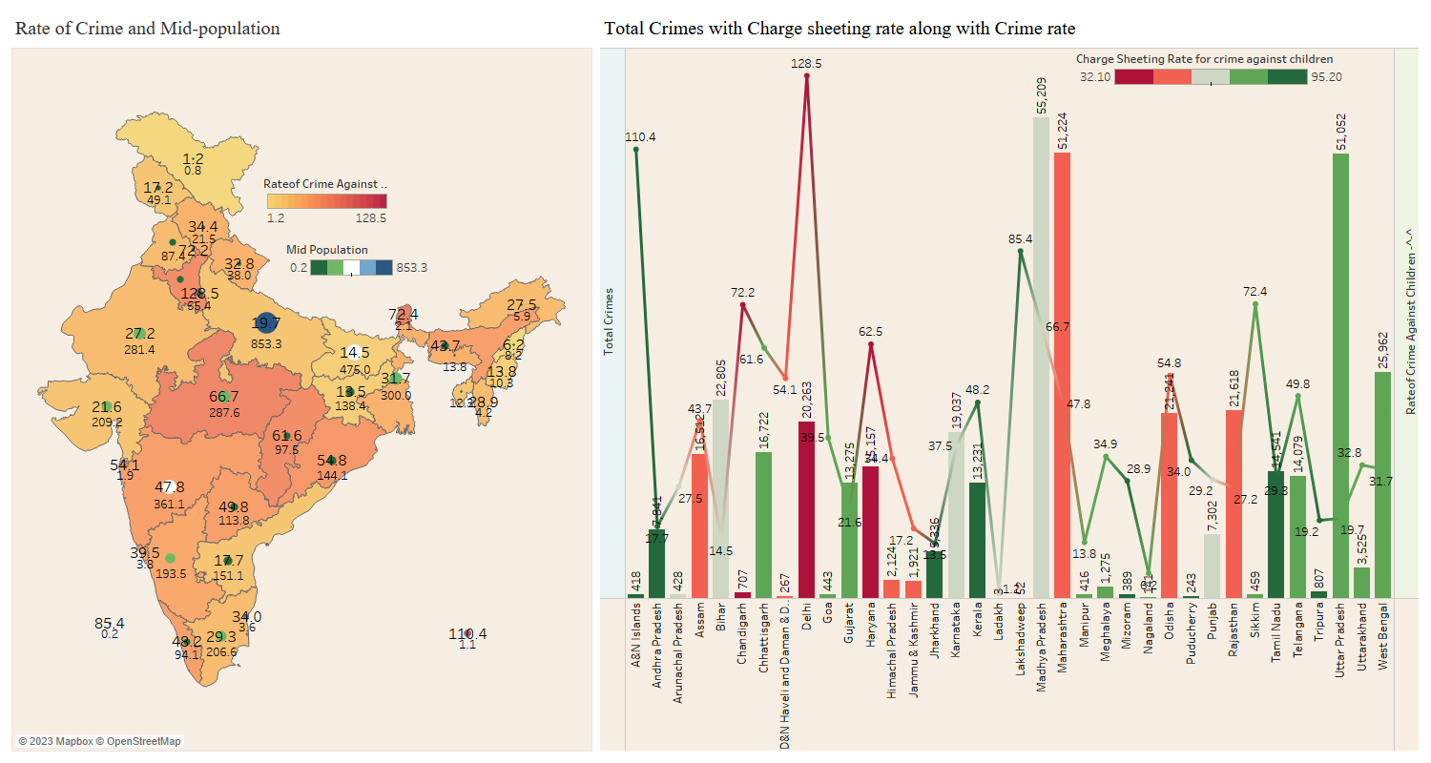
Crimes Against Children

Slide 8
Crimes Against Women
We can see that the crime rate per capita against women in states like Assam, Delhi, and Odisha is high, despite having some lower total crime values than others like Uttar Pradesh, West Bengal, and Maharashtra being unsafe places for women with high crime values which can be attributed to a combination of :
socio-economic factors
reporting practices
population density and other factors
These states may experience higher levels of poverty, inequality, and socio-economic Cultural norms and attitudes towards women, as well as variations in reporting practices, can also play a role.
Additionally, the higher population density in some states may lead to a higher incidence of crimes against women

Slide 9
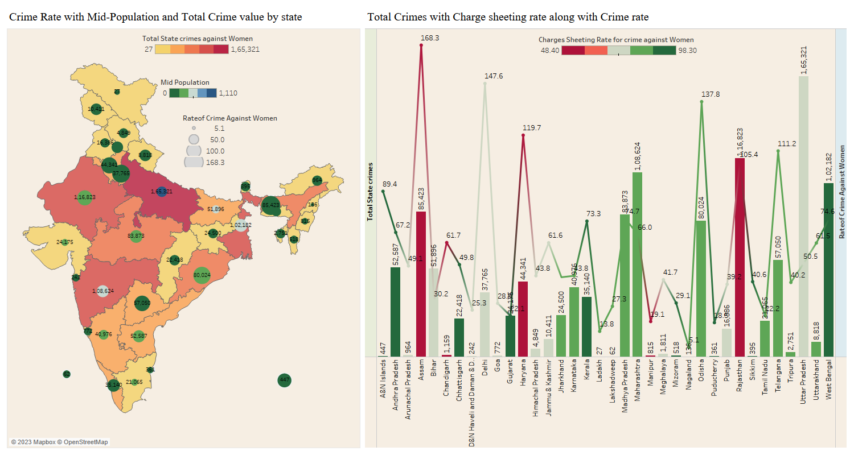
Crimes Against Women

Slide 10
Murder Cases
We can see nearly higher murder cases in Uttar Pradesh, Bihar, and Maharashtra, with a significant impact on males above the age of 30 and 60, which can be attributed to socio-economic factors
These states face socio-economic challenges such as poverty and unemployment, which contribute to higher crime rates
The higher proportion of males in these age groups makes them more vulnerable to becoming victims of murder, often due to disputes, conflicts, and personal vendettas

Slide 11
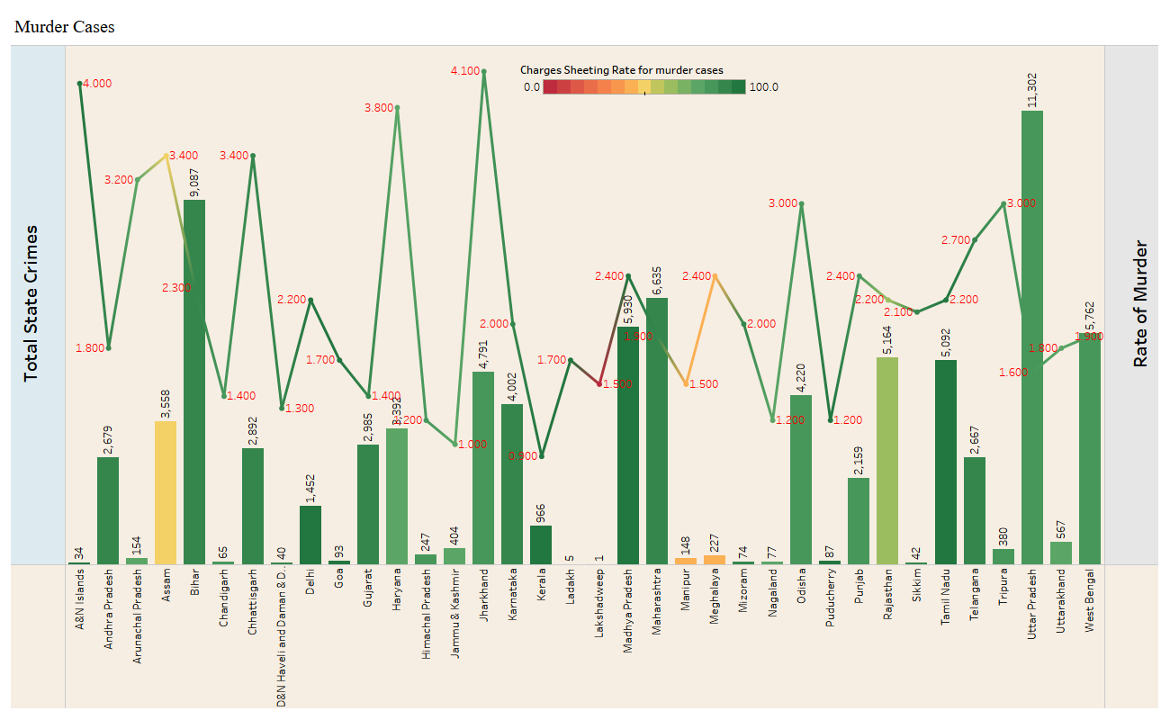

Slide 12
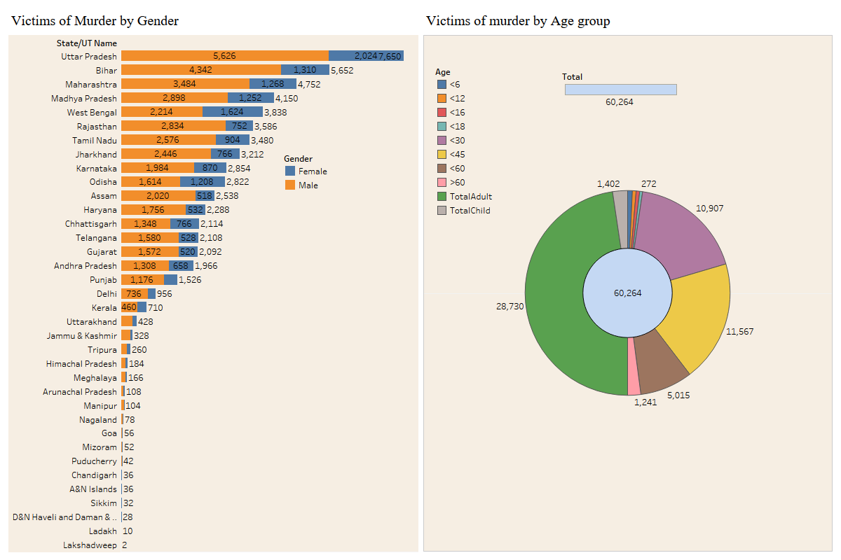

Slide 13
IPC Crimes
Variations of IPC Crimes in States during Covid-19:
There was a significant increase in IPC crimes in Tamil Nadu in 2020 by 8 times of what was in 2019, followed by a reduction of 5 times in 2021, which can be attributed to various factors:
Socio-economic Impact of COVID-19
Migration and Trafficking
Variations in reporting practices and effectiveness of law enforcement agencies
However, the subsequent reduction in IPC crimes in 2021 by 5 times could be attributed to the gradual recovery and stabilization of socio-economic conditions of COVID-19 and changes in reporting mechanisms and law enforcement strategies
Similarly, in the case of other Constantly increasing IPC crime states like UP, Maharashtra, and Delhi due to COVID-19, Disruptions in Law Enforcement, etc

Slide 14
Complaints & its types
Types of Complaints & its FIRs
No of complaints through written, distress calls, O/C or SHO is high however FIRs are filed more for written complaints than for distress calls and complaints made to the Officer-in-Charge (O/C) or Station House Officer (SHO) due to the fact that written ones provide:
Good Documentation and Evidence
Procedural Requirements
Severity of the Incident
Standard Reporting Mechanisms

Slide 15
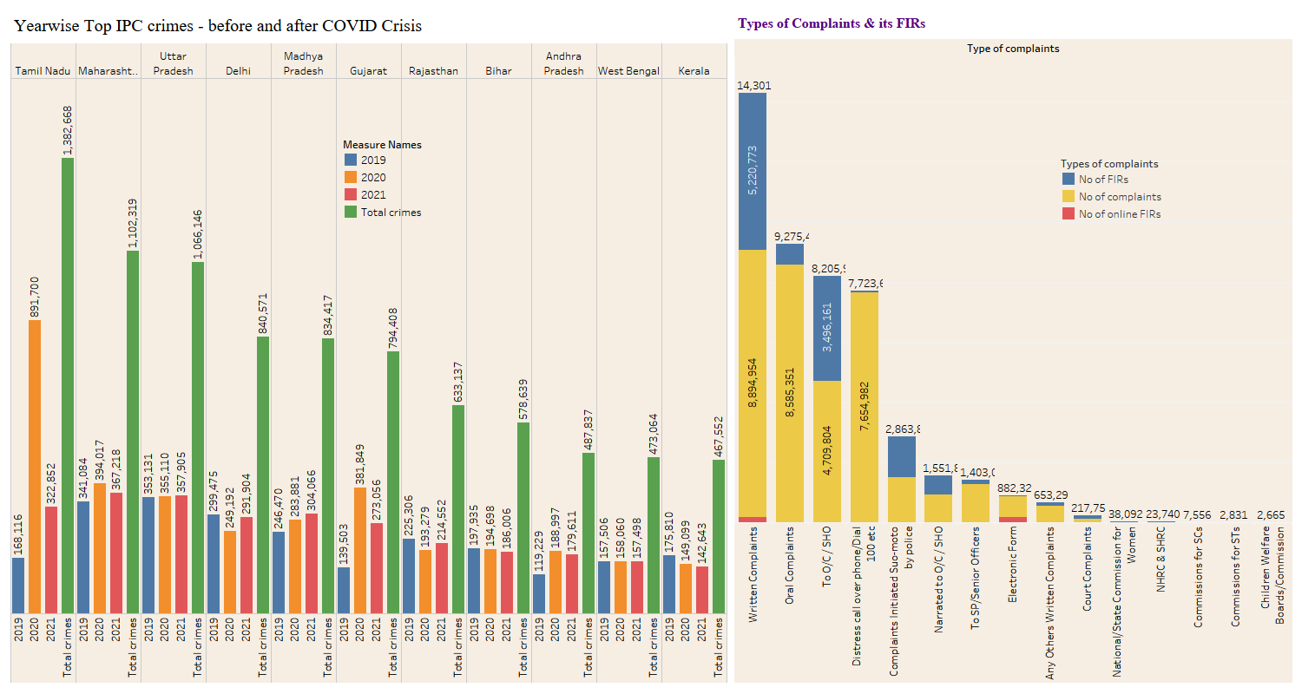

Slide 16
Kidnapping Abduction
The high kidnapping crime rate per capita in Assam, Madhya Pradesh, and Odisha from 2019 to 2020, despite having lower overall crime numbers compared to states like Uttar Pradesh, Maharashtra, and Bihar, can be influenced by factors:
Lower and higher mid-population
Regional dynamics
Presence of criminal networks like proximity to international borders transportation networks
Differences in law enforcement
Reporting practices
Variations in awareness and reporting

Slide 17
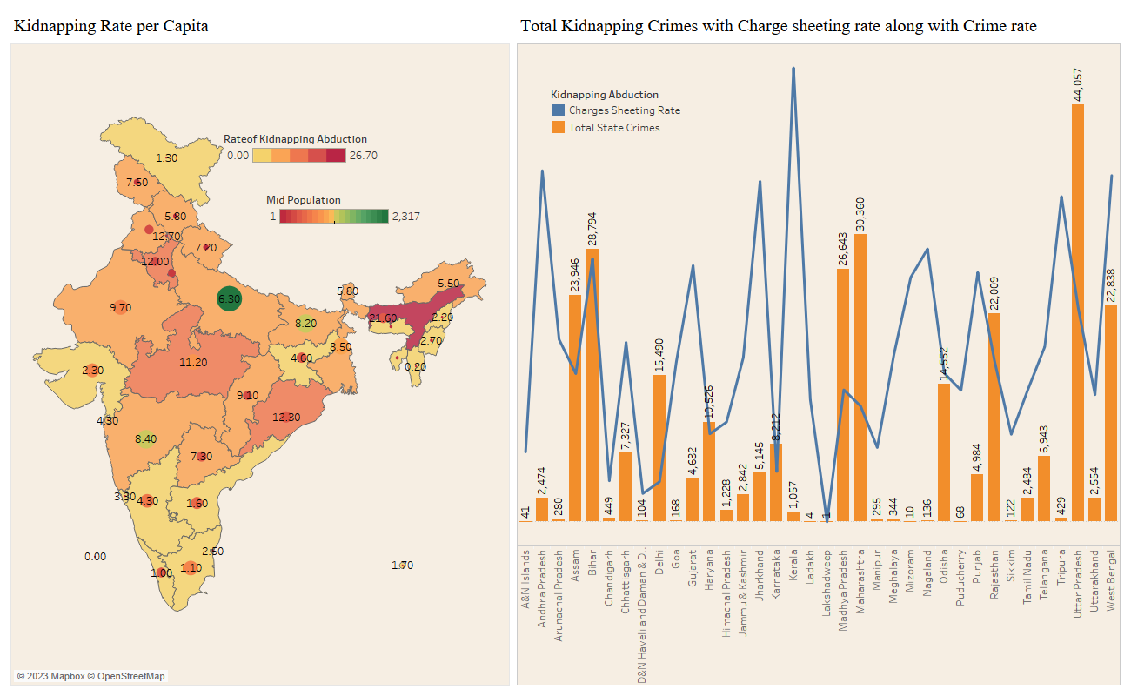

Slide 18
Violent Crimes
The high violent crime numbers in Uttar Pradesh (UP), Bihar, and West Bengal from 2019 to 2020 during the COVID-19 crisis can be influenced by various factors:
Higher incidence of poverty and socio-economic disparities
Gang-related activities like organized crimes including territorial disputes, Economic hardships and Unemployment
Migration, Trafficking and the Impact of the Covid Pandemic
Historical Factors and Social Dynamics

Slide 19
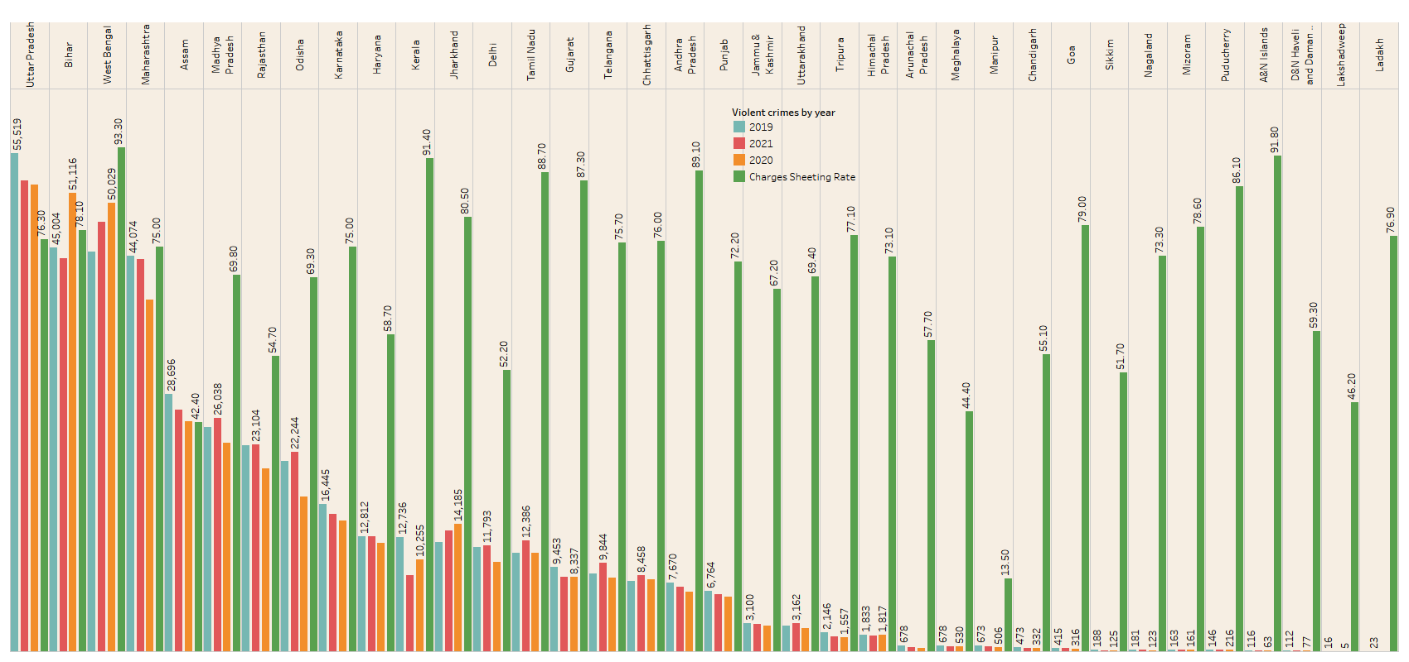
Violent Crimes by Year

Slide 20
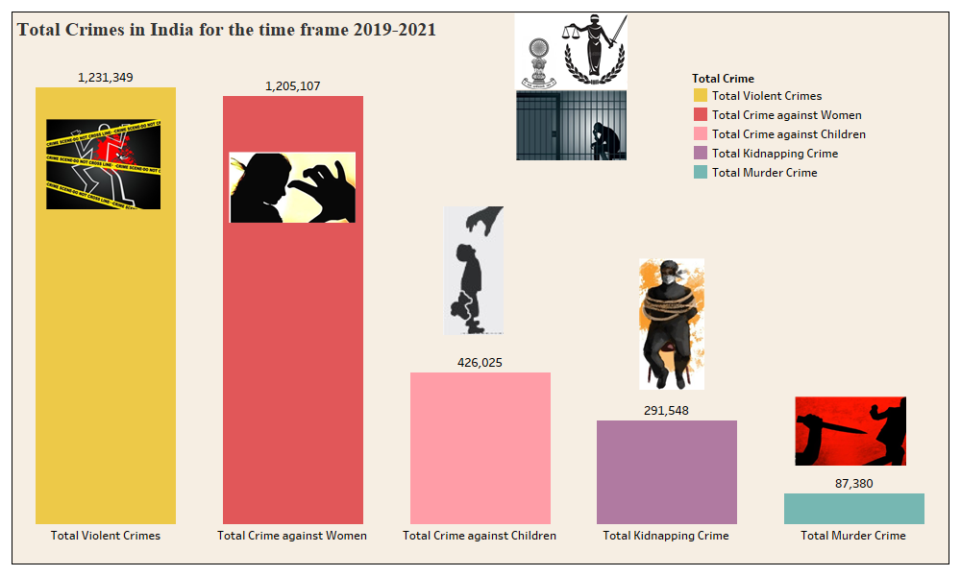

Slide 21
Conclusion- Preventive Measures against Crimes
To prevent crimes against children, women, IPC crimes, violent crimes, and murder cases, it is crucial to implement comprehensive strategies that address the root causes and provide effective law enforcement and support systems. Some potential measures may include:
Strengthening law enforcement agencies
Enhancing public awareness and education programs
Implementing stricter legal measures and ensuring swift and fair justice for victims.
Establishing support systems, helplines, and safe spaces
Promoting community engagement and collaboration
Addressing socio-economic disparities and providing opportunities for education, employment, and skill development to reduce crime rates.
It is important to note that the prevention of crimes requires a multi-faceted approach involving government bodies, law enforcement agencies, civil society organizations, and individuals. Additionally, the specific strategies and interventions should be tailored to the unique challenges and characteristics of each state and region.

