Slide 1
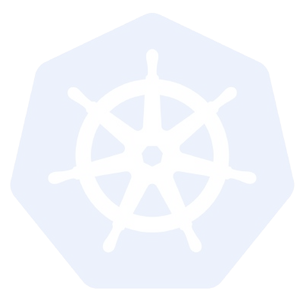
Kubernetes
A Comprehensive Overview
Kubernetes v1.8

Slide 2
Agenda
Introduction
What is Kubernetes?
What does Kubernetes do?
Architecture
Master Components
Node Components
Additional Services
Networking
Concepts
Core
Workloads
Network
Storage
Configuration
Auth and Identity
Behind the Scenes
Deployment from Beginning to End

Slide 3
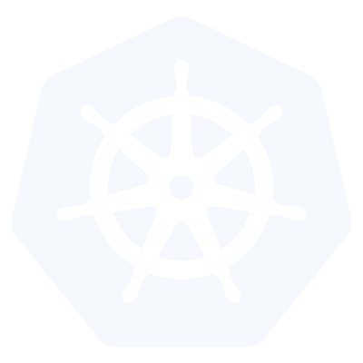
Introduction

Slide 4
Intro - What is Container Orchestration?
In the quality assurance (QA) environments, we can get away with running containers on a single host to develop and test applications. However, when we go to production, we do not have the same liberty, as we need to ensure that our applications:
Are fault-tolerant
Can scale, and do this on-demand
Use resources optimally
Can discover other applications automatically, and communicate with each other
Are accessible from the external world
Can update/rollback without any downtime.
Container orchestrators are the tools which group hosts together to form a cluster, and help us fulfill the requirements mentioned above.

Slide 5
Container Orchestrators
Docker Swarm Docker Swarm is a container orchestrator provided by Docker, Inc. It is part of Docker Engine.
Kubernetes Kubernetes was started by Google, but now, it is a part of the Cloud Native Computing Foundation project.
Mesos Marathon Marathon is one of the frameworks to run containers at scale on Apache Mesos.
Amazon ECS Amazon EC2 Container Service (ECS) is a hosted service provided by AWS to run Docker containers at scale on its infrastructrue.
Hashicorp Nomad Nomad is the container orchestrator provided by HashiCorp.

Slide 6
Intro - What is Kubernetes?
Kubernetes or K8s was a project spun out of Google as a open source next-gen container scheduler designed with the lessons learned from developing and managing Borg and Omega.
Kubernetes was designed from the ground-up as a loosely coupled collection of components centered around deploying, maintaining, and scaling applications.

Slide 7
Intro - What Does Kubernetes do?
Kubernetes is the linux kernel of distributed systems.
It abstracts away the underlying hardware of the nodes and provides a uniform interface for applications to be both deployed and consume the shared pool of resources.

Slide 8
Kubernetes
Architecture

Slide 9
Architecture Overview
Masters - Acts as the primary control plane for Kubernetes. Masters are responsible at a minimum for running the API Server, scheduler, and cluster controller. They commonly also manage storing cluster state, cloud-provider specific components and other cluster essential services.
Nodes - Are the ‘workers’ of a Kubernetes cluster. They run a minimal agent that manages the node itself, and are tasked with executing workloads as designated by the master.

Slide 10
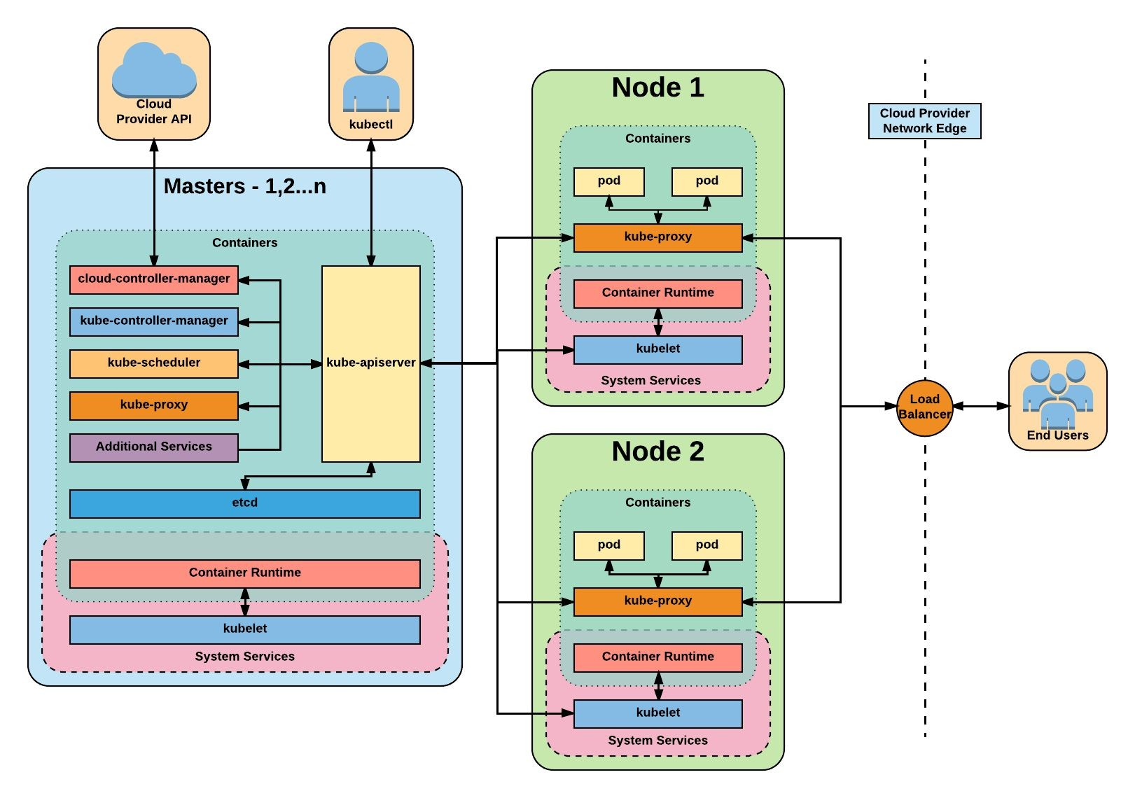
Architecture Overview

Slide 11
Master
Components

Slide 12
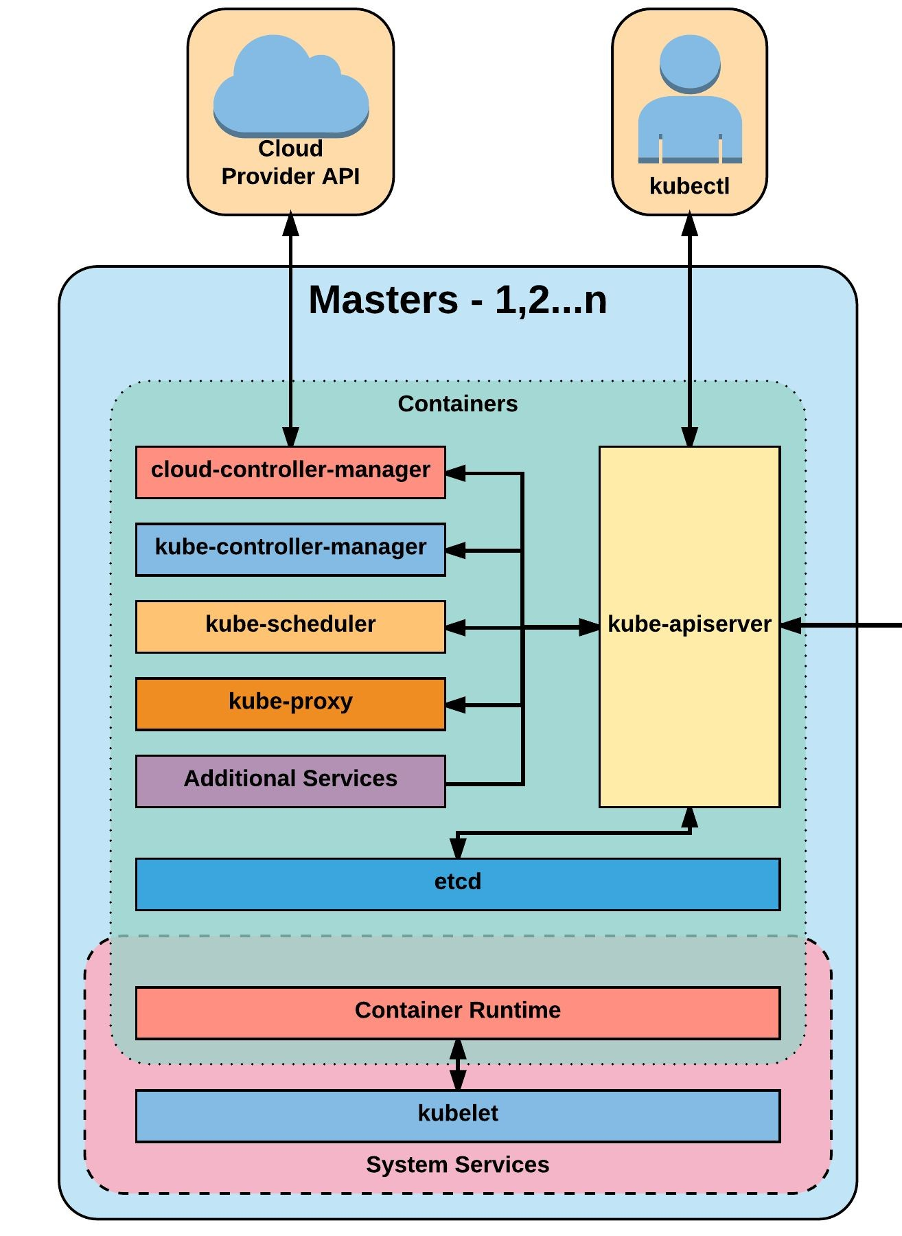
Master Components
Kube-apiserver
Etcd
Kube-controller-manager
Cloud-controller-manager
Kube-scheduler

Slide 13
kube-apiserver
The apiserver provides a forward facing REST interface into the kubernetes control plane and datastore. All clients, including nodes, users and other applications interact with kubernetes strictly through the API Server.
It is the true core of Kubernetes acting as the gatekeeper to the cluster by handling authentication and authorization, request validation, mutation, and admission control in addition to being the front-end to the backing datastore.

Slide 14
etcd
Etcd acts as the cluster datastore; providing a strong, consistent and highly available key-value store used for persisting cluster state.

Slide 15
kube-controller-manager
The controller-manager is the primary daemon that manages all core component control loops. It monitors the cluster state via the apiserver and steers the cluster towards the desired state.
List of core controllers:
https://github.com/kubernetes/kubernetes/blob/master/cmd/kube-controller-manager/app/controllermanager.go#L332

Slide 16
cloud-controller-manager
The cloud-controller-manager is a daemon that provides cloud-provider specific knowledge and integration capability into the core control loop of Kubernetes. The controllers include Node, Route, Service, and add an additional controller to handle PersistentVolumeLabels .

Slide 17
kube-scheduler
Kube-scheduler is a verbose policy-rich engine that evaluates workload requirements and attempts to place it on a matching resource. These requirements can include such things as general hardware reqs, affinity, anti-affinity, and other custom resource requirements.

Slide 18
Node
Components

Slide 19
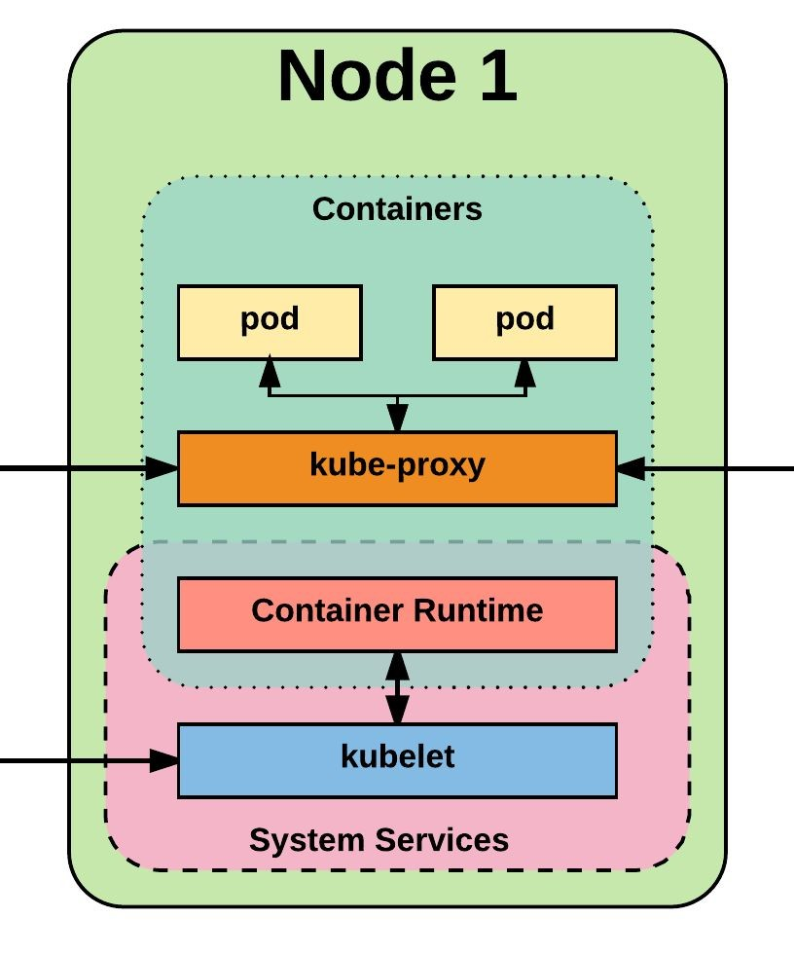
Node Components
Kubelet
Kube-proxy
Container runtime engine

Slide 20
kubelet
Acts as the node agent responsible for managing pod lifecycle on its host. Kubelet understands YAML container manifests that it can read from several sources:
File path
HTTP Endpoint
Etcd watch acting on any changes
HTTP Server mode accepting container manifests over a simple API.

Slide 21
kube-proxy
Manages the network rules on each node and performs connection forwarding or load balancing for Kubernetes cluster services.
Available Proxy Modes:
Userspace
iptables
ipvs (alpha in 1.8)

Slide 22
Container Runtime
With respect to Kubernetes, A container runtime is a CRI (Container Runtime Interface) compatible application that executes and manages containers.
Containerd (docker)
Cri-o
Rkt
Kata (formerly clear and hyper)
Virtlet (VM CRI compatible runtime)

Slide 23
Additional Services
Kube-dns - Provides cluster wide DNS Services. Services are resolvable to
<service>.<namespace>.svc.cluster.local.
Heapster - Metrics Collector for kubernetes cluster, used by some resources such as the Horizontal Pod Autoscaler. (required for kubedashboard metrics)
Kube-dashboard - A general purpose web based UI for kubernetes.

