Slide 1
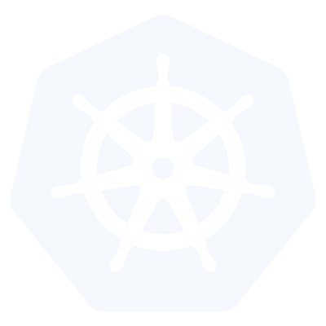
Networking

Slide 2
Networking - Fundamental Rules
A Unique IP is assigned to each POD
All Pods can communicate with all other Pods without NAT
All nodes can communicate with all Pods (and vice-versa) without NAT.
The IP that a Pod sees itself as is the same IP that others see it as.

Slide 3
Networking - Fundamentals Applied
Containers in a pod exist within the same network namespace and share an IP; allowing for intrapod communication over localhost.
Pods are given a cluster unique IP for the duration of its lifecycle, but the pods themselves are fundamentally ephemeral.
Services are given a persistent cluster unique IP that spans the Pods lifecycle.
External Connectivity is generally handed by an integrated cloud provider or other external entity (load balancer)

Slide 4
Networking - CNI
Networking within Kubernetes is plumbed via the Container Network Interface (CNI), an interface between a container runtime and a network implementation plugin.
Compatible CNI Network Plugins:
Calico
Cillium
Contiv
Contrail
Flannel
GCE
kube-router
Multus
OpenVSwitch
OVN
Romana
Weave

Slide 5
Kubernetes Configurations
Kubernetes can be installed using different configurations. The four major installation types are briefly presented below:
All-in-One Single-Node Installation
With all-in-one, all the master and worker components are installed on a single node. This is very useful for learning, development, and testing. This type should not be used in production. Minikube is one such example, and we are going to explore it in future chapters.
Single-Node etcd, Single-Master, and Multi-Worker Installation
In this setup, we have a single master node, which also runs a single-node etcd instance. Multiple worker nodes are connected to the master node.
Single-Node etcd, Multi-Master, and Multi-Worker Installation
In this setup, we have multiple master nodes, which work in an HA mode, but we have a single-node etcd instance. Multiple worker nodes are connected to the master nodes.
Multi-Node etcd, Multi-Master, and Multi-Worker Installation
In this mode, etcd is configured in a clustered mode, outside the Kubernetes cluster, and the nodes connect to it. The master nodes are all configured in an HA mode, connecting to multiple worker nodes. This is the most advanced and recommended production setup.

Slide 6
Infrastructure for Kubernetes Installation
Once we decide on the installation type, we also need to make some infrastructure-related decisions, such as:
Should we set up Kubernetes on bare metal, public cloud, or private cloud?
Which underlying system should we use? Should we choose RHEL, CoreOS, CentOS, or something else?
Which networking solution should we use?
And so on.
The Kubernetes documentation has details in regards to choosing the right solution. Next, we will take a closer look at these solutions.

Slide 7
Localhost Installation
There are a few localhost installation options available to deploy single- or multi-node Kubernetes clusters on our workstation/laptop:
Minikube
Ubuntu on LXD.
Minikube is the preferred and recommended way to create an all-in-one Kubernetes setup.

Slide 8
On-Premise Installation
Kubernetes can be installed on-premise on VMs and bare metal.
On-Premise VMs
Kubernetes can be installed on VMs created via Vagrant, VMware vSphere, KVM, etc. There are different tools available to automate the installation, like Ansible or kubeadm.
On-Premise Bare Metal
Kubernetes can be installed on on-premise bare metal, on top of different operating systems, like RHEL, CoreOS, CentOS, Fedora, Ubuntu, etc. Most of the tools used to install VMs can be used with bare metal as well.

Slide 9
Cloud Installation
Kubernetes can be installed and managed on almost any cloud environment:
Hosted Solutions
With hosted solutions, any given software is completely managed by the provider. The user will just need to pay hosting and management charges. Some examples of vendors providing hosted solutions for Kubernetes are listed below:
Google Kubernetes Engine (GKE)
Azure Container Service (AKS)
Amazon Elastic Container Service for Kubernetes (EKS) - Currently in Tech Preview
OpenShift Dedicated
Platform9
IBM Cloud Container Service.
Turnkey Cloud Solutions
For Kubernetes, we have some Turnkey Cloud Solutions, with which Kubernetes can be installed with just a few commands on an underlying IaaS platform, such as:
Google Compute Engine
Amazon AWS
Microsoft Azure
Tectonic by CoreOS.
Bare Metal
Kubernetes can be installed on bare metal provided by different cloud providers.

Slide 10
Kubernetes
Concepts

Slide 11
Kubernetes Concepts - Core
Cluster - A collection of hosts that aggregate their available resources including cpu, ram, disk, and their devices into a usable pool.
Master - The master(s) represent a collection of components that make up the control plane of Kubernetes. These components are responsible for all cluster decisions including both scheduling and responding to cluster events.
Node - A single host, physical or virtual capable of running pods. A node is managed by the master(s), and at a minimum runs both kubelet and kube-proxy to be considered part of the cluster.
Namespace - A logical cluster or environment. Primary method of dividing a cluster or scoping access.

Slide 12
Concepts - Core (cont.)
Label - Key-value pairs that are used to identify, describe and group together related sets of objects. Labels have a strict syntax and available character set. *
Annotation - Key-value pairs that contain non-identifying information or metadata. Annotations do not have the the syntax limitations as labels and can contain structured or unstructured data.
Selector - Selectors use labels to filter or select objects. Both equality-based (=, ==, !=) or simple key-value matching selectors are supported.
* https://kubernetes.io/docs/concepts/overview/working-with-objects/labels/#syntax-and-character-set

Slide 13
Concepts - Workloads
Pod - A pod is the smallest unit of work or management resource within Kubernetes. It is comprised of one or more containers that share their storage, network, and context (namespace, cgroups etc).
ReplicationController - Method of managing pod replicas and their lifecycle. Their scheduling, scaling, and deletion.
ReplicaSet - Next Generation ReplicationController. Supports set-based selectors.
Deployment - A declarative method of managing stateless Pods and ReplicaSets. Provides rollback functionality in addition to more granular update control mechanisms.

Slide 14
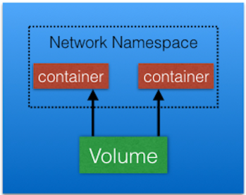
A Pod is the smallest and simplest Kubernetes object. It is the unit of deployment in Kubernetes, which represents a single instance of the application. A Pod is a logical collection of one or more containers, which: Are scheduled together on the same host Share the same network namespace Mount the same external storage (volumes).
PODS

Slide 15
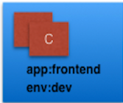
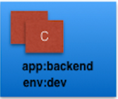

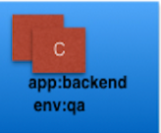
Labels are key-value pairs that can be attached to any Kubernetes objects (e.g. Pods). Labels are used to organize and select a subset of objects, based on the requirements in place. Many objects can have the same Label(s). Labels do not provide uniqueness to objects.
LABELS

Slide 16
With Label Selectors, we can select a subset of objects. Kubernetes supports two types of Selectors: Equality-Based Selectors Equality-Based Selectors allow filtering of objects based on Label keys and values. With this type of selectors, we can use the =, ==, or != operators. For example, with env==dev we are selecting the objects where the env Label is set to dev. Set-Based Selectors Set-Based Selectors allow filtering of objects based on a set of values. With this type of Selectors, we can use the in, notin, and exist operators. For example, with env in (dev,qa), we are selecting objects where the env Label is set to dev or qa.
Label Selectors

Slide 17
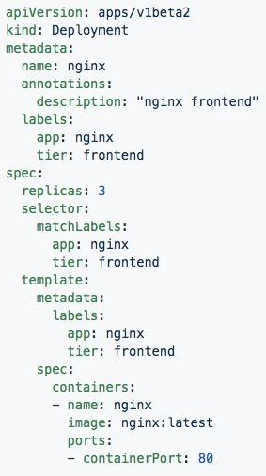
Labels, and Annotations, and Selectors
Labels: app: nginx
tier: frontned
Annotations
description: “nginx frontend”
Selector: app: nginx
tier: frontend

Slide 18
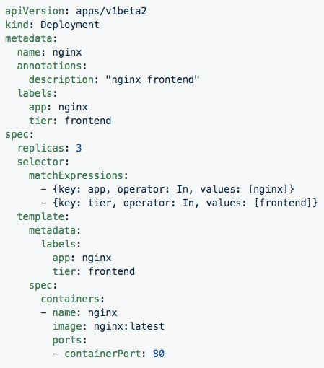
Set-based selectors
Valid Operators:
In
NotIn
Exists
DoesNotExist
Supported Objects with set-based selectors:
Job
Deployment
ReplicaSet
DaemonSet
PersistentVolumeClaims

Slide 19
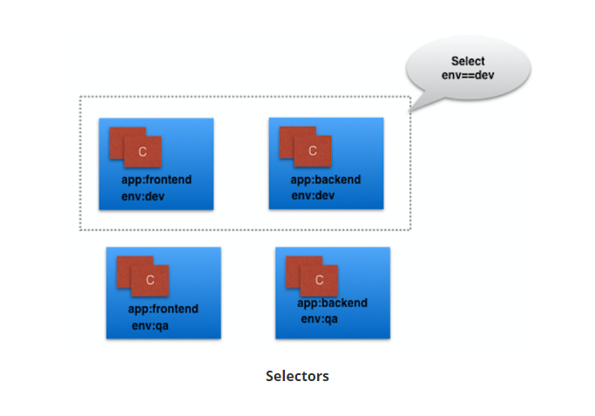

Slide 20
A ReplicationController (rc) is a controller that is part of the master node's controller manager. It makes sure the specified number of replicas for a Pod is running at any given point in time. If there are more Pods than the desired count, the ReplicationController would kill the extra Pods, and, if there are less Pods, then the ReplicationController would create more Pods to match the desired count. Generally, we don't deploy a Pod independently, as it would not be able to re-start itself, if something goes wrong. We always use controllers like ReplicationController to create and manage Pods.
ReplicationControllers

Slide 21
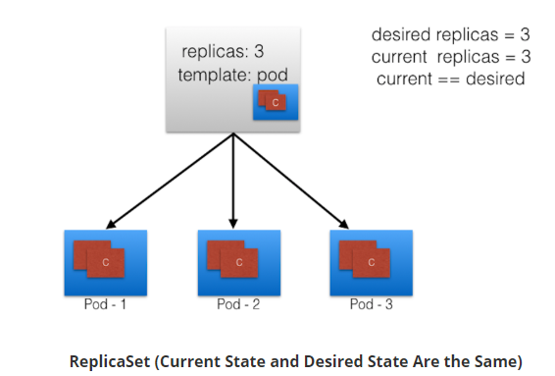
A ReplicaSet (rs) is the next-generation ReplicationController. ReplicaSets support both equality- and set-based selectors, whereas ReplicationControllers only support equality-based Selectors. Currently, this is the only difference.
Replica Sets

Slide 22
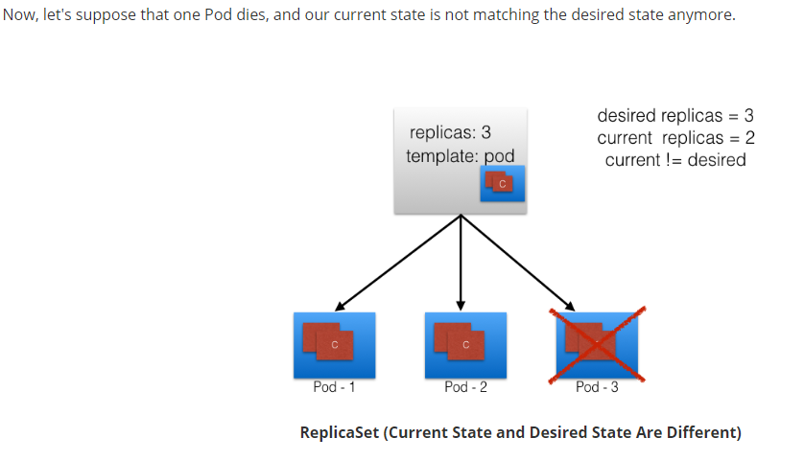

Slide 23
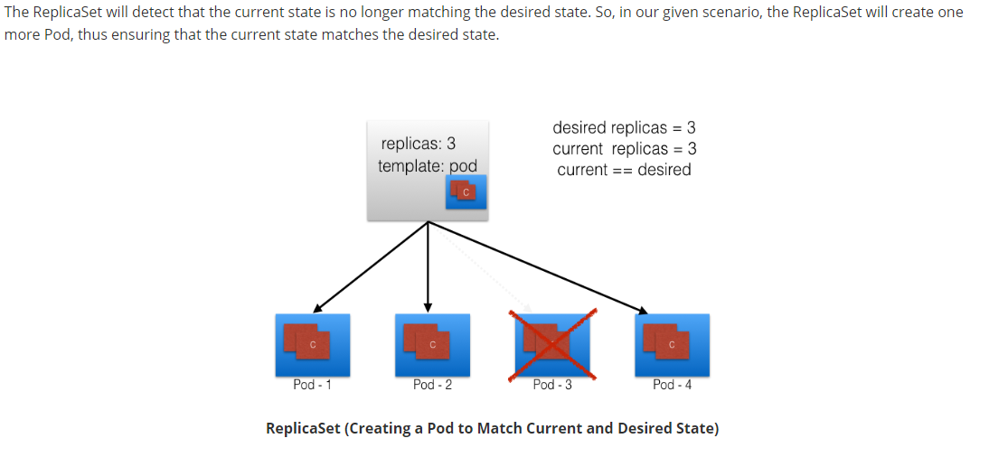

Slide 24
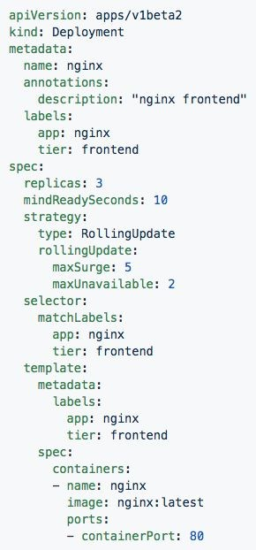
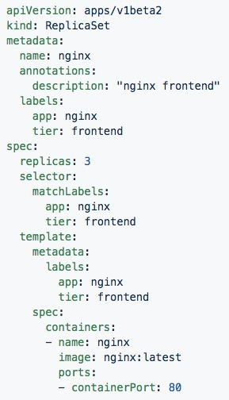
Deployment
ReplicaSet
Generated ReplicaSet from Deployment spec.
Contains configuration of how updates or ‘deployments’ should be managed in addition to the pod template used to generate the ReplicaSet.

Slide 25
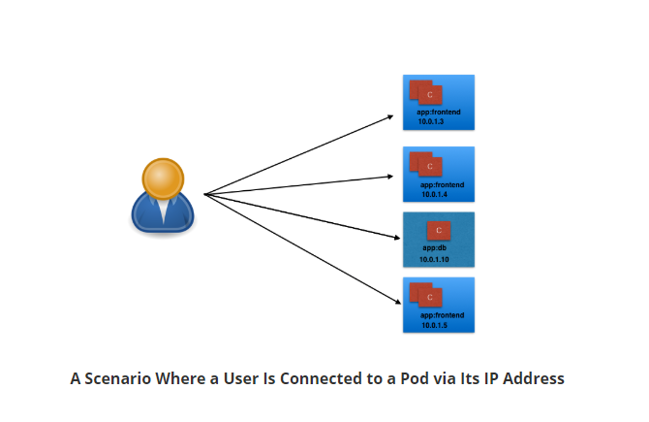
Connecting Users to PODS
To access the application, a user/client needs to connect to the Pods. As Pods are ephemeral in nature, resources like IP addresses allocated to it cannot be static. Pods could die abruptly or be rescheduled based on existing requirements.

Slide 26
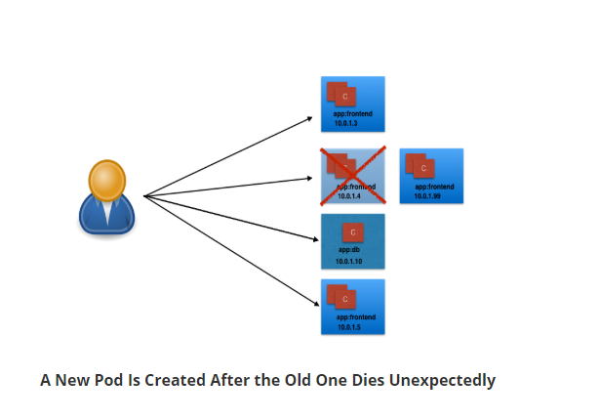
Unexpectedly, the Pod to which the user/client is connected dies, and a new Pod is created by the controller. The new Pod will have a new IP address, which will not be known automatically to the user/client of the earlier Pod.
To overcome this situation, Kubernetes provides a higher-level abstraction called Service, which logically groups Pods and a policy to access them. This grouping is achieved via Labels and Selectors

Slide 27
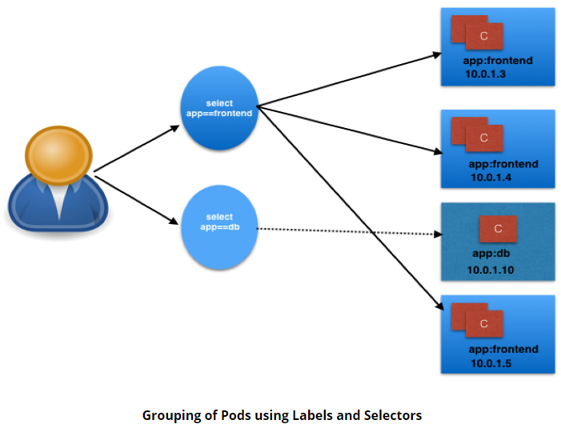
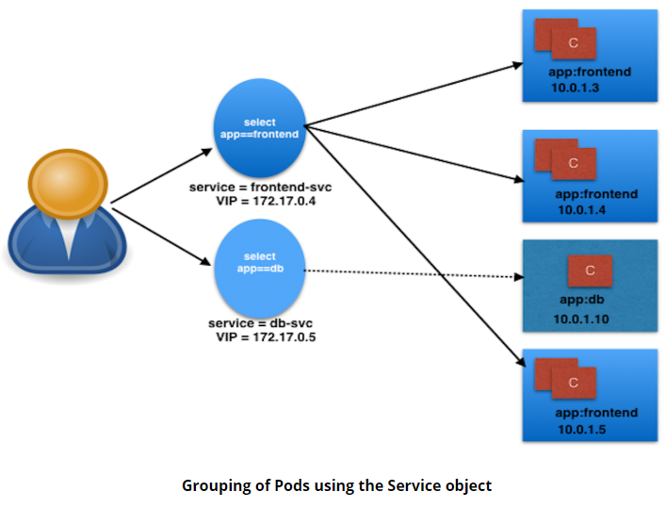
Services
In the following graphical representation we have used the app keyword as a Label, and frontend and db as values for different Pods..
Services provide a method of exposing and consuming L4 Pod network accessible resources. They use label selectors to map groups of pods and ports to a cluster-unique virtual IP.

Slide 28
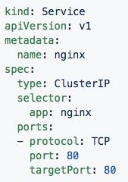
Service
Acts as the unified method of accessing replicated pods.
While defining a Service, we can also choose its access scope, We can decide whether the Service:
Is only accessible within the cluster
Is accessible from within the cluster and the external world
Maps to an external entity which resided outside the cluster
Four major Service Types:
CluterIP - Exposes service on a strictly cluster-internal IP (default)
NodePort - Service is exposed on each node’s IP on a statically defined port.
LoadBalancer - Works in combination with a cloud provider to expose a service outside the cluster on a static external IP.
ExternalName - used to references endpoints OUTSIDE the cluster by providing a static internally referenced DNS name.

Slide 29
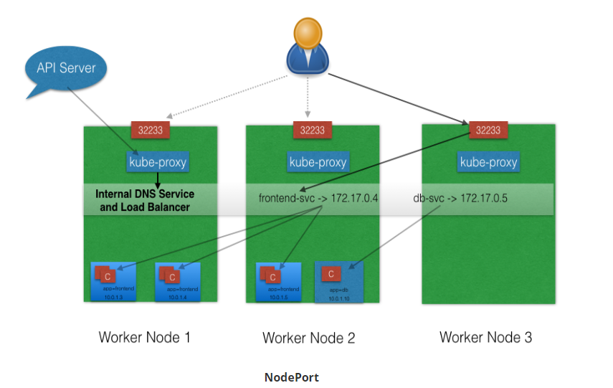
ServiceType: ClusterIP and NodePort
ClusterIP is the default ServiceType. A Service gets its Virtual IP address using the ClusterIP. That IP address is used for communicating with the Service and is accessible only within the cluster.
With the NodePort ServiceType, in addition to creating a ClusterIP, a random port from the range 30000-32767 is mapped to the respective Service, from all the worker nodes. For example, if the mapped NodePort is 32233 for the service frontend-svc, then, if we connect to any worker node on port 32233, the node would redirect all the traffic to the assigned ClusterIP - 172.17.0.4
If we don't want to assign a dynamic port value for NodePort, then, while creating the service, we can also give a port number from the earlier specific range.
The NodePort ServiceType is useful when we want to make our Services accessible from the external world. The end-user connects to the worker nodes on the specified port, which forwards the traffic to the applications running inside the cluster

Slide 30
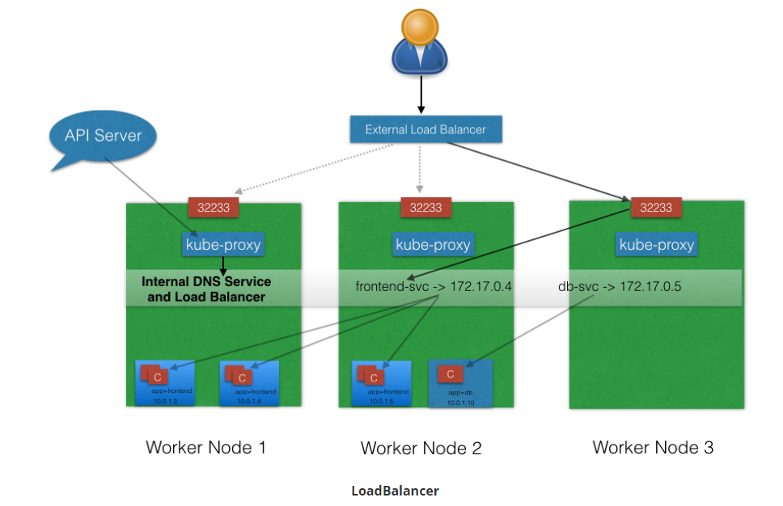
ServiceType: LoadBalancer
With the LoadBalancer ServiceType:
NodePort and ClusterIP Services are automatically created, and the external load balancer will route to them
The Services are exposed at a static port on each worker node
The Service is exposed externally using the underlying cloud provider's load balancer feature.
The LoadBalancer ServiceType will only work if the underlying infrastructure supports the automatic creation of Load Balancers and have the respective support in Kubernetes, as is the case with the Google Cloud Platform and AWS

Slide 31
Concepts - Network
Service - Services provide a method of exposing and consuming L4 Pod network accessible resources. They use label selectors to map groups of pods and ports to a cluster-unique virtual IP.
Ingress - An ingress controller is the primary method of exposing a cluster service (usually http) to the outside world. These are load balancers or routers that usually offer SSL termination, name-based virtual hosting etc.

Slide 32
Concepts - Storage
Volume - Storage that is tied to the Pod Lifecycle, consumable by one or more containers within the pod.
PersistentVolume - A PersistentVolume (PV) represents a storage resource. PVs are commonly linked to a backing storage resource, NFS, GCEPersistentDisk, RBD etc. and are provisioned ahead of time. Their lifecycle is handled independently from a pod.
PersistentVolumeClaim - A PersistentVolumeClaim (PVC) is a request for storage that satisfies a set of requirements instead of mapping to a storage resource directly. Commonly used with dynamically provisioned storage.
StorageClass - Storage classes are an abstraction on top of an external storage resource. These will include a provisioner, provisioner configuration parameters as well as a PV reclaimPolicy.

Slide 33
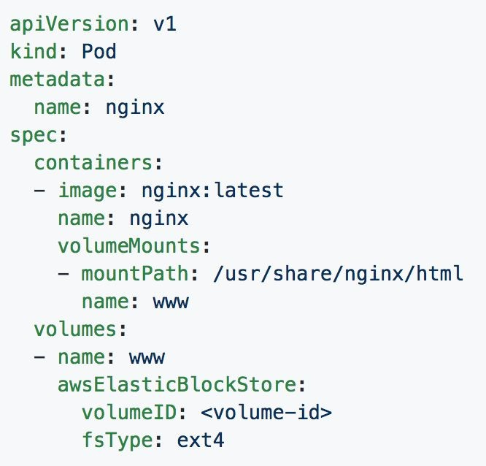
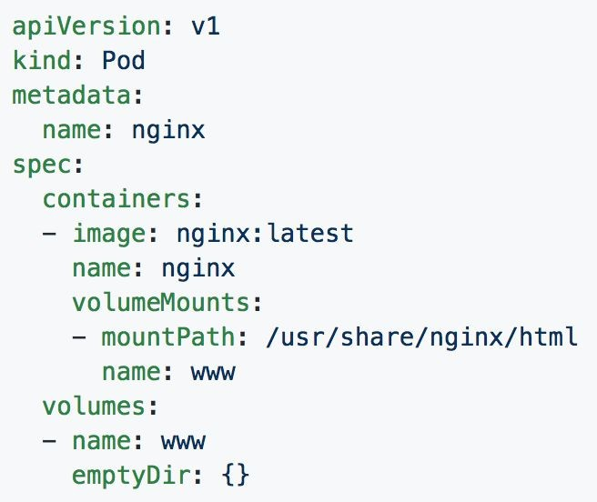
Volumes

Slide 34
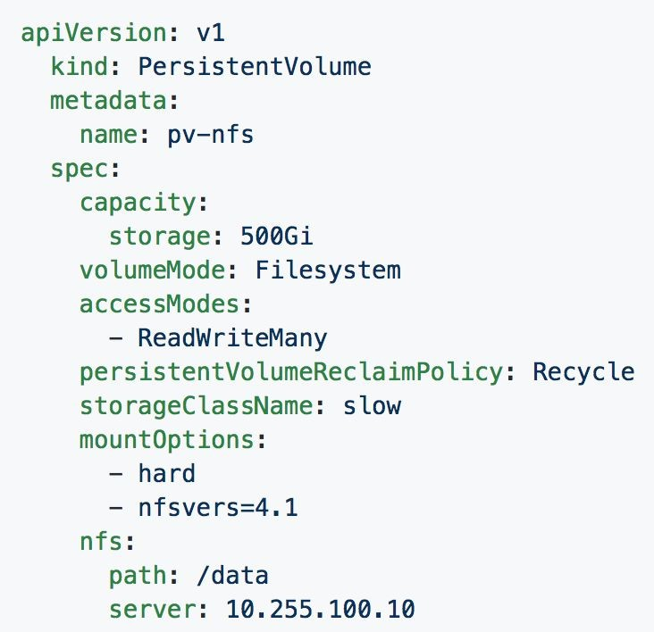
Persistent Volumes
PVs are a cluster-wide resource
Not directly consumable by a Pod
PV Parameters:
Capacity
accessModes
ReadOnlyMany (ROX)
ReadWriteOnce (RWO)
ReadWriteMany (RWX)
persistentVolumeReclaimPolicy
Retain
Recycle
Delete
StorageClass

Slide 35
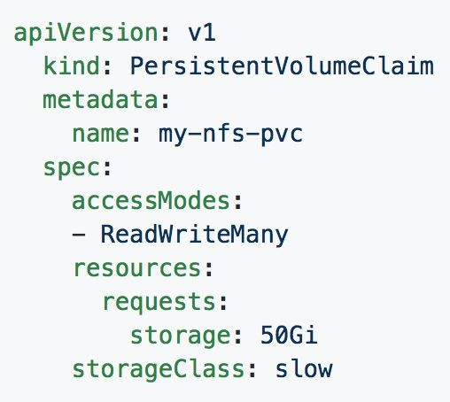
Persistent Volume Claims
PVCs are scoped to namespaces
Supports accessModes like PVs
Uses resource request model similar to Pods
Claims will consume storage from matching PVs or StorageClasses based on storageClass and selectors.

Slide 36
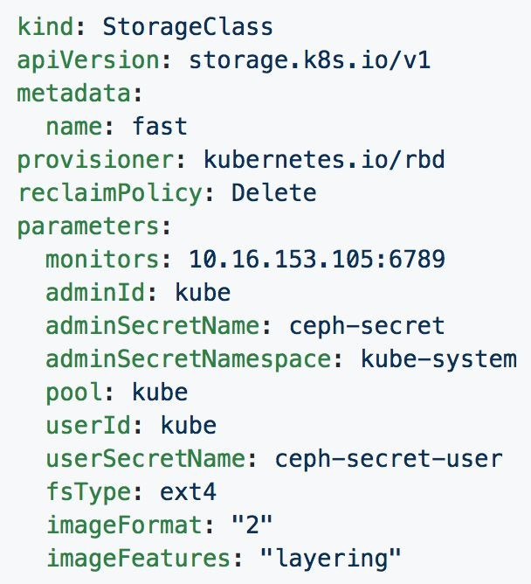
Storage Classes
Uses an external system defined by the provisioner to dynamically consume and allocate storage.
Storage Class Fields
Provisioner
Parameters
reclaimPolicy

Slide 37
Concepts - Configuration
ConfigMap - Externalized data stored within kubernetes that can be referenced as a commandline argument, environment variable, or injected as a file into a volume mount. Ideal for separating containerized application from configuration.
Secret - Functionally identical to ConfigMaps, but stored encoded as base64, and encrypted at rest (if configured).

Slide 38
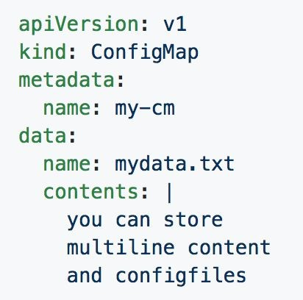
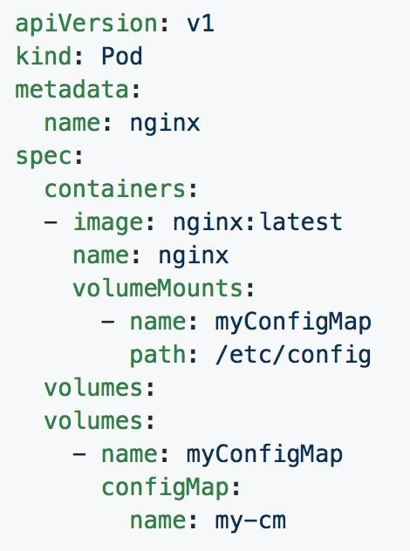
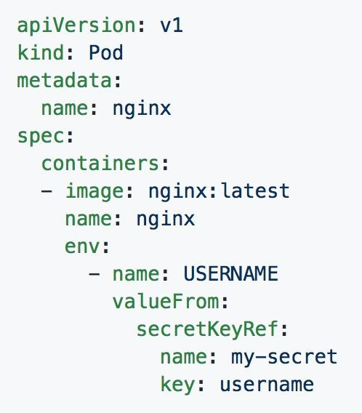
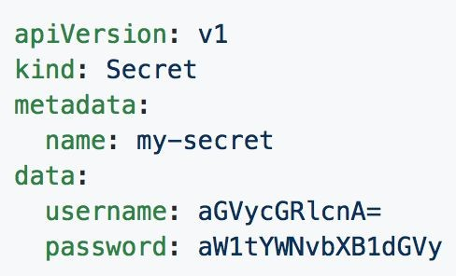
ConfigMaps and Secrets
Can be used in Pod Config:
Injected as a file
Passed as an environment variable
Used as a container command (requires passing as env var)

Slide 39
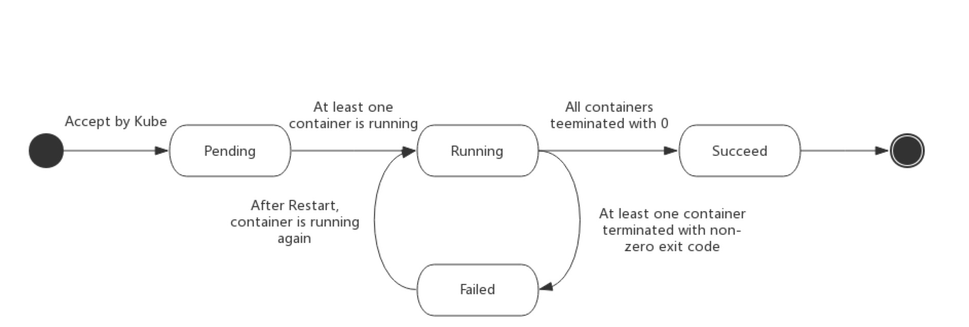
Pod Lifecycle

Slide 40
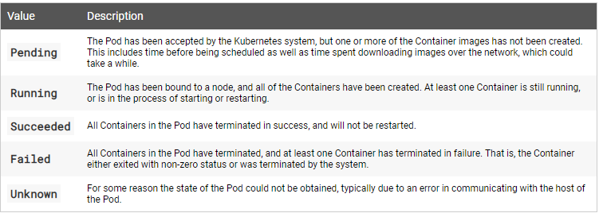
POD LifeCycle

Slide 41
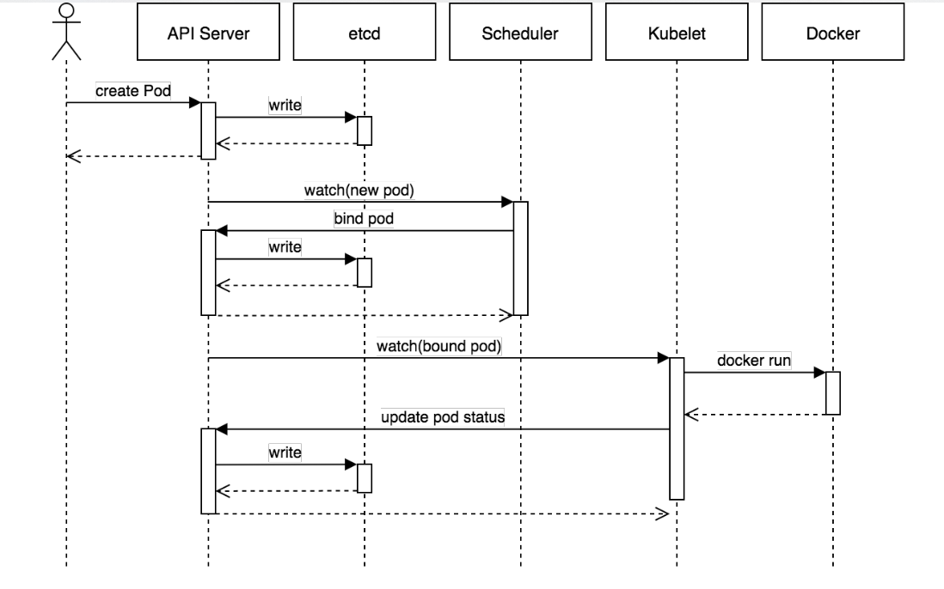
Birth Of a Pod

Slide 42
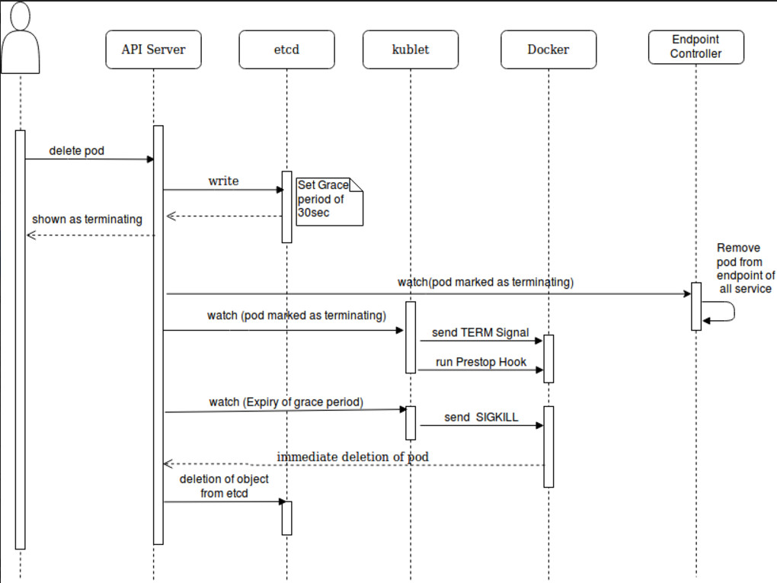
Termination

Slide 43
Concepts - Auth and Identity (RBAC)
[Cluster]Role - Roles contain rules that act as a set of permissions that apply verbs like “get”, “list”, “watch” etc over resources that are scoped to apiGroups. Roles are scoped to namespaces, and ClusterRoles are applied cluster-wide.
[Cluster]RoleBinding - Grant the permissions as defined in a [Cluster]Role to one or more “subjects” which can be a user, group, or service account.
ServiceAccount- ServiceAccounts provide a consumable identity for pods or external services that interact with the cluster directly and are scoped to namespaces.

Slide 44
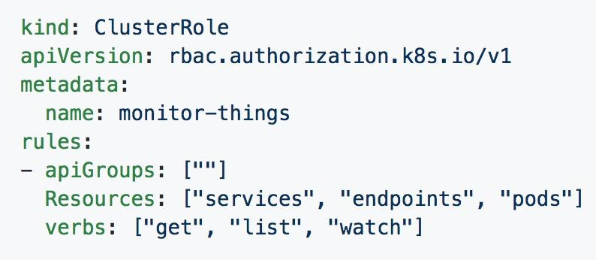
[Cluster]Role
Permissions translate to url path. With “” defaulting to core group.
Resources act as items the role should be granted access to.
Verbs are the actions the role can perform on the referenced resources.

Slide 45
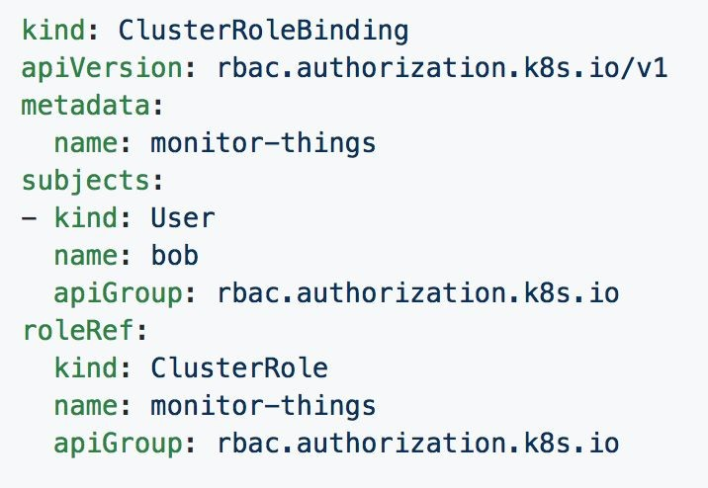
[Cluster]RoleBinding
Can reference multiple subjects
Subjects can be of kind:
User
Group
ServiceAccount
roleRef targets a single role only.

