Slide 1
Lecture 15
Document based databases aka NoSQL

Slide 2




Map
Getting Started
Front End
Back End
Advanced Topics
Introduction
Fundamentals
Git
Command Line
HTML
CSS
Responsive Design
JavaScript & jQuery
Web Frameworks
Architecture
Database Design
APIs
Visualization
Security
Deployment
Notes:
This is the course map for IOLab 2016
We have packaged the course in f
Open up netflix and utube
our modules

Slide 3
Map
Getting Started
Front End
Back End
Advanced Topics
Introduction
Fundamentals
Git
Command Line
HTML
CSS
Responsive Design
JavaScript & jQuery
Web Frameworks
Architecture
Database Design
APIs
Visualization
Security
Deployment
Notes:
This is the course map for IOLab 2016
We have packaged the course in four modules

Slide 4

Next Week – Mega Lab !
Notes:
We wont teach anything new
The idea is to help you distill all the content you have learnt over the last few weeks
At this point conceptually you can build an information system, and we want to give you guys a platform to try and do it
read up,

Slide 5

Post spring break– Checkpoint Presentations
Notes:
We wont teach anything new
The idea is to help you distill all the content you have learnt over the last few weeks
At this point conceptually you can build an information system, and we want to give you guys a platform to try and do it
read up,

Slide 6
Today
Quick Recap – SQL / RDBMS
Document DB - NoSQL
Lab

Slide 7
Example requirements - university
“As a University Dean, I need access to records of all our students, so that we can store and verify them in the future
“As a CS 170 Professor , I need list of students in my class, so that I can communicate with them effectively”
“As a University Admin, I need list of all classes across departments so that I can update course offerings”
What resources your system has to organize
What interactions your system has to support
DATABASE MODEL

Slide 8
Example requirements
“As a University Dean, I need access to records of all our students, so that we can store and verify them in the future
Attributes
Entities

Slide 9
Example requirements - 2

Slide 10
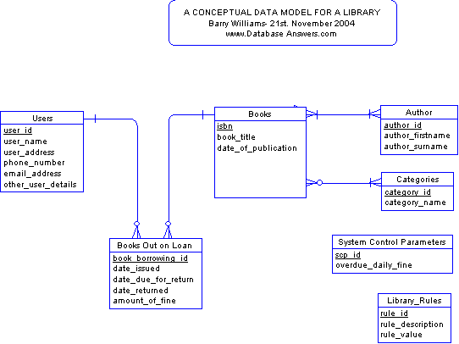
Notes:
http://www.databaseanswers.org/data_models/orders_parts/index.htm
Have a slde to expose ppl to normalization

Slide 11
Agility

Slide 12
The problem(s)

Slide 13
Name: Andy Johnson
Birth: 15 June 1986
Overall Grade : A+
Academic Status: Enrolled
Classes Taken
INFO 202 : A+
CHEM 190 : B-
PHYS 210 : A
INFO 205 : B

Slide 14
Application Object versus Database Model

Slide 15
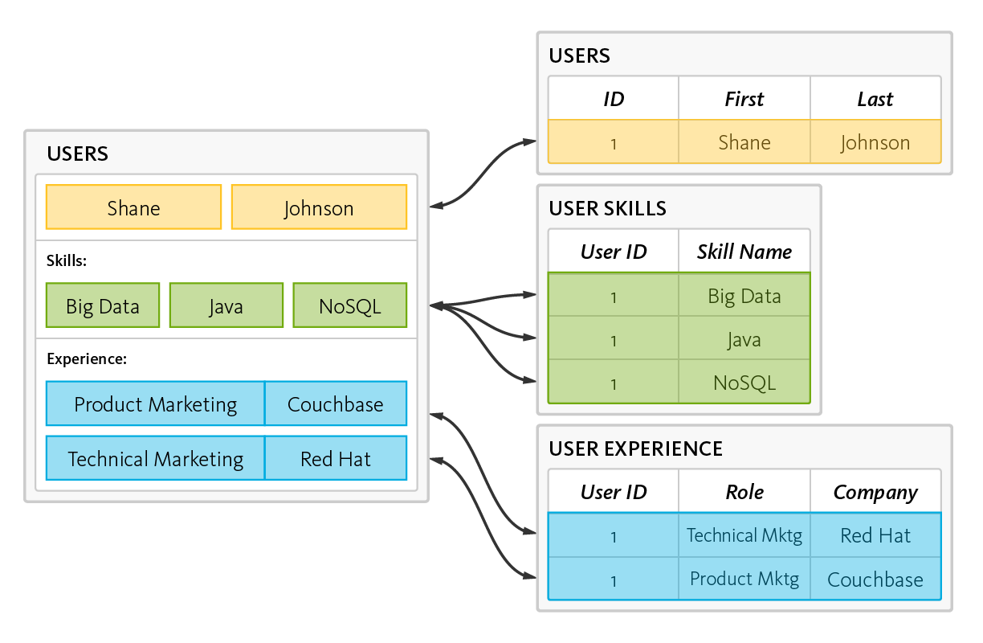
Model in the DB
Source:couchbase
Notes:
As an example, consider an application for managing resumes. It interacts with resumes as an object, the user object. It contains an array for skills and a collection for positions. However, writing a resume to a relational database requires the application to “shred” the user object.
Storing this resume would require the application to insert six rows into three tables, as illustrated here:

Slide 16
In-app representation
Source:couchbase

Slide 17
Shredding in RDBMS
Source:couchbase
Applications “shred” objects into rows of data stored in multiple tables
Notes:
SHREDDING
Reading this profile would require the application to read six rows from three tables:
http://www.couchbase.com/nosql-resources/what-is-no-sql

Slide 18
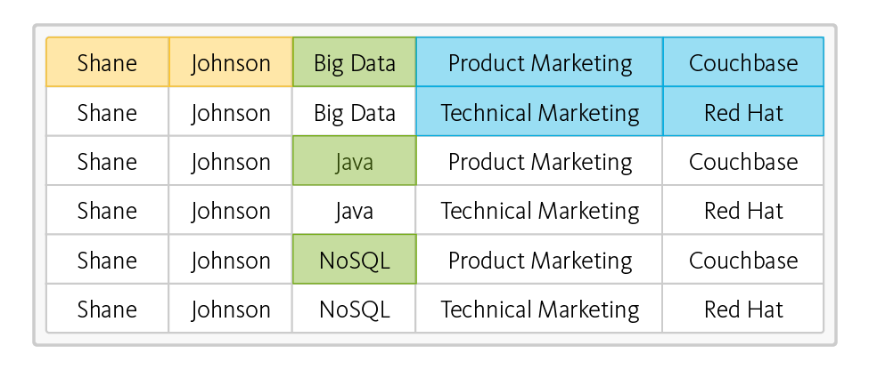
Shredding in RDBMS
Source:couchbase
Queries return duplicate data, applications have to filter it out.
Notes:
SHREDDING
Reading this profile would require the application to read six rows from three tables:
http://www.couchbase.com/nosql-resources/what-is-no-sql

Slide 19
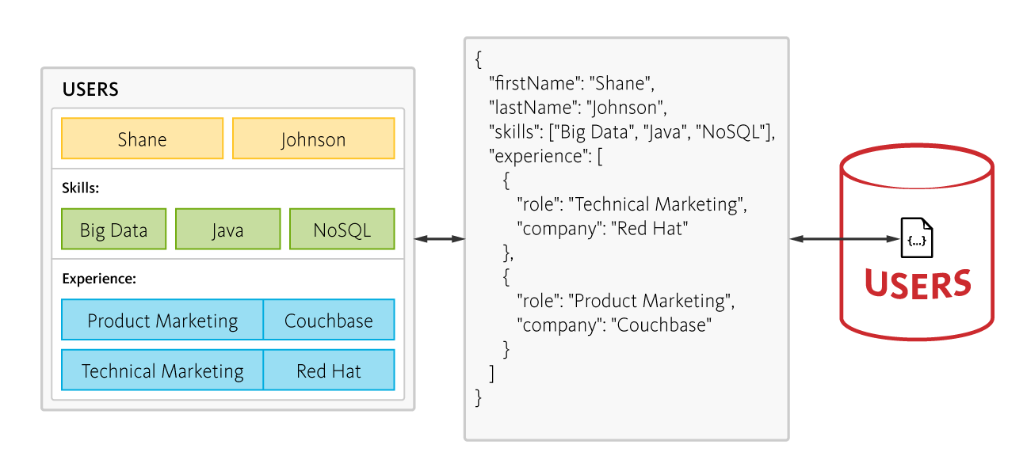
Same use-case in Doc-DB
Source:couchbase
Applications can store objects with nested data as single documents
Notes:
In contrast, a document-oriented NoSQL database reads and writes data formatted in JSON – which is the de facto standard for consuming and producing data for web, mobile, and IoT applications. It not only eliminates the object-relational impedance mismatch, it eliminates the overhead of ORM frameworks and simplifies application development because objects are read and written without “shredding” them – i.e., a single object can be read or written as a single document, as illustrated here:

Slide 20
RDBMS Advantages
Maintains data integrity & rules
Great for fault-intolerant applications like payments processing
Better suited for slow growth & known data model
Relatively simple yet powerful syntax (SQL)

Slide 21
RDBMS Disadvantages
Rigid structure - schema must be known in advance
Not easily distributed - requires manual sharding
Not as performant with large volumes of concurrent transactions

Slide 22
NoSQL
‘Opposite’ of RDBMS/SQL
Key/Value Pairs and Documents & Collections instead of Rows & Tables
Denormalization - no JOINs; all the things at once
Flexible schema - quick implementation
Auto-sharding/distributed - scalability

Slide 23
NoSQL Advantages
Flexible schema
Fast WORM/basic operations
Auto-sharding/distributed
Auto-replication

Slide 24
NoSQL Disadvantages
Do not support ACID transactions
Eventually Consistent
Non-Atomicity of multi-document trxns
Complex transactions become convoluted & performance suffers

Slide 25
Integrity

Slide 26
The Bottom Line
Performance dependent on system/schema design, regardless of db type
Try to figure out the needs of your system ahead of time
Don’t just choose NoSQL to avoid schema design or because it’s new & fresh

Slide 27
Lab

