Slide 1
Database and Your App
Vijay Velagapudi

Slide 2




Map
Getting Started
Front End
Back End
Advanced Topics
Introduction
Fundamentals
Git
Command Line
HTML
CSS
Responsive Design
JavaScript & jQuery
Web Frameworks
Architecture
Database Design
APIs
Visualization
Security
Deployment
Notes:
This is the course map for IOLab 2016
We have packaged the course in f
Open up netflix and utube
our modules

Slide 3
Map
Getting Started
Front End
Back End
Advanced Topics
Introduction
Fundamentals
Git
Command Line
HTML
CSS
Responsive Design
JavaScript & jQuery
Web Frameworks
Architecture
Database Design
APIs
Visualization
Security
Deployment
Notes:
This is the course map for IOLab 2016
We have packaged the course in four modules

Slide 4
Announcements
Communicate through bCourses
Deadline Extensions

Slide 5
Agenda
SQL
Data Modelling
ORMs
Notes:
https://syncano.io/blog/advanced-concepts-flask/
https://github.com/humiaozuzu/awesome-flask

Slide 6
Read
SQL
Application
Server
Database
DATA

Slide 7
SQl – Structured Query Language
A query language to access the data in a DB
SELECT column1, column2, etc
FROM tablename

Slide 8
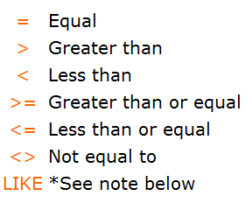
SQL - Conditions
SELECT column1, column2, etc
FROM tablename
WHERE column1 like “Jon%”

Slide 9
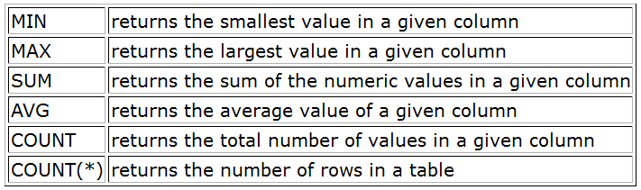
SQL – Aggregate Functions
SELECT sum(column1)
FROM tablename
WHERE column1 = “some condition”

Slide 10
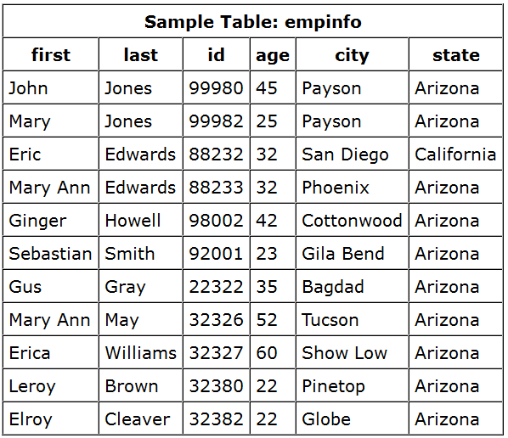
SQL Example - How many people are from Arizona?
SELECT COUNT(*)
FROM empinfo e
WHERE e.state like ‘Arizona’
;

Slide 11
SQL Example – How Many People Over the Age of 50?
SELECT COUNT(*)
FROM empinfo e
WHERE e.age > 50
;

Slide 12

SQL - JOIns
Table 1
Table 2
Names of the customers that have bought a certain item
SELECT c.firstname, c.lastname
FROM customers c
LEFT JOIN purchases p ON c.customer_number = p.customer_number
WHERE p.item = “TDO”
Notes:
We have joins, because we normalize the data. Does anyone remember what normalization means from the last lecture?
http://sqlfiddle.com/#!15/35773/1

Slide 13
Object Relational Mapping

Slide 14
Read
Wrapper
SQL
Application
Server
Database
DATA

Slide 15
Object-Relational Impedance Mismatch
a set of conceptual and technical difficulties that are often encountered when a relational database management system (RDBMS) is being used by a program written in an object-oriented programming language or style

Slide 16


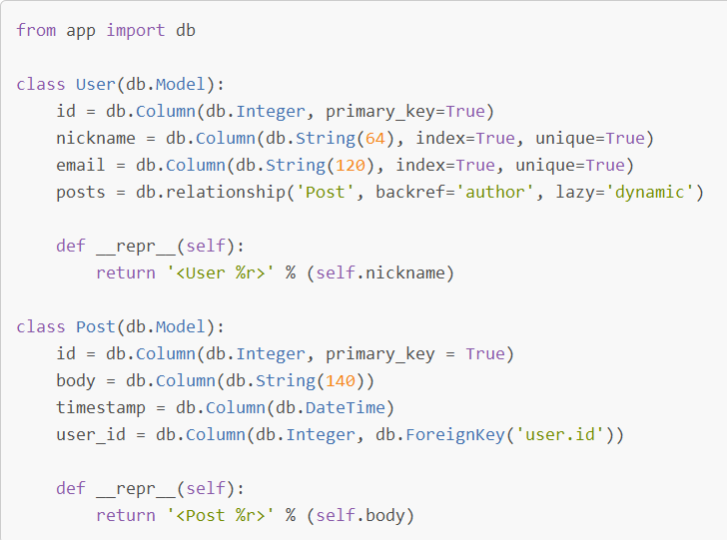
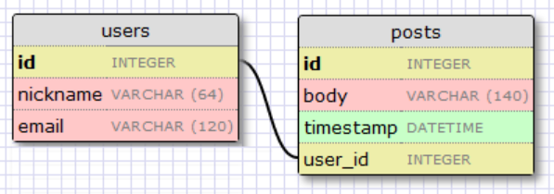
Application
Database

Slide 17
ORMS
Allow applications to work with objects
Instead of tables and SQL
Operation performed on object converted to SQL Commands

Slide 18
Flask-SQLAlchemy
Flask wrapper for SQLAlchemy
SQLAlchemy is a Python ORM tool

Slide 19
Lab
git pull --rebase upstream master
git checkout -b hw6
cd flask/orm-tutorial/models-tutorial
(activate virtualenv if you use them)
pip install –r requirements.txt
python run.py

Slide 20
git remote –v
Check to see if upstream starts with git@ or https:
gi

