Slide 1
Best Use of ANS
Build interoperable agents strangers can trust.
GoDaddy · VTHacks 14 · Workshop #1

Slide 2
We have been here before.
In 1994, a person met a machine they had never seen and asked: do I trust it?
RSA and Verisign answered with three parts: a domain, an SSL certificate carrying that name in its CN or SAN field, and DNS tying the two together.
The check runs one way. The person verified the machine.
Now machines discover machines over the open internet. The client can become the server, and either side can demand proof. ANS v2 was built for it.
Notes:
In 1994 you sat at a browser and met a machine you had never seen. Then you typed your credit card into it. That took trust, and trust needed machinery. RSA and Verisign built it from three parts: a domain name, an SSL certificate carrying that name in its CN or SAN field, and DNS tying the two together. It worked. And it ran one way — you checked the machine, and the machine never checked you.
That pattern has flipped. Tonight your agent calls another machine, and an hour later that machine calls yours. The client becomes the server. Either side can ask who the other is and demand proof. The one-sided machinery of 1994 does not cover that. ANS v2 was built for it: identity both sides can check, anchored in the same DNS the web already trusts.

Slide 3
The easy way in.
A stolen key. A copied agent card. A lookalike domain.
Your agent cannot tell the difference.
For this hackathon, it will have to.

Slide 4
Who is that?
An unknown agent calls yours at 2 AM.
Who operates it?
Which version are you reaching?
What changed since yesterday?

Slide 5
Talking is not proving.
MCP and A2A teach agents to talk.
Their agent metadata describes.
Neither proves who you are talking to.
ANS binds identity to a domain, a version, certificates, and an auditable history.

Slide 6
One name you can check.
ans://v1.0.9.agent.webmesh.ai
Domain — who controls the name.
Version — which deployment you meant.
Certificates prove it. A public log records every change.
A real production name. Source: the agent's identity certificate.

Slide 7
Six commands. One identity.
export ANS_BASE_URL="https://api.godaddy.com" # production
ans-cli generate-csr \
--host myagent.example.com --version 1.0.0 --out-dir ./certs
ans-cli register \
--host myagent.example.com --version 1.0.0 \
--identity-csr ./certs/identity.csr --server-csr ./certs/server.csr \
--endpoint-url https://myagent.example.com/mcp
# place the DNS TXT record from the response
ans-cli verify-acme <agentId>
ans-cli status <agentId>
ans-cli get-identity-certs <agentId>
Install: brew install agentnameservice/ans/ans-cli · API key: GoDaddy table or #godaddy

Slide 8
Watch what it does.
Integrity · Identity · Solvency · Behavior · Safety
Five scored dimensions — each with reasons, not just a number.
A low score warns you off. A high score never vouches for anyone.
Trust Index: github.com/agentnameservice/agent-trust-discovery

Slide 9
Discover. Resolve. Verify. Connect.
Search by domain, capability, protocol.
Pick a version and endpoint.
Check who it is, whether it is still valid, what backs it up, and what your policy allows.
Then — and only then — connect.
Never let discovery alone authorize an action.

Slide 10
Build for strangers.
Build agents that talk to strangers' agents.
Find them by ANS name. Verify first.
That is the mesh. That is what wins.

Slide 11
The challenge.
Build agents that find each other, check each other, and work together across the open web.
ANS proves who everyone is.
The strongest entries make identity the core mechanic: agents that know who they're talking to, and can prove it.

Slide 12
What could you build?
Agents that buy and sell from each other — and catch the impostor.
Ticket resale where the buyer's agent spots the fake seller.
A fantasy draft run entirely by team agents.
Scheduling across companies, where every invite is verified.
A capture-the-flag where the flag is a forged identity.
Agents playing Diplomacy — lying is legal, but identity isn't.

Slide 13
fraud.webmesh.ai is already attacking.
13 attacks. Forged signatures. Replayed requests. Swapped quotes.
Every attack must be BLOCKED.
Inspect its card. Steal its playbook.
Then bring your endpoint to our table — we will try to break it.
Live now: https://fraud.webmesh.ai/.well-known/agent-card.json

Slide 14
Make identity do the work.
Show the success path and the refusal path.
Show the evidence, not just the demo.
Name your threat model and the tradeoff you chose.

Slide 15
Best Use of ANS
1st — Meta Ray-Ban Gen 2 smart glasses
2nd — Beats Studio Pro
3rd — Cocopar 15.6″ portable monitor
For each winning-team member.

Slide 16
Ship by Sunday, 8 AM.
Use ANS. Public repo. Working demo.
Opt into the GoDaddy categories on Devpost.
vthacks-14.devpost.com
Judging Sunday 10:30 AM · New Classroom Building · science-fair format

Slide 17
Your free domain is your identity anchor.
1. Claim your free weekend domain — the MLH coupon
2. Install the CLI
3. Register one agent
4. Break it, then fix it
First evidence on screen within the hour.

Slide 18
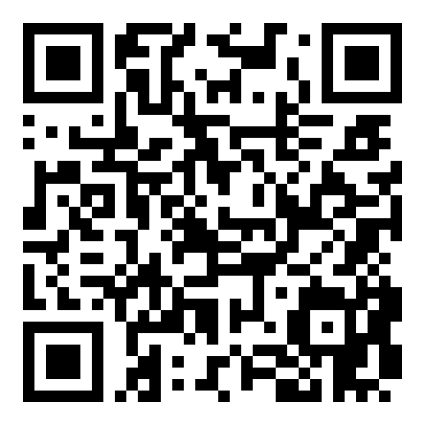
Where to get help.
#godaddy on the VTHacks Discord
GoDaddy tables · Saturday 1:00–3:30 PM
Workshop #2 · Sat 4:30 PM · hands-on
developer.godaddy.com/doc/endpoint/ans
Connect with me
linkedin.com/in/scottbcourtney

Slide 19
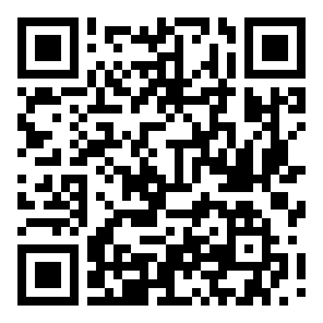
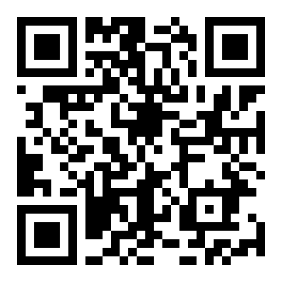
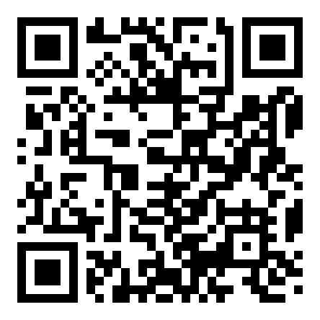
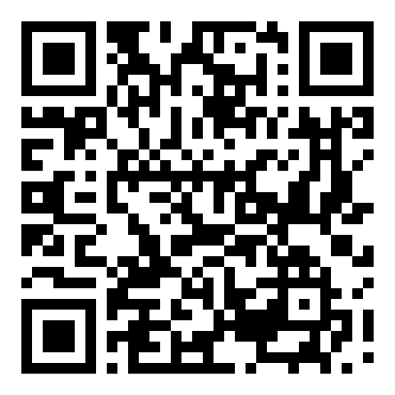
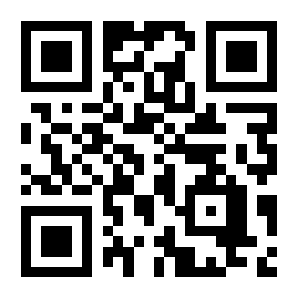
Take the code.
github.com/agentnameservice · webmesh.ai
Specs
ans-registry
Reference
ans
CLI / SDK
ans-sdk-go
Trust Index
agent-trust-discovery
Live agents
webmesh.ai

Slide 20
What will your agents need to prove?
Questions. Architectures. Wild ideas.

