Slide 1
Short Message Voicing Using Speech Synthesis Engine
Rajalakshmi Engineering College,
Information Technology
Team Members:
Mohamed Ali Khan A
Srinivasan N
Vijay V

Slide 2
Literature Survey
Existing model : Natural Language processing with Text-to-Speech on Android(May 2011) Sonal Bhatt, Graduate Student, Arizona State University
Limitations
        Do not process long messages
        Need GPS like external resources

Slide 3
Abstract
Develop an application using Android. Text input, is given and Voice output is received. Helps Disabled people, helps during driving. Text-To-Speech(TTS) Engine is used for this purpose. Messaging, quick Mailing options are available

Slide 4
System Architecture
Based on Linux Kernel – C
Libraries – C/C++
Dalvik virtual machine
Application framework –Java
Applications - Java

Slide 5
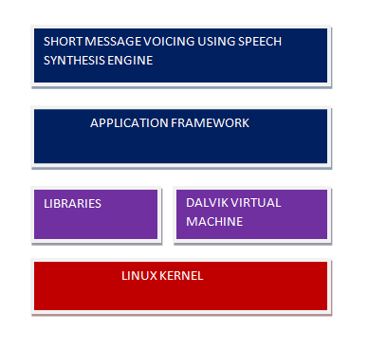
System Architecture

Slide 6
Requirements
Java Development Kit
Android Development Kit (SDK)
Android Platform 2.3.3
Eclipse Indigo 3.7.1
ADT Plugin

Slide 7
Implementation
Xml used for UI
Android.permission.RECEIVE_SMS, Android.permission.SEND_SMS, Android.permission.READ_Contacts
startActivity, intent
BroadcastReceiver class
getOriginatingAddress ( )

Slide 8
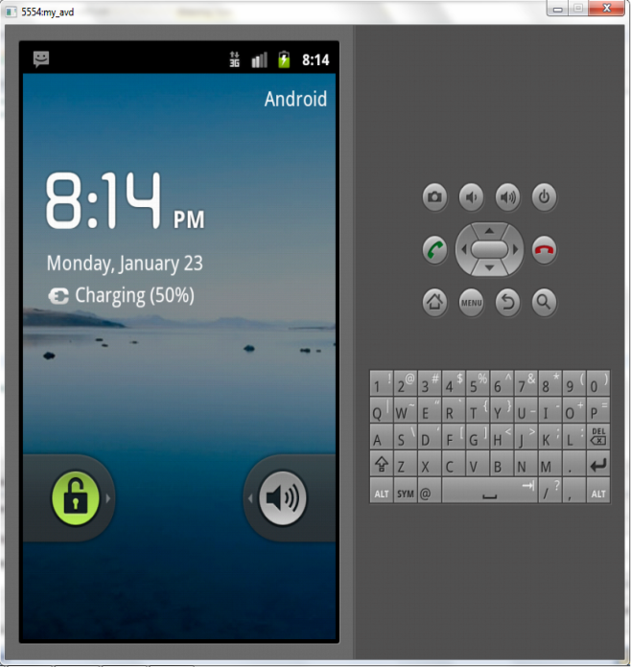
Implementation
Virtual Device (AVD) is present in SDK
Used for testing applications
Similar to an Android Mobile

Slide 9
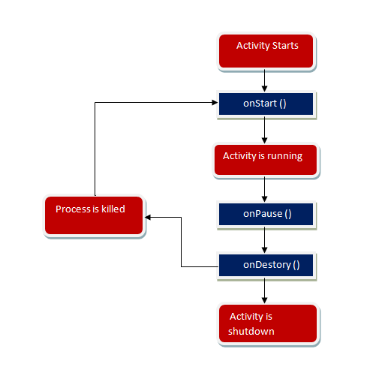
Activity Flow

Slide 10
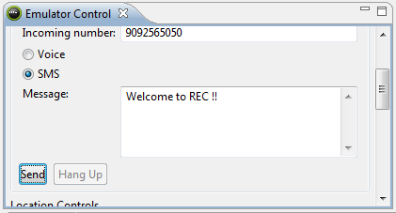
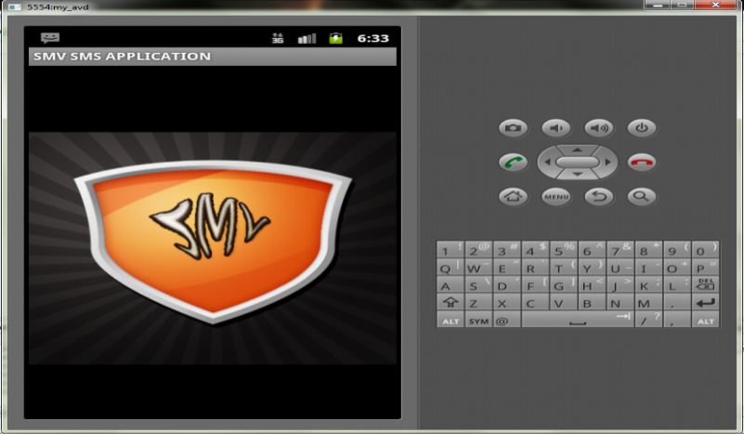
Working
Dalvik Debug Monitor Server (DDMS)
Application receives the message
Voice output along with contact name

Slide 11
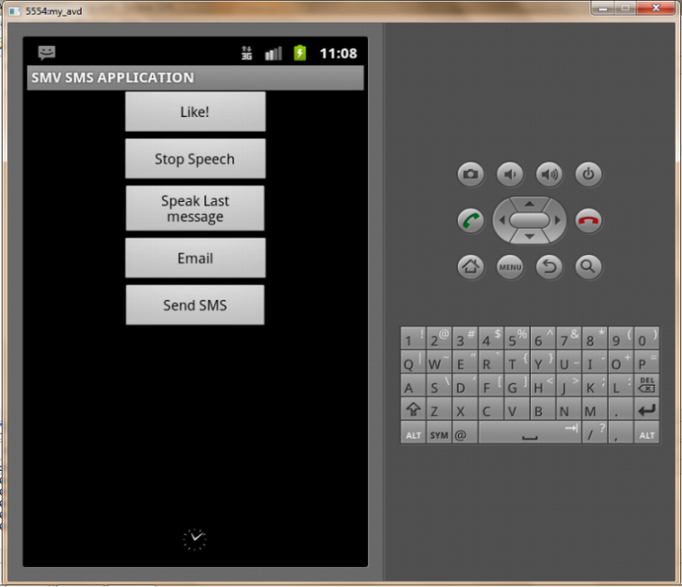
Working
The entire text message is displayed
Speech can be stopped; heard when needed
Voice output stored in
.WAV format in SDCard

Slide 12
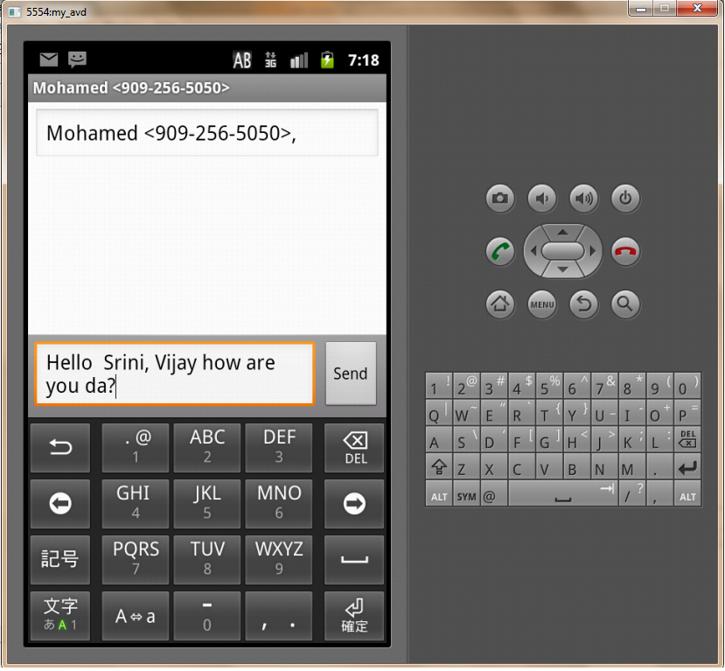
Working
Messaging interface is provided
Send messages from this application
Conversation view of the inbox is shown

Slide 13
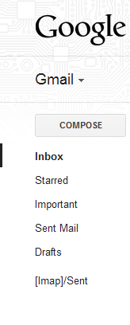
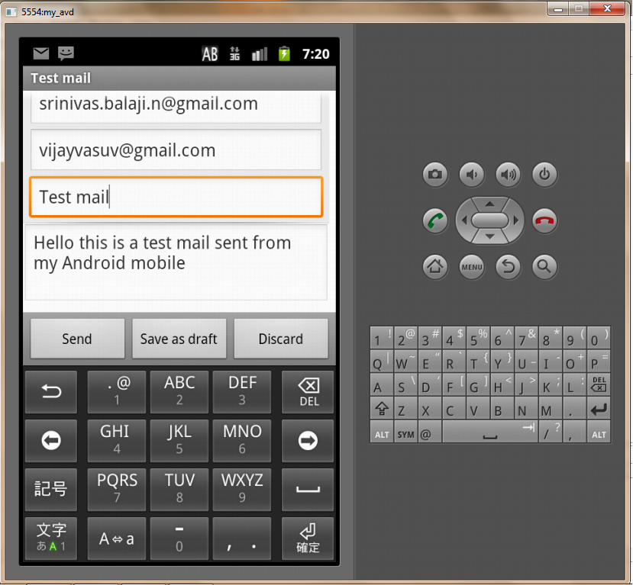
Working
Send quick mail
Configure a particular ID in Android phone
Separate folder [IMAP]/Sent created

Slide 14
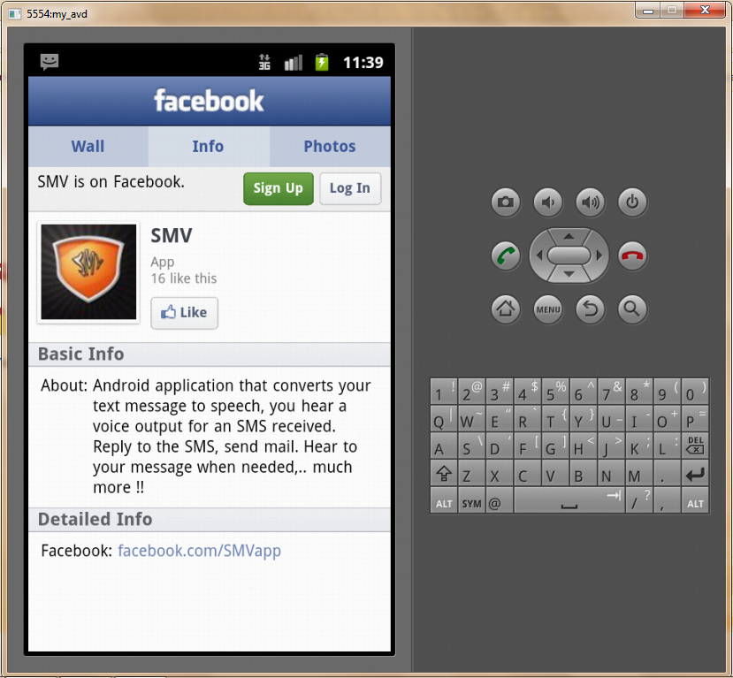
Working
Support through Facebook
Application information, queries solved
Click of a button to ‘Like’
http://www.facebook.com/SMVapp

Slide 15
Future work
Voice output of Email received
Voice input in SMS interface

Slide 16
References
“Designing Effective Speech Application”, JavaTM Speech API Programmer's Guide, May 6, 2009
T.Dutoit, “An Introduction to Text-to-Speech Synthesis.” TTS Research team , TCTS Lab, June 19, 2010
http://www.developer.android.com
http://code.google.com/android

Slide 17
Thank You !

