Slide 1
Insurance FNOL: Distributed Edge AI Orchestration (Mobile + Physical Edge + Cloud Fallback)
Innovative AI-driven solutions for distributed insurance claims processing
Notes:
AI-generated content may be incorrect. ---

Slide 2
Prospect-Grade MVP Narrative Insurance FNOL (First Notice of Los) Customer Self‑Service
Notes:
--- This slide references information from the following file: https://outlook.office365.com/owa/?ItemID=AAMkADFjOGFiYTE1LTdmZjAtNDdlMy1hZjBlLWJhYmU1MTdhMjExMwBGAAAAAAACXBUxxaiVT7HB8qvni%2b99BwDAQhsuxvVXSJe2LIF0e1WwAAAAAj%2ftAAApHpDpa7xpRJbny2ajM7lCAAUYv5PHAAA%3d&exvsurl=1&viewmodel=ReadMessageItem Flagship Use Case (A): Customer Self‑Service FNOL at the Edge, Business Pain & Value (Why Prospects Care), Customer Journey (FNOL End-to-End Flow), Distributed Edge Roles (One Orchestrator, Multiple Runtimes), AI/GenAI Components (MVP-Buildable, High Impact), Edge AI Orchestrator Core (Reusable Across Apps & Devices), Policy Inputs / Parameters (What the Orchestrator Evaluates), Routing Policy (Deterministic Example, Policy-as-Config), Decision Matrix (Slide-Friendly Summary), Cloud Fallback (Considerable, Credible, and Auditable), 10-Week MVP Plan (AI-Heavy Delivery Roadmap), Demo Scenarios (Three Impactful Runs), Success Criteria & Next Extensions (iOS, Cross-Platform, More Edge)

Slide 3
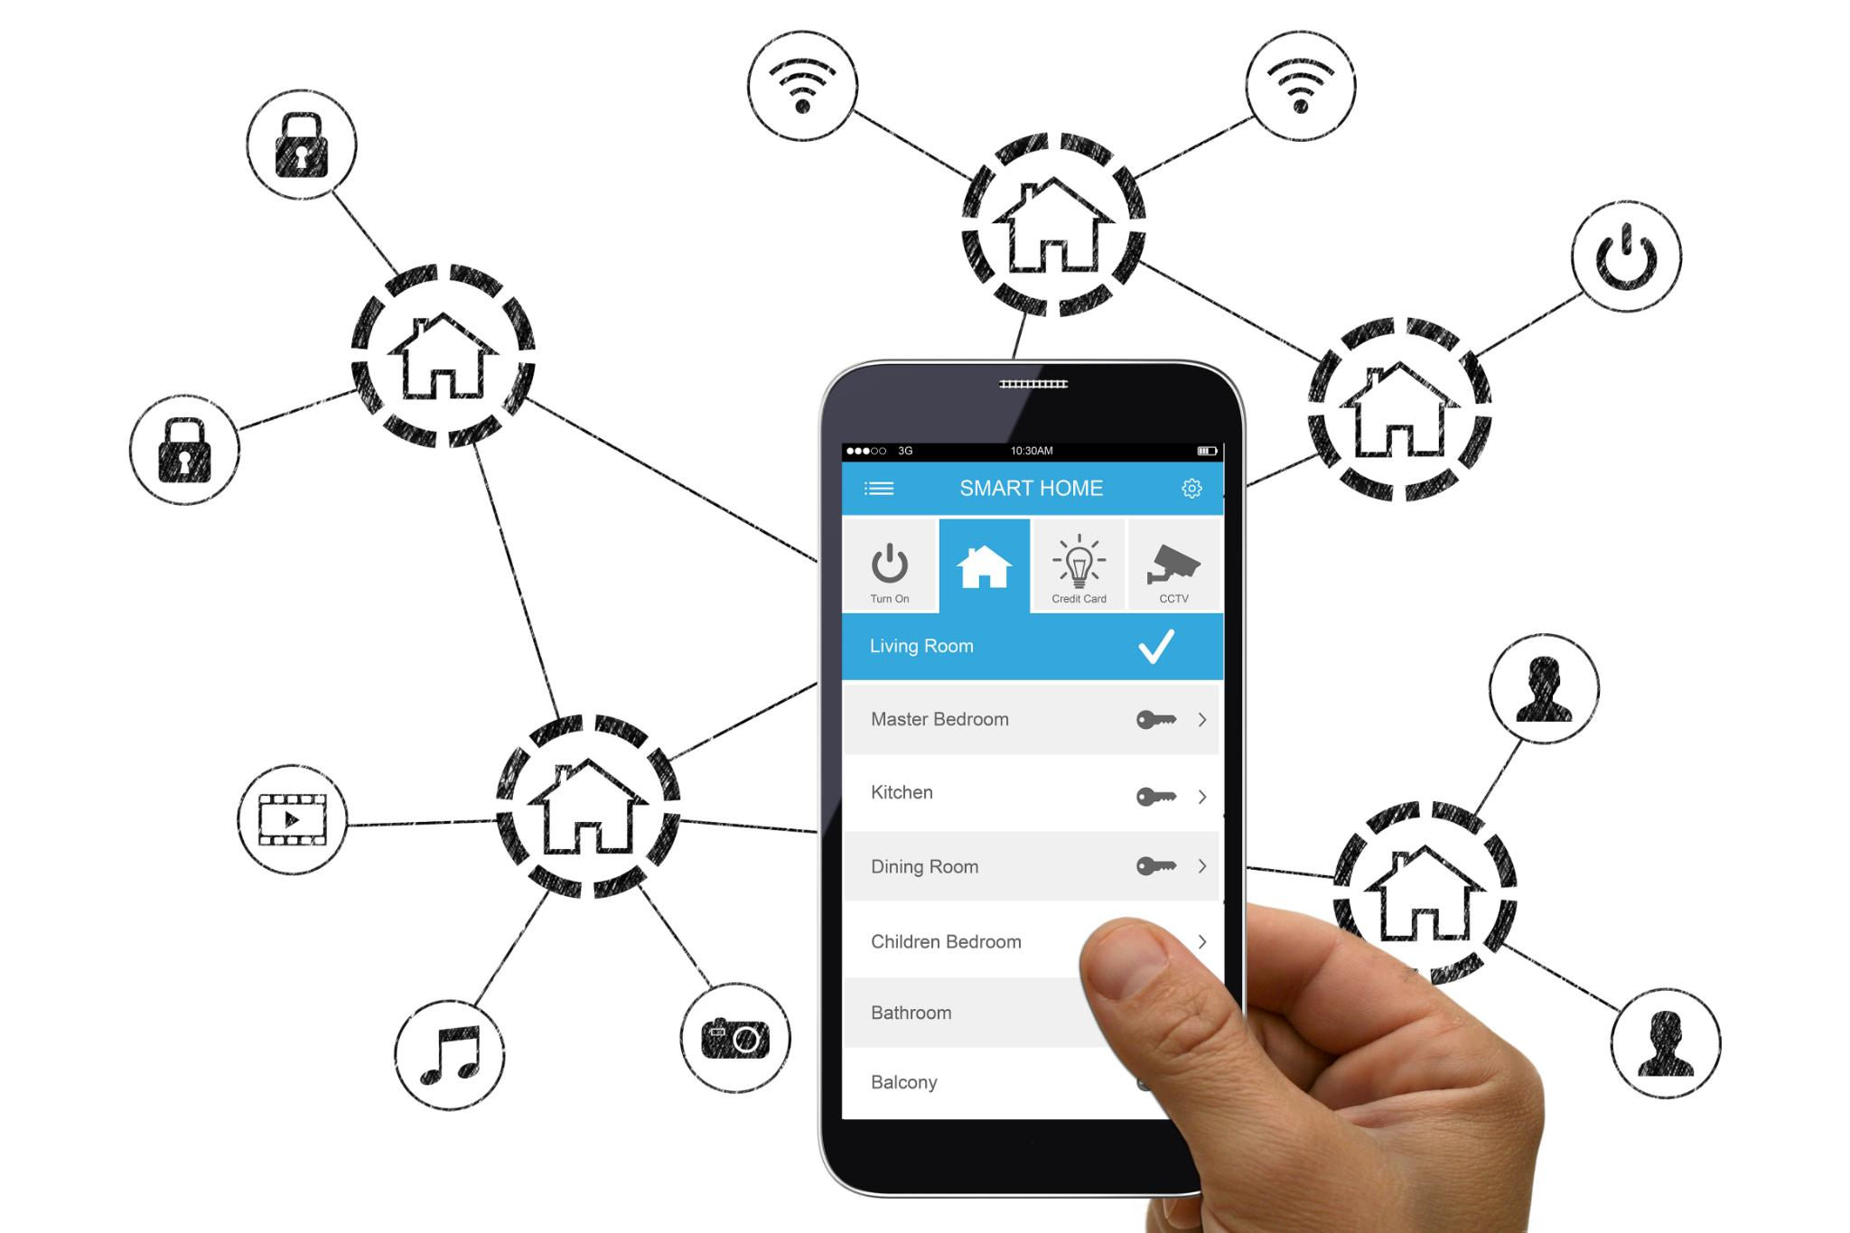
Flagship Use Case (A): Customer Self‑Service FNOL at the Edge
Distributed Edge AI Architecture
The solution orchestrates AI across mobile, physical edge devices, and cloud for seamless claim processing.
Privacy and Latency Benefits
Edge processing ensures privacy, fast recommendations, resilience to connectivity issues, and cost efficiency.
Reusable Orchestrator Module
Core orchestrator module supports multiple platforms and can be reused for various insurance claim types.
Success Metrics
Success is measured by auditable decisions, clear routing logic, and scalable architecture for claims.
Notes:
--- This slide references information from the following file: https://outlook.office365.com/owa/?ItemID=AAMkADFjOGFiYTE1LTdmZjAtNDdlMy1hZjBlLWJhYmU1MTdhMjExMwBGAAAAAAACXBUxxaiVT7HB8qvni%2b99BwDAQhsuxvVXSJe2LIF0e1WwAAAAAj%2ftAAApHpDpa7xpRJbny2ajM7lCAAUYv5PHAAA%3d&exvsurl=1&viewmodel=ReadMessageItem This slide frames the MVP as a flagship, prospect-ready Insurance use case: Customer Self‑Service First Notice of Loss (FNOL) delivered through Distributed Edge AI governed by a reusable Edge AI Orchestrator. The business problem is straightforward and universal in insurance: the “moment of truth” after an incident is when customers want immediate guidance, rapid triage, and confidence that their claim is being handled fairly. The MVP positions your capability not as “we can run a model on a phone,” but as “we can orchestrate intelligence across multiple edges with governance, auditable decisions, and graceful fallback.” The key narrative is that the customer’s Android app acts as the primary experience and decision-owning edge, while the physical edge (Raspberry Pi + ESP32) provides independent evidence signals and localized inference, and the cloud edge provides heavyweight validation and GenAI-based reasoning when needed. This combination demonstrates the core differentiator: a consistent orchestration pattern that decides where to run inference (mobile, physical edge, or cloud) depending on policy and real-time context, rather than hardcoding a single pathway. The slide should emphasize why this is uniquely suited to edge: privacy and regulatory considerations (especially around images, PII, and claim details), latency sensitivity (instant recommendations), resilience (tolerate poor connectivity), and cost control (avoid unnecessary cloud calls). It also sets up the reuse story: the same orchestrator core will be packaged as a native module (Kotlin today, Swift next for iOS, wrappers possible for cross-platform frameworks later) and can also run in a scoped mode on the physical edge runtime. Finally, define what “success” looks like for this MVP: a compelling demonstration that orchestration is a first-class architectural capability, evidenced by clear decision traces, reasons for routing, and a repeatable pattern that prospects can imagine scaling to many claim types (motor, property, travel) without redesigning the control plane.

Slide 4
Business Pain & Value (Why Prospects Care)
Pain Point (FS Industry) | How the MVP Responds
Latency & cloud dependency for real-time decisions | Runs initial triage on mobile/physical edge; escalates selectively to cloud when needed.
Data residency, privacy & regulation | Keeps sensitive raw media and PII local; sends only redacted summaries/embeddings as policy allows.
Fragmented “mini-PoCs” on devices | Uses a single orchestrator pattern and policy model to standardize routing and governance.
No consistent way to connect edge inference back to workflows | Produces decision traces and structured outputs that plug into claims workflows and case creation.
Notes:
--- This slide references information from the following file: https://outlook.office365.com/owa/?ItemID=AAMkADFjOGFiYTE1LTdmZjAtNDdlMy1hZjBlLWJhYmU1MTdhMjExMwBGAAAAAAACXBUxxaiVT7HB8qvni%2b99BwDAQhsuxvVXSJe2LIF0e1WwAAAAAj%2ftAAApHpDpa7xpRJbny2ajM7lCAAUYv5PHAAA%3d&exvsurl=1&viewmodel=ReadMessageItem This slide translates the use case into a business case that resonates with prospects: claim intake is often slow, expensive, and prone to leakage because evidence gathering and triage are inconsistent. Customer self-service FNOL can reduce cycle time dramatically, but only if the system can produce fast, trustworthy guidance under real-world constraints such as intermittent connectivity, privacy requirements, and inconsistent customer-provided data. Distributed Edge AI brings immediate impact by running key intelligence close to where the incident is reported. The MVP should be positioned around measurable outcomes: (1) reduced time-to-triage, where a customer gets a preliminary claim pathway within minutes rather than waiting for manual review; (2) reduced cloud cost and improved resilience, since the orchestrator routes only genuinely ambiguous or high-risk cases to the cloud; and (3) reduced fraud exposure, because the system can detect conflicts between customer-submitted media and independent IoT evidence early, creating a proactive, evidence-backed triage flow. The narrative should also highlight non-financial business value: improved customer trust through transparency (why a claim step was recommended), improved compliance posture through data locality and controlled data sharing (raw images can remain local while only redacted summaries or embeddings are transmitted), and improved operational scalability by standardizing triage and evidence validation. In internal and prospect conversations, consider emphasizing KPI-style proof points tailored to the demo: decision latency (edge response time), “edge decision rate” (percent processed without cloud), “fallback triggers” (what conditions cause escalation), and “conflict detection rate” (how often IoT + vision disagree). This framing aligns with financial services’ pain points around latency, privacy, governance, and fragmented PoCs, and it supports the larger message that the orchestrator reduces fragmentation by making edge AI deployments consistent and manageable.

Slide 5
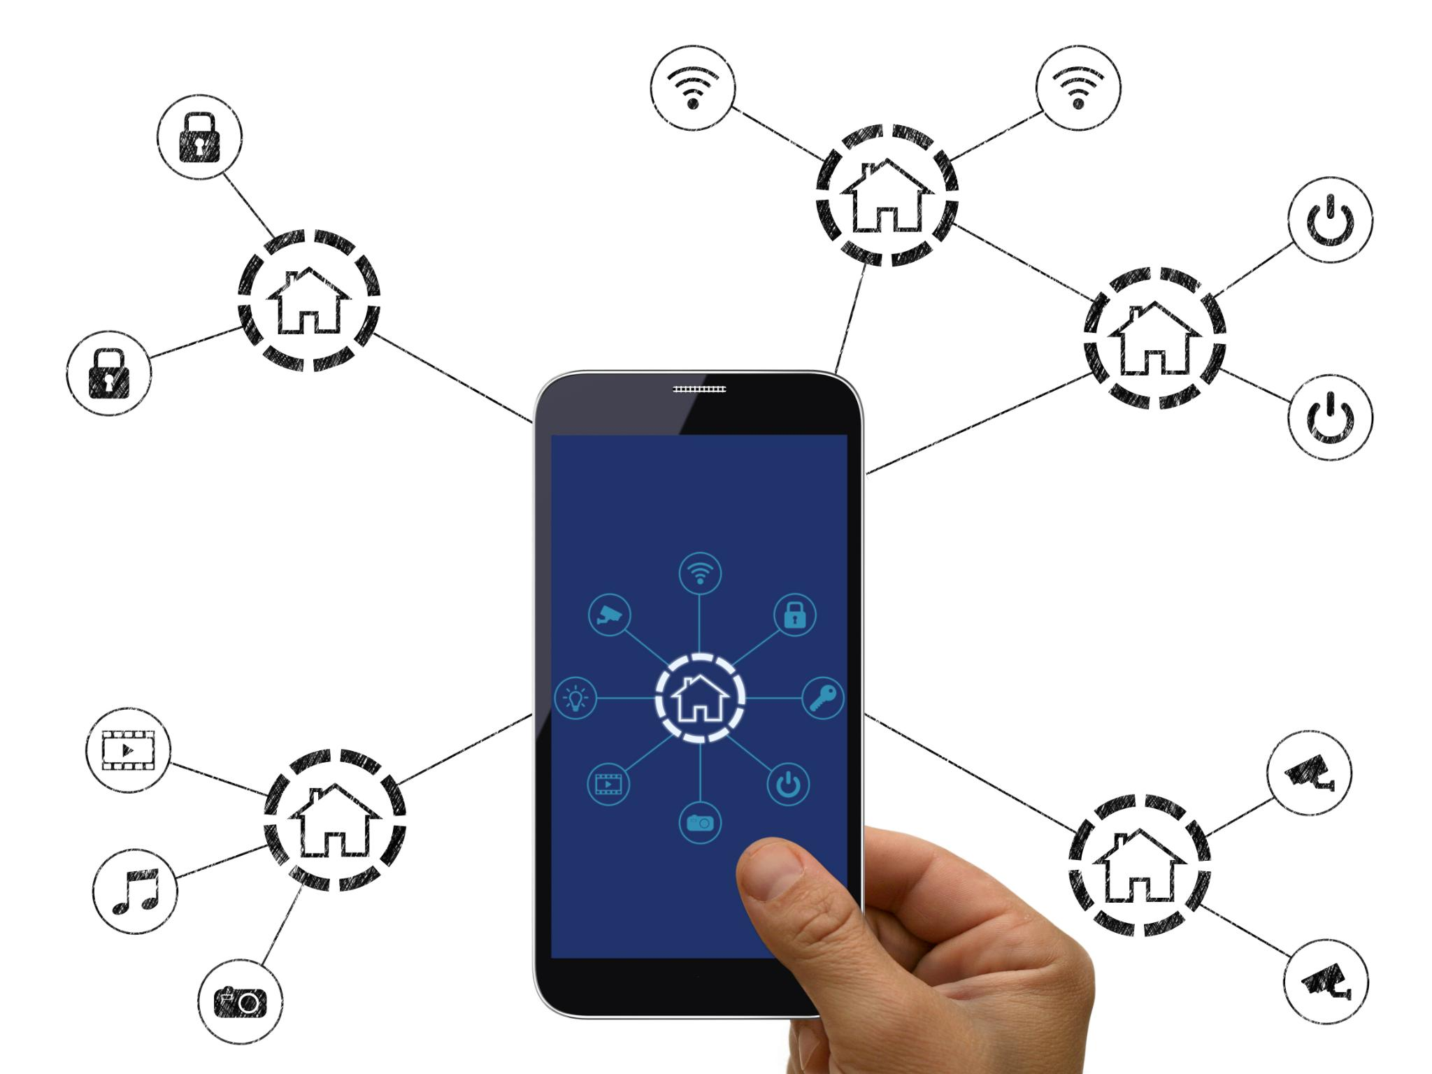
Customer Journey (FNOL End-to-End Flow)
Incident Capture via Mobile App
The app collects photos, videos, voice, text, and metadata to document the incident comprehensively.
On-Device AI Inference
AI models analyze damage severity and incident category locally for quick feedback without cloud dependency.
Edge Device Corroboration
Physical sensors provide additional evidence such as impact and environment data to support claims.
Resilient Offline-First Workflow
The app captures and processes evidence offline, buffering results until connectivity is restored.
Notes:
--- This slide references information from the following file: https://outlook.office365.com/owa/?ItemID=AAMkADFjOGFiYTE1LTdmZjAtNDdlMy1hZjBlLWJhYmU1MTdhMjExMwBGAAAAAAACXBUxxaiVT7HB8qvni%2b99BwDAQhsuxvVXSJe2LIF0e1WwAAAAAj%2ftAAApHpDpa7xpRJbny2ajM7lCAAUYv5PHAAA%3d&exvsurl=1&viewmodel=ReadMessageItem This slide explains the FNOL customer journey in a way that makes the orchestrator’s value intuitive. Start with the moment an incident occurs: the customer opens the insurance mobile app and is guided through incident capture. The app collects multimodal inputs—photos or short video of damage, optional voice or text description, basic incident metadata such as location and time, and device context such as connectivity and battery. The first key capability is on-device AI inference: the app runs a lightweight computer vision model that estimates damage severity or incident category and produces a confidence score, enabling immediate feedback without waiting for a cloud round trip. Next, the distributed aspect is introduced: simultaneously, a physical edge device (e.g., a sensor unit representing vehicle/property instrumentation) produces a corroborating evidence packet—impact classification, environment reading, and integrity indicators—so the claim is not based only on user-provided media. The orchestrator then evaluates the combined context and policy: if connectivity is poor or the data is sensitive, it keeps processing local; if confidence is low, the claim is high value, or evidence conflicts are detected, it escalates to cloud edge for deeper validation. The output to the customer should be designed as a “provisional outcome” rather than a final claims adjudication: recommended next steps (e.g., proceed with self-service claim submission, schedule inspection, or request additional evidence), a clear explanation of why that next step was recommended, and an ETA if cloud validation is required. The journey ends with telemetry and audit trace creation: every decision is logged with reasons, enabling later review and making this a governance-friendly demonstration. This slide should also communicate resilience: offline-first behavior where the app can capture evidence and perform initial triage even without network, buffering structured results and uploading later when connectivity returns. That offline pathway is an especially compelling differentiator for prospects because it demonstrates reliability in the real world rather than an ideal connectivity environment.

Slide 6
Distributed Edge Roles (One Orchestrator, Multiple Runtimes)
Layer | Primary Role | What It Produces
Mobile Edge (Android / iOS) | Decision-owning orchestration + on-device AI + user guidance | Severity score, confidence, structured FNOL narrative, routing decision + reasons
Physical Edge (Raspberry Pi) | Scoped orchestration + sensor inference + integrity checks | Evidence packet: impact class, confidence, integrity/tamper score
Signal Edge (ESP32) | Sensor capture + timestamp + basic features | Raw or feature data stream (impact/env) with device identity
Cloud Edge | Heavy validation + GenAI report + cross-claim correlation + governance | Validated triage outcome, report, audit trace, model updates
Notes:
--- This slide references information from the following file: https://outlook.office365.com/owa/?ItemID=AAMkADFjOGFiYTE1LTdmZjAtNDdlMy1hZjBlLWJhYmU1MTdhMjExMwBGAAAAAAACXBUxxaiVT7HB8qvni%2b99BwDAQhsuxvVXSJe2LIF0e1WwAAAAAj%2ftAAApHpDpa7xpRJbny2ajM7lCAAUYv5PHAAA%3d&exvsurl=1&viewmodel=ReadMessageItem This slide clarifies roles to avoid confusion and to make the distributed story credible. The architecture should be presented as a set of complementary responsibilities: Mobile Edge is the decision-owning edge, Physical Edge is the decision-participating edge, and Cloud Edge is the heavy fallback and governance layer. On the mobile side, the Android app hosts the full orchestrator runtime as an SDK-integrated component, collecting context, executing policy, and routing inference. It runs on-device inference for immediate triage, and it produces user-facing explanations and guidance. On the physical edge, Raspberry Pi represents a gateway-class edge node capable of running a scoped orchestrator runtime in Python or a containerized service. This scoped orchestrator does not own user workflow decisions; instead, it focuses on evidence integrity, local sensor inference, and producing a compact “evidence packet” with confidence and tamper indicators. ESP32 plays the signal edge role: capture, timestamping, basic feature extraction, and secure transmission to Pi. The cloud edge layer exists to handle tasks that are too complex or too uncertain for edge devices: multimodal validation, cross-claim correlation, audit, reporting, and model lifecycle. Crucially, this slide should emphasize reuse across platforms: the orchestrator core is defined by responsibilities (context manager, policy engine, inference router, telemetry/state) and a stable policy schema, enabling a Kotlin SDK today, a Swift SDK for iOS next, and wrappers for cross-platform frameworks such as Flutter or React Native later. Similarly, the physical edge runtime implements the same policy semantics and telemetry contract, enabling consistent fleet-level governance and observability. This unified control plane narrative aligns with existing internal positioning about avoiding fragmented tooling and creating a platform spine that normalizes multi-edge runtimes into a coherent architecture for regulated financial services.

Slide 7
AI/GenAI Components (MVP-Buildable, High Impact)
Component | Runs Where | Why It Matters to Orchestration
Damage severity vision model | Mobile Edge | Produces confidence; low confidence triggers cloud validation
FNOL narrative GenAI/SLM | Mobile Edge first, Cloud fallback | Shows hybrid GenAI; policy controls data sharing and latency
Impact event time-series model | Physical Edge (Pi) | Independent evidence confidence; conflicts trigger escalation
Integrity/tamper scoring | Physical Edge (Pi) | Improves trust in evidence; informs fraud/triage decisions
Multimodal validation + report generation | Cloud Edge | Provides deeper reasoning and audit-ready outputs when needed
Notes:
--- This slide references information from the following file: https://outlook.office365.com/owa/?ItemID=AAMkADFjOGFiYTE1LTdmZjAtNDdlMy1hZjBlLWJhYmU1MTdhMjExMwBGAAAAAAACXBUxxaiVT7HB8qvni%2b99BwDAQhsuxvVXSJe2LIF0e1WwAAAAAj%2ftAAApHpDpa7xpRJbny2ajM7lCAAUYv5PHAAA%3d&exvsurl=1&viewmodel=ReadMessageItem This slide makes the demo feel “AI/GenAI heavy” while remaining implementable within an MVP timebox. The key is to present a layered AI stack, where each layer provides tangible value and contributes to an orchestration decision. On the mobile edge, the first AI component is computer vision for damage or incident severity classification. Rather than claiming perfect accuracy, emphasize that it produces a severity class and a confidence score used by the orchestrator to decide whether cloud validation is needed. A second mobile component is lightweight fraud heuristics or a small classifier built around metadata and patterns: duplicate media detection cues, inconsistent timestamps/GPS, unreasonable combinations of damage type and narrative, or repeated submissions from the same device (in the MVP, simulated patterns are acceptable). The GenAI enhancement is a “structured FNOL narrative generator”: using an on-device small language model where feasible, the app converts user voice/text and the vision result into a standardized, insurer-friendly FNOL summary, plus recommended next steps. If the on-device model is constrained, the orchestrator can offload this narrative generation to cloud edge when network and sensitivity policies permit. On the physical edge, add meaningful AI by running a time-series model on Raspberry Pi that classifies impact events (minor bump vs major impact) and outputs a confidence score; complement it with integrity checks for tamper/spoof patterns so the evidence packet has trust signals. In the cloud edge, demonstrate heavyweight AI value: multimodal validation (combining text, vision signals, and IoT evidence), a GenAI report that is richer than the on-device summary (including suggested documentation and workflow triggers), and correlation checks across claims (MVP uses a small synthetic dataset for similarity checks). This layered approach aligns with internal materials describing Mobile Edge AI for claims assessment and hybrid GenAI to generate structured claim reports and suggestions, while also grounding the demo in a realistic division of labor across edge and cloud.

Slide 8
Edge AI Orchestrator Core (Reusable Across Apps & Devices)
Aspect | Traditional Edge ML | Orchestrated Distributed Edge AI (This MVP)
Decision logic | Hardcoded per app/device | Policy-driven, reusable across runtimes
Observability | Inference logs only | Decision trace + reasons + outcomes
Privacy role | Afterthought | First-class routing constraint
Fallback strategy | Ad hoc | Deterministic thresholds (confidence, conflict, value tier)
Portability | Low | SDK + adapters (Kotlin/Swift/Python, wrappers for RN/Flutter)
Notes:
--- This slide references information from the following file: https://outlook.office365.com/owa/?ItemID=AAMkADFjOGFiYTE1LTdmZjAtNDdlMy1hZjBlLWJhYmU1MTdhMjExMwBGAAAAAAACXBUxxaiVT7HB8qvni%2b99BwDAQhsuxvVXSJe2LIF0e1WwAAAAAj%2ftAAApHpDpa7xpRJbny2ajM7lCAAUYv5PHAAA%3d&exvsurl=1&viewmodel=ReadMessageItem This slide defines the orchestrator as an architecture archetype and a reusable component, not a one-off implementation. The “core” should be described in terms of stable responsibilities that remain constant across Android, iOS, cross-platform frameworks, and physical edge runtimes. The Context Manager collects runtime signals: connectivity status (offline/poor/good bandwidth), device health (battery, thermal throttling), hardware capability (availability of NPU/GPU), and data sensitivity classification (whether the incident payload includes raw images or PII). The Policy Engine is intentionally deterministic and auditable: rules and thresholds define what must stay local (privacy), what should be local when network is poor (resilience), what must be validated in the cloud (high value, low confidence, conflicting evidence), and when workloads should be offloaded (device constraints). The Inference Router executes policy decisions by selecting the appropriate execution target and model profile: mobile TFLite, physical-edge time-series inference, or cloud inference endpoints. Telemetry and State make the orchestrator enterprise-grade: every decision emits a trace with inputs, chosen pathway, model versions, confidence values, and reasons. This is what turns “distributed inference” into “orchestrated intelligence.” To support reuse across multiple app frameworks, the implementation should be framed as an SDK strategy: Kotlin library for Android today, Swift library for iOS next, and wrapper modules for React Native/Flutter that standardize orchestration calls and telemetry. On Raspberry Pi, a Python runtime implements the same policy schema and emits the same decision events, enabling consistent observability. This approach aligns with internal positioning around modular design for MVVM integration, hybrid edge-cloud offload, privacy-first architecture, and a cross-platform unified API approach. Emphasize to prospects that models and hardware may vary, but the orchestration core and governance contract remain stable, which is where the long-term platform value is created.

Slide 9
Policy Inputs / Parameters (What the Orchestrator Evaluates)
Category | Parameters (Examples) | Why It Matters
Runtime Context | Network status, RTT, bandwidth; battery; thermal; NPU availability | Controls latency and resilience; avoids device overload
Data & Risk | PII level; raw media present; jurisdiction; claim value tier | Enforces privacy and compliance; increases assurance for high-risk claims
Model Signals | Vision confidence, sensor confidence, conflict score, novelty score | Triggers cloud validation when uncertainty or inconsistency exists
Governance | Cloud budget, escalation rules, audit verbosity, model approval state | Ensures enterprise viability: cost, auditability, controlled change
Notes:
--- This slide references information from the following file: https://outlook.office365.com/owa/?ItemID=AAMkADFjOGFiYTE1LTdmZjAtNDdlMy1hZjBlLWJhYmU1MTdhMjExMwBGAAAAAAACXBUxxaiVT7HB8qvni%2b99BwDAQhsuxvVXSJe2LIF0e1WwAAAAAj%2ftAAApHpDpa7xpRJbny2ajM7lCAAUYv5PHAAA%3d&exvsurl=1&viewmodel=ReadMessageItem This slide details the policy inputs that drive routing decisions, making the orchestrator feel concrete and defensible. Organize inputs into four buckets—runtime context, data/risk, model signals, and governance—so audiences can clearly see that decisions are not arbitrary. Runtime context includes network quality (offline/poor/good), measured via latency (RTT), bandwidth estimates, and packet loss; device health includes battery percentage, thermal state, and whether the device’s AI accelerator is available or saturated. These inputs explain why the same model might run locally now but be offloaded later. Data and risk inputs represent safety and compliance: sensitivity classification (raw images, PII from forms, location) determines whether payloads can be sent to cloud, whether only embeddings/redacted summaries are allowed, or whether processing must stay on-device. Claim tier signals—estimated claim value based on quick heuristics (e.g., severity class + insured item), customer risk tier (basic segmentation), and jurisdiction—drive higher assurance requirements. Model signals provide the “AI reason” inputs: confidence score from mobile vision inference, confidence score from physical-edge impact inference, and evidence conflict score (how much the two disagree). Governance inputs keep the architecture deployable in enterprises: cloud budget constraints (limit cloud spend), audit requirements (what must be recorded), and escalation policies for specific scenarios. This slide should emphasize that these parameters are not baked into code; they are configurable as policy-as-config so teams can reuse the orchestrator core across apps and devices and only adjust policies for domain needs and client constraints. The practical demonstration can log these inputs for each scenario, showing a transparent, auditable chain from inputs to route, which is often what architecture councils and clients ask for first in regulated industries.

Slide 10
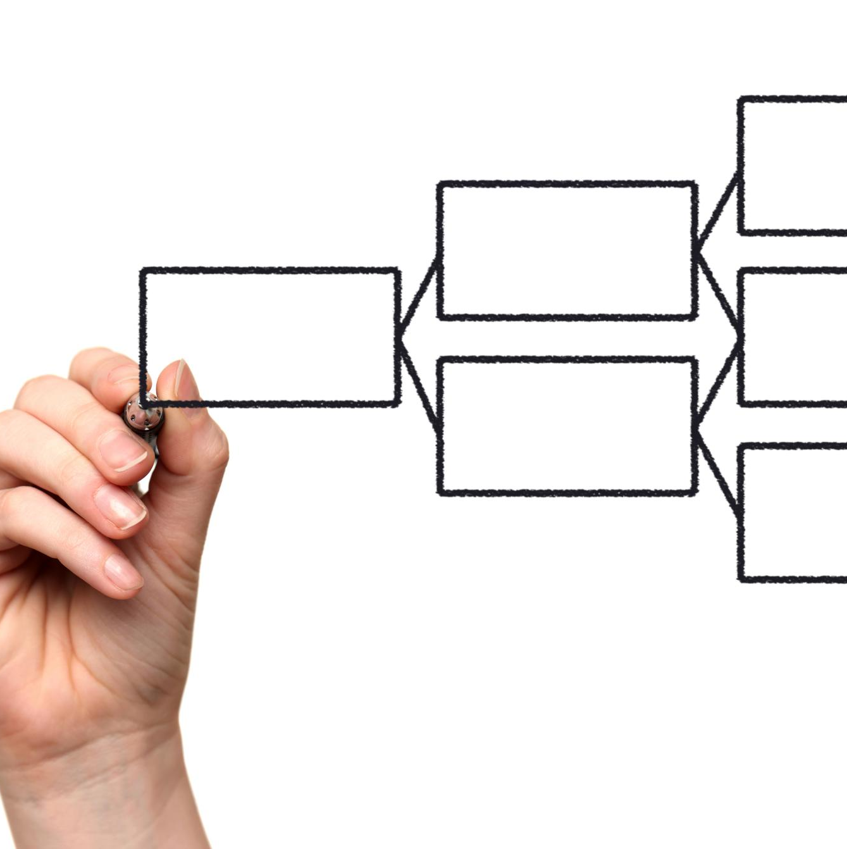
Routing Policy (Deterministic Example, Policy-as-Config)
Resilience in Routing
Network failures force inference to run on mobile and physical edge, queuing cloud for later validation.
Privacy Enforcement
Sensitive data remains on edge; only redacted summaries or embeddings are sent when allowed.
Uncertainty and Conflict Escalation
Low confidence or evidence conflicts trigger routing to cloud for deeper validation and fraud triage.
Risk and Device Health Policies
High-risk cases require cloud validation; poor device health allows offload to preserve usability.
Notes:
--- This slide references information from the following file: https://outlook.office365.com/owa/?ItemID=AAMkADFjOGFiYTE1LTdmZjAtNDdlMy1hZjBlLWJhYmU1MTdhMjExMwBGAAAAAAACXBUxxaiVT7HB8qvni%2b99BwDAQhsuxvVXSJe2LIF0e1WwAAAAAj%2ftAAApHpDpa7xpRJbny2ajM7lCAAUYv5PHAAA%3d&exvsurl=1&viewmodel=ReadMessageItem This slide is the heart of the orchestrator demonstration: it shows that routing is deterministic, policy-driven, and auditable. Present the routing logic as an ordered set of rules, where hard constraints override optimization preferences. Start with resilience: if network is offline or severely degraded, inference must run on the mobile edge and physical edge only; cloud is queued for later upload and validation, ensuring the customer still receives guidance. Next enforce privacy: if sensitivity is high—raw images or PII that cannot be transmitted—processing remains on edge; optionally only redacted summaries or embeddings can be sent to cloud when allowed. Then introduce uncertainty-based escalation: if the confidence from mobile vision inference is below a threshold (e.g., 0.75) or physical-edge sensor inference confidence is low (e.g., 0.70), the system routes to cloud for deeper validation. Evidence conflict escalation is a strong distributed-edge differentiator: if the conflict score between IoT evidence and visual severity is high, the orchestrator triggers a cloud fraud/triage workflow because independent signals disagree. Finally, risk-based escalation: for high value claims or customers tagged as high risk, cloud validation is required even if confidence is high, because the cost of a wrong decision is larger. Device health constraints come last: if the mobile device is in poor health (low battery/thermal throttling), and if policies allow, the orchestrator can offload to cloud to preserve device usability. For an MVP, emphasize that thresholds and rules are configurable; do not hardcode them. In demos, show a visible “decision trace” that prints which rule fired, what inputs were evaluated, and which pathway was selected. This is how you turn a complex multi-edge system into something clients can trust: explicit reasoning, not hidden heuristics. It also makes the reuse story compelling: other mobile frameworks and devices can adopt the same routing rules and telemetry contracts, changing only adapters and policy values, not the orchestration pattern.

Slide 11
Decision Matrix (Slide-Friendly Summary)
Condition | Default Route | Reason
Offline / poor network | Mobile + Physical Edge | Continuity and resilience
High sensitivity payload | Edge-only (or redacted to Cloud) | Privacy and compliance constraints
Low model confidence | Cloud Edge | Higher assurance via heavier validation
Evidence conflict (IoT vs Vision) | Cloud Edge | Fraud/triage escalation and auditability
High claim value tier | Cloud Edge | Risk-based governance
Low battery / thermal limit | Cloud Edge (if allowed) | Preserve device health and UX
Cloud budget exceeded | Edge degrade mode | Cost control with controlled accuracy tradeoff
Notes:
--- This slide references information from the following file: https://outlook.office365.com/owa/?ItemID=AAMkADFjOGFiYTE1LTdmZjAtNDdlMy1hZjBlLWJhYmU1MTdhMjExMwBGAAAAAAACXBUxxaiVT7HB8qvni%2b99BwDAQhsuxvVXSJe2LIF0e1WwAAAAAj%2ftAAApHpDpa7xpRJbny2ajM7lCAAUYv5PHAAA%3d&exvsurl=1&viewmodel=ReadMessageItem This slide compresses the routing policy into a matrix that stakeholders can quickly understand and that engineers can map directly into configuration and test cases. The matrix should list the most common conditions and their default routing decisions, with brief rationales. Start with connectivity: offline or poor network defaults to edge-only because it guarantees continuity; good connectivity keeps options open for cloud escalation. Next include sensitivity: high-sensitivity payloads (raw images, PII) default to local processing, optionally with redacted outputs transmitted to cloud, ensuring compliance is treated as a primary architectural unit. Confidence thresholds provide the strongest AI justification for cloud: low confidence defaults to cloud validation to improve accuracy, while high confidence enables edge decisions. Evidence conflict is the distributed-edge “wow factor”: if IoT evidence indicates low impact while vision indicates severe damage, route to cloud triage and potential fraud workflow, and log the conflict as a first-class event. Claim value tier supports business governance: high value claims trigger cloud validation because the cost of false acceptance is higher; low value claims can remain edge-driven for speed. Add device health and cost governance: low battery or high thermal state can push inference to cloud when allowed, while cloud budget limits can force edge degrade mode, showing responsible cost awareness. This matrix is also a test harness: you can derive scenario-based tests from each row and demonstrate them live. Present it as a policy artifact that can be customized per client without rewriting the orchestrator. Finally, tie it back to observability: each matrix decision should correspond to a logged rule ID and a human-readable explanation, which is essential in regulated financial services where teams will ask “why did the system do that?” as much as “what did the model predict?” The demonstration becomes more compelling when you show the matrix, run a scenario, and then show the telemetry event that records the exact decision path and reasons.

Slide 12
Cloud Fallback (Considerable, Credible, and Auditable)
Layer | Function | Key AI Element
On-Device (Mobile App) | Local inference, privacy-first triage, offline continuity | SLM/GenAI via TFLite/CoreML + NPU acceleration
Cloud Edge | Offload complex multimodal validation, richer GenAI reporting, model updates | Larger vision/text models, containerized inference runtime, report generation
Cloud Core | Model training, audit and compliance workflows, governance | MLOps, encrypted model registry, policy/prompt versioning
Notes:
--- This slide references information from the following file: https://outlook.office365.com/owa/?ItemID=AAMkADFjOGFiYTE1LTdmZjAtNDdlMy1hZjBlLWJhYmU1MTdhMjExMwBGAAAAAAACXBUxxaiVT7HB8qvni%2b99BwDAQhsuxvVXSJe2LIF0e1WwAAAAAj%2ftAAApHpDpa7xpRJbny2ajM7lCAAUYv5PHAAA%3d&exvsurl=1&viewmodel=ReadMessageItem This slide ensures the cloud fallback is substantial enough to feel enterprise-grade rather than token. First, describe what cloud does that edge should not: heavyweight multimodal reasoning, cross-claim pattern analysis, and audit-grade reporting. For multimodal validation, cloud combines the customer’s media, on-device severity signals, narrative summary, and IoT evidence packet to produce a validated triage outcome. It can also run a more capable model set (larger vision model, richer text reasoning) to compensate for the limitations of edge compute without forcing every request to incur that cost. Second, highlight GenAI value: cloud generates a structured FNOL report suitable for downstream claims systems, including consistent fields, suggested documentation, and standardized language. This is particularly compelling when paired with on-device summary generation: the demo can show the on-device summary when offline or privacy-restricted and the richer cloud report when escalation occurs. Third, emphasize governance and change control: cloud hosts a model registry that versions models and policies, supports approval workflows, and pushes OTA updates to mobile and physical edge nodes. Fourth, describe correlation checks that are difficult on edge: similarity across historical claims to flag potential fraud patterns, repeated submissions, and anomalous clusters. Even in an MVP, a small synthetic dataset can demonstrate the concept without overselling scale. Finally, connect cloud fallback to observability: the orchestrator logs decision traces at the edge, and cloud consolidates them into dashboards for audit and operational learning. This aligns with internal value propositions about observability, governance, and privacy-first design in edge architectures. If questions arise about edge layers like 5G/MEC, you can position them as optional future deployment targets while keeping this MVP strictly in device + cloud edge scope, ensuring you remain consistent with earlier MVP constraints while still demonstrating enterprise-grade fallback behavior.

Slide 13
10-Week MVP Plan (AI-Heavy Delivery Roadmap)
Phase | Weeks | Key Deliverables
Discovery & Architecture | 1–2 | Policy model, event schemas, hardware setup, backlog and acceptance criteria
Mobile Edge Build | 3–4 | Android FNOL flow, on-device inference baseline, orchestrator SDK integration
Physical Edge Build | 5–6 | ESP32 sensing, Pi inference + integrity, evidence packet, scoped orchestration trace
Cloud Fallback | 7–8 | Multimodal validation, GenAI report, telemetry ingestion, model/policy versioning
Hardening & Demo | 9–10 | Offline/low-confidence/conflict scenarios, dashboards, packaged demo narrative
Notes:
--- This slide references information from the following file: https://outlook.office365.com/owa/?ItemID=AAMkADFjOGFiYTE1LTdmZjAtNDdlMy1hZjBlLWJhYmU1MTdhMjExMwBGAAAAAAACXBUxxaiVT7HB8qvni%2b99BwDAQhsuxvVXSJe2LIF0e1WwAAAAAj%2ftAAApHpDpa7xpRJbny2ajM7lCAAUYv5PHAAA%3d&exvsurl=1&viewmodel=ReadMessageItem This slide lays out a realistic 10-week plan that matches the heavier AI/GenAI scope without drifting into production-scale complexity. In Weeks 1–2, focus on architecture and policy foundations: choose the insurance FNOL claim subtype to demo (motor damage is easiest), define event schemas (media metadata, sensor evidence packet), formalize the policy model and thresholds, and set up hardware (ESP32 sensors and Raspberry Pi gateway). This phase also establishes acceptance criteria for the orchestrator traces—what must be logged for each decision. In Weeks 3–4, build the Android app skeleton: guided capture workflow, local storage/buffering, baseline TFLite vision inference integration, and a first version of the orchestrator SDK integrated via MVVM. Aim to show at least one on-device decision path by end of week 4. In Weeks 5–6, implement physical edge intelligence: ESP32 firmware to publish sensor data, Raspberry Pi service to run time-series inference and integrity rules, generate the evidence packet, and expose it to the mobile app via Wi‑Fi/BLE/MQTT as appropriate. Also implement scoped orchestrator semantics on the Pi so it emits telemetry consistent with mobile. In Weeks 7–8, build cloud fallback: inference endpoints (vision/text), GenAI report generation service, telemetry ingestion, and a simple dashboard showing decision traces, fallback rate, and conflicts. Implement OTA artifacts at least as a versioned download mechanism to demonstrate lifecycle thinking. In Weeks 9–10, harden and package the demo: offline scenarios, low-confidence triggers, conflict scenarios, and scripted runs that highlight decision-making. Finalize the deck, demo script, and architectural documentation so the MVP can be reused with prospects. Throughout, keep the emphasis on orchestration clarity and governance rather than maximizing model accuracy; that is what makes the demo repeatable and credible.

Slide 14

Demo Scenarios (Three Impactful Runs)
Offline FNOL Resilience
Demonstrates edge-only operation with on-device inference and Raspberry Pi evidence during network outage.
Low Confidence Cloud Fallback
Shows hybrid intelligence escalating uncertain data to cloud for enhanced validation and richer report generation.
Conflict-Based Escalation
Uses independent IoT and vision data to detect conflicts, triggering cloud triage and fraud workflow escalation.
Decision Trace & Governance
Focus on decision trace with telemetry, rules, and dashboard showing governable and scalable system design.
Notes:
--- This slide references information from the following file: https://outlook.office365.com/owa/?ItemID=AAMkADFjOGFiYTE1LTdmZjAtNDdlMy1hZjBlLWJhYmU1MTdhMjExMwBGAAAAAAACXBUxxaiVT7HB8qvni%2b99BwDAQhsuxvVXSJe2LIF0e1WwAAAAAj%2ftAAApHpDpa7xpRJbny2ajM7lCAAUYv5PHAAA%3d&exvsurl=1&viewmodel=ReadMessageItem This slide packages the demo into three compelling runs that demonstrate orchestration decisions under different constraints. Scenario 1 is Offline FNOL, which is often the most memorable for prospects because it proves resilience: disable network, capture incident media, run on-device severity inference, attach physical-edge evidence from Raspberry Pi, generate an on-device structured summary, and present a provisional next step. Emphasize that the orchestrator logs the decision as “edge-only due to connectivity” and queues cloud upload for later, showing design for real-world conditions rather than lab conditions. Scenario 2 is Low Confidence Cloud Fallback, which demonstrates hybrid intelligence: use a borderline image (blurred, partial damage) or reduce the model confidence threshold so the on-device inference yields low confidence. The orchestrator escalates to cloud, where heavier validation occurs and a richer GenAI report is returned. The demo should show side-by-side: a quick on-device summary versus a cloud-enriched report, plus the trace stating “escalated due to confidence < threshold.” Scenario 3 is Conflict-based escalation, showcasing distributed edge value: simulate IoT evidence as low impact while vision suggests severe damage, or vice versa. The orchestrator computes a conflict score and triggers cloud triage and potential fraud workflow. This scenario demonstrates why adding physical edge is not gimmicky: it creates independent evidence that improves trust and yields a clear decision reason. In all scenarios, the most important output is not the model label; it is the decision trace. Show telemetry events with inputs, rules fired, route chosen, and model versions. If possible, maintain a simple dashboard that lists last N decisions with route reasons, fallback trigger type, and conflict flags. This is what convinces prospects that the system is governable, scalable, and reusable. The slide can also include a rehearsal checklist: preconfigure thresholds, prepare example media inputs, and ensure the physical edge sensor event can be triggered reliably (tap/shake). The end goal is a repeatable demonstration that can be performed consistently in front of prospects.

Slide 15
Success Criteria & Next Extensions (iOS, Cross-Platform, More Edge)
Layer | What Hyperscalers/Vendors Offer | MVP Extension Point (Differentiator)
Developer Environment | Cloud ML tools with deploy-to-edge hooks | Orchestrator SDKs + templates + simulation scenarios for multi-edge routing
Marketplace | Edge modules and vendor catalogs | BFSI policy packs and reusable orchestration patterns across channels
Control Tower | Device management and telemetry per vendor | Unified decision trace observability and governance across mobile + physical edge
Core Edge Runtime | Edge runtimes (containers/functions) close to data | Consistent policy semantics, routing, and audit across heterogeneous edge nodes
Foundation | Connectivity/IAM/networking primitives | Compliance-aware routing patterns and enterprise integration readiness
Notes:
--- This slide references information from the following file: https://outlook.office365.com/owa/?ItemID=AAMkADFjOGFiYTE1LTdmZjAtNDdlMy1hZjBlLWJhYmU1MTdhMjExMwBGAAAAAAACXBUxxaiVT7HB8qvni%2b99BwDAQhsuxvVXSJe2LIF0e1WwAAAAAj%2ftAAApHpDpa7xpRJbny2ajM7lCAAUYv5PHAAA%3d&exvsurl=1&viewmodel=ReadMessageItem This slide defines success in a way aligned with an orchestrator-first narrative and outlines extensions that prospects can easily imagine. Success is not measured primarily by model accuracy; instead, it is measured by clarity, governance, and reuse. The MVP succeeds when stakeholders can clearly articulate what the orchestrator is, how it makes routing decisions, and how that logic and telemetry can be reused across multiple app frameworks and edge nodes. Define measurable success metrics: edge decision latency, proportion of decisions made on edge vs escalated, rate of conflict detection and resolution paths, and completeness of decision traces (policy ID, rule fired, inputs captured, model versions). For prospects, stress that this becomes a repeatable architecture blueprint they can apply to other domains and channels. Then outline extensions that increase business and technical value without changing the orchestrator archetype. First extension is iOS: implement the same orchestrator core as a Swift package integrated into a SwiftUI/UIKit MVVM structure, mirroring the Android SDK approach. Next, cross-platform wrappers: provide a stable API surface for React Native/Flutter so multiple teams can adopt the same orchestration behavior without rewriting the core logic. On physical edge, extend evidence signals (additional sensors, optional camera feeds later) and strengthen on-edge inference as hardware allows. On the cloud side, evolve the governance story: richer dashboards, drift monitoring, and update rings for OTA deployments. If desired, introduce privacy-preserving learning patterns later (federated learning or differential privacy), but keep MVP scope focused on orchestration, routing, and outcome reporting. Conclude with the strongest takeaway: Edge AI without orchestration becomes fragmented distributed inference. This MVP proves orchestration as an architectural primitive and demonstrates a practical path to scale across devices, platforms, and regulated environments while maintaining trust, auditability, and cost control.

